Slide 1
AutoFly

Slide 2
Problem
Peak Hour
Over Crowded buses
Cab/Auto price increases
More private vehicles
More Traffic
Slow Speed

Slide 3
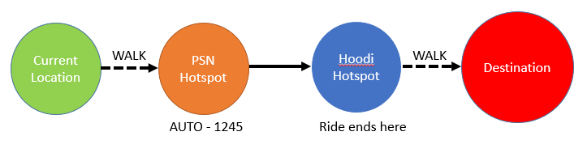
Passenger Interface

Slide 4
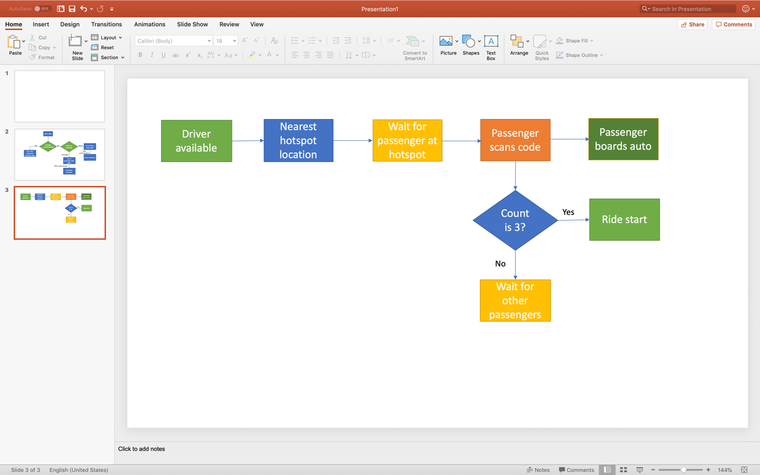
Driver Interface

Slide 5
Benefits for Passenger
Zero-waiting time
Fixed Price/ No surge unlike cabs
Convenient
Faster and comfortable than other public transports

Slide 6
Benefits for Driver
Work Part/Full time
Earn more in short span of time
Use of local knowledge to reach faster
No idle time

Slide 7
Solution
Peak Hour
Encourage Public transport
Reduce Traffic congestion
Effective utilization of autos
Happy drivers and passengers
AutoFly takes over
Over Crowded bus
Cab/Auto price increases
Slow Speed

