Slide 1

AutoFly
By Team_AutoFly

Slide 2
Problem
Peak Hour
How to reach office on time?
More Traffic
Over Crowded buses
More private vehicles
Slow Speed
Cab/Auto price increases

Slide 3
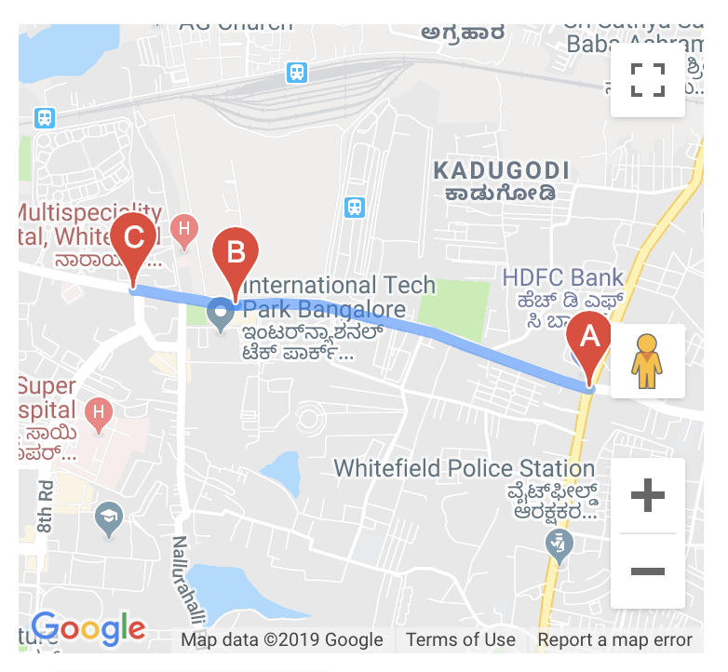
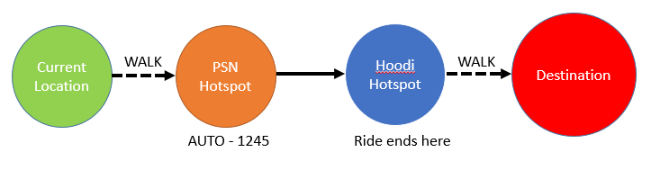
Passenger Workflow

Slide 4
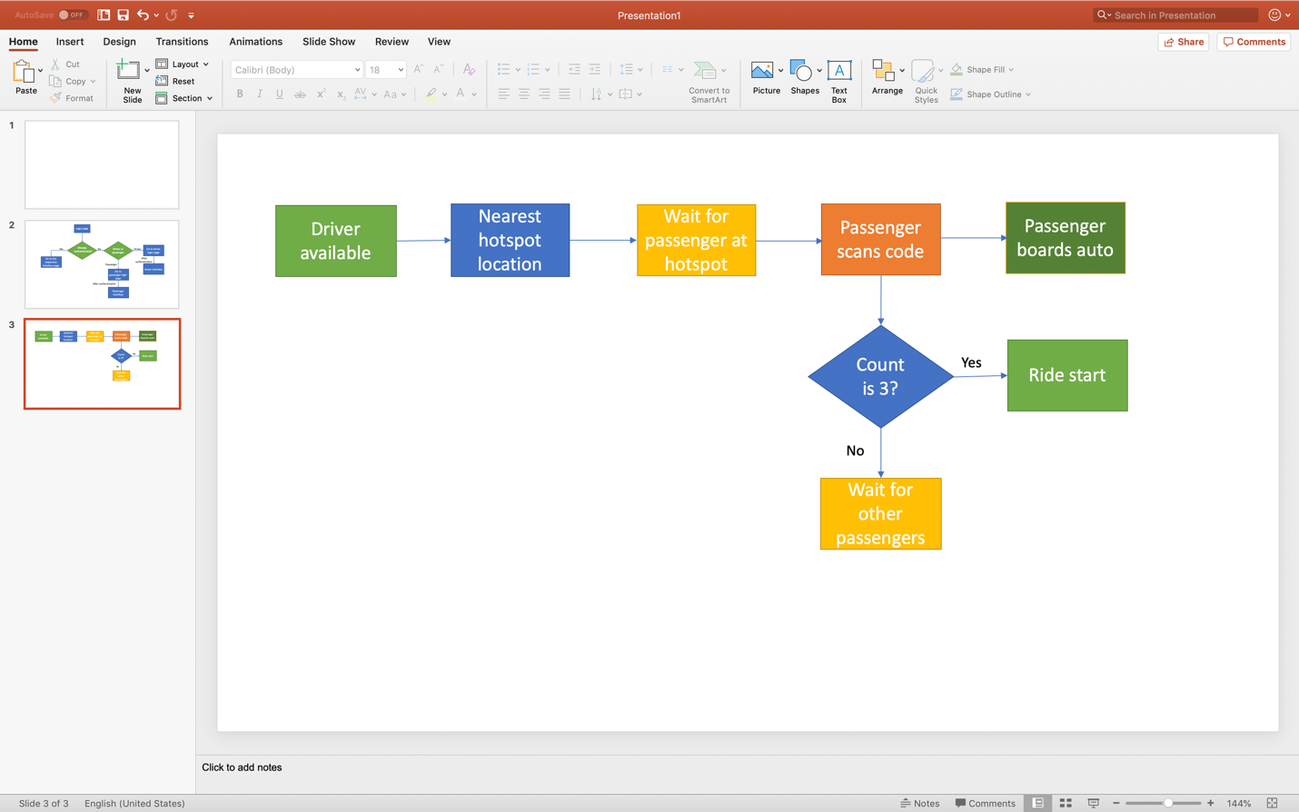
Driver Workflow
Passenger Joins Ride

Slide 5
Benefits for Passenger
Zero-waiting time
Fixed Price/ No surge unlike cabs
Faster and comfortable than other public transports
Convenient and hassle-free

Slide 6
Benefits for Driver
Work Part/Full time
Earn more in short span of time
Use of local knowledge to reach faster
No waiting time

Slide 7
Our Solution - Autofly
Encourage Public transport
Reduce Traffic congestion
Effective utilization of autos
Happy drivers and passengers
Peak Hour
Use Autofly

Slide 8
Thank You. Any Questions?

