Slide 1
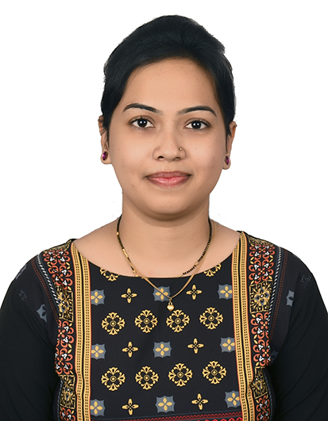
Poonam Dodake, Full Stack Developer
3.3 years of experience in software development and enhancement with java technologies along with tools like Maven, Spring boot, Postman API , Swagger UI, My SQL , Angular, Docker, microservices etc.
Work Experience
Skillset
Full Stack Developer– T-Systems ICT – 2022-Till Now
Domain – Logistic
Build REST API’s using Spring Boot Data JPA, My SQL database, spring security JWT ,Apache Tomcat 8.0
Testing the REST API’S using Postman Rest client .
Preparing or modifying the low level design document and analysis document .
Involved in query methods , Java features ,exception handling DTO’s ,spring security , mapping while building REST API’s.
Involved in reviewing & discussion of Design and Development of Frontend architecture applications.
Involved in Design/Development for Java, Sprint boot, REST, Microservices, Docker, Angular, making use of best practices for implementing performance-oriented applications
Developed and maintained web application using angular , HTML, CSS, Typescript .
working with agile /scrum based teams that utilizes continuous delivery process using GIT , JIRA.
Java
Spring Boot Data JPA
Microservices
Angular,Typescript,CSS,HTML
Docker, Docker-Compose
MySQL,
NodeJS
Tools-IntelliJ Idea, Jira, Postman API, Agile Methods, Apache Maven, Git, Bitbucket,
Swagger UI
Education Qualifications
Bachelor of Engineering – Mechanical

