Slide 1
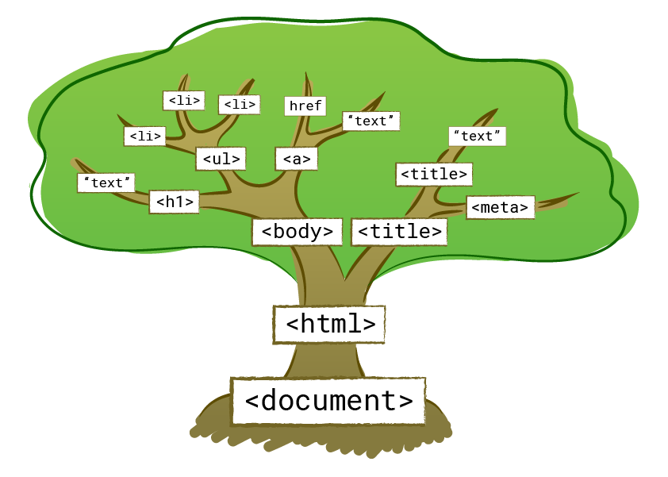
DOM
--
POONAM CHAUHAN

Slide 2
Document Object Model
D
M
O
HTML PAGE
ELEMENT &
ATTRIBUTES
Tree Structure of
HTML elements
Document
Object
Model

Slide 3
DOM TREE
HTML
HEAD
HEADER
SECTION
BODY
META
LINK
TITLE
H1
P
FOOTER
Header Text
Paragraph Text

Slide 4
WHY SHOULD WE LEARN?
Create
Read
Update
Delete
So we can manage/manipulate the DOM elements By Using Javascript
Easily control its elements, Attributes and all nodes

Slide 5
Node:
Everything in an HTML Page is node
Entire document is a document node
Each element in a HTML page is element node
All text of the document is text nodes
All attributes of elements are attributes nodes
Comments of page are comment nodes

Slide 6
DOM TREE
HTML
ROOT ELEMENT
HEAD
PARENT
HEADER
Child
SECTION
Child/Parent
BODY
PARENT
META
Child
LINK
Child
TITLE
Child
H1
Child
P
Child
FOOTER
Child
First Child Element
Last Child Element
GET
SET
ADD
DELETE
Header Text
Paragraph Text

Slide 7
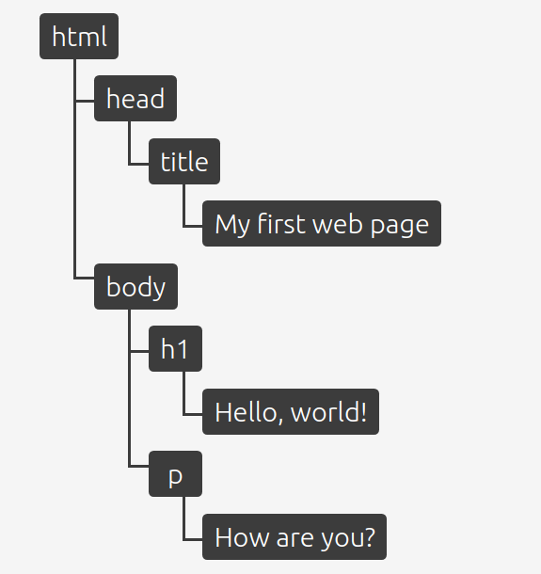
Example:

Slide 8

Thank You!!!
😎😎😎

