Slide 1



Slide 2
About Us
Sadhavi Translines was established in 2008 with the mind set to become the market leader as a service provider specially by Road.
We have been in the business with excellent quality service record for the past 14 years. We are a company which you can rely upon with complete trust and faith.
You can be rest assured that your goods are in safe hands and be assured of timely delivery when you use our service for the distribution of your urgent, time bound and high value consignments.

Slide 3
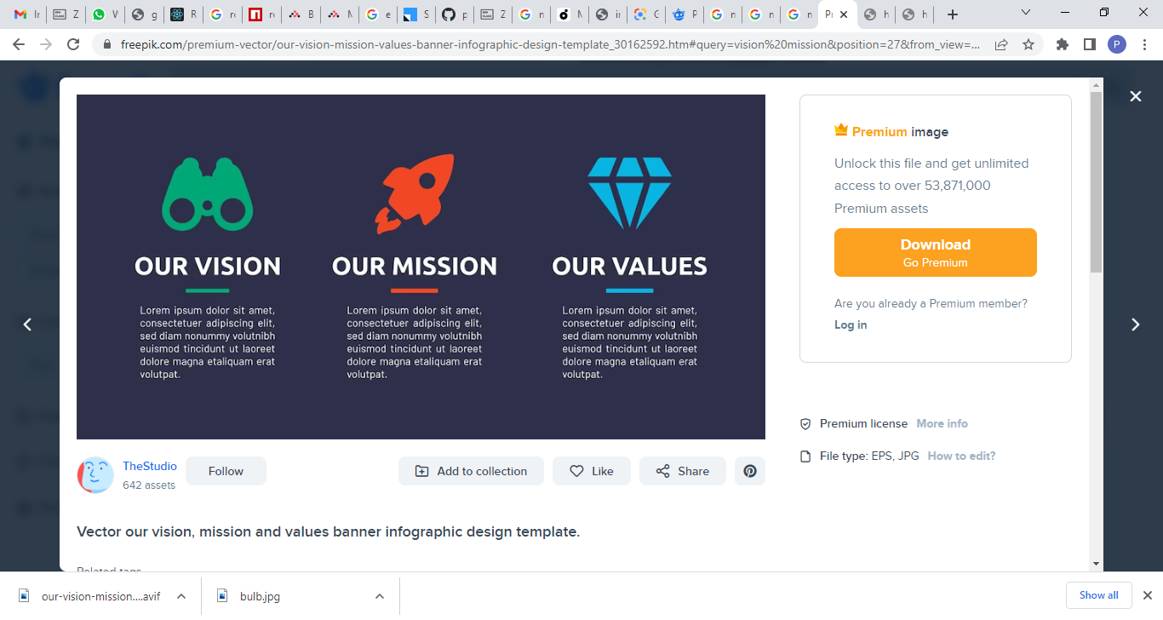
To become one stop solution.
Provide world class transport and logistics services.
We will always sustain the absolute best quality service standard to our customers every load as if it’s the first .
Our purpose as freight transportation is to provide superior customer service .
Our mission is to make out integrated services of oversized transport .
We do projected work on time , and at a high level of professionalism.
Services
Reliability
Trust
Transparency
Flexibility
Safety of the goods
Make Effective Presentations
Using Awesome Backgrounds
Engage your Audience
Capture Audience Attention

Slide 4
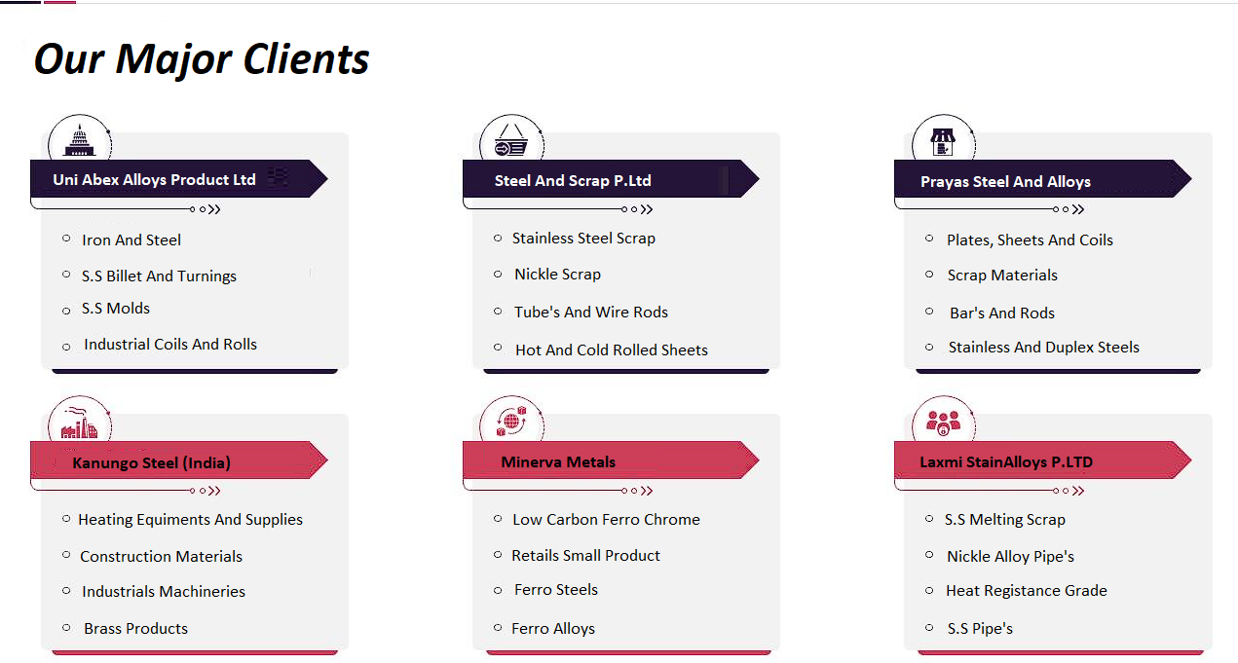
Our Major Clients

Slide 5
Our Details
Established in:2008
Office Address: H - 101 , Mayuresh Park , Lake Road , Bhandup (W)
Phone:8082727625
Email Address: sadhavitranslines@hotmail.com

Slide 6
THANK YOU

