Slide 1


Breast cancer classification and detection using deep learning
Presented by
Kajal Patil(B-04)
Sunidhi Jain(B-22)
Poonam Jadhav(B-23)
Komal Bhadane(B-51)
Under the Guidance of
DR. AMOL D. POTGANTWAR
Department of Computer Engineering,
SITRC, Nashik
Sandip Institute of Technology and Research Center, Nashik

Slide 2
Content
Introduction
Literature Survey
Problem Statement
Objectives
Proposed System
Dataset used
Software and hardware Requirements
Conclusion and Future scope
References

Slide 3
Introduction
Breast cancer is the country's leading cause of cancer in women, followed by cervical cancer. Together they account for 39.4 percent of the total cancer cases in women in India in 2020.
Despite High Awareness, 75% of Indian Women Shy Away from Breast Cancer Screening.
In 2020, more than two lakh women in India were estimated to have been diagnosed with breast cancer, and more than 76,000 deaths were reported as per the estimates. As per the 2020 National Cancer Registry Program Report, the number is expected to rise to more than 2.3 lakh cases in 2025.

Slide 4
Literature Review
G. Chen, Y. Chen, Z. Yuan, X. Lu, X. Zhu, and W. Li, "Breast Cancer Image Classification based on CNN and Bit-Plane slicing," 2019[1] - In this paper, authors propose a CNN classifier base on image bit-plane slicing. The purpose is to improve recognition accuracy when we apply it to breast cancer image classification. Each texture image is decomposed into eight bit-plane images. Different bit-planes provide different levels and detail of image texture features. At the same time, they have also tested feature classification performance by each bit-plane respectively and the fusion of all bit-planes. CNN classifier is used for classification and recognition.

Slide 5
Literature Review
Bah and M. David, "Analysis of Breast Cancer Classification with Machine Learning based Algorithms," 2022[2] - In this paper, four Machine Learning algorithms, which are Random Forest, Support Vector Machine (SVM), K-Nearest Neighbors (KNN) and Convolutional Neural Networks (CNN), with five different breast cancer datasets are tested and analyzed to verify their performance in a binary classification of breast cancer. The results show that CNN obtained higher accuracy than the other tested algorithms in this type of data. This study will help future researchers in the breast cancer field to continue their research and focus on improving the performance of specific algorithms.

Slide 6
Literature Review
P. T. Nguyen, T. T. Nguyen, N. C. Nguyen, and T. T. Le, "Multiclass Breast Cancer Classification Using Convolutional Neural Network," 2019 - In this paper, the author uses CNN to classify and recognize breast cancer images from public Break His dataset. This dataset includes 7,909 breast cancer (BC) histopathology images with four benign subclasses and four malignant subclasses. Our new task with this dataset is the automated multi-classification of these breast cancer images in eight classes, which can help reduce death rates and save people's lives in the world. Our method is based on the resizing of original images for building the CNN model and classifying breast cancer classes.

Slide 7
Problem Statement
To develop a deep learning model to classify cancer cells, thus facilitating doctors to achieve an accurate and fast diagnosis of cancer in an early stage.

Slide 8
Objectives
This study aims to establish a deep learning model to classify cancer cells, thus facilitating doctors to diagnose breast cancer accurately and quickly in an early stage.
To improve the accuracy and speed of detection using deep learning techniques.
To deploy the application on the cloud, enabling anyone to access it via the internet at any time and from anywhere

Slide 9
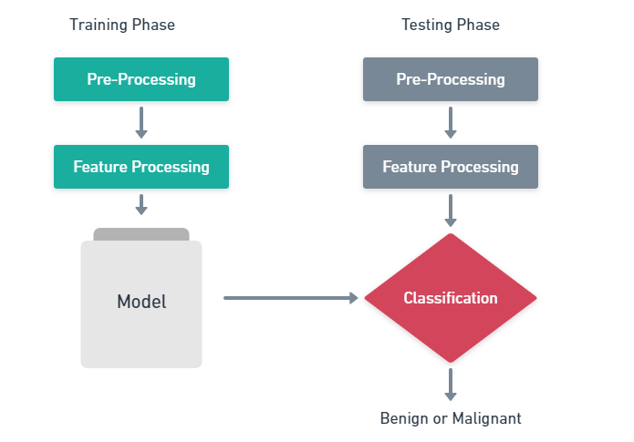
Proposed Work

Slide 10
Proposed Work
Classification and data mining methods are effective ways to classify data. Especially in the medical field, where those methods are widely used in diagnosis and analysis to make decisions.
We have designed a series of steps to generate the most reliable results in identifying whether the tumor stage is malignant (cancerous) or benign (non-cancerous).
Our overall methodology is divided into four sections: Data Preparation, Model training, Result visualization, and Fine-tuning

Slide 11
Continue…
Data pre-processing: loading a dataset in memory and processing it to gather image-label pairs for the classification task.
Model training: creating a CNN model that can fit the data to learn the training set samples. Predictions are carried out once the model finishes training on the validation and test sets.
Result visualization: the model’s performance is evaluated by calculating various metrics and plotting predictions.
Fine tuning: a bag-of-tricks approach is used, experimenting with various deep learning techniques.

Slide 12
Algorithm used
When the training data is ready to be fed into the CNN model. The classification models will learn the processed images from the training set loaded in memory before making their predictions, which will be compared to the ground truth labels for evaluation.
Different CNN architectures can be used as the base of a custom CNN model tailored for breast cancer detection. This is achieved by using popular CNN architectures available with Keras such as VGG19, ResNet50, InceptionV3, DenseNet121, and MobileNetV2 as the base of the CNN.

Slide 13
Software Requirements
Programming language - Python3
Libraries - OpenCV, NumPy, TensorFlow, SciPy
Algorithm – CNN
Cloud – Azure
Web - Streamlit (Python Framework)

Slide 14
Conclusion
It's remarkable to see deep learning accomplished in such a wide range of real-world challenges. Our proposed system demonstrates that end-to-end machine learning models can be highly accurate and potentially easily accessible across diverse mammography platforms. As training datasets and computational resources expand, machine learning methods have enormous potential to improve the accuracy of breast cancer detection on screening mammography.

Slide 15
Future Scope
Our approach may aid in the future development of superior CAD systems that could be used to help prioritize the most suspicious cases for reading by a radiologist, or as an automatic second reader after an initial independent interpretation.

Slide 16
References
B. Bılgıç, "Comparison of Breast Cancer and Skin Cancer Diagnoses Using Deep Learning Method," 2021 29th Signal Processing and Communications Applications Conference (SIU), 2021, pp. 1-4, doi: 10.1109/SIU53274.2021.9477992.
Y. Shao et al., "Breast Cancer Detection Using Multimodal Time Series Features From Ultrasound Shear Wave Absolute Vibro-Elastography," in IEEE Journal of Biomedical and Health Informatics, vol. 26, no. 2, pp. 704-714, Feb. 2022, doi: 10.1109/JBHI.2021.3103676.
Kaplan JG, Desouza TG, Farkash A, Shafran B, Portenoy R. Leptomeningeal Metastases: Comparison of Clinical Features and Laboratory Data of Solid Tumors, Lymphomas and Leukemias. J Neurooncol (1990) 9(3):225–9. doi: 10.1007/BF02341153
Kaplan JG, Desouza TG, Farkash A, Shafran B, Portenoy R. Leptomeningeal Metastases: Comparison of Clinical Features and Laboratory Data of Solid Tumors, Lymphomas and Leukemias. J Neurooncol (1990) 9(3):225–9. doi: 10.1007/BF02341153
Kaplan JG, Desouza TG, Farkash A, Shafran B, Portenoy R. Leptomeningeal Metastases: Comparison of Clinical Features and Laboratory Data of Solid Tumors, Lymphomas and Leukemias. J Neurooncol (1990) 9(3):225–9. doi: 10.1007/BF02341153

Slide 17
Thank You

