Slide 1
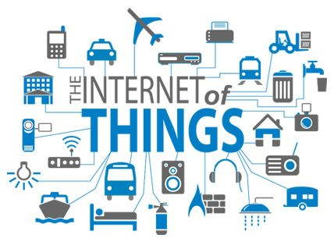
Internet of Things (IoT)

Slide 2
Plan of Presentation
Meaning?
What is IoT ?
Definition
Basic Concepts & Components
Interaction with the internet
Features of Devices
Few Applications of IoT
Technological Challenges of IoT

Slide 3
Unit-5 Future of Automotive
Basics of IOT, Technologies behind IoT, Autonomous vehicles , GPS tracking system, onboard-online monitoring systems, Introduction to cloud computing, RFID system for vehicle service history, Data-driven intelligent cars and few recent applications of IoT.

Slide 4
Introduction
“When we talk about an Internet of things, it's not just putting RFID tags on some dumb thing so we smart people know where that dumb thing is. It's about embedding intelligence so things become smarter and do more than they were proposed to do.”
Nicholas Negroponte

Slide 5
What is IoT?
Internet initially started as the “Internet of Computers”, which now include the WWW, FTP & others allowing computers & also users to communicate with each other & exchange information.
In recent years , IoT has become popular because of following reasons:
Device processing power & Storage Capacity both are increasing.
Technology is making devices Pervasive, Mobile & Wearable.
Communication Electronic Systems are becoming smaller and cheaper.
IoT allows objects to be sensed and controlled remotely across existing network infrastructure, creating opportunities for more direct integration between the physical world and computer-based systems, and resulting in improved efficiency, accuracy and economic benefit.

Slide 6
IoT is creating a considerable impact on health care, agriculture, retail and it’s already started influencing its approach towards the auto sector, changing it to a great degree at a very quick pace.
A best example is the Advancement of driverless, the ultimate expression of a car that drives itself is being developed through IoT.
It would be connected with everything – from vehicle to vehicle, vehicle to cloud and vehicle to driver

Slide 7
Definitions….
1. The internet of things (IoT) is a computing concept that describes the idea of everyday physical objects being connected to the internet and being able to identify themselves to other devices. The term is closely identified with RFID as the method of communication, although it also may include other sensor technologies, wireless technologies
2. “A part of a dynamic global network infrastructure with self-configuring capabilities based on open and interoperable communication protocols where physical and virtual ‘Things’ have specific identities, physical attributes, and virtual personalities and use intelligent interfaces to interact and communicate among themselves and with the environment by exchanging data and information ‘sensed’ about the environment, while reacting autonomously to the ‘real/physical world’ events and influencing them by running processes that trigger actions and create services with or without our direct intervention. ”

Slide 8
Characteristics of IoT
Dynamic & Self adapting
Self-Configuring
Interoperable Communication Protocols
Unique Identity
Integrated into Information Network

Slide 9
Basic Concepts
‘Things’ of IOT
Have specific identities, physical attributes, virtual ‘personalities’ and use intelligent interfaces.
They are able to interact and communicate among themselves and with the environment by exchanging data and information ‘sensed’ about the environment.
Reacts autonomously to the ‘real/physical world’ events and influencing them by running processes that trigger actions and create services with or without our direct intervention.

Slide 10
What kind of Things?
1. Heart monitoring implants and pace makers
2. Biochip transponders on farm animals
3. Home Electronic devices such as smart Tvs
4. Automobiles with built-in sensors
5. Home Appliances such as smart refrigerators, ovens, laundry machines
6. Home automation devices such as thermostats, alarm systems and smoke detectors.
These devices collect useful data with the help of various existing technologies and then autonomously flow the data between other devices.

Slide 11
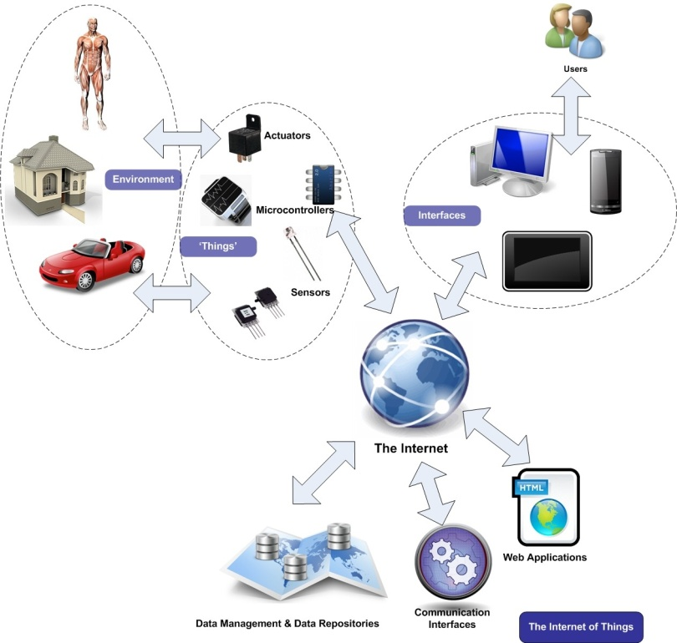
An illustration of the ‘Internet of Things’

Slide 12
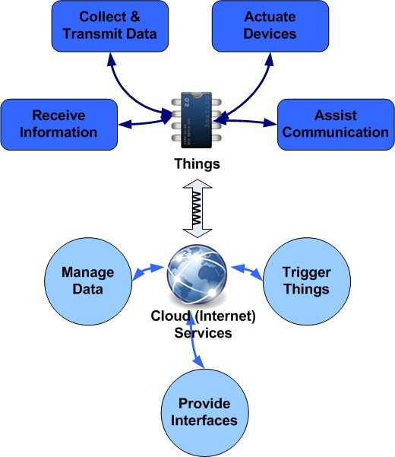
Interaction of Things with the Internet
What makes IoT devices different than ordinary sensor devices is basically the ability to communicate (most usually) directly or indirectly to the Internet.

Slide 13
Features of Devices
Collect and transmit data: The device can sense the environment (e.g., your home or your body) and collect information related to it (e.g., temperature and lighting conditions) and transmit it to a different device (can be your mobile phone or your laptop) or to the Internet.
Actuate devices based on triggers: It can be programmed to actuate other devices (e.g., turn on the lights or turn off the heating) based on conditions set by you. For instance, you can program the device to turn on the lights when it gets dark in your room.
Receive information: One unique characteristic for IoT devices is that they can also receive information from the network they belong to (i.e. other devices) or through the Internet (e.g., information from you like new triggers, new status of operation and in some cases new functionality).
Communication assistance: IoT devices that are members of a device network can also assist in communication (i.e. data forwarding) between other nodes of the same network. Think of them as messengers for devices (nodes) that are not very close to an endpoint (e.g., your router) in order to get direct information from.

Slide 14
Few Applications of IoT
Building and Home automation
Manufacturing
Medical and Healthcare systems
Media
Environmental monitoring
Infrastructure management
Energy management
Transportation
Better quality of life for elderly
... ... ...
You name it, and you will have it in IoT!

Slide 15
Major Components of IoT Devices
Control units (the ‘brains’ of the devices),
Sensors that collect information – signals from the environment,
Communication modules and
Power sources.

Slide 16
Control Units
A microcontroller can be considered as a small computer on a single integrated circuit (often abbreviated as IC) containing a processor core, memory, and programmable input and output peripherals.
Peripherals are controlled through several general-purpose input/output pins, known as GPIO pins. GPIO pins are configured to either input (read) data or output data. They are configured to
An input state, they are used to read information from sensors and accept external signals (e.g., button events).
To the output state, GPIO pins can control external devices such as LEDs, motors, relay switches, etc.
In addition, these pins are also used by the controller to communicate with devices, such as modems and other communication modules.

Slide 17
Analog to digital converters (ADC) are used to convert incoming analog (signal) data into a form that the processor can recognize.
Include a variety of timers as well.
Additional modules like Pulse Width Modulation (PWM) modules are also included in the microcontroller and enable it to process and control more advanced devices like power converters and, motors without using lots of resources in generating pulse signals programmatically.

Slide 18
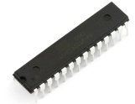
The Atmega328 chip from Atmel
One of the most widely used microcontrollers in embedded projects. Each pin has a specific function; receive analog signals, communicate through serial interface with other components, receive input voltage, generate pulses or digital output, etc

Slide 19
Sensors
Sensors are devices that can measure a physical quantity (like temperature, humidity, etc.) and convert it into a signal, which can be read and interpreted by the microcontroller unit. They are the devices that are most likely attached to the input pins of the microcontroller in our embedded projects. Generally, most sensors fall into two categories;
Analog
Digital

Slide 20
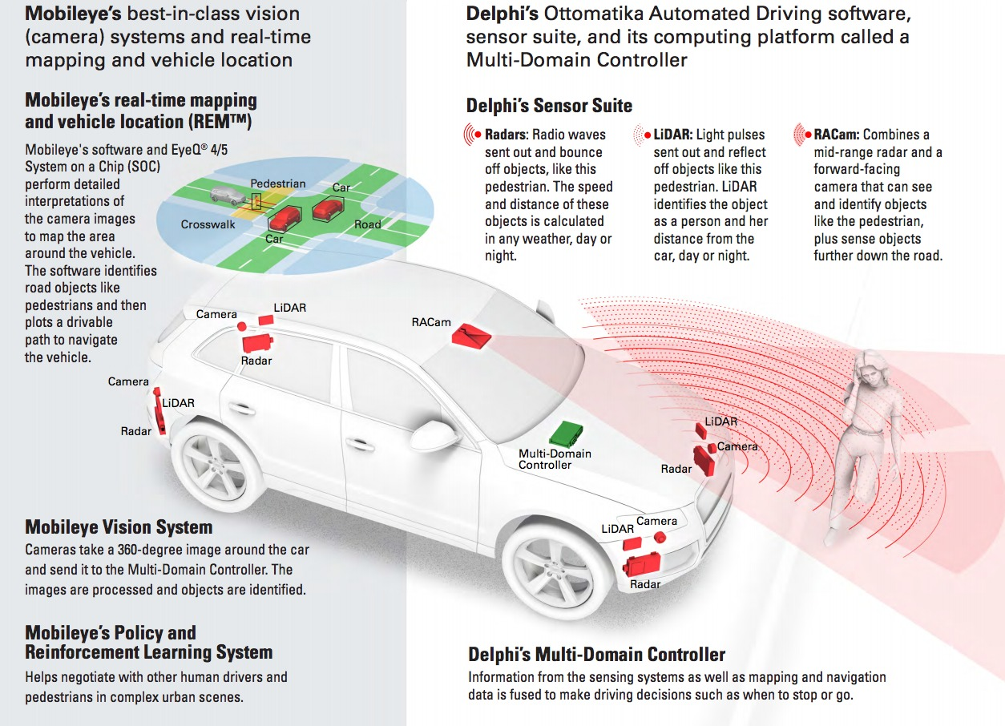
An Example….

Slide 21
Communication Technologies
‘Things’ need to talk to each other and also talk to the Internet in order to exchange sensor outputs, triggers, status messages etc. In order to do so, devices need to integrate a wireless (preferably) or a wired communication system. The major communication technologies that can be utilized by such devices are summarized as,
RFID
Bluetooth
ZigBee
WiFi
RF Links
Cellular Networks: The Mobile Internet
In addition to the brief description of the technologies, samples of electronic modules that enable the respective communication are also presented.

Slide 22
RFID
The Radio Frequency Identification (RFID) technology has been initially introduced for identifying and tracking objects with the help of small electronic chips, called tags. It is the most common technology behind asset tracking (that tells you where your mail parcel is before arriving its destination) and identifying objects (e.g., in automatic toll collection).
RFID tags are categorized into
Passive - Do not have a power source (battery) and thus cannot transmit and information on their own.
Active – Have their own battery and can broadcast data continuously
Battery assisted passive (BAP)- Can be considered as a hybrid: it carries a battery but only transmits information in presence of an RFID reader. Battery helps them to transmit their signal in longer distance than the passive tags (restricted to a few cm).

Slide 23
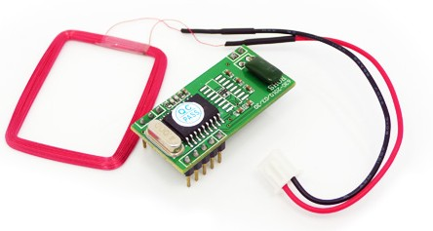
. RFID module and its antenna.
It can directly communicate with the Arduino using the Serial protocol. it cannot alone support the creation of IoT networks since it cannot provide any direct or indirect (e.g., through a gateway) communication to the Internet. The device proximity is also another drawback.

Slide 24
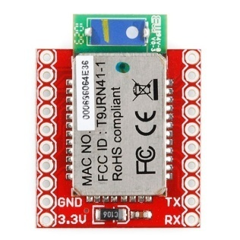
Bluetooth communication module

Slide 25
Bluetooth
Bluetooth is a technology standard for exchanging data over short distances (using short wavelength radio transmissions in the ISM band from 2400-2480 MHz) from fixed and mobile devices, creating personal area networks.
Bluetooth has been one of the first wireless communication protocols designed with lower power consumption for replacing short-range wired communications (in computer peripherals, mobile phone accessories, etc.).
One important feature of Bluetooth is that devices can discover and communicate with each other without the need to be in visual line of sight (like in infrared communication), which is very important when using Bluetooth as a network technology for sensor systems deployment.

Slide 26
Continued…
It is commonly used for connecting small devices with each other, due to the fact that it can support automatically the creation of peer networks (i.e. networks of devices that exchange and forward information) and provides communication functionality with low power consumption.
It is very important for the case of IoT since many of the devices that one would like to interconnect to the IoT (sensors, actuators, etc.) have limited power resources.
However on major drawback of Bluetooth is that it cannot provide direct connectivity to the Internet. One has to provide an intermediate node, e.g., a PC that will act as a gateway to the outer world.

Slide 27
Bluetooth communication module

Slide 28
ZigBee
ZigBee is one of the latest and most advanced wireless technologies being widely integrated into home automation & smart devices worldwide. The ZigBee standard operates in unlicensed bands including 2.4 GHz, 900 MHz and 868 MHz & The physical layer and link layer protocol of ZigBee technology applied mainly IEEE 802.15.4 standard.
Low consumption of 50mA.
Eg: A rechargeable battery of 850mAH can provide about 17 hours of continuous operation for such module.
Maximum data rate is about 250kbps and communication range can vary from 100m to 1km (maximum) depending on the output power .
Compared to Bluetooth, ZigBee provides better power efficiency, and higher range, making it thus a better wireless technology to consider for your IoT network.

Slide 29
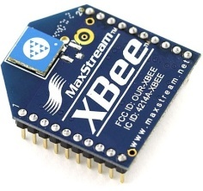
Zigbee Module
However it still requires a gateway with Internet connectivity (e.g., a laptop) that will forward information from the Internet to the ZigBee network and vice versa.

Slide 30
WiFi
WiFi, also known as the IEEE 802.11x standard, is the most common way to connect devices wirelessly to the Internet. Your laptop, smartphone and Tablet PC are equipped with WiFi interfaces and talk to your wireless router and provide you this way access to the Internet.
The commercially available WiFi modules can be directly integrated to an IoT device and provide instant connectivity.
The major advantage over the other wireless technologies is the fact that WiFi networks are very easy to establish and thus IoT devices with WiFi modules can have direct connection to the Internet.
One drawback is the fact that this technology (which was at no means designed for IoT networks) is more power demanding than the others.

Slide 31
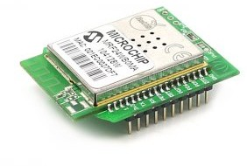
WiFi communication module in a pluggable form (known as XBee series modules)

Slide 32
RF Links
Another option to connect devices and make them talk is utilize simple radio frequency (RF) interfaces. These are
Quite cheap and small (ideal when size matters)
Can provide communication range between 100m and 1km (depending on the transmission power and the antenna used).
RF communication modules are connected to microcontroller and devices via through serial ports as the rest of the modules
However they do not provide any implementation of the TCP/IP communication protocol (or any other protocol). This means that if you want your devices to communicate you have to create your own protocol for establishing communication, identifying devices with each other and make sure all the information you have transmitted is delivered.
Data rates are quite low (up to 1Mpbs) and you also need an Internet-enabled gateway that will provide access to your devices for making a complete IoT network.

Slide 33
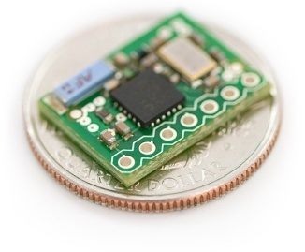
An RF transceiver module (it can be used both as a receiver and transmitter).

Slide 34
Cellular Networks: The Mobile Internet
The ‘Mobile Internet' refers usually to access to the Internet from a mobile device, such as a smartphone or laptop through a mobile broadband network.
The mobile broadband network is based on cellular communication, same technology that is used in our mobile phones for serving our calls and text messages.
It can provide direct Internet connectivity to a variety of data rates. Various network standards have existed for serving mobile Internet. GPRS, 3G, WiMax, are a few to name. Depending on the standard and the available network coverage, connection speeds can go from 80Kbps (GPRS) to a few Mbps (3G and 4G).

Slide 35
Continued…
Due to the complexity of the communication protocol and the information coding, in addition to high power requirements in cases where reception signal is low, the battery consumption of mobile Internet – enabled devices is an issue.
Think of how fast the battery of your cell phone is drained when you browse the Internet. Still it is a good option for connecting devices directly to the Internet, since small GPRS modules for the Arduino are available (see Figure ) and connectivity does not require further infrastructure (e.g., Internet connected laptop like in case of ZigBee or Bluetooth).

Slide 36
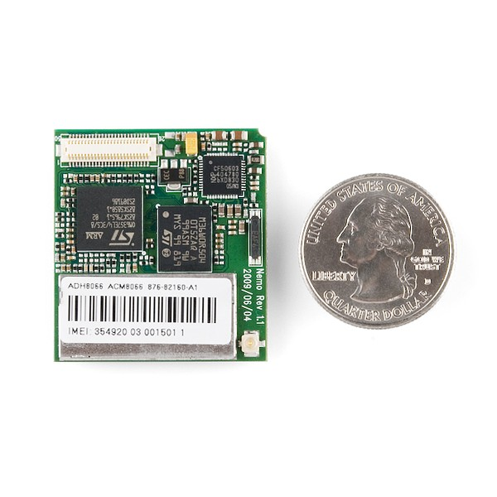
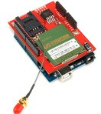
GPRS shield for your Arduino on the left
The GPRS module on the right. The small size of it allows it to fit easily in mobile phones, Tablet PCs and sensor devices.

Slide 37
Autonomous Vehicles
An autonomous vehicle is one that can drive itself from a starting point to a predetermined destination in “autopilot” mode using various in-vehicle technologies and sensors, including adaptive cruise control, active steering (steer by wire), anti-lock braking systems (brake by wire), GPS navigation technology, lasers and radar.
The first commercial adopters of this technology (other than the military) will be fleets of long haul trucks. Advantages are
Savings on labor and fuel efficiency
Just-in-time delivery optimization
Uber and other taxi services have already announced their desire to convert to driverless cars in an attempt to improve service and lower costs.
Car sharing services may convert to the on-demand driverless taxi model as well.

Slide 38
We can expect the same trajectory for mail carriers, utility meter readers, and other such activities.
City buses will eventually see the end of human drivers, particularly as dedicated bus lanes and BRT come to dominate the surviving transit systems. In many suburban locations public buses may cease to exist at all due to loss of funding and competition from decentralized on demand services.
You need look no farther than the fully digitized and mechanized toll both or parking garage to see how this is going to play out over time. The end result of all this is that some highly skilled workers are going to make lots of money in innovative technologies while large numbers of less educated people are going to be made redundant.

Slide 39
Global Positioning System (GPS)
It is a worldwide radio-navigation system formed from the constellation of 24 satellites and their ground stations. The Global Positioning System is mainly funded and controlled by the U.S Department of Defense (DOD). The system was initially designed for the operation of U. S. military. But today, there are also many civil users of GPS across the whole world. The civil users are allowed to use the Standard Positioning Service without any kind of charge or restrictions.
Global Positioning System tracking is a method of working out exactly where something is. A GPS tracking system, for example, may be placed in a vehicle, on a cell phone, or on special GPS devices, which can either be a fixed or portable unit

Slide 40
GPS…
It can also track the movement of a vehicle or person.
For example, a GPS tracking system can be used by a company to monitor the route and progress of a delivery truck, and by parents to check on the location of their child, or even to monitor high-valued assets in transit.
A GPS tracking system uses the Global Navigation Satellite System (GNSS) network. This network incorporates a range of satellites that use microwave signals that are transmitted to GPS devices to give information on location, vehicle speed, time and direction. So, a GPS tracking system can potentially give both real-time and historic navigation data on any kind of journey.

Slide 41
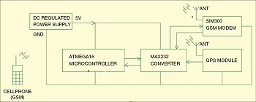
GPS based vehicle tracking System

Slide 42
It is based on the ATMega16 microcontroller using global positioning system (GPS) and global system for mobile communication (GSM).
This is a cheaper solution than a two-way GPS communication system wherein communication is done in both ways with GPS satellites. This uses only one GPS device and two-way communication is achieved using a GSM modem. GSM modem with a SIM card used here implements the same communication technique as in a regular cellphone.

Slide 43
The system can be mounted or fitted in your vehicle in a hidden or suitable compartment. After this installation, you can easily track your vehicle using your mobile phone by dialling the mobile number of the SIM attached to the GSM modem. You will automatically get the location of the vehicle in the form of an SMS (short message) on your mobile phone.

Slide 44
GPS Module and Its Working:
GPS stands for Global Positioning System and used to detect the Latitude and Longitude of any location on the Earth, with exact UTC time (Universal Time Coordinated). GPS module is the main component in our vehicle tracking system . This device receives the coordinates from the satellite for each and every second, with time and date.
GPS module sends the data related to tracking position in real time, and it sends so many data in NMEA format . NMEA format consist several sentences, in which we only need one sentence. This sentence starts from $GPGGA and contains the coordinates, time and other useful information.

Slide 45
Eg:
$GPGGA,HHMMSS.SSS,latitude,N,longitude,E,FQ,NOS,HDP,altitude,M,height,M,,checksum data.
$GPGGA - Global Positioning system fix data
HHMMSS.SSS - Time in hour minute seconds and milliseconds format.
Latitude - Latitude (Coordinate)
N - Direction N=North, S=South
Longitude - Longitude(Coordinate)
E - Direction E= East, W=West
FQ - Fix Quality Data
- No. of Satellites being Used
- Horizontal Dilution of Precision
- Altitude from sea level
- Meter, Height, Checksum Data

Slide 46
Working Explanation:
Arduino is used for controlling whole the process with a GPS Receiver and GSM module. GPS Receiver is used for detecting coordinates of the vehicle, GSM module is used for sending the coordinates to user by SMS. And an optional 16x2 LCD is also used for displaying status messages or coordinates. We have used GPS Module SKG13BL and GSM Module SIM900A.
When we ready with our hardware after programming, we can install it in our vehicle and power it up. Then we just need to send a SMS, “Track Vehicle”, to the system that is placed in our vehicle. We can also use some prefix (#) or suffix (*) like #Track Vehicle*, to properly identify the starting and ending of the string.
Sent message is received by GSM module which is connected to the system and sends message data to Arduino. Arduino reads it and extract main message from the whole message. And then compare it with predefined message in Arduino. If any match occurs then Arduino reads coordinates by extracting $GPGGA String from GPS module data (GPS working explained above) and send it to user by using GSM module. This message contains the coordinates of vehicle location.

Slide 47
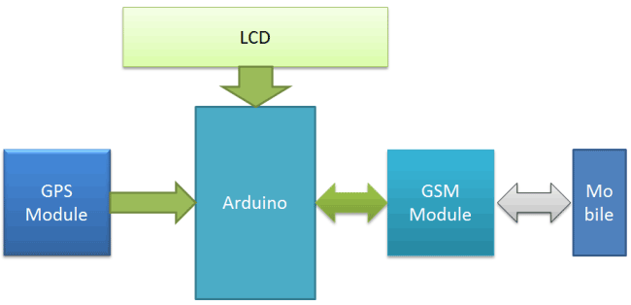
GPS based vehicle tracking System

Slide 48
BUILDING BLOCKS of IoT
Four things form basic building blocks of IoT system
–sensors,
processors,
gateways,
applications.
Each of these nodes has to have their own characteristics in order to form an useful IoT system.

Slide 49
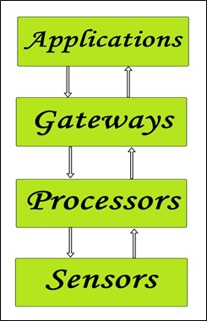
BUILDING BLOCKS of IoT

Slide 50
Applications:
Applications form another end of an IoT system. Applications are essential for proper utilization of all the data collected.
These cloud based applications which are responsible for rendering effective meaning to the data collected. Applications are controlled by users and are delivery point of particular services.
Examples of applications are: home automation apps, security systems, industrial control hub etc.
In a nutshell, from the figure we can determine that the information gathered by the sensing node (end node) is processed first then via connectivity it reaches the embedded processing nodes that can be any embedded hardware devices and are processed there as well. It then passes through the connectivity nodes again and reaches the remote cloud-based processing that can be any software and are sent to the application node for the proper applied usage of the data collected and also for data analysis via big data.

Slide 51
Gateways:
Gateways are responsible for routing the processed data and send it to proper locations for its (data) proper utilization.
In other words, we can say that gateway helps in to and fro communication of the data. It provides network connectivity to the data. Network connectivity is essential for any IoT system to communicate.
LAN, WAN, PAN etc are examples of network gateways.
Processors:
Processors are the brain of the IoT system. Their main function is to process the data captured by the sensors and process them so as to extract the valuable data from the enormous amount of raw data collected. In a word, we can say that it gives intelligence to the data.
Processors mostly work on real-time basis and can be easily controlled by applications. These are also responsible for securing the data – that is performing encryption and decryption of data.
Embedded hardware devices, microcontroller etc are the ones that process the data because they have processors attached to it.

Slide 52
Sensors:
These form the front end of the IoT devices. These are the so called “Things” of the system. Their main purpose is to collect data from its surrounding (sensors) or give out data to its surrounding (actuators).
These have to be uniquely identifiable devices with a unique IP address so that they can be easily identifiable over a large network.
These have to be active in nature which means that they should be able to collect real time data. These can either work on their own (autonomous in nature) or can be made to work by the user depending on their needs (user controlled).
Examples of sensors are: gas sensor, water quality sensor, moisture sensor etc.

Slide 53
HOW IoT WORKS
First, it acquires information with respect to basic resources (names, addresses and so on) and related attributes of objects by means of automatic identification and perception technologies such as RFID, wireless sensor and satellite positioning, in other words the sensors, RFID tags and all other uniquely identifiable objects or "things" acquire real-time information (data) with the virtue of a central hub like smartphones.
Second, by virtue of many kinds of communications technologies, it integrates object-related information into the information network and realizes the intelligent indexing and integration of the information related to masses of objects by resorting to fundamental resource services (similar to the resolution, addressing and discovery of the internet).

Slide 54
Finally, utilizing intelligent computing technologies such as cloud computing, fuzzy recognition, data mining and semantic analysis, it analyzes and processes the information related to masses of objects so as to eventually realize intelligent decision and control in the physical world.

Slide 56
雲端計算 Cloud Computing
Introduction to Cloud Computing

Slide 57
Agenda
What is Cloud Computing ?
Different perspectives
Properties and characteristics
Benefits from cloud computing
Service and deployment models
Three service models
Four deployment models

Slide 58

Cloud Definitions
Definition from NIST (National Institute of Standards and Technology)
Cloud computing is a model for enabling convenient, on-demand network access to a shared pool of configurable computing resources (e.g., networks, servers, storage, applications, and services) that can be rapidly provisioned and released with minimal management effort or service provider interaction.
This cloud model promotes availability and is composed of five essential characteristics, three service models, and four deployment models.

Slide 59

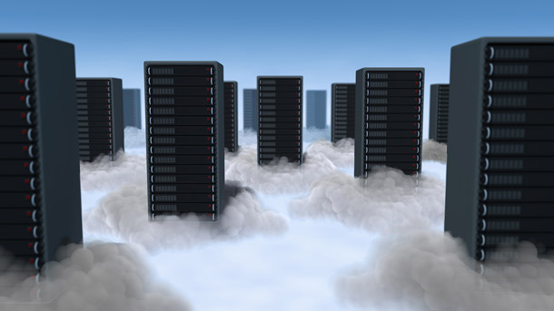
Cloud Definitions
Definition from Wikipedia
Cloud computing is Internet-based computing, whereby shared resources, software, and information are provided to computers and other devices on demand, like the electricity grid.
Cloud computing is style of computing in which dynamically scalable and often virtualized resources are provided as a service over the Internet.

Slide 60

In Our Humble Opinion
Cloud computing is a paradigm of computing, a new way of thinking about IT industry but not any specific technology.
Central ideas
Utility Computing
SOA - Service Oriented Architecture
SLA - Service Level Agreement
Properties and characteristics
High scalability and elasticity
High availability and reliability
High manageability and interoperability
High accessibility and portability
High performance and optimization
Enabling techniques
Hardware virtualization
Parallelized and distributed computing
Web service

Slide 61
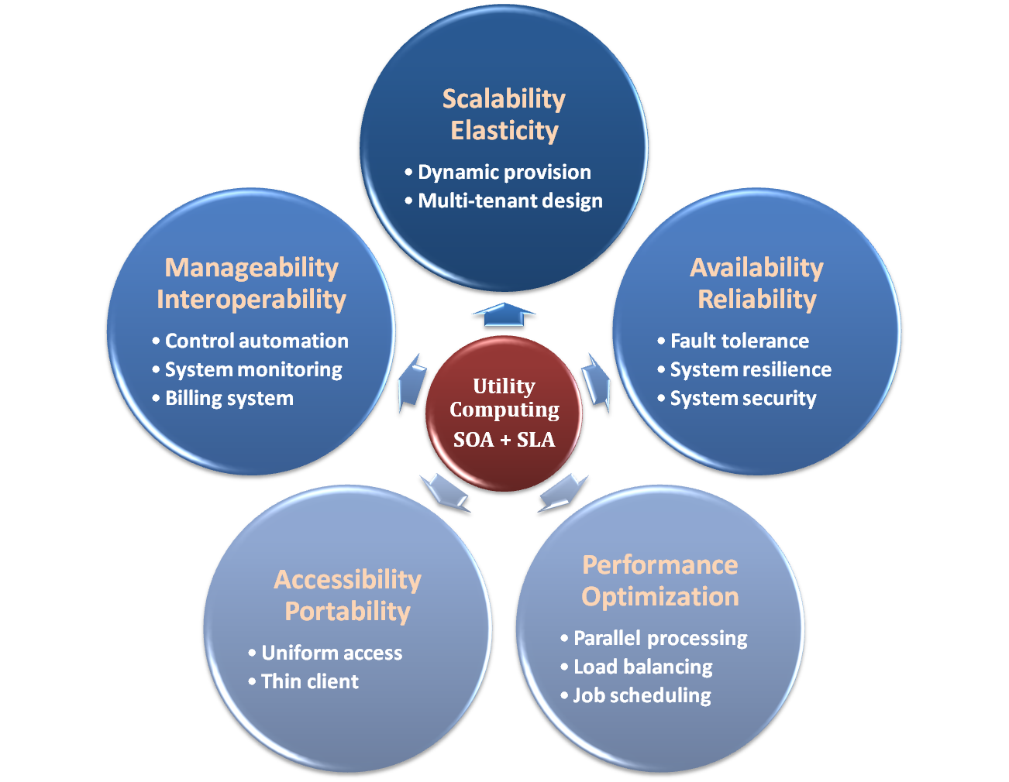

Properties and Characteristics

Slide 62

Benefits From Cloud
Cloud computing brings many benefits :
For the market and enterprises
Reduce initial investment
Reduce capital expenditure
Improve industrial specialization
Improve resource utilization
For the end user and individuals
Reduce local computing power
Reduce local storage power
Variety of thin client devices in daily life

Slide 63
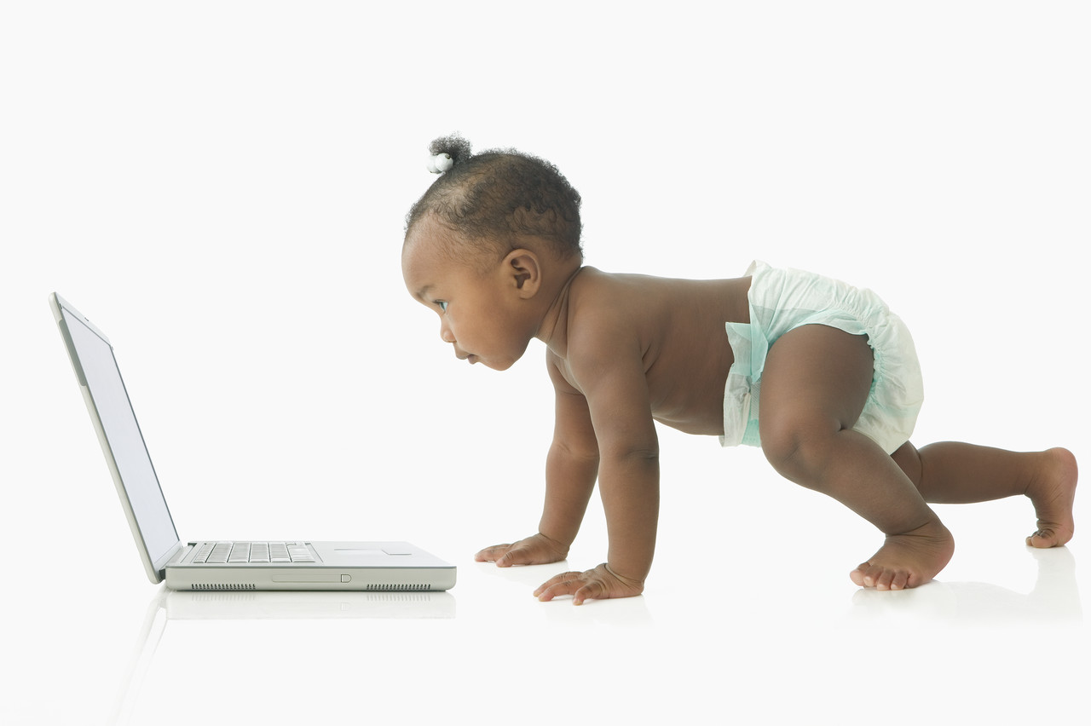
For End User and Individual

Slide 64
Reduce Local Computing Power
Traditional local computing power requirement :
One need to buy your own personal computer
Buy powerful processor if you need intensive computing
Buy large memory to meet application requirement
Install plenty of applications in need
Some drawbacks :
One can hardly replicate the same system environment
One needs to regularly update or upgrade software and hardware
One needs to reinstall all applications if you reinstall the OS

Slide 65
Reduce Local Computing Power
Using Cloud Computing services :
One can utilize the remote computing power in the cloud
One needs only basic computing power to connect to internet
Application in the cloud will automatically upgrade
Some benefits :
One can access his/her applications anywhere through the Internet
One can dynamically request for computing power on demand
Application may need not to be reinstalled even reinstall the OS

Slide 66
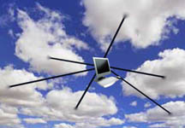
Reduce Local Computing Power
What dose cloud computing achieve ?
 | Traditional | With Cloud Computing
Hardware Requirement | User needs to buy powerful hardware | Only basic hardware to connect to internet
Software Requirement | Install application in local computer | No local installation requirement
Portability | Hard to be portable | Natively portable

