Slide 1


Slide 2
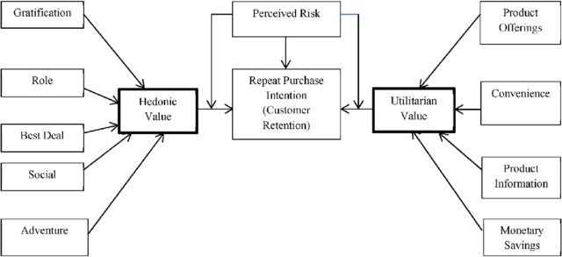

Slide 3
TABLE OF CONTENTS
DEFINITION
INTRODUCTION
Business Problem Framing
Conceptual Background Of Domain Knowledge
Problem Statement
ANALYTICAL PROBLEM FRAMING
Data Sources
Data Preprocessing
EXPLORATORY DATA ANALYSIS
Visualizations
Count-plots
Pie Charts
Bar Graphs
CONCLUSION
Key Findings and Conclusions of the Study

Slide 4
CUSTOMER RETENTION
Customer retention is a business’s ability to keep existing customers and continue to generate revenue from them. Companies use different tactics to convert first-time buyers into repeat shoppers. In other words, customer retention allows a business to increase the profitability of an existing customer and maximize their lifetime value (LTV).

Slide 5
Customer satisfaction has emerged as one of the most important factors that guarantee the success of online store; it has been posited as a key stimulant of purchase, repurchase intentions and customer loyalty.
A comprehensive review of the literature, theories and models have been carried out to propose the models for customer activation and customer retention.
Five major factors that contributed to the success of an e-commerce store have been identified as: service quality, system quality, information quality, trust and net benefit.
The research furthermore investigated the factors that influence the online customers repeat purchase intention.
The combination of both utilitarian value and hedonistic values are needed to affect the repeat purchase intention (loyalty) positively.

Slide 6
BUSINESS PROBLEM FRAMING
The objective was to perform extensive data analysis on a given dataset and produce valuable insights that will help in customer retention

Slide 7
CONCEPTUAL BACKGROUND OF THE DOMAIN PROBLEM
Customer satisfaction has emerged as one of the most important factors that guarantee the success of online store; it has been posited as a key stimulant of purchase, repurchase intentions and customer loyalty. A comprehensive review of the literature, theories and models have been carried out to propose the models for customer activation and customer retention. Five major factors that contributed to the success of an e-commerce store have been identified as: service quality, systemquality, information quality, trust and net benefit.

Slide 8
Problem statement
The combination of both utilitarian value and hedonistic values are needed to affect the repeat purchase intention (loyalty) positively .
The objective was to perform extensive data analysis on a given dataset and produce valuable insights that will help in customer retention.
The dataset consist of 71 features and 269 rows

Slide 9
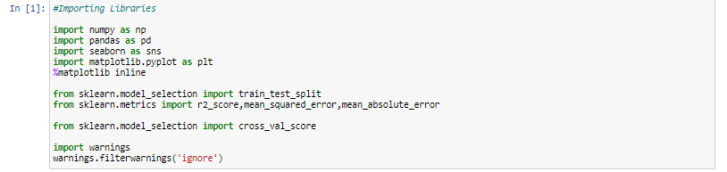
DATA SOURCES
Imported Libraries:
- All the important libraries were imported before starting the project

Slide 10
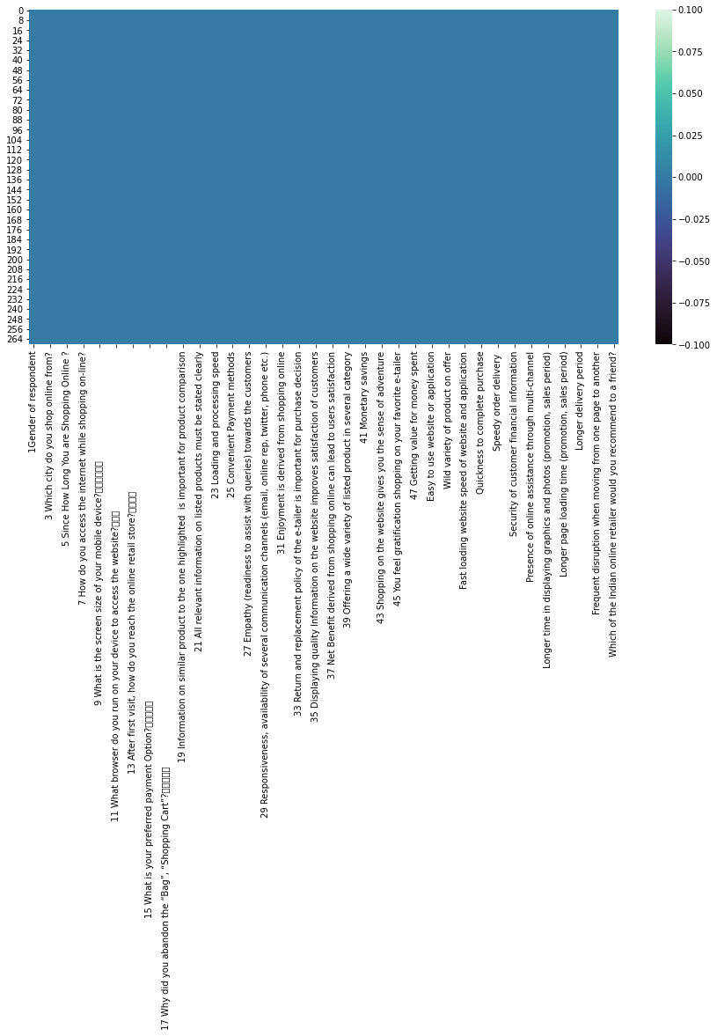
Dataset - check for any empty values
- The datasent contains no null values

Slide 11
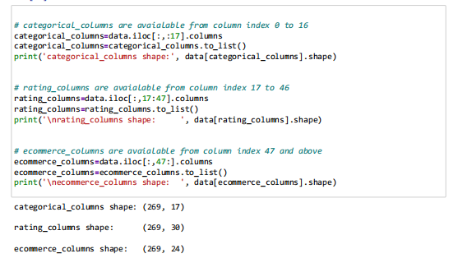
For a clear understanding, the features are divided in 3 parts as shown below

Slide 12
Exploratory Data Analysis(EDA)
Let’s explore our dataset in 3 parts:
- Categorical columns
- Ratings columns
- Ecommerce columns

Slide 13
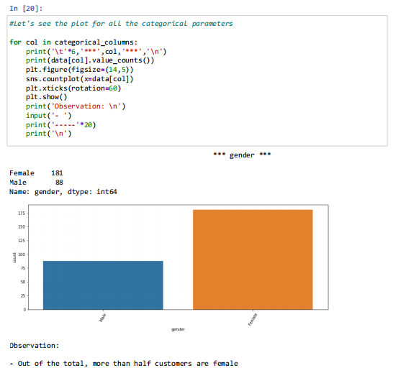
Gender
Out of the total, more than half customers are female

Slide 14
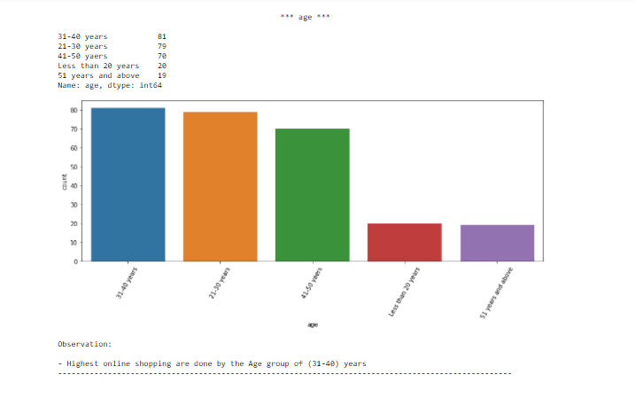
Age

Slide 15
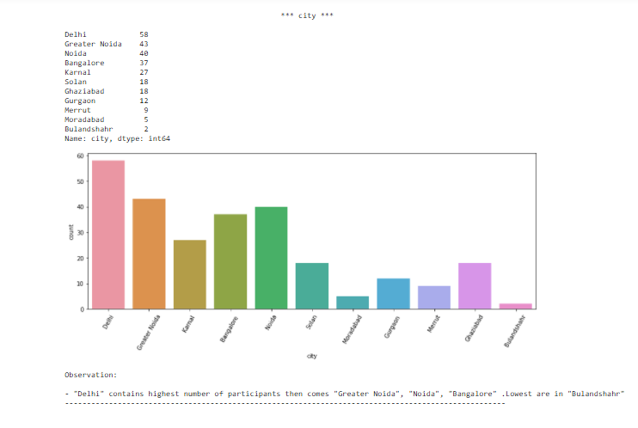
Customers from different cities

Slide 16
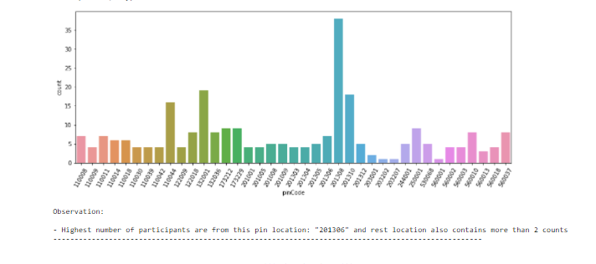
Customers from different pincodes

Slide 17
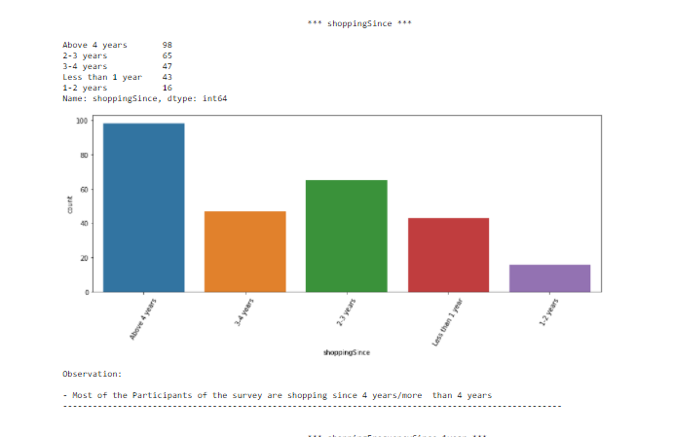
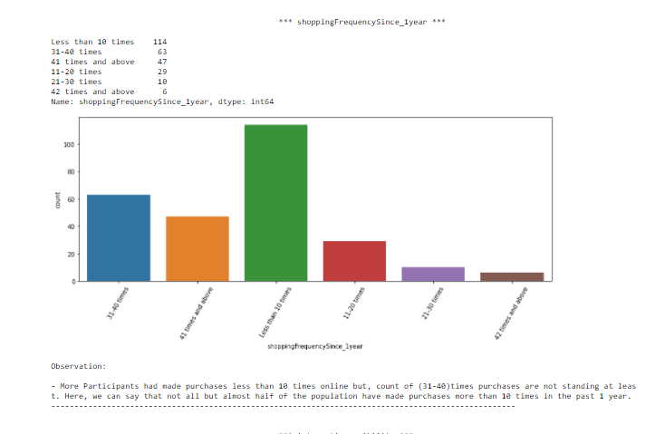
Customer distribution since how many years they are shopping and their shopping frequency

Slide 18
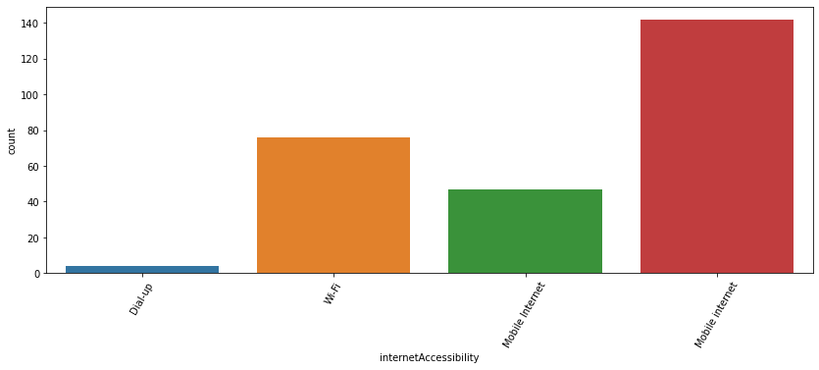
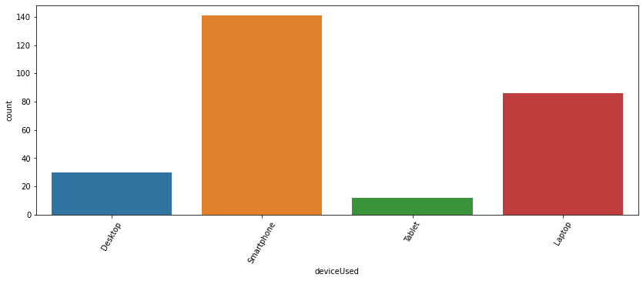
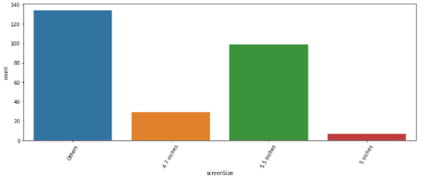
InternetAccessibility
- Most of the participants use their Mobile internet to access products online/shop online
deviceUsed
- Large number of participants use their Smartphone to shop online and we also have a good number of participants who go with purchases by Laptop
Screensize
- Participants use their 5.5 inches of screensize to shop online largely, and here we can see that in our dataset contains most of the particpants use any other screensize

Slide 19
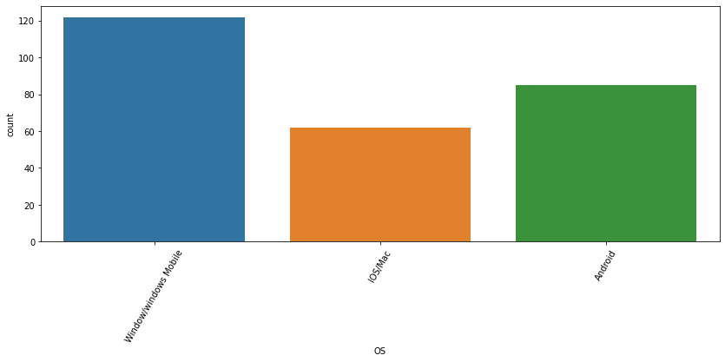
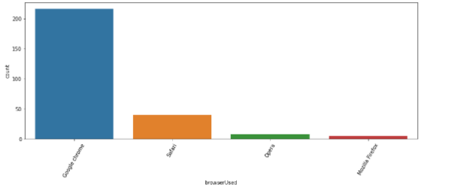
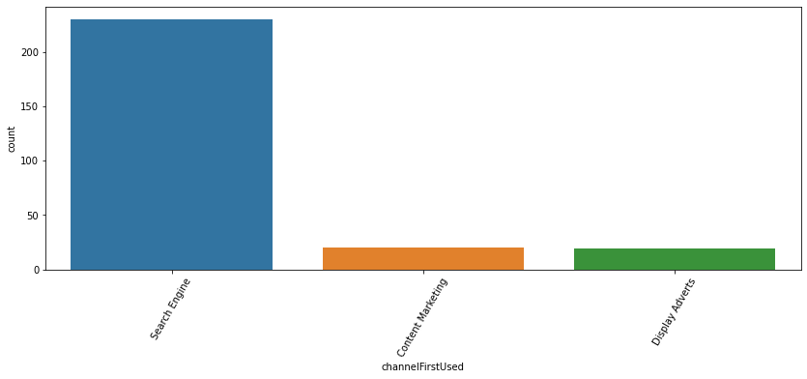
Operating System used
- Most participants uses "Window/windows Mobile" to shop online then, "Android" then, comes "IOS/Mac" at least
Browser Used
- "Google Chrome" browser are widely used for online website access when compared to other browser
channelFirstUsed
- "Search Engine" were widely used to follow to arrive at their favorite online store for the first time. And rest 50-50% "Content Marketing" and "Display Adverts" are used

Slide 20
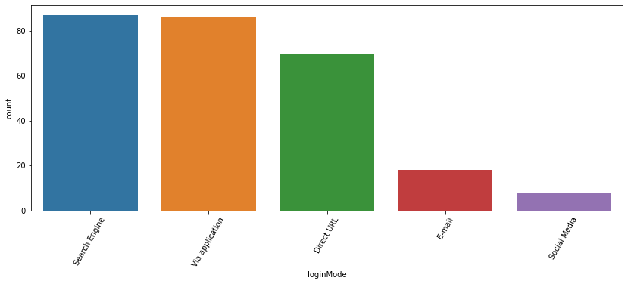
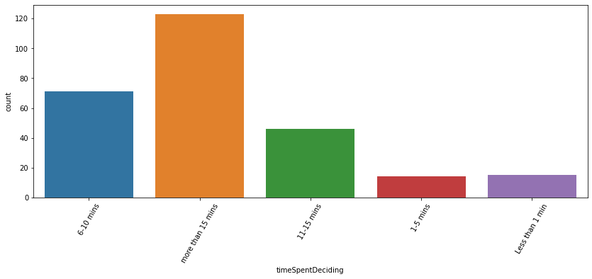
loginMode
- Most Participants use"Search Engine" and "Application" for reaching the online retail store.
timeSpentDeciding
- Most of the customers explore the e- retail
store for about more than 15 minutes before making a purchase decision..

Slide 21
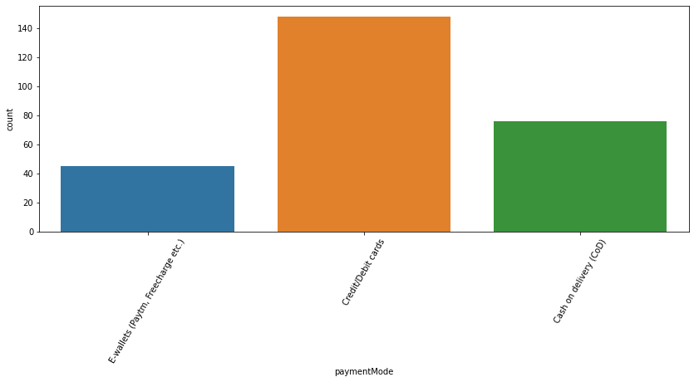
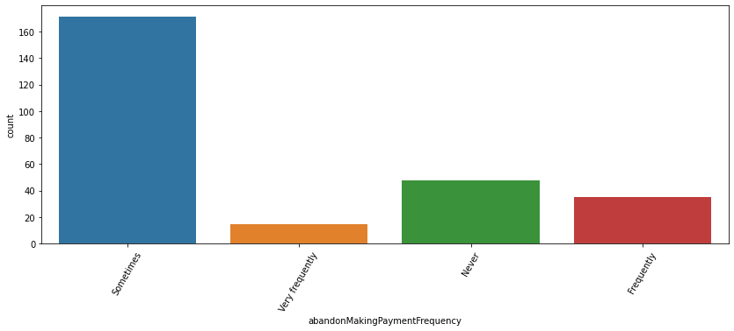
Payment Mode Used
- "Credit/Debit cards" are the most preferred payment Option then, the "Cash on Delivery" has the highest count when compared to "E-wallets (Paytm,Freecharge etc.)".
abandonMakingPaymentF
- Most of the participants sometimes abandon(leaving without making payment)
their shopping cart.

Slide 22
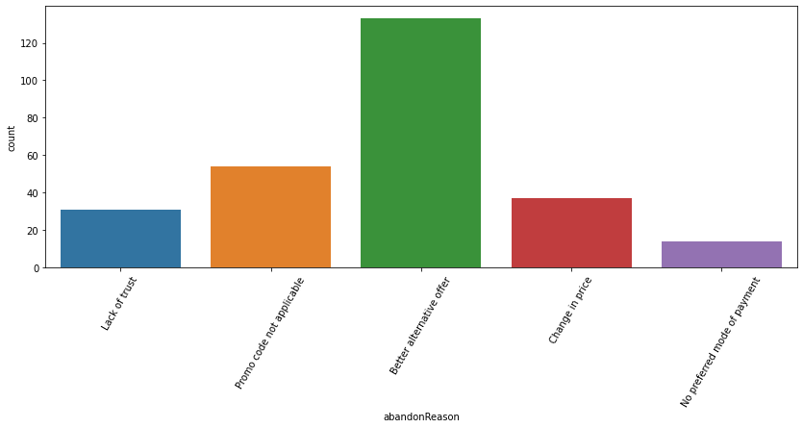
Abandon Reason
- Most participants get "Better alternative offer" so, they abandon their shopping cart. And the second main reason to abandon is "Promo code not applicable". Then comes the reasons "Change in Price", "Lack of trust" and "No preferred mode of payment". Here, we can see that we also have a good number ofparticipants who abandon due to "Lack of trust", hence. there is a need to get the trust from the participants

Slide 23
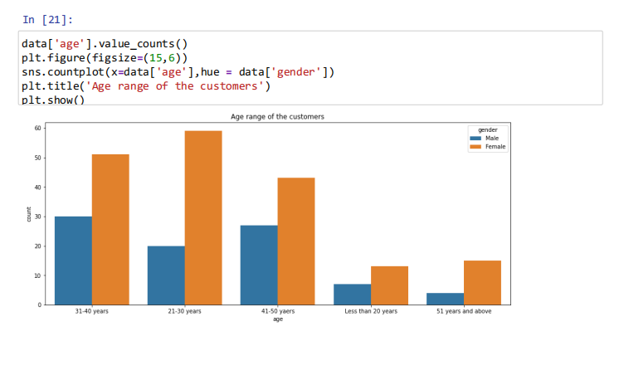
Age v/s Gender
Here, in every age group Female customers are more in number

Slide 24
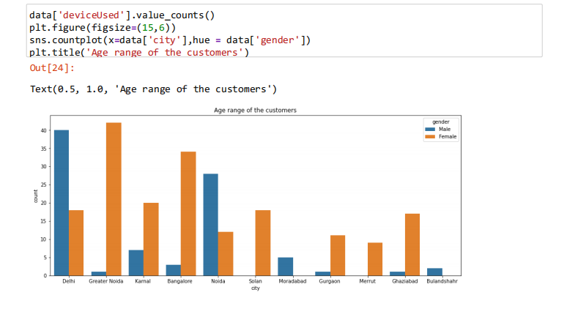
Relatin b/w Gender and City
- In Delhi, Noida, Moradabad and Bulandshahr, we find "Male shoppers" are more in number
- Rest, high number of Female shoppers are almost everywhere

Slide 25
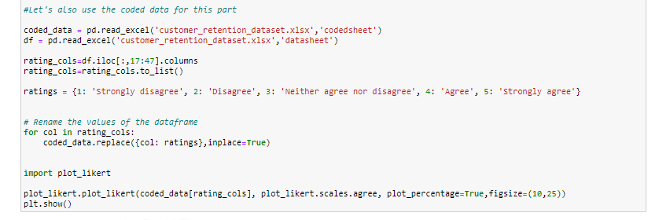
Ratings Columns Visualization

Slide 26
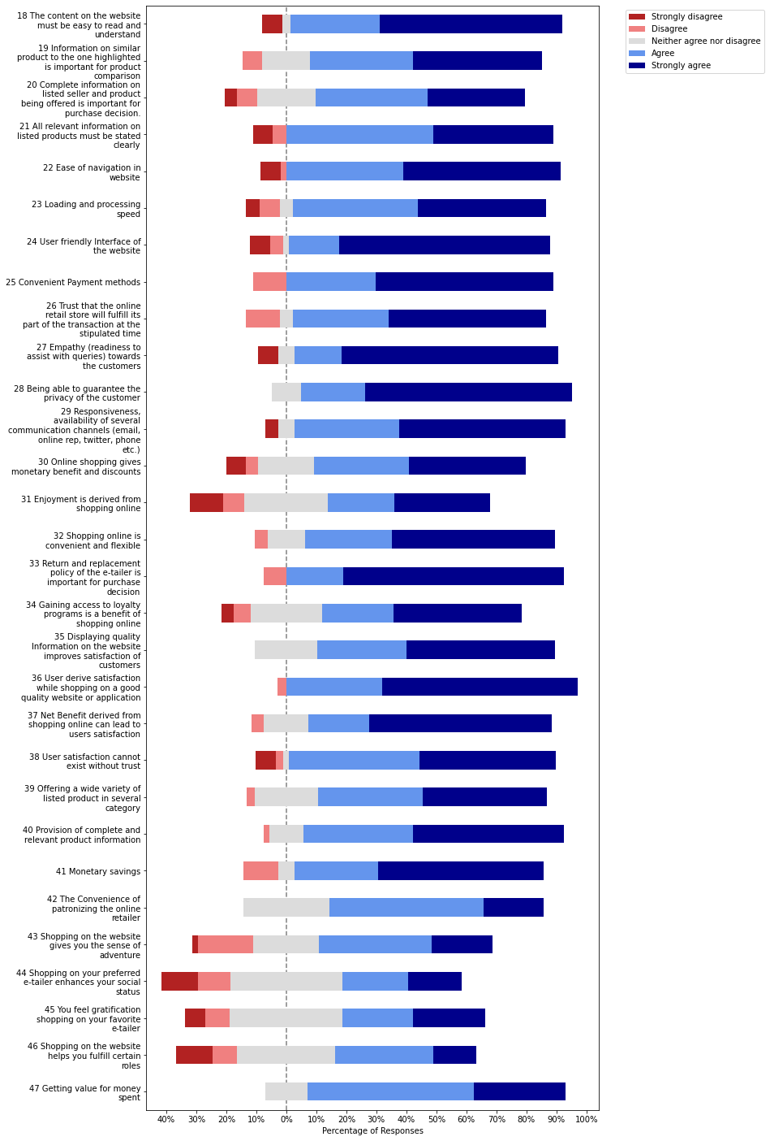

Slide 27
Observations on the basis of Customer's perception:
Customers mostly believe that the content on the website must be easy to read and understand
People agree that information on similar product to the one highlighted is important for product comparison
70% people believe that Complete information on listed seller and product is important for purchase decision.
90% people believe that All relevant information on listed products must be stated clearly
For more than 90% of the people believe that the following parameters are important
- Ease of navigation in website
- Loading and processing speed
- User friendly Interface of the website
- Convenient Payment methods
- Trust that the online retail store will fulfill its part of the transaction at the stipulated time
- Empathy (readiness to assist with queries) towards the customers
- Being able to guarantee the privacy of the customer
- Responsiveness, availability of several communication channels (email, online rep, twitter, phone etc.)
- Online shopping gives monetary benefit and discounts
- Getting value for money spent
Around 70% people believe that Enjoyment is derived from shopping online
90% people believe that Shopping online is convenient and flexible
more than 90% of the people believe that Return and replacement policy of the e-tailer is important for purchase decision
most of the people believe that Gaining access to loyalty programs is a benefit of shopping online

Slide 28
Observations based on Satisfaction:
Around 20% people don't that Displaying quality Information on the website improves satisfaction of customers. The other 80% agree that it os important.
customers are in favour of "Strongly Agreement or Agree" :
- User derive satisfaction while shopping on a good quality website or application
- Net Benefit derived from shopping online can lead to users satisfaction
- User satisfaction cannot exist without trust
- Offering a wide variety of listed product in several category
- Provision of complete and relevant product information
- Monetary savings
- The Convenience of patronizing the online retailer
People strongly believe: Shopping on the website gives you the sense of adventure, but we do have 10-30% who disagree
Around 60-80 % people believe that
- Shopping on your preferred e-tailer enhances your social status
- You feel gratification shopping on your favorite e-tailer
- Shopping on the website helps you fulfill certain roles

Slide 29
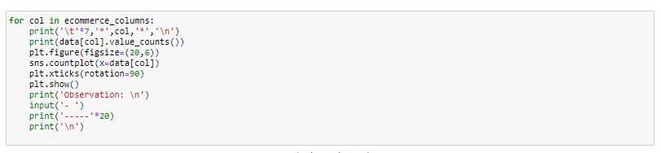
Ecommerce Columns
Let’s visualize and understand

Slide 30
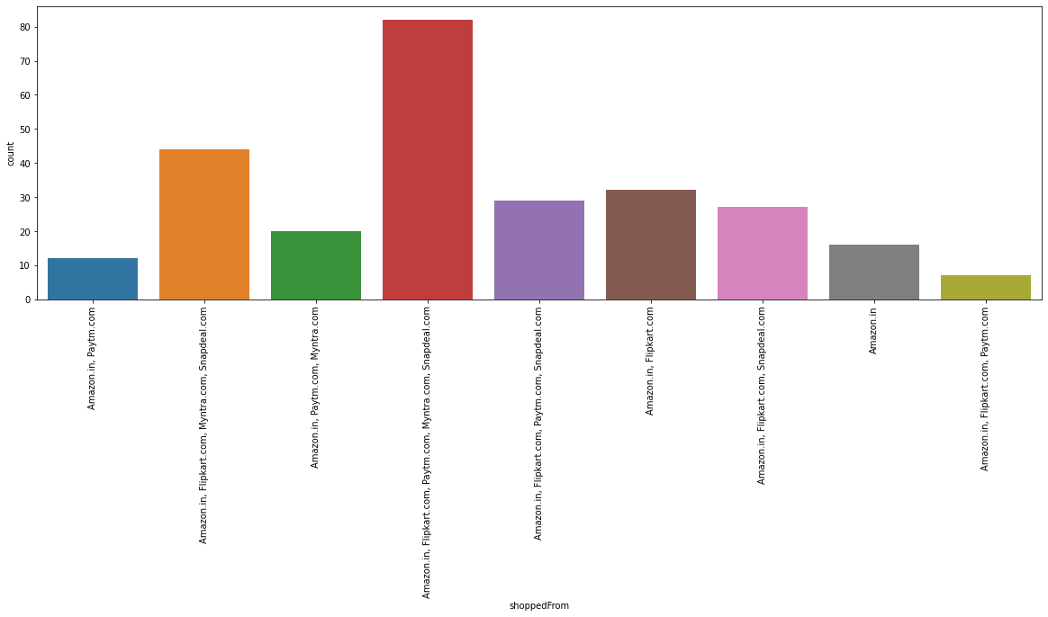
Shopped From
Most Participants have shopped from these 5 companies
"Amazon.in, Flipkart.com, Paytm.com, Myntra.com, Snapdeal.com".

Slide 31
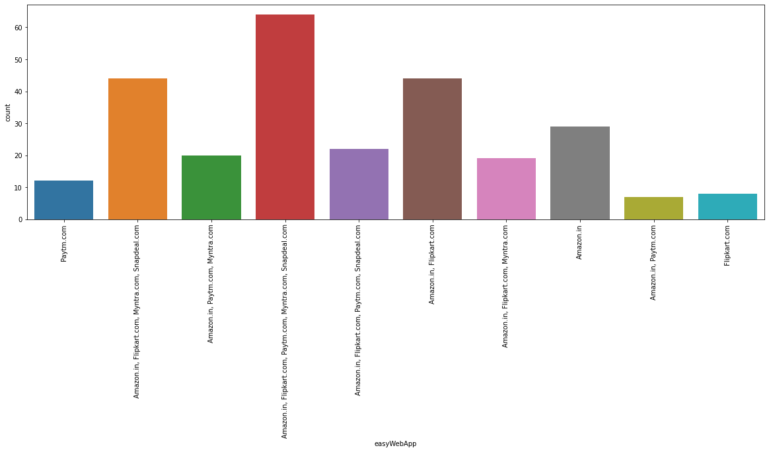
EasyWebApplication
"Amazon.in, Flipkart.com, Paytm.com, Myntra.com, Snapdeal.com Also, Amazon.com and Flipkart.com" have the website or application which are Easy to use

Slide 32
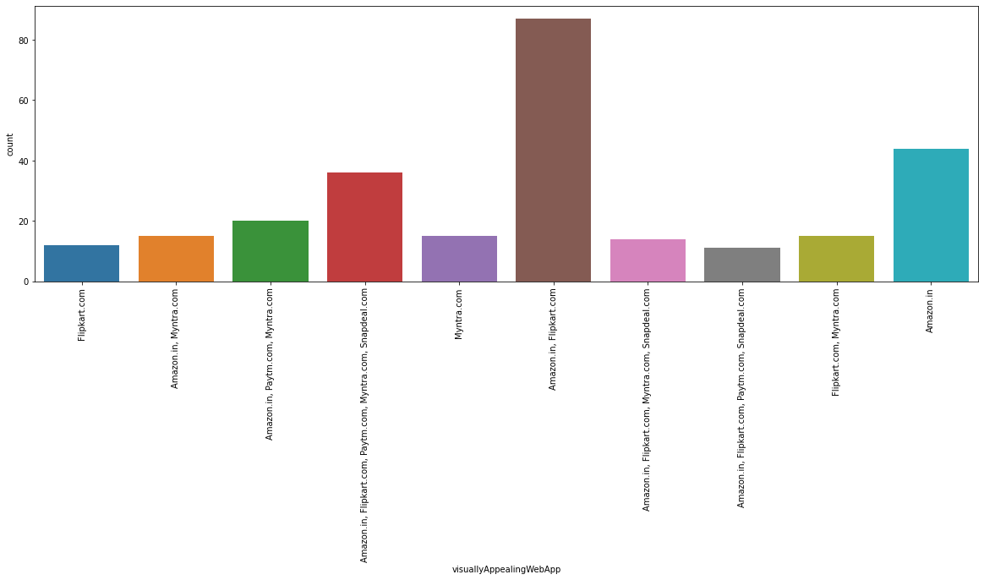
Visually Apeaing WebApplication
"Amazon.com and Flipkart.com" has a good "Visual appeal web-page layout' as per the survey

Slide 33
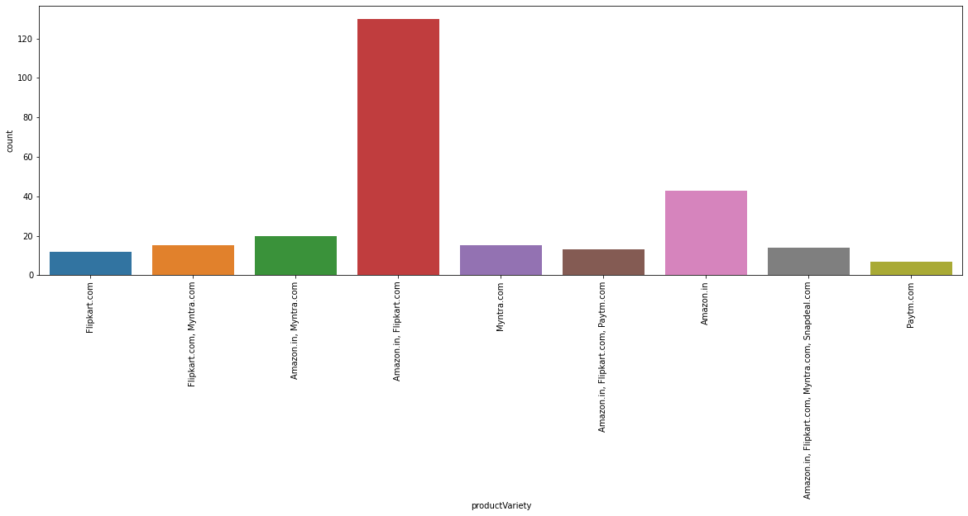
Product Variety
Wide variety of product on offer are mostly obtained in ""Amazon.com and Flipkart.com""

Slide 34
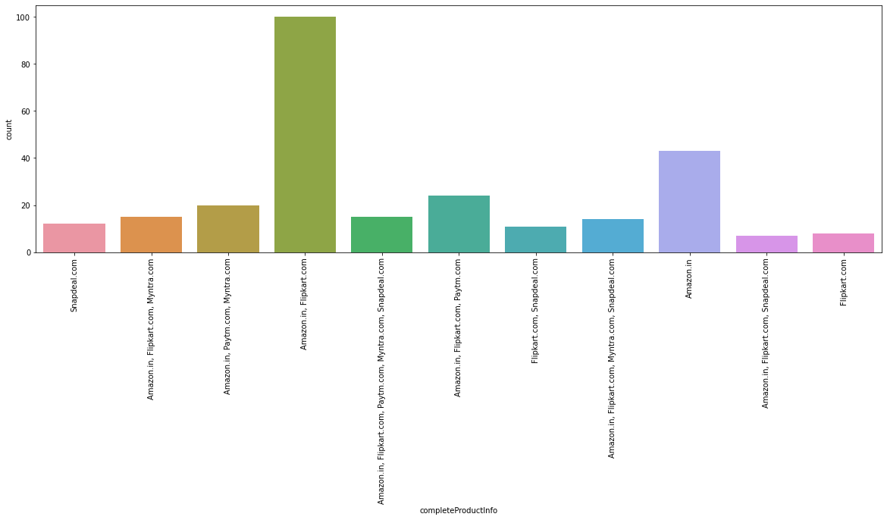
Complete Product Information
Complete, relevant description information of products: Highest count again goes to "Amazon.com and Flipkart.com"

Slide 35
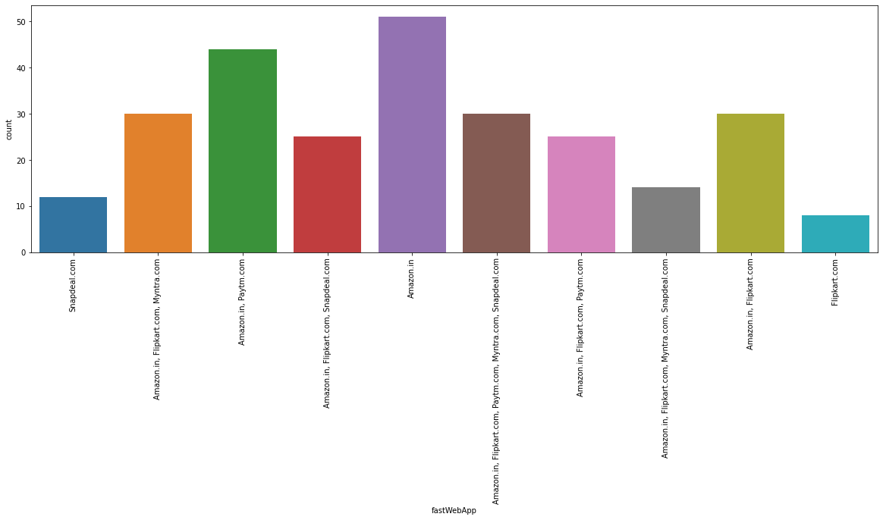
Fast Web Application
Fast loading website speed /of website and application : "Amazon.com" stands at the highest count

Slide 36
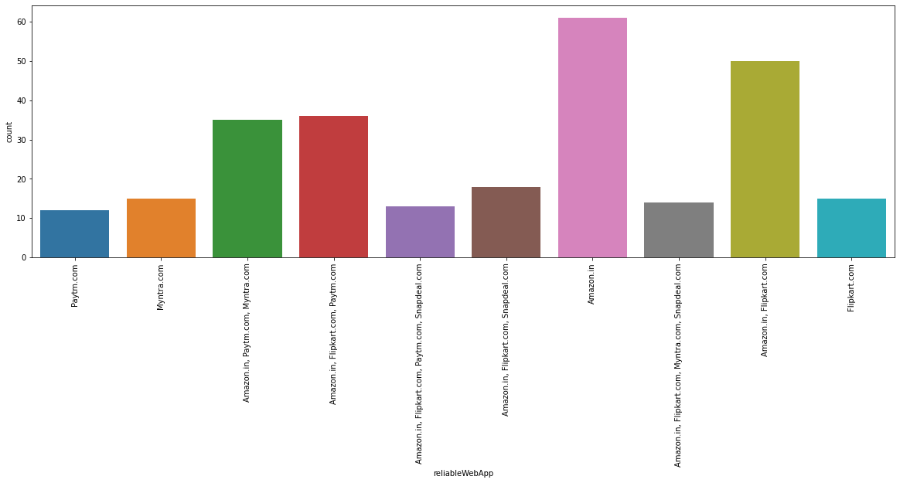
Reliable Web Application
Reliability of the website or application:
"Amazon.com" is at highest next "Amazon.com and Flipkart.com " once again

Slide 37
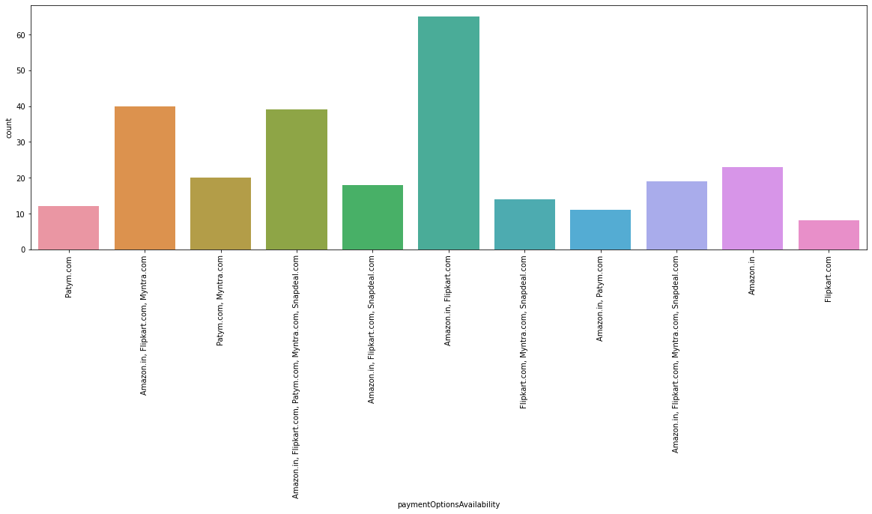
Payment Options Availability
Availability of several payment options: Here, Amazon and Flipkart, both are the favourites. Although a lot of people also tend to go towards Myntra

Slide 38
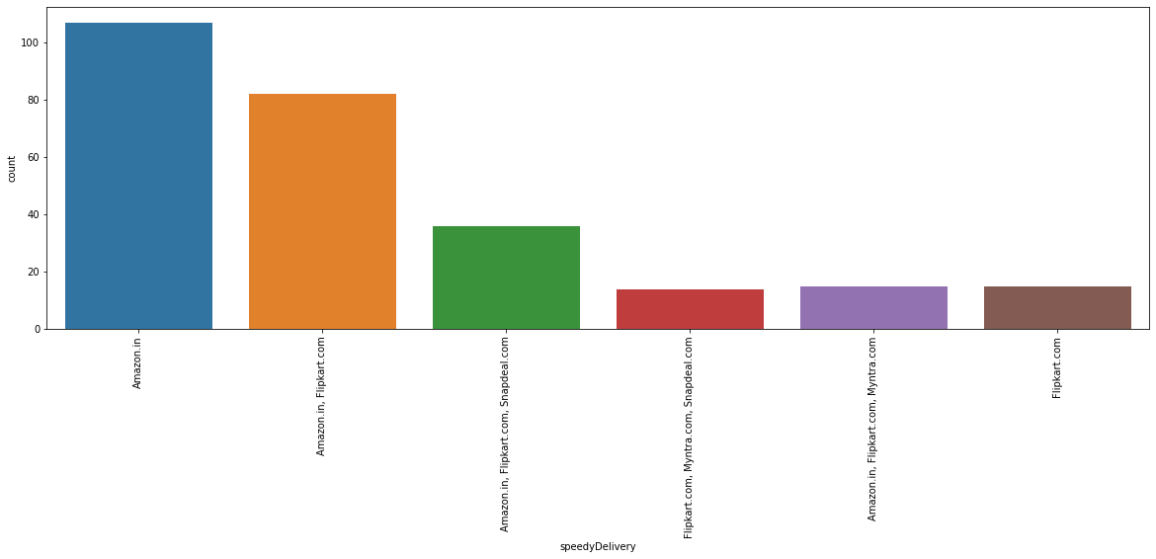
Speedy order delivery
Speedy order delivery: Amazon seems to take the lead in this category too, followed by Flipkart.

Slide 39
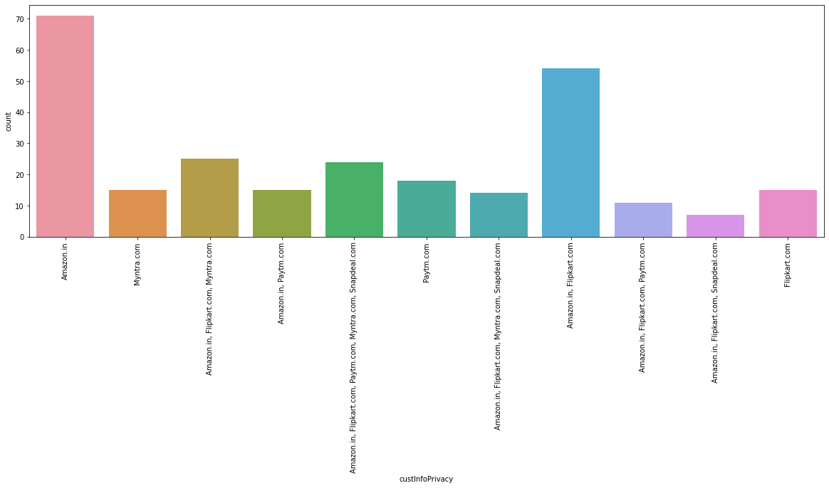
Privacy of customers’ information
Privacy of customers’ information: Amazon has a good reputation for maintaining privacy, followed by Flipkart

Slide 40
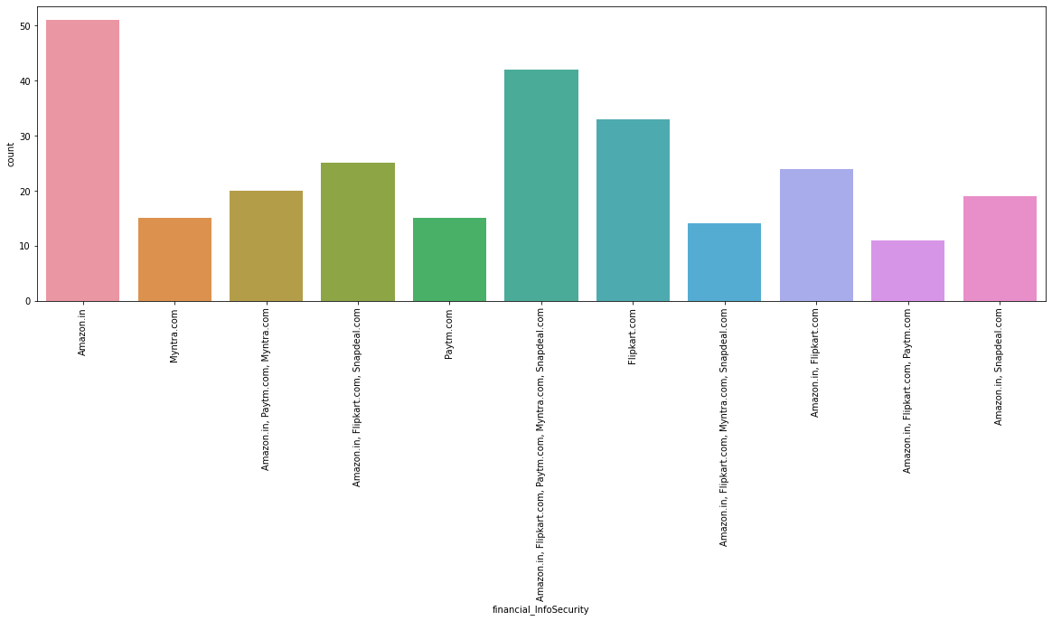
Security of customer financial information:
Not only Amazon but also Flipkart, Paytm.com, Myntra.com, Snapdeal.com are also trusted by a lot of people. This shows that all companies pay special attention to security.

Slide 41
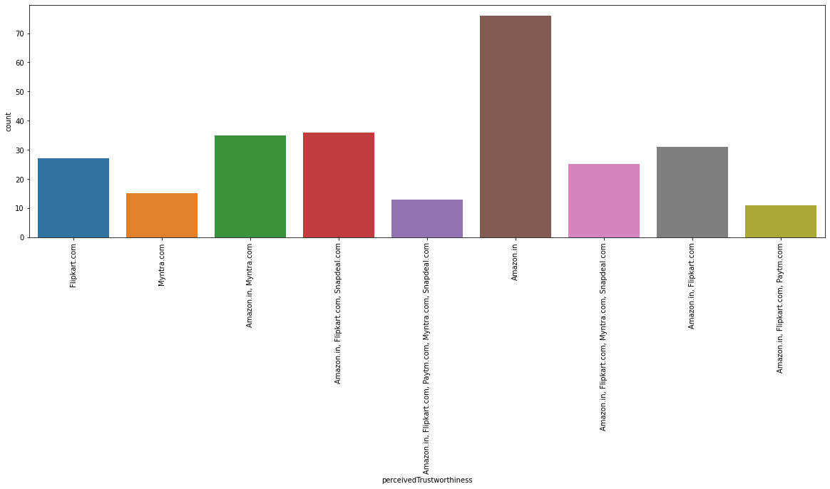
Perceived Trustworthiness
Perceived Trustworthiness: Amazon has gained the most trust worthy company by the participants and the next votes goes to "Flipkart.com, Snapdeal.com and Myntra.com"

Slide 42
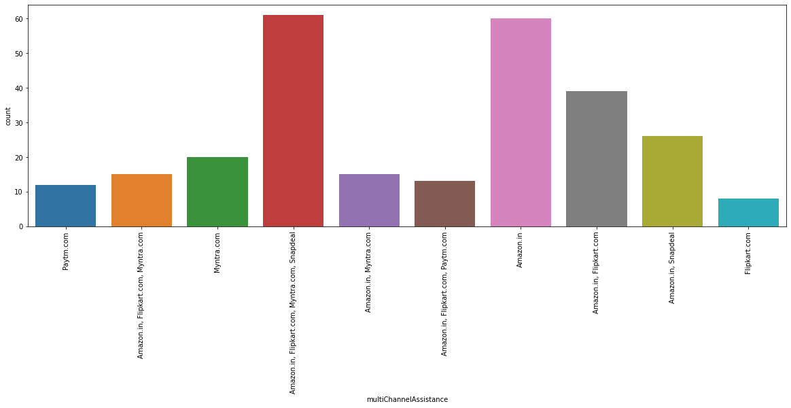
multiChannelAssistance
multiChannelAssistance: Amazon.in, Flipkart.com, Myntra.com, Snapdeal

Slide 43
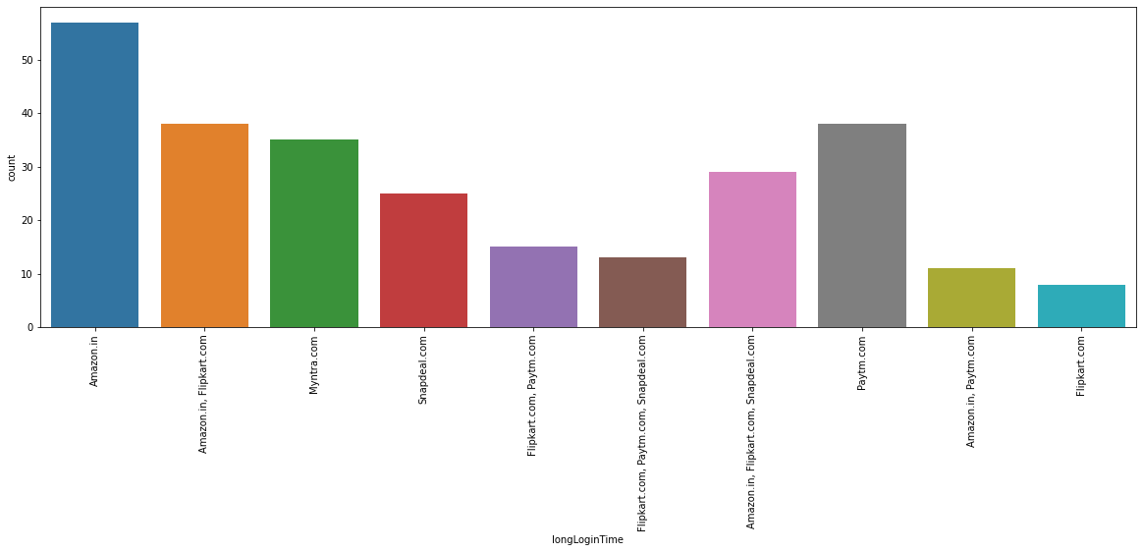
Long Login Time
Longer time to get logged in (promotion, sales period): "Amazon.in" and next "Paytm.com"

Slide 44
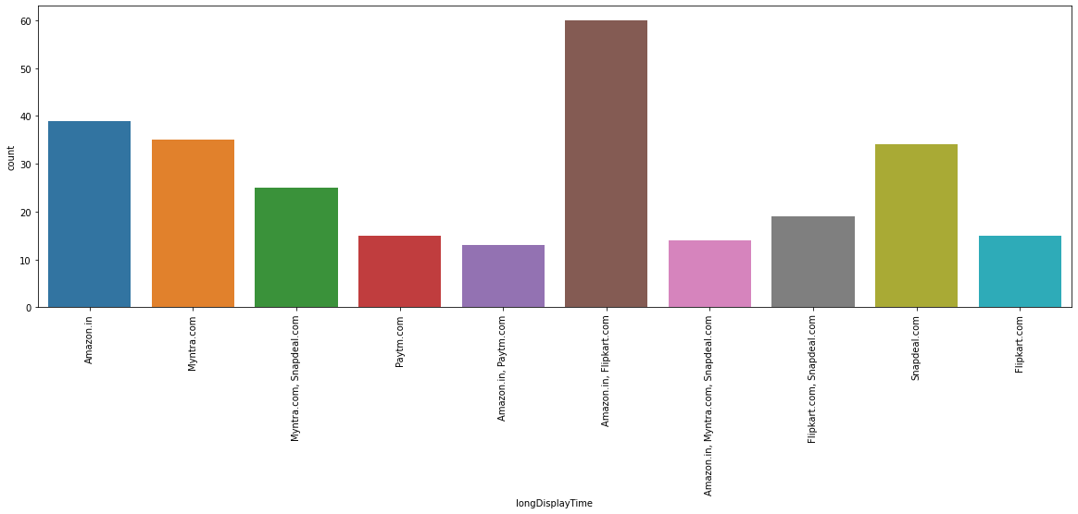
Long Display Time
Longer time in displaying graphics and photos (promotion, sales period): "Amazon.in", "Flipkart.com"

Slide 45
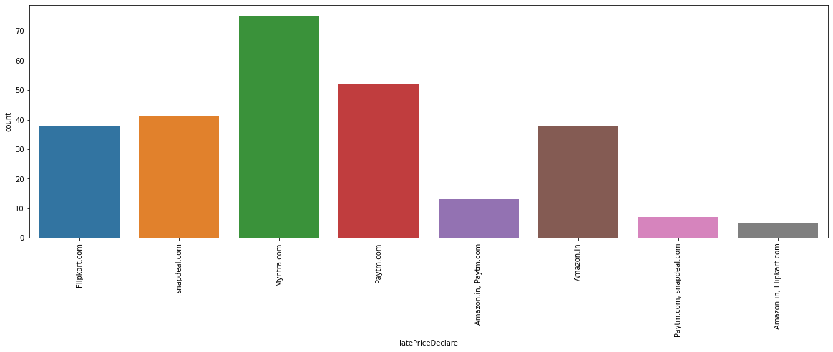
Late declaration of price
Late declaration of price: Myntra, Paytm, Snapdeal. These companies should work on this area to improve.

Slide 46
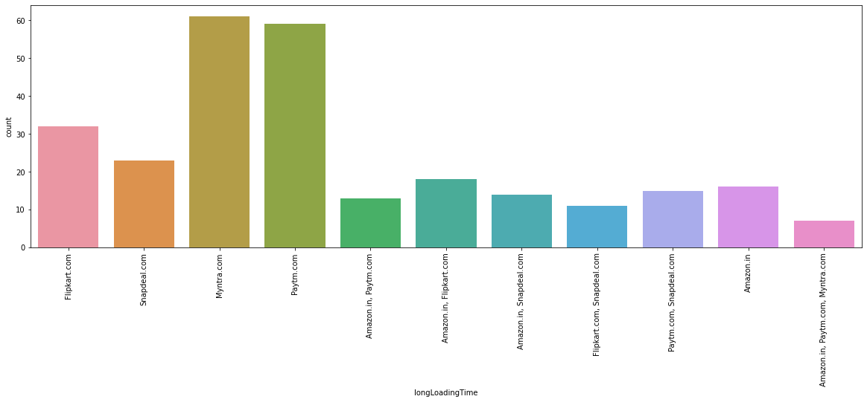
Longer page loading time
Longer page loading time (promotion, sales period): Myntra and Paytm have bad feedback in this. Flipkart should also have a look into it, as it is at the 3rd place

Slide 47
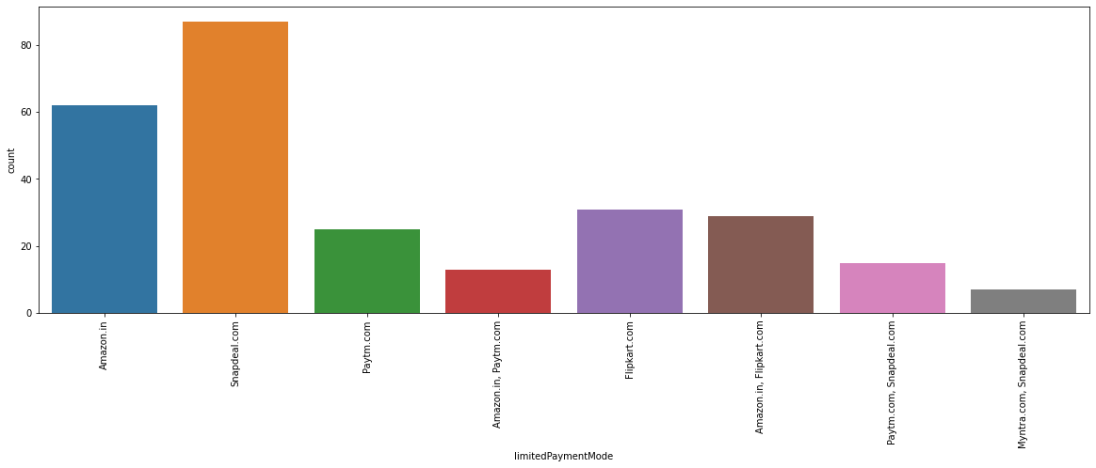
Limited mode of payment
Limited mode of payment on most products (promotion, sales period): Snapdeal is the most voted answer for this.

Slide 48
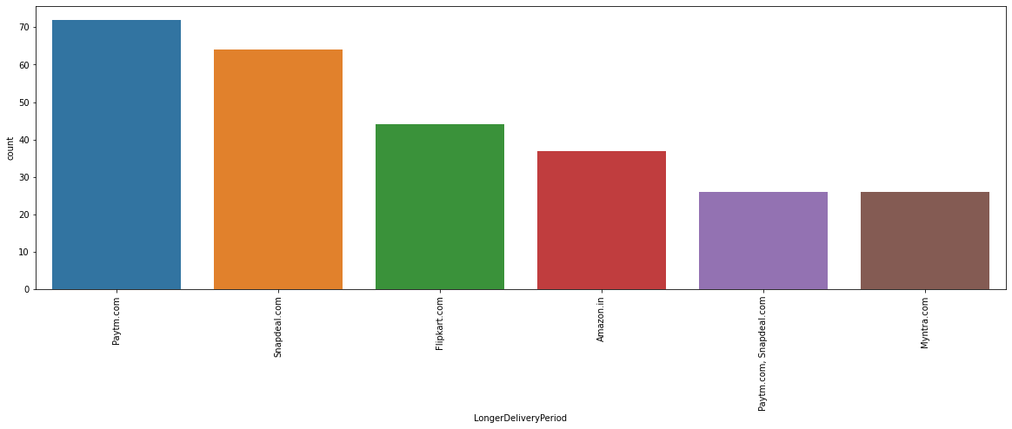
Longer delivery period
Longer delivery period: "Paytm" and "Snapdeal" need to reduce their delivery time.

Slide 49
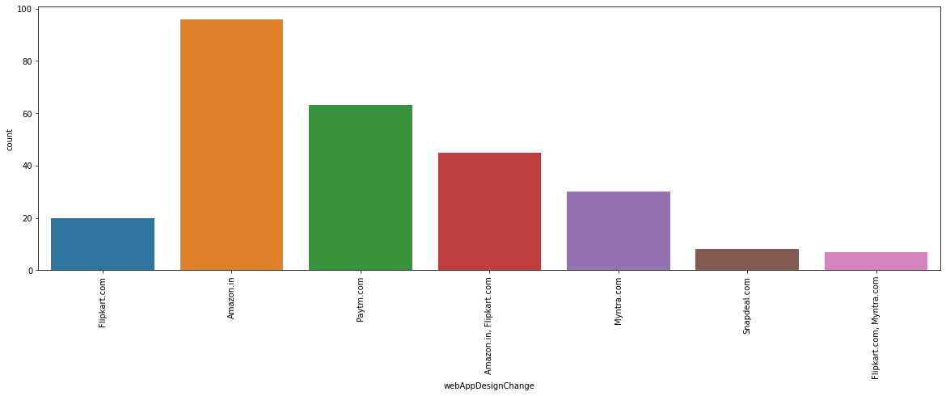
Change in website/Application design
Change in website/Application design: "Amazon.in"

Slide 50
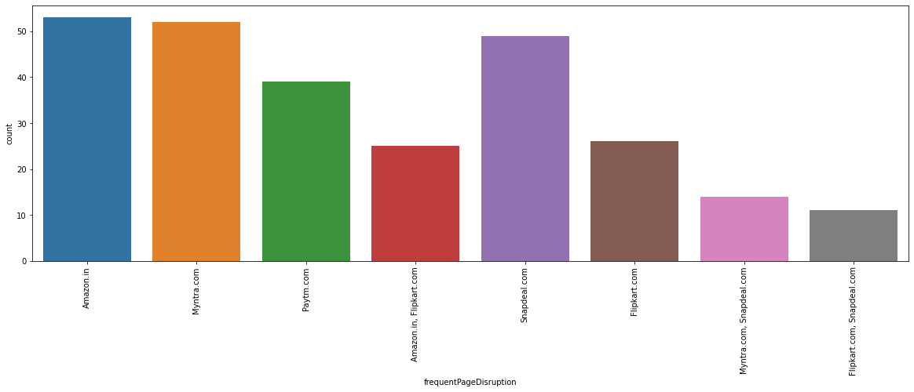
Frequent page disruption
Frequent disruption when moving from one page to another: Amazon.in

Slide 51
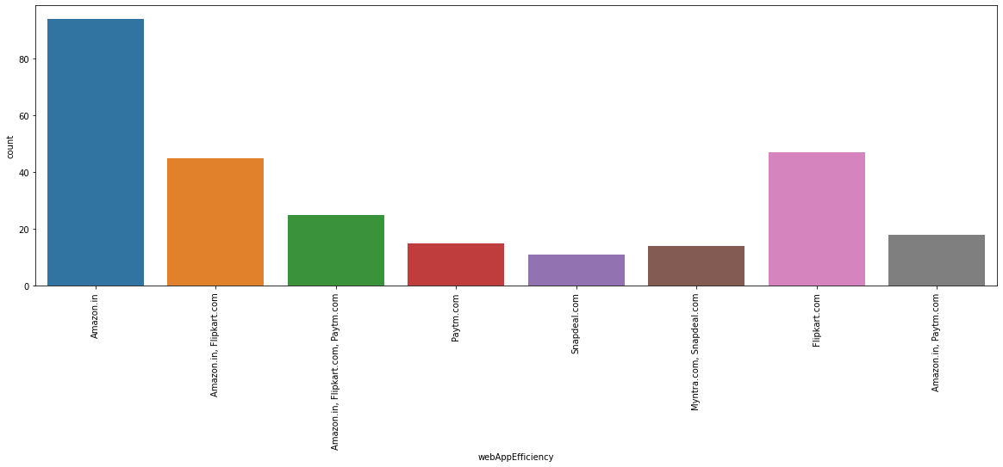
Web Application Efficiency
Website is as efficient as before: Amazon.in

Slide 52
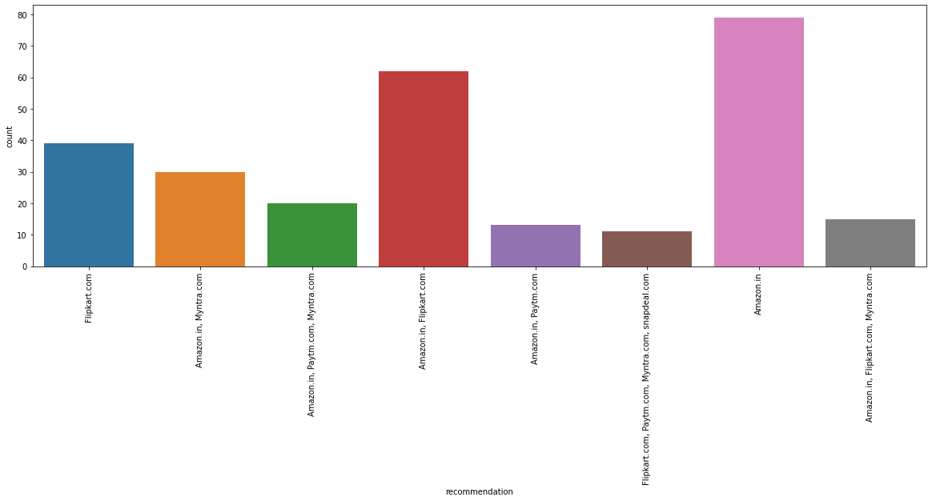
Recommendation
Which of the Indian online retailer would you recommend to a friend?:
"Amazon/Flipkart"

Slide 53
Comparing the Customer's Perceptions and the Company's performance we can conclude that the Companies likely to have
High Customer Satisfaction and Retenton:
Amazon.com
Flipkart.com
High Risk of Customer Churn:
Myntra.com
Snapdeal.com

Slide 54
Conclusion
AMAZON: The most recommended websites with attractive web-page layout, easy to use, relevant descriptive information, product offers, reliability of website, quickness to complete purchase, trust worthiness. What can be improved: Takes longer time to login, Late declaration or price during sales and promotion, frequent disruption when moving from one page to another, Limited mode of payment on most of products.
FLIPKART: This is the 2nd most recommended website with fast loading page, security of financial information, trust worthiness, several payments modes, website is as efficient as before. What can be improved: Takes longer time in displaying graphics, late declaration of price during sales and promotion.
PAYTM: Reliability of website, speedy delivery of products, quickness in purchase. What can be improved: Longer page loading time, Longer delivery period , late declaration of price during sales and promotion.
MYNTRA: Myntra stands on 3rd most recommended websites with easy to use, wild variety of product offers, several payment methods, attractive visual appealing web-page layout. What can be improved: Relevant information about product, website loading speed, speedy delivery of products, websites is not much efficient as before.
SNAPDEAL: Least recommended website having less page loading time. What can be improved: Limited mode of payments, frequent disruption while moving from one page to another, Longer delivery period, customer’s privacy information, reliability of website, offers on product, and must be an attractive web-page layout.

