Slide 1
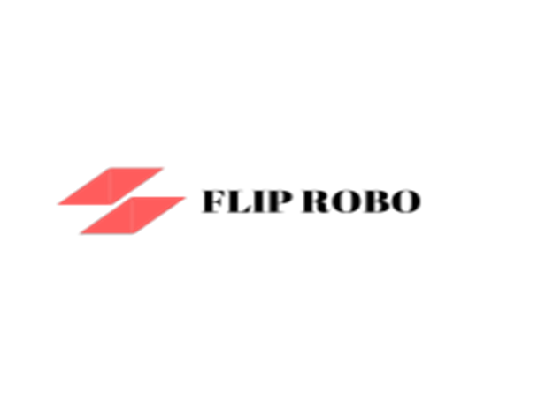
Image Scraping and Classification Project
Poonam Singh
Internship 17

Slide 2
Business Problem Framing
Here the project is divided in two phase :
1. Data collection:
Here we have collected the data from the online shopping website that is, Amazon.com . For collecting the data we use the scraping tools as Beautiful soup and Selenium. And store the scrapped images in a folder in form of train and test folder.
2. Model building:
Here we analysis the data and try to build the model , train it and then predict the category of test data.

Slide 3
Project Objectives:
Collect a dataset of images of clothing of saree for women, jeans for men, trouser for men from the online shopping website amazon.com
Produce a convolutional neural network which is capable correctly classifying images of clothes with an average confidence level of 80% or more.

Slide 4
Web Scraping
Web scraping is the process of gathering information from the Internet. Even copy-pasting the lyrics of your favorite song is a form of web scraping! However, the words “web scraping” usually refer to a process that involves automation. Some websites don’t like it when automatic scrapers gather their data, while others don’t mind. Web scraping is the process of using bots to extract content and data from a website.Unlike screen scraping, which only copies pixels displayed onscreen, web scraping extracts underlying HTML code and, with it, data stored in a database. The scraper can then replicate entire website content elsewhere.

Slide 5
Data scrapping
Beautiful Soup:
Beautiful Soup is a Python library for getting data out of HTML, XML, and other markup languages. Say you’ve found some webpages that display data relevant to your research, such as date or address information, but that do not provide any way of downloading the data directly. Beautiful Soup helps you pull particular content from a webpage, remove the HTML markup, and save the information. It is a tool for web scraping that helps you clean up and parse the documents you have pulled down from the web. The Beautiful Soup documentation will give you a sense of variety of things that the Beautiful Soup library will help with, from isolating titles and links, to extracting all of the text from the html tags, to altering the HTML within the document you’re working with.

Slide 6
Selenium:
In general, Selenium is well-known as an open-source testing framework for web applications – enabling QA specialists to perform automated tests, execute playbacks, and implement remote control functionality (allowing many browser instances for load testing and multiple browser types). In my case, this seemed like it could be useful. My go-to language for web scraping is Python, as it has well-integrated libraries that can generally handle all of the functionality required. And sure enough, a Selenium library exists for Python. This would allow me to instantiate a “browser” – Chrome, Firefox, IE, etc. – then pretend I was using the browser myself to gain access to the data I was looking for. And if I didn’t want the browser to actually appear, I could create the browser in “headless” mode, making it invisible to any user.

Slide 7
Deep-Learning
Deep learning, also called neural networks, is a subset of machine learning that uses a model of computing that’s very much inspired by the structure of the brain.
It is already working in Google search and in image search. It allows you to image-search a term like ‘hug.’
It’s used to getting you Smart Replies to your Gmail. It’s in speech and vision.

Slide 8
IMAGE CLASSIFICATION
• For increased accuracy, Image classification using CNN is most effective.
• Let us take an example of saree, jeans and trousers, as our initial training data set.
• The most common image data input parameters are the number of images, image dimensions, number of channels, and number of levels per pixel.
• With classification, we get to categorize images (in this case, as beauty and pharmacy). Each category again has different classes of objects.

Slide 9
DATA LABELING
• It’s better to manually label the input data so that the deep learning algorithm can eventually learn to make the predictions on its own.
• Some off the shelf manual data labelling tools are given here. The objective at this point will be mainly to identify the actual object or text in a particular image, demarcating whether the word or object is oriented improperly, and identifying whether the script (if present) is in English or other languages.
• To automate the tagging and annotation of images, NLP pipelines can be applied. ReLU (Rectified Linear Unit) is then used for the non-linear activation functions, as they perform better and decrease training time.
• To increase the training dataset, we can also try data augmentation by emulating the existing images and transforming them.
• We could transform the available images by making them smaller, blowing them up, cropping elements etc.

Slide 10
Problem-solving approaches
Sequential
Convo2D
MaxPooling2D
BatchNormalization
Dropout
Flatten
Optimizer
Stochastic Gradient Descent

Slide 11
CONCLUSION
The objective of the image classification project was to enable the model to understand about the image and its features and make model able to predict the given image’s label. To start working with Keras to solve real-time deep learning problems.
In this keras deep learning Project, we talked about the image classification paradigm for digital image analysis, such as human.
In the above model building we use different optimizer to train our model from which the best one is SGD but by improving the other aspects of our model we can see may be some other is performing better.

Slide 12
Thank You

