Slide 1
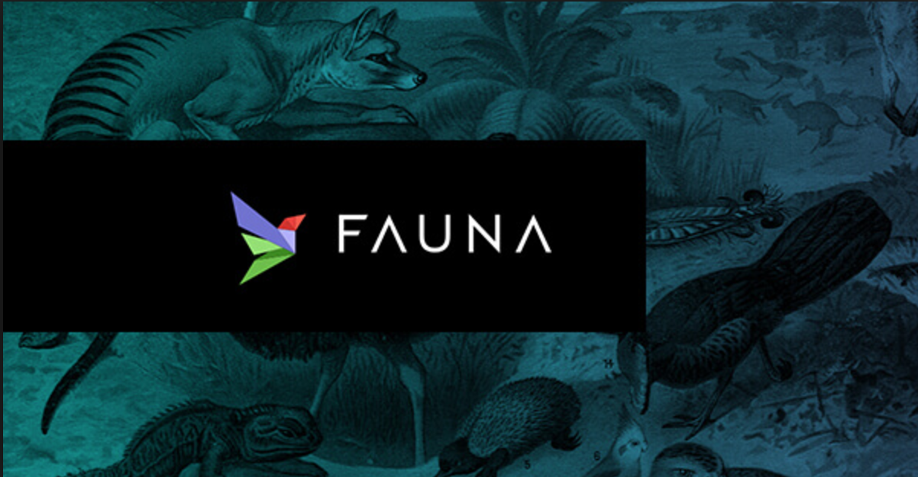
Fauna
Poonam Thawani
July 10th 2017

Slide 2
Agenda
Dynamo DB
Partitioning and Versioning
Calvin DB
Architecture
Fauna
Data Model
Query Language
Scalability
Implementation
Project – FindFriends using Fauna DB

Slide 3
Dynamo
Highly available key-value storage system provides always-on experience
Sacrifice strong consistency for availability
“always writeable” data store where no updates are rejected due to failures or concurrent writes.
Conflict resolution is executed during read instead of write, i.e. “always writeable”.
Every node in Dynamo is assumed to be trusted.

Slide 4
Partitioning – Consistent Hashing
Automated addition and removal of storage nodes
Advantages of using virtual nodes:
If a node becomes unavailable，the load handled by this node is evenly dispersed across the remaining available nodes.
When a node becomes available again, or a new node is added to the system, the newly available node accepts a roughly equivalent amount of load from each of the other available nodes.

Slide 5
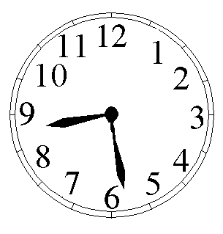
Data Versioning
A put() call may return to its caller before the update has been applied at all the replicas
A get() call may return many versions of the same object.
Key Challenge: distinct version sub-histories - need to be reconciled.
Solution: uses vector clocks in order to capture causality between different versions of the same object.

Slide 6
Summary of techniques used in Dynamo and their advantages
Problem | Technique | Advantage
Partitioning | Consistent Hashing | Incremental Scalability
High Availability for writes | Vector clocks with reconciliation during reads | Version size is decoupled from update rates.

Slide 7
Calvin
Calvin provides high availability, strong consistency.
Calvin accomplishes by providing a layer above Storage System that handles scheduling as well as replication that uses deterministic ordering technique
Deterministic locking mechanism allows scalability in the face of distributed transactions.

Slide 8
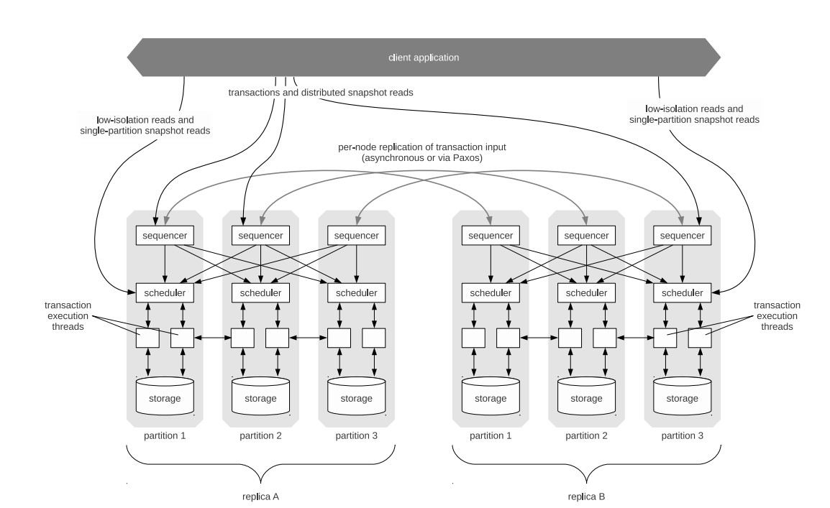
Architecture

Slide 9
Calvin’s Deterministic Locking
All calvin nodes reach to an agreement regarding what transaction to attempt and in what order, before the transaction is committed.
Reducing the contention footprint of distributed transactions
Thereby allowing throughput to scale out nearly linearly.

Slide 10
Calvin-System Architecture
Scalable transactional layer above storage system which provides CRUD interface (Create / Insert, read, update,delete )
Sequencing layer
Batches transaction inputs into some order
All replica will follow this order
Replication and logging
Scheduling layer
Handles concurrency control
Orchestrates execution using deterministic locking to guarantee order specified by sequencer.
Storage layer
Handles physical data layout
Transactions access data using CRUD interface

Slide 11
Fauna
FaunaDB’s transaction consistency algorithm is inspired by Calvin.
A FaunaDB cluster maintains availability in the face of faults due to multiple replica
FaunaDB is resilient to many types of faults
A node is temporarily unavailable (process crash; hardware reboot)
A node is permanently unavailable (physical hardware failure)
A node becomes slow (local resource contention or degraded hardware)

Slide 12
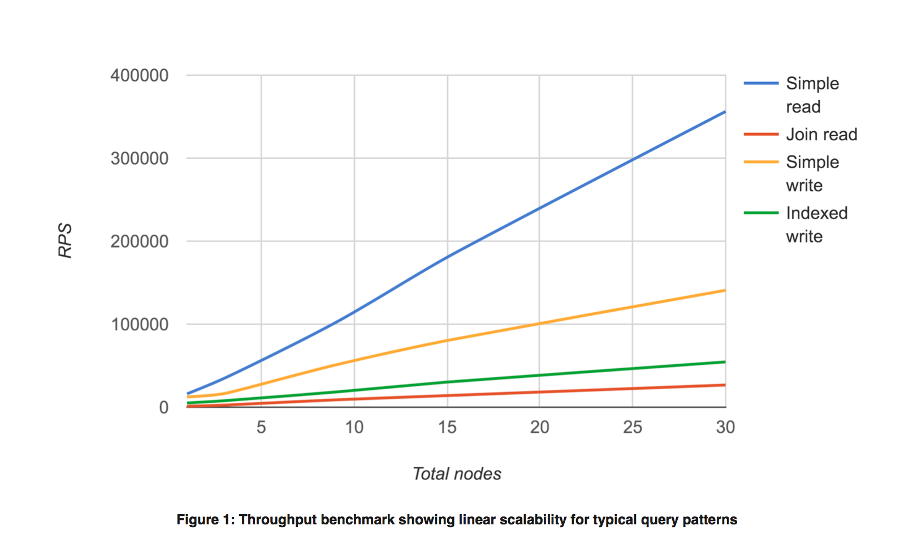
Fauna Throughput for all operations scales linearly

Slide 13
Fauna – Data Model
Inheritance-free object-relational data model
Records are inserted as structured documents called instances, which can include recursively nested objects and arrays
Instances are grouped into classes, which are similar to tables in a relational database
Classes are grouped into databases
Database access is controlled by keys
Derived relations are built with indexes
An index is a set of input instances into one or more result sets composed of terms and values.

Slide 14
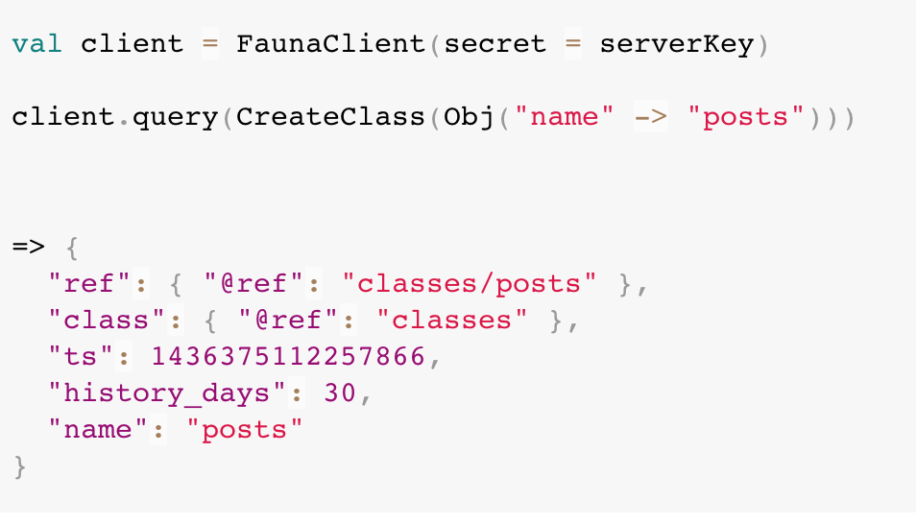
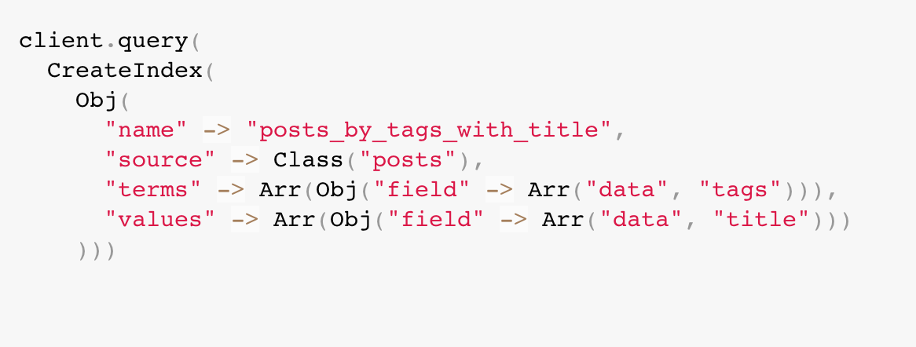
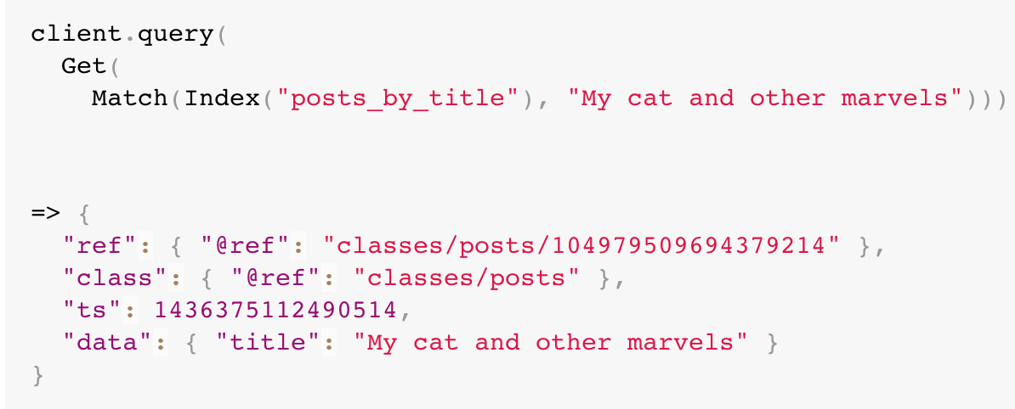
Fauna Data Model and Query Language

Slide 15
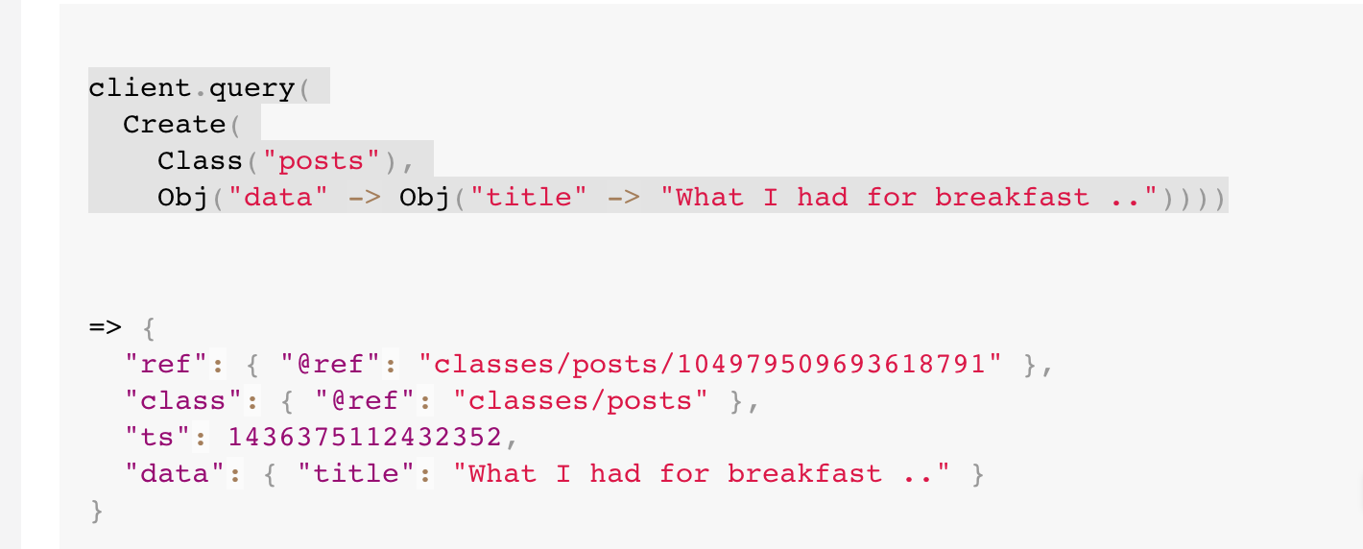
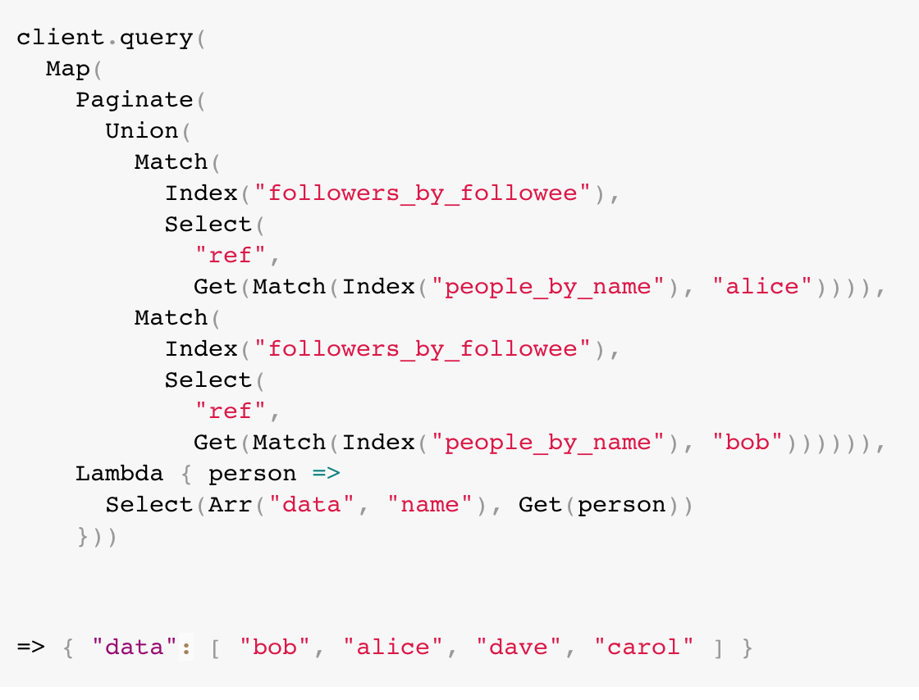
Query Language
FaunaDB implements a new relational query language that is functional, flexible, and type safe
Queries are transactional

Slide 16
Query Language
All records in fauna DB are temporal.
Configurable retention policies
This is useful for auditing, rollback, syncing to second systems, and forms a fundamental part of FaunaDB’s isolation model.
Privileged actors can manipulate historical versions.

Slide 17
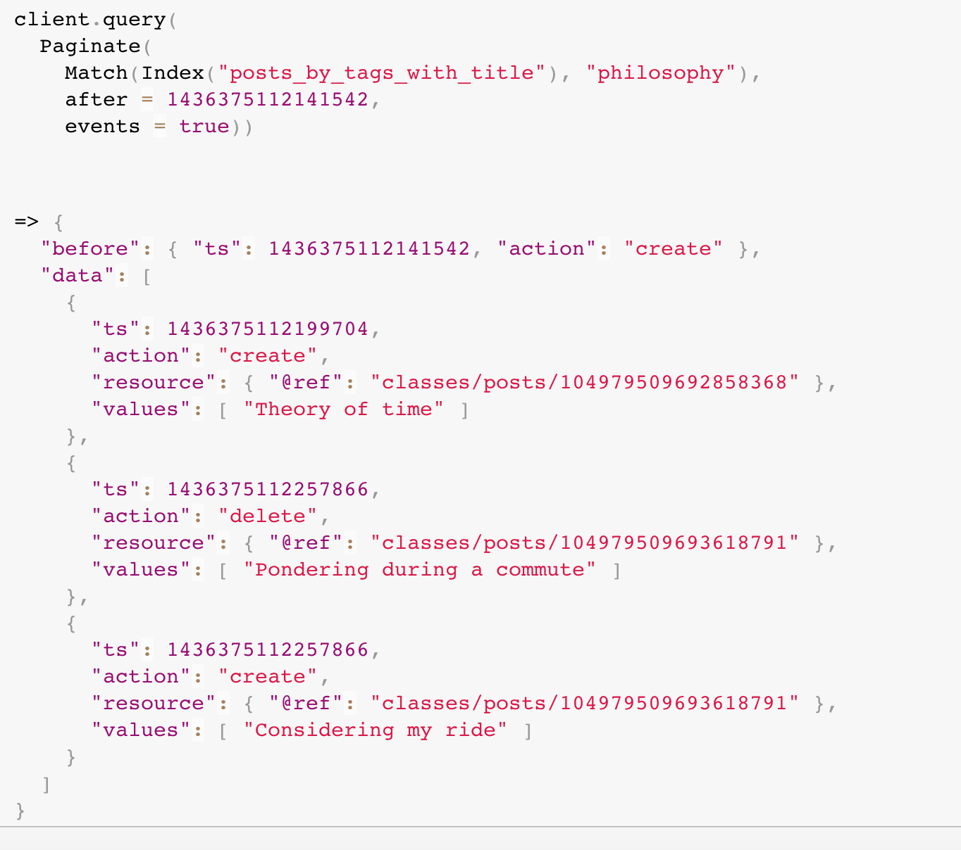
Temporal Queries

Slide 18
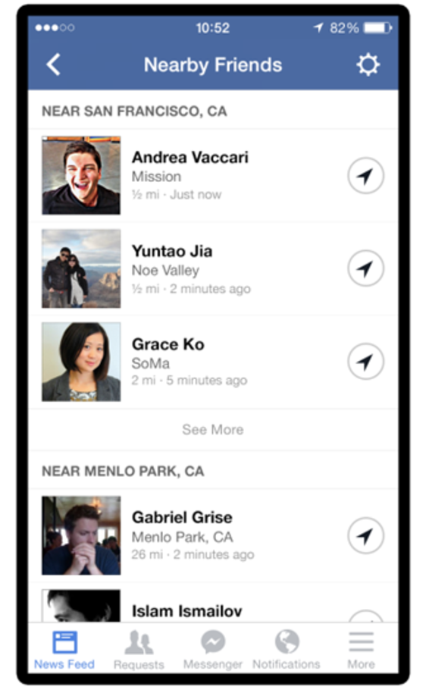
FindFriends Demo using Fauna Db
Find Friends
By Name
By Location
Add Friend
My Profile – Current Location
View My Friends and their Locations
Update my Location
View all of my past Locations

Slide 19
Friend Table
Name | Current Location | Updated Location
Poonam | Starbucks
AJ | Disney
Ron | PikePlace
Mark | PikePlace
Jen | PikePlace
Kelly | Disney | UW

Slide 20
Durability
FaunaDB’s local storage engine is implemented as a compressed log-structured merge tree
Writes
Transactions are committed in batches to the global transaction log
This model maintains very high throughput
FaunaDB’s temporal data model is composed of immutable versions, there are no synchronous overwrites

