Slide 1
NAME :POONGOTHAI.S REGISTER NO :2213331042129 DEPARTMENT :III B.COM, S-I, B-II. COLLEGE :BHARATHI WOMENS COLLEGE

Slide 2
PROJECT TITLE
Employee dataset using excel

Slide 3
AGENDA
Problem Statement
Project Overview
End Users
Our Solution And Proposition
Dataset Description
Modelling Approach
Result And Discussion
Conclusion

Slide 4
PROBLEM STATEMENT
Understanding workforce demographics.
Identifying performance trends.
Optimizing department structures.
Enhancing decision-making efficiency.

Slide 5
PROJECT OVERVIEW
Analyse employee data for insights on demographics, role,
and performance.
Improve decision-making and strategic planning.
Covers key metrics of all employees.

Slide 6
END USERS
HR TEAMS: Recruitment and training.
MANADERS: Team performance and resource optimization.
LEADERSHIP: Strategic planning and development.

Slide 7
SOLUTION PROPOSITION
Use data analytics to identify treads and patterns.
Implement predictive modelling for performance forecasting.
Drive HR and operational strategies based on insights.

Slide 8
DATASET DESCRIPTION
INCLUDES: Name, Designation, Salary, Gender, Hire Date, Contact, Address.
Comprehensive coverage of all employees.
Aimed at revealing workforce dynamics.

Slide 9
MODELING APPROACH
TECHNIQUES: Regression analysis, clustering, machine learning.
Predict performance and identify key treads.
Segment data to uncover insights.

Slide 10
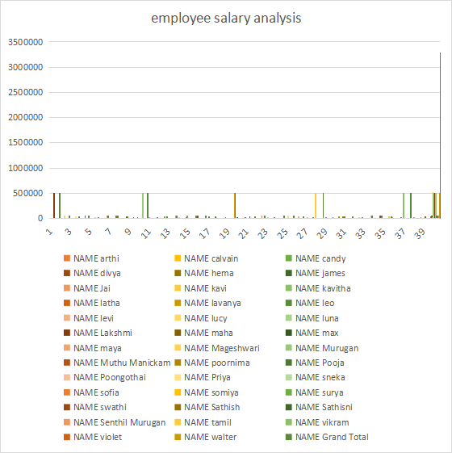
RESULTS AND DISCUSSION

Slide 11
CONCLUSION
Analysis provides actionable insights.
Recommendations for recruitment, training, and performance optimization.
Implement findings to enhance efficiency.

Slide 12
THANK YOU

