Slide 1


D
Sign Wave
Giving Every Gesture a Voice
E
By:
ARYAN SETHI

Slide 2
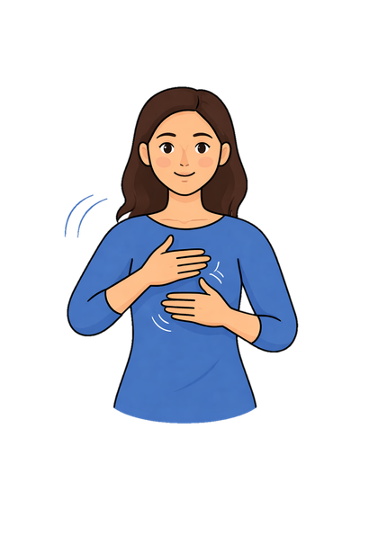
INTRODUCTION
ASL Signer
The Overview: An automated, deep-learning pipeline translating American Sign Language (ASL) videos directly into English text.
AI
The Mission: Bridging the communication gap between the 70+ million Deaf/Hard-of-Hearing individuals and the hearing world.
Deep Learning Model
The Tech: Powered by Computer Vision (3D spatial tracking) and Sequential Learning (temporal pattern recognition) using Recurrent Neural Networks.
Hello!
How are you?
English Text

Slide 3


PROBLEM STATEMENT
H
The Global Context: Over 430 million people worldwide require rehabilitation for ‘disabling’ hearing loss, yet sign language remains widely misunderstood by the hearing population.​
E
L
The Social Barrier: Lack of real-time translation leaves the DHH community marginalized, especially in high-stakes environments (e.g., healthcare, emergency response) where waiting for human interpreters costs critical time.
P
Inconsistent Data: Real-world ASL videos vary drastically in length, speed, and spatial positioning.

Slide 4
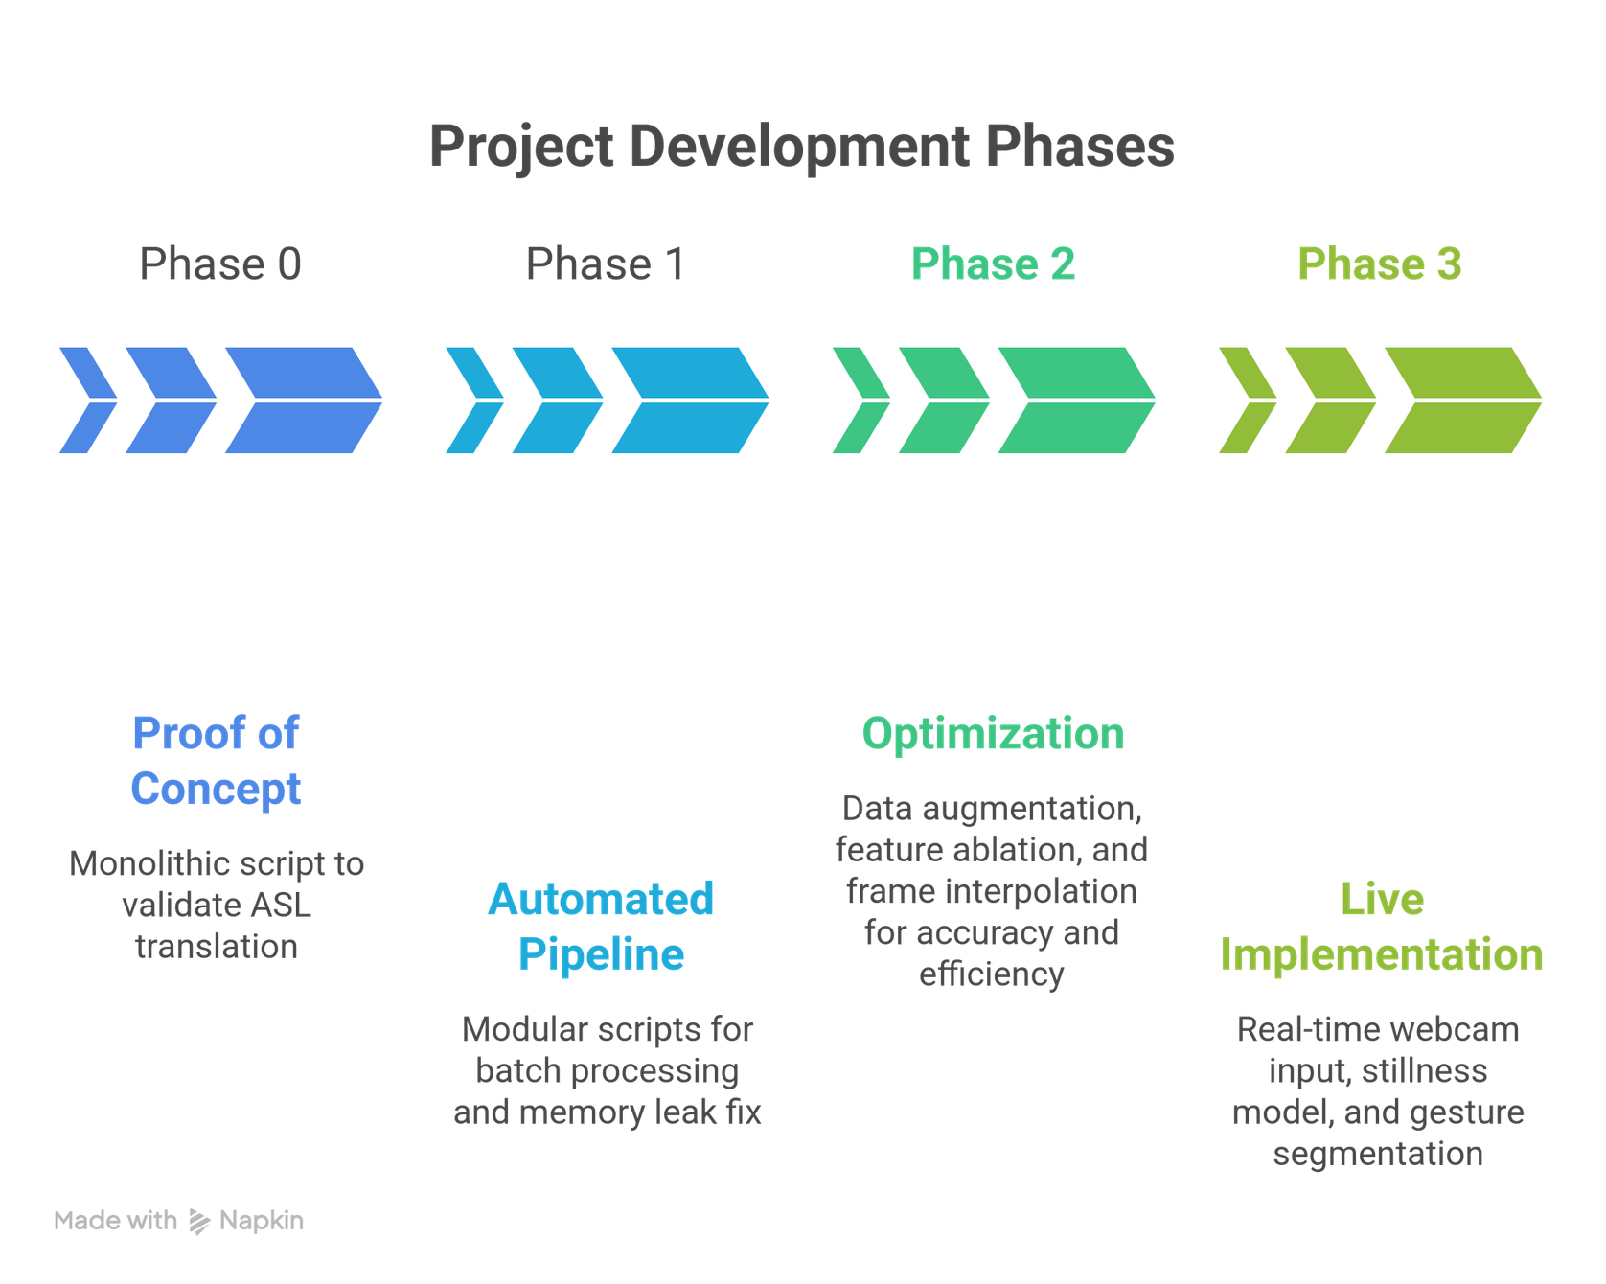
SOLUTION / INNOVATION
A scalable, modular architecture that decouples spatial feature extraction from temporal sequence learning.

Slide 5
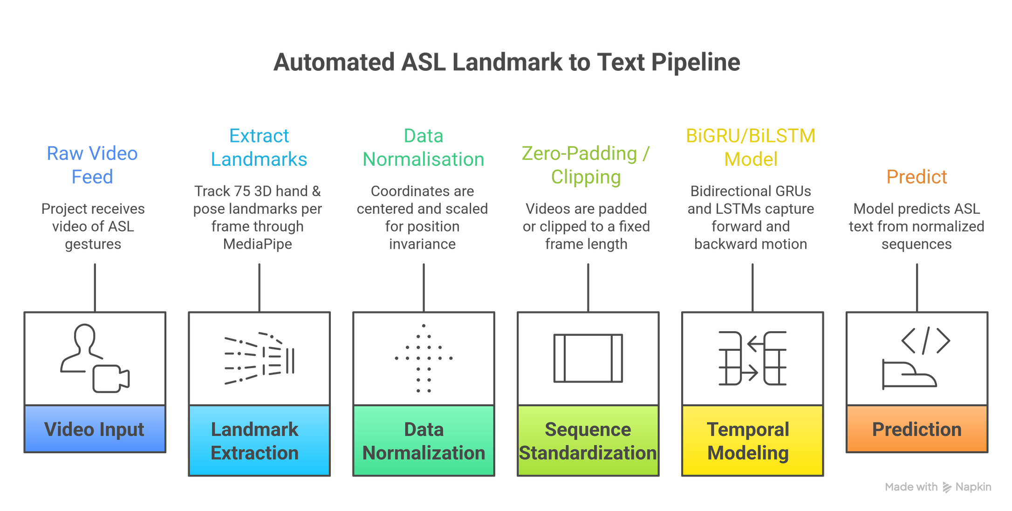
IMPLEMENTATION
An end-to-end automated pipeline translating raw video into text through spatial landmark normalization and temporal sequence modeling.

Slide 6
RESULTS
Metrics Table
METRIC | BiGRU | BiLSTM
Peak Validation Accuracy | 83% | 71%
F1 Score | 82% | 69%
Final Validation Loss | ~0.85 | ~1.10
Convergence Speed | Faster (35-40 Epochs) | Slower (50+ Epochs)

Slide 7
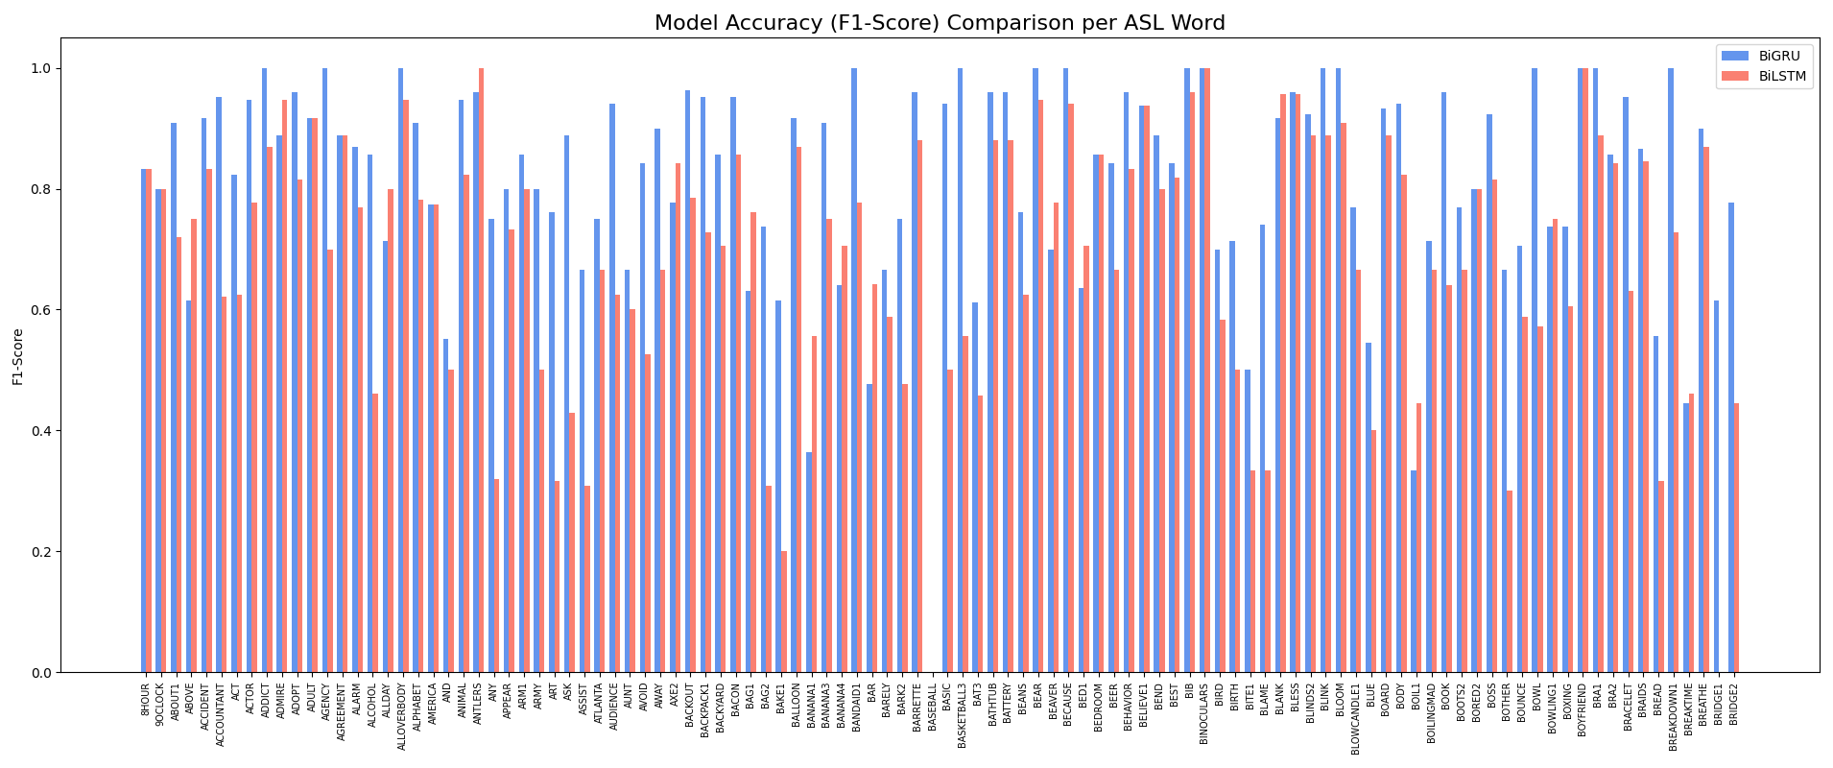
RESULTS
F1 Score Graph

Slide 8
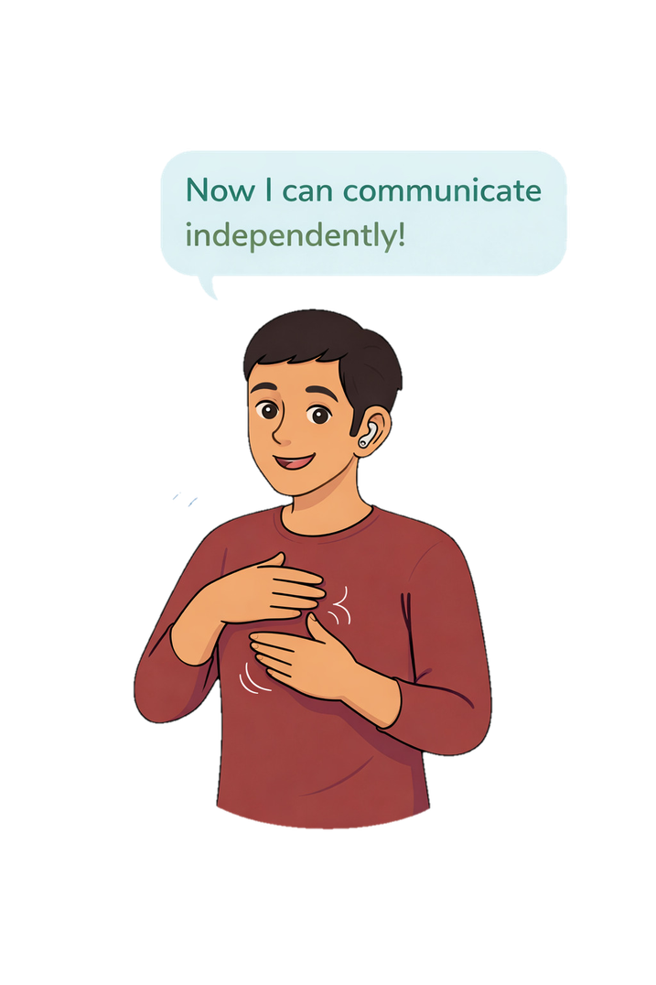
BENEFITS
External Impact (The End-User)
Real-World Accessibility: Lays the foundation for a low-latency, daily-use translation tool.
High-Stakes Reliability: Designed to eliminate critical delays in emergency and healthcare settings.
Internal Impact (Developers & Researchers)
Modular Scalability: Decoupled architecture allows for rapid batch processing.
Plug-and-Play Vocabulary: New signs can be trained and added without rewriting the core extraction logic.

Slide 9
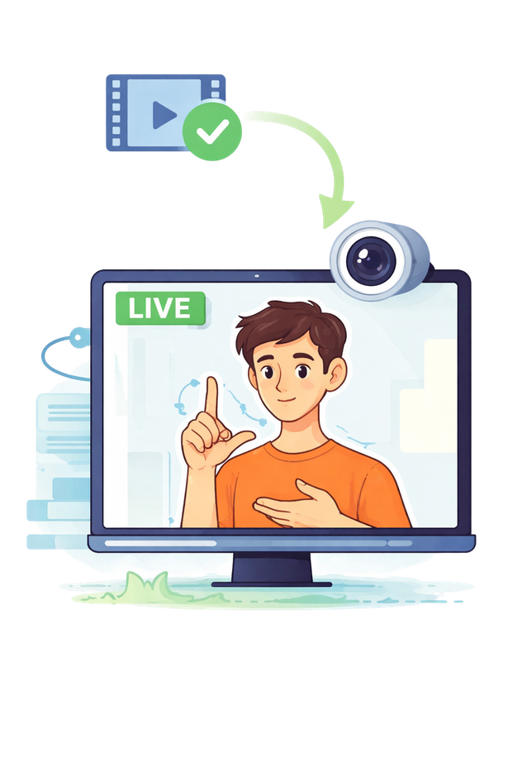
FUTURE SCOPE
Real-Time Live Translation
Shifting from video-file processing to live webcam input (Phase 3).
Stillness Modeling
Implementing a trigger to segment distinct gestures automatically, differentiating resting hands from active signing.
Efficiency & Accuracy
Interpolating frames to reduce CPU load and latency.
Introducing spatial noise (jitter, rotational) to build a more robust model.

Slide 10
SUMMARY
The Challenge Solved
Bridging the communication gap for the Deaf and Hard-of-Hearing (DHH) community through automated, accessible translation.
The Technical Innovation
Engineered a fully automated, batch-processing pipeline utilizing bidirectional sequence modeling (BiGRU).
The Current Milestone
Achieved a scalable, end-to-end translation system maintaining ~80% validation accuracy.
The Vision
Transitioning to real-time, live webcam translation with continuous gesture segmentation.

Slide 11
THANK YOU

