Slide 1
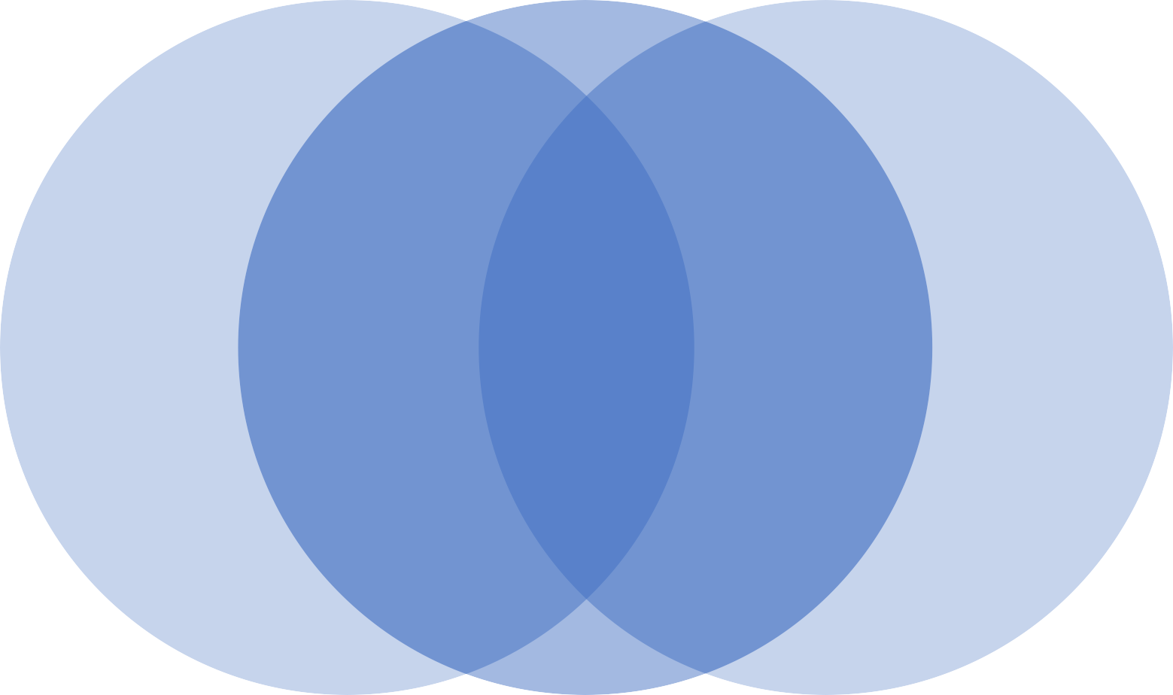
EM ALGORITHM & Applications
Name: Isaac Zhang
UID: u7344258
Notes:
Hello guys, I'm Isaac and I will introduce EM algorithm and its application in this video.
Without further ado, lets get started.

Slide 2
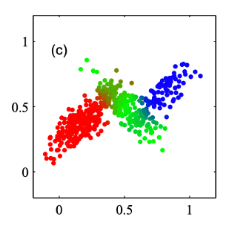
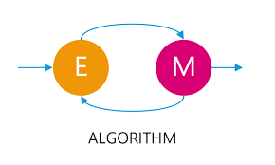
Contents
Overview
Latent variable modeling
Maximum likelihood and responsibilities
EM algorithm for Gaussian Mixtures
Derivation
Overview
Useful and powerful
How does it work
Why EM always converge
Widely used
1. Gaussian Mixture
2. EM algorithm
3. Improvement & Summary
2
Notes:
The is my plain that how am I going to cover these topics.
First of all, I will talk about Gaussian Mixture model, lets go to next page.

Slide 3
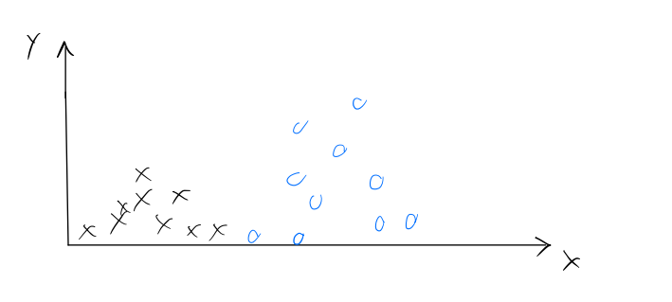
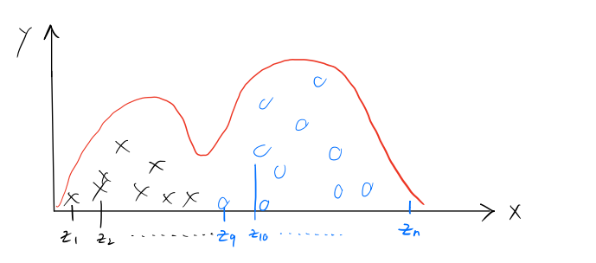
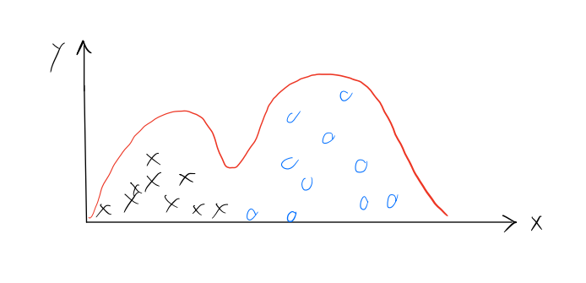
Overview – Gaussian Mixture
Notes:
Suppose we have some data, and their distribution is shown in the figure, we can clearly see that there are two Gaussians, that means these data subject the combination of 2 Gaussian distributions.
For each input x, it will belong to one of the Gaussians, so if we have a variable Z to tell us which Gaussian it will belong to, then we have trained the GMM model. We call this variable z the hidden variable.
Of course, at the beginning, it is impossible to know this latten variable Z, otherwise we would already know to which sub-Gaussian each x belongs. This is like the chicken and egg problem.

Slide 4

Overview – Gaussian Mixture
New P(xⁱ) =
We get its log-likelihood :
New log-likelihood:
Why EM instead of MLE?
Very difficult to get the answer
Importance of EM
Classify groups without labels
Approaching the optimal solution by iteration, guarantee of convergence
One of the strongest algorithms in unsupervised learning
Notes:
Now let's look at the distribution of x after introducing the hidden variables.
We now have an x distribution determined by z, which we can derive from the joint probability formula
Here k means we have k sub-Gaussian. In last page case , our k equals 2.
If we assume we have m training examples, then we can get its new log-likelihood form its original loglikelihood.
You can see here, we have another summation for each entry, which is difficult to compute directly.
So, we introduce the EM algorithm.
EM can be trained without any labels, and it will definitely converge(will prove this latter), and it is one of the most power tools in unsupervised learning field.

Slide 5
Overview - EM algorithm
E-step
M-step
Iteration until log likelihood stop change & Convergence proof
5
Notes:
That is my plan to elaborate EM algorithm, I will introduce E-step, M-step and how do we iterate it for converging respectively.

Slide 6


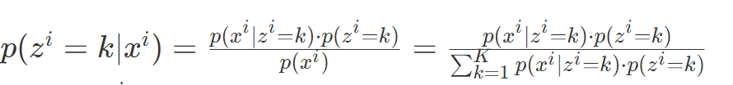


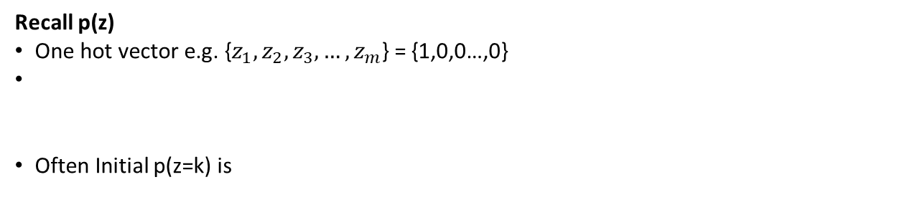
E-step - EM algorithm
Recall p(z)
One hot vector e.g. {$z_{1},z_{2},z_{3},…,z_{m}$} = {1,0,0…,0}
Often Initial p(z=k) is
Estimate the value of Z
For every zⁱ:
Denote above equation is wⁱ for latter M-step
Hence
Expand to Gaussian distribution form:
6
Notes:
the E of EM，which is call Expectation step or E-step.
For each z, by the Bayesian formula, we can get this form of equation. And we will denote the final term as w^I for latter M-step.
How do we plug variables and do our calculation? Since P(x given z =k) subject to gaussian, we can expand this to gaussian distribution form.
And that‘s it for E-step。

Slide 7



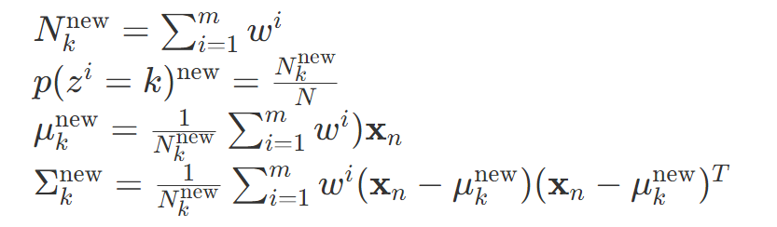
M-step - EM algorithm
Recall wⁱ:
Where =
Find the max value for each variable and assign to themselves as new variable:
7
Notes:
The so-called M-step is to maximize the variables we need, by taking the values obtained on E-step,
and the most common way to do this is to find the derivatives of each variable.
since the time constrain, I will directly show the result.
And that all for M-step.

Slide 8



Convergence - EM algorithm
Jensen inequality
For any convex function:
Further fact: if f‘’(x) > 0, we can take the equal sign
How about concave?
For any concave function:
Further fact: if f‘’(x) < 0, we can take the equal sign
8
Notes:
Following, how do we prove its convergence? The answer is applying Jessen's inequality
If we introduce Jensen's inequality, we can know that for any convex function: The function of expectation X is less or equal to the expectation of function X
In addition, if F is a strictly convex function, means its second derivative still greater than zero, then we can let the sign to be equal.
In the proof of the EM algorithm convergence, we need to use another form of Jessen's inequality, that is we take the concave function.
in fact, the concave function can be equivalently considered as the convex function by taking the opposite value. So, we will also have these conclusions (but note the inequality sign takes the opposite, which The function of expectation X is greater or equal to the expectation of function X,
and if the second derivative of function f less than 0, we can let f(Ex) = E(fx)
Why introduce this inequality formula and why it is able to prove the convergence of EM I will mention soon, but for now let us just remember and then move to the next part.

Slide 9

Convergence - EM algorithm
Back to loglikelihood Of GMM
We can rewrite this into:
E(x) = sum of (P.D.F of xⁱ) * xⁱ
9
Notes:
We now look back at the loglikelihood of GMM.
We can simply multiply and dived a same value in any equation, here We introduce a new Probability function Qi(Zi), that is sum of Qi zi equal to 1.
And according to Expectation function definition, we can convert the sum of [Probability density function of (x)] times [x] into Expectation of X.
After we get this equation, we are able to use the Jessen's inequality.

Slide 10

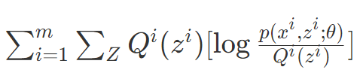
Convergence - EM algorithm
Application of Jessen's inequality
Denote Second term as :
10
Notes:
Firstly, we know that the log function is a strictly concave function because its shape is bound down and second derivative is still less than 0, then at this point, we can use the Jensen inequality mentioned before.
moreover, if we look that the second term in this inequality, which we can unpack the expectation to probability distribution function Qi(zi) back. we denote this term G(theta).

Slide 11

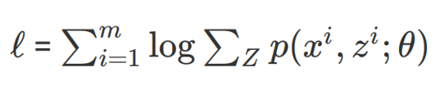
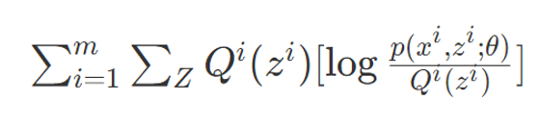
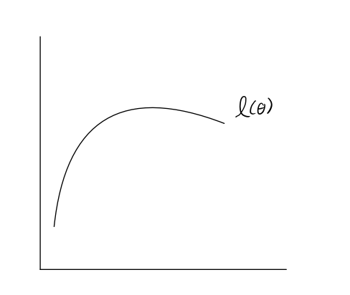
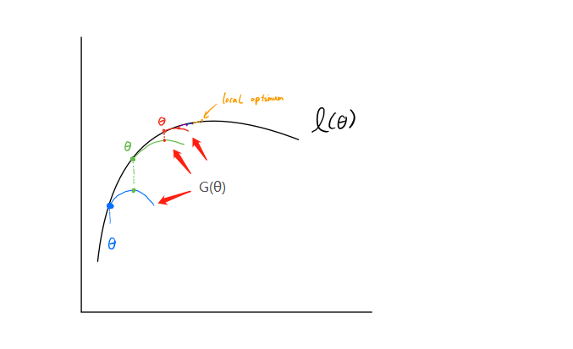
Convergence - EM algorithm
Construct
Since Jessen's inequality, construct
11
Notes:
We know loglikelihood is a log shape function, so we roughly draw a picture, and Since we have proofed G(theta) has to less or equal to curve L (theta).
We then construct the function G(theta). For each iteration, we take the point as Starting Point when G(theta) = curve L(theta), that actually is E-step.
After that, we set the max value in current G(theta) to be the starting point on next iteration.
By repeatedly doing this, we can nearly Approach the optimum.
Be careful this optimum cannot guarantee a global optimum, just think of there is another peak after current point. We cannot determine that by EM.

Slide 12
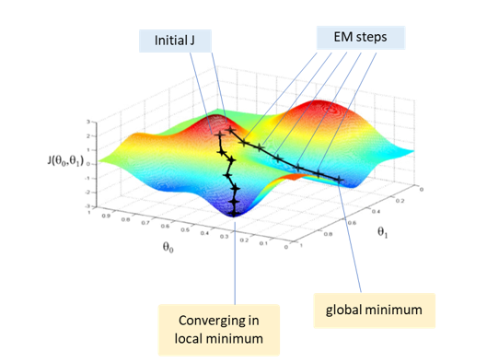
Cost on Convergence
Cost (J) monotonically decrease in each EM step
Always converge to the direction of the local minimum
12
Notes:
This 3D picture actually illustrate why it cannot guarantee a global optimum but a local one.
Of course, it has some chance to reach global optimum, that mainly depend on the initial parameters. In this picture, you can see EM will reach global optimum on second path.
Although it not the general case, since we do not know what is the best initial points or parameters.

Slide 13
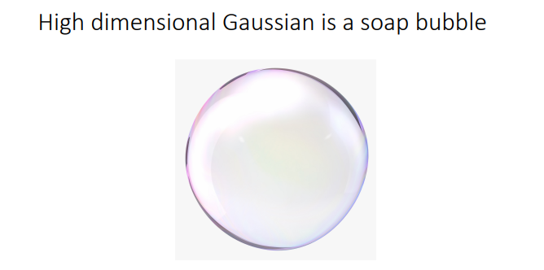
Motivation of Improvement
drawback
Excessive number of iterations
Cannot guarantee the global optimum
Very sensitive in initial parameters
Perform poor on higher dimension
Solutions
Use Newton method to speed up converge progress
Exclusively searching when feature dimension is low
Try modeling GMM on different initial parameters a few time and take the best one
Apply PCA / Manifold learning on training date first
Notes:
Every algorithm has drawbacks, and the EM algorithm is no exception. From previous slides, we can tell EM requires many iterations to converge to local optimum, and it result could depends on initial parameters.
Moreover, it will perform poor or not working on higher dimension since Gaussian distribution is a bubble in high dimension because of the curse of dimension but it is anther story.
So, what can we do to deal with these issues?
We can apply some technology to speed up its converge progress. And try exclusively searching if our data amount is small in low dimension.
For sensitiveness of initial state, we could try different initial parameters to smooth the result. Like we apply on different initial parameters a few time and take the best result.
For high dimension problem, we could use PCA or the any manifold learning algorithm. Well, that depends on your training data.

Slide 14
Summary
EM is widely used
K-means
GMM
ICA
HMM
…….
Unsupervised learning
Do not require extra time to label each data
Do not require compute latten variables
Notes:
Now please allow me to Summary EM algorithm. Again, it is a powerful tool and widely used, such as K-means, Gaussian Mixture Model, Hidden Markov Model and so on.
And we often can train our raw data with EM algorithm since it does not require labels. Even though we introduce a hidden variable z, we do not need to compute it. EM algorithm will figure it out by itself during each iteration.

Slide 15
References:
COMP8600 lecture slides
Bishop, CM. 2006, “Pattern Recognition and Machine Learning”, New York :Springer
https://www.youtube.com/watch?v=rVfZHWTwXSA&list=PLoROMvodv4rMiGQp3WXShtMGgzqpfVfbU&index=14&t=4166s
figures and online sources:
Other figures are taken from PRML book or lecture slides
https://www.indowhiz.com/articles/en/the-simple-concept-of-expectation-maximization-em-algorithm/
Slides Template from previous COMP8600 assignment:
https://github.com/rbdm/comp8600-video-material-topic-9
Notes:
Here is my reference, hope you enjoy my video, see you next time.

Slide 16
THANK YOU

