Slide 1

Human Resource Management Services

Slide 2
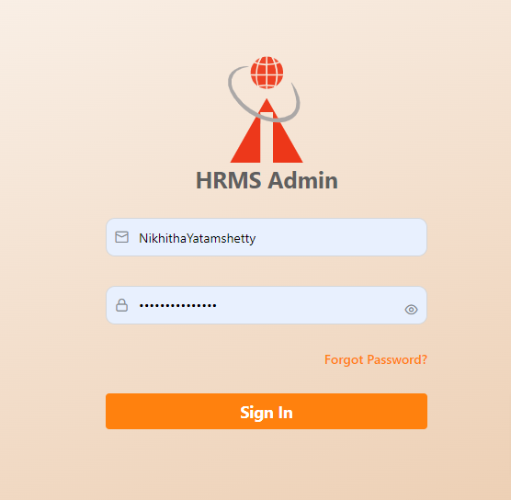
Login Screen
Collect credentials from the HR administrator.
To log in, use the provided credentials, which are your username and password.

Slide 3
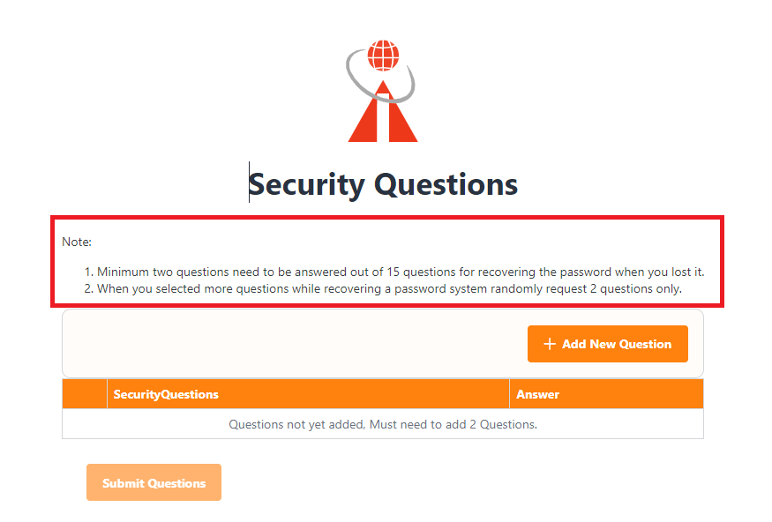
First time login
The application requires employees to set up security questions when logging in for the first time.
A minimum of two questions must be answered, but employees have the option to provide up to fifteen questions.
Initially, the submit button will be disabled until the minimum requirement is met.
Employees also have the ability to edit and delete their security questions as needed.

Slide 4
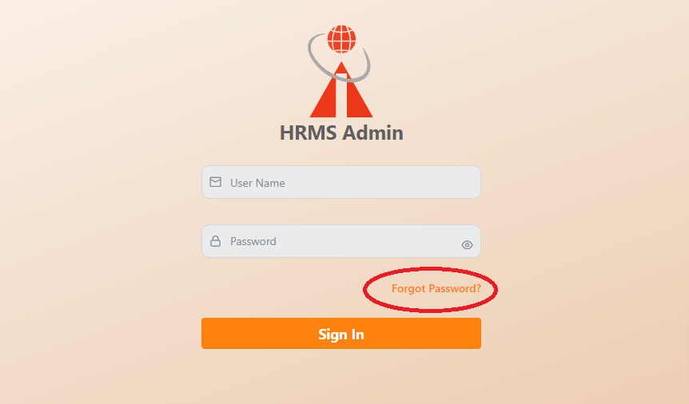
Forgot Password
If an employee forgot their password, they can utilize the “Forgot password" button located on the login page.
This feature enables them to initiate the password recovery process.

Slide 5
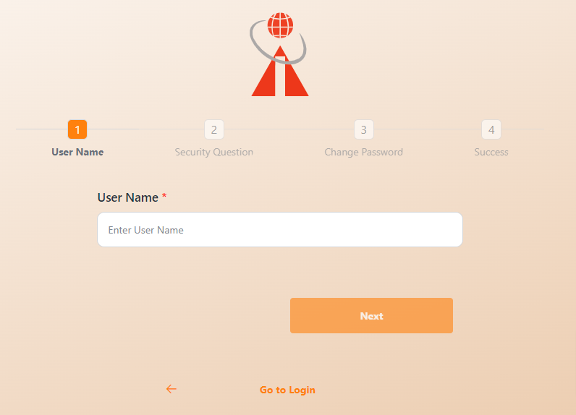
User Name :
After clicking the “Forgot Password" button, users are redirected to the password recovery page where they can enter their authorized username.
Once the username is entered, the “Next" button will be enabled, allowing the user to proceed with the password recovery process.

Slide 6
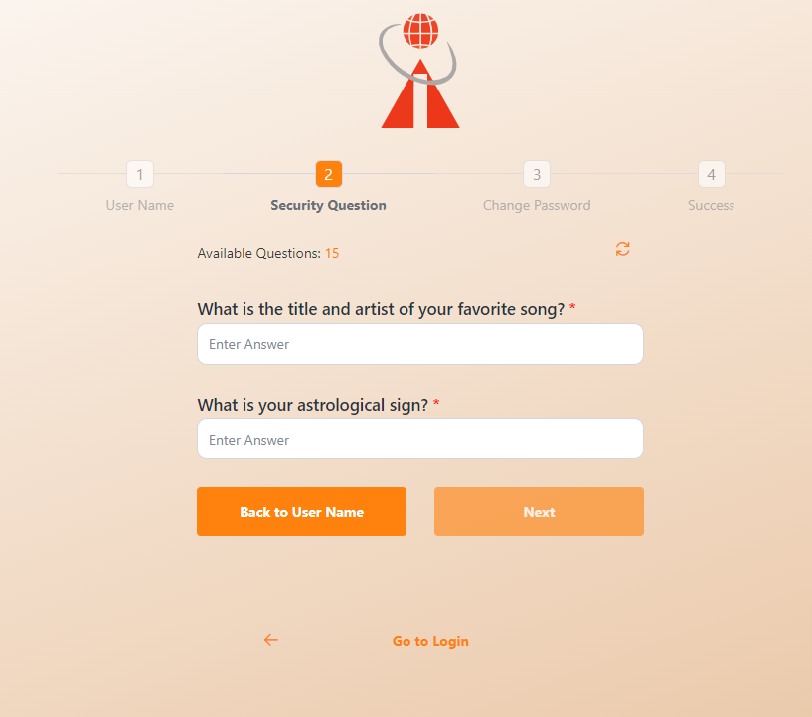
Security Questions :
Once the employee enters the authorized username, they will be prompted with security questions.
After providing valid answers to the displayed questions, the “Next" button will become enabled.
If the employee chooses to save more than two questions, the system will display the count of available questions.
To change the viewable questions, the employee can click on the refresh icon.
If the employee wants to navigate back to the username entry, they can click on the "Back to Username" button.

Slide 7
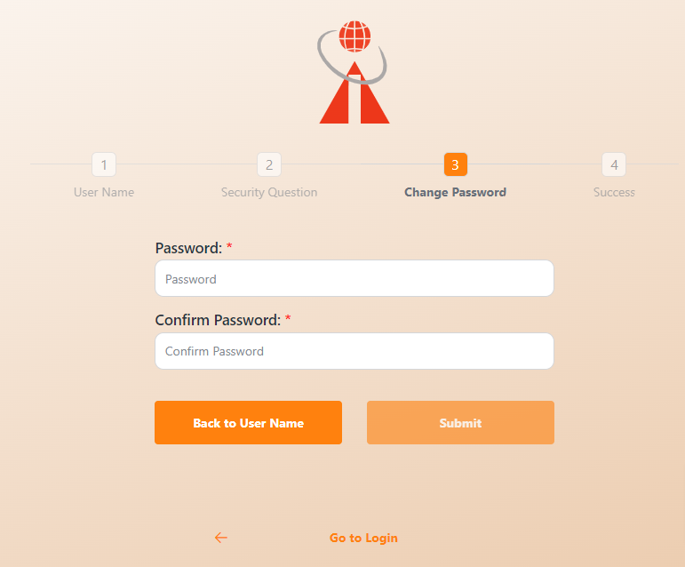
Change Password :
If the employee has provided valid answers, changing the password becomes feasible.
Once the employee enters and confirms a valid password, the submit button will be enabled.
If the employee wishes to navigate to the username, they can click on the "Back to Username" button.

Slide 8
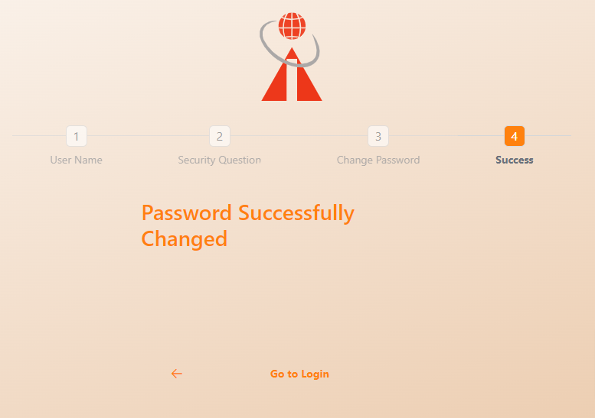
Success Message :
After submitting the form, the employee successfully updated the password.
To proceed to the login page, click on "Go to Login" when the employee wishes to navigate to the login section.

Slide 9
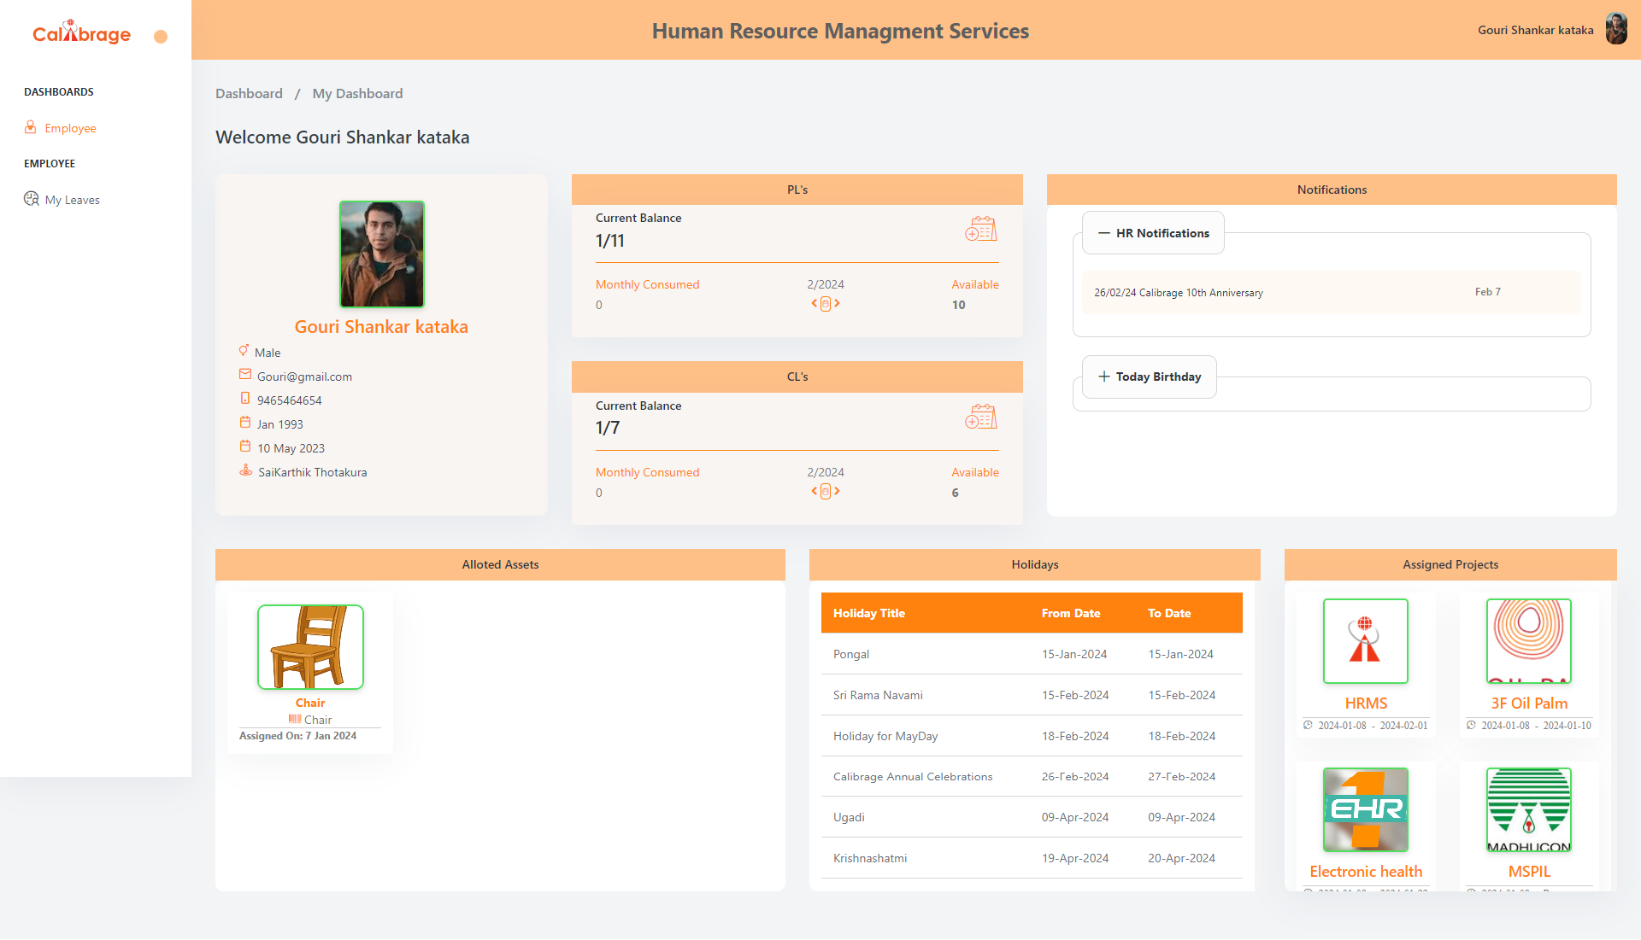
Employee Login
Employee Dashboard:
After logging in with their employee credentials, the employee can access the employee dashboard.
Within the dashboard, employees have the capability to view various sections including basic information, notifications, assigned assets, holidays list, and assigned projects.

Slide 10
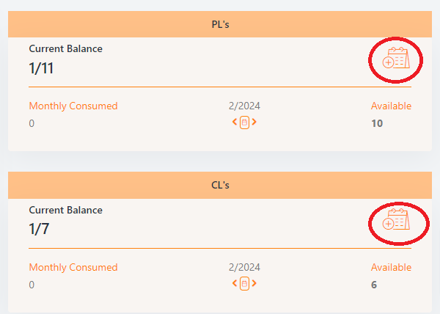
Employee can apply for Casual Leave (CL) and Privilege Leave (PL) through their employee dashboard.
The availability of the "add" icon is contingent upon the employee having a current leaves balance for the year. If an employee's current leaves balance is zero, the "add" icon will be disabled.
Employee can also check their available leave count for the current year.
Additionally, they have the capability to view the monthly consumed leaves, based on the selected month.

Slide 11
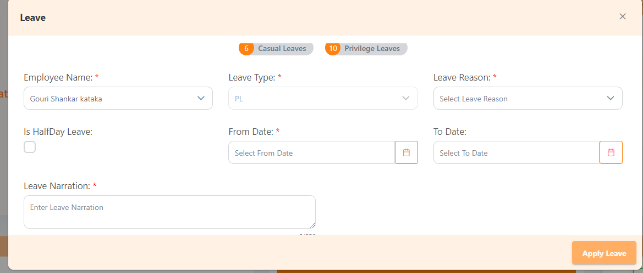
Based Upon on clicking the Casual Leave (CL) and Privilege Leave (PL) add icons, the leave form becomes visible.
The leave type is automatically set based on the icon selected.
Only when all the required information is provided will the "Apply Leave" button be enabled, allowing the employee to submit the leave application successfully.

Slide 12
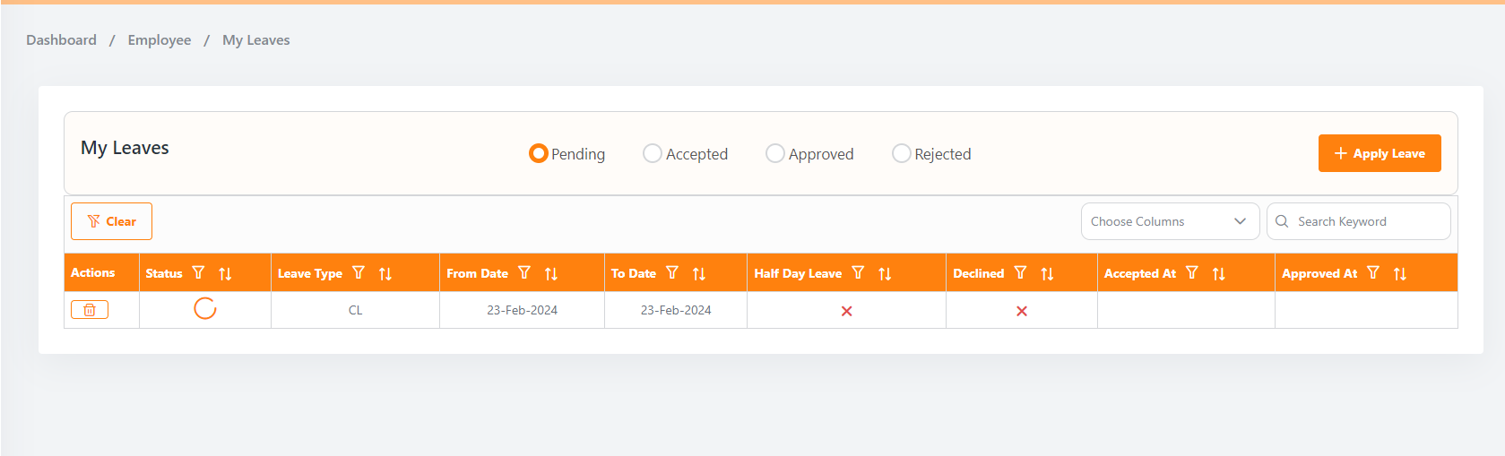
My Leaves :
On this screen, employees can view their applied leaves, filtered based on the selected leave status.
If a leave has not been utilized, employees have the option to reschedule it. However, it's important to note that once a leave has been utilized, rescheduling is not permitted.
To apply for a new leave, employees can click the "Apply Leave" button, which will make the leave application form visible.

Slide 13
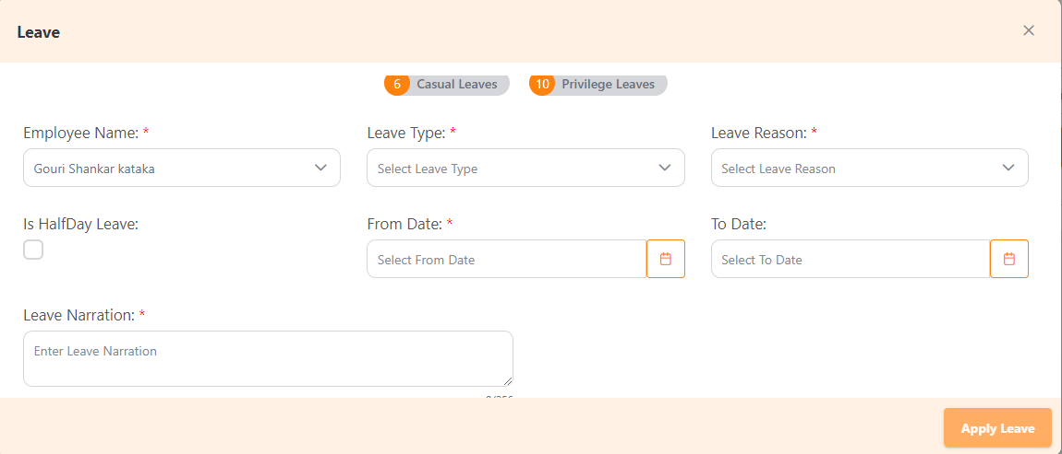
Apply Leave Form :
The employee's name is automatically bind in the leave form based on the logged-in employee.
Within the leave form, employees can view the number of Casual Leave (CL) and Privilege Leave (PL) counts based on the selected employee name.
The available leave counts determine which leave types are visible in the leave type menu.
If an employee's CL and PL leave counts are zero, only Work From Home (WFH) and Leave Without Pay (LWP) options are shown in the leave type menu.
Depending on the selected leave type, employees can apply for the specific leave they are eligible
To proceed with the leave application, the employee needs to enter all the valid details, and only when this information is complete will the "Apply Leave" button be enabled.

Slide 14
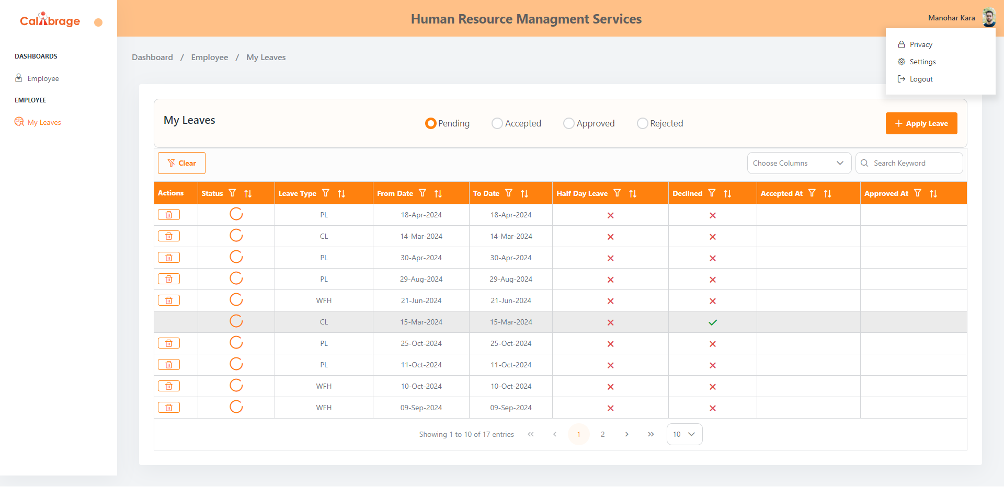
My Profile(My Account) :
By clicking on "My Profile," the interface displays menus such as "Privacy," "Settings," and "Logout.“
If an employee chooses the "Settings" menu, it navigates them to the password change and security question page, allowing them to manage their account security.
Alternatively, if an employee clicks the "Logout" button, the system directs them to the login page, ensuring a secure logout process.

Slide 15
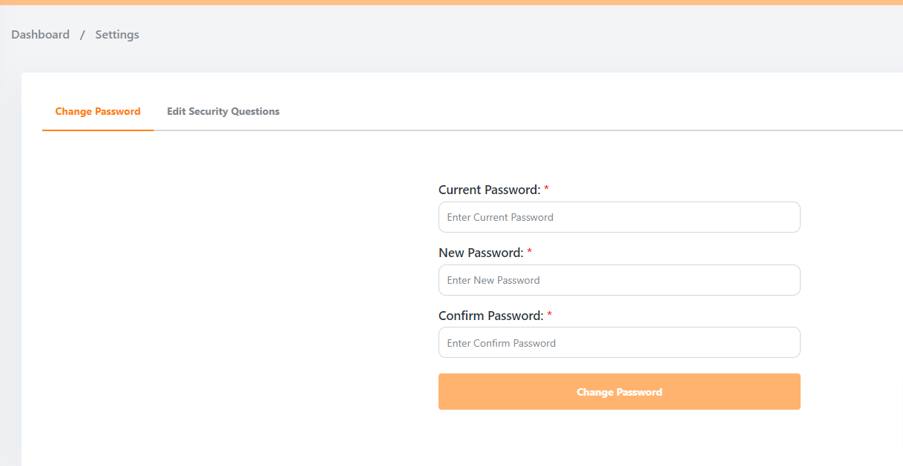
Settings :
Selecting "Settings," the system navigates the user to the "Change Password" and "Edit Security Questions" page.
Change Password:
If an employee decides to change the password and enters a valid password, then only the "Change Password" button enabled
If the employee clicks the enabled "Change Password" button, the system processes the request, and the password is successfully changed.

Slide 16
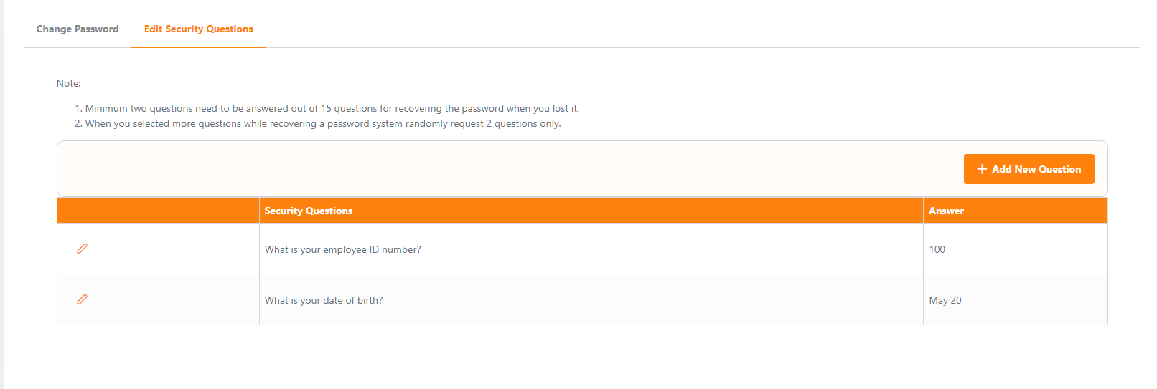
Edit Security Questions :
To modify an employee's visible security questions, click the edit icon.
Employees who have saved more than two questions will have the delete icon enabled, allowing them to remove unnecessary security questions.
Clicking the delete icon removes the selected security question.
If an employee wishes to add new security questions, they can click on the "Add New Questions" option.

Slide 17
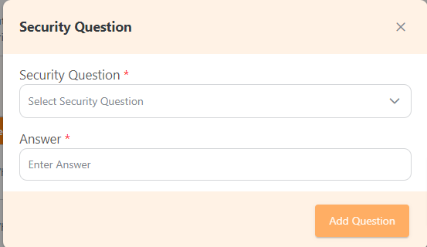
Add New Security Questions :
If an employee wishes to add security questions, they can do up to a maximum of 15 questions.
After providing valid data for each question, the "Add" button becomes enabled. Clicking the "Add" button is required to save the newly added security questions.

