Slide 1
INSURANCE CLAIM ANALYSIS
AN EDA BY POORANI

Slide 2
PROJECT OBJECTIVE
To perform Exploratory Data Analysis (EDA) on a Life Insurance Death Claims dataset to uncover meaningful patterns in claim behaviour, policyholder demographics, and risk factors — using Python-based data analysis tools.

Slide 3
DATASET SUMMARY
This analysis is performed with a Kaggle dataset, life insurance death claims recorded during the period 2018 – 2022 with claim amounts, claim status and claim outcomes in two datasets for two categories individual policy and group policy. It serves as a real-world representation of how insurance companies process and evaluate death claims.

Slide 4
DATASET CLEANING
Both the datasets been mounted onto Python for the analysis process.
Dataset cleaning was performed checking the datatypes, handling missing values, standardized duplicates.
Fine-tuned column names and lengthy texts for readability and better analysis.

Slide 5
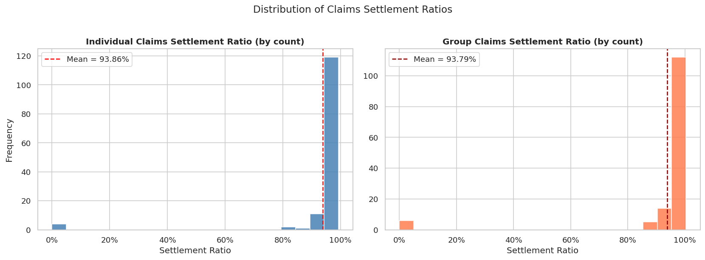
Distribution Of Claim Settlement Ratio
Settlement ratio is above 80% on whole in both categories.
Most insurers settle >95% of claims.

Slide 6
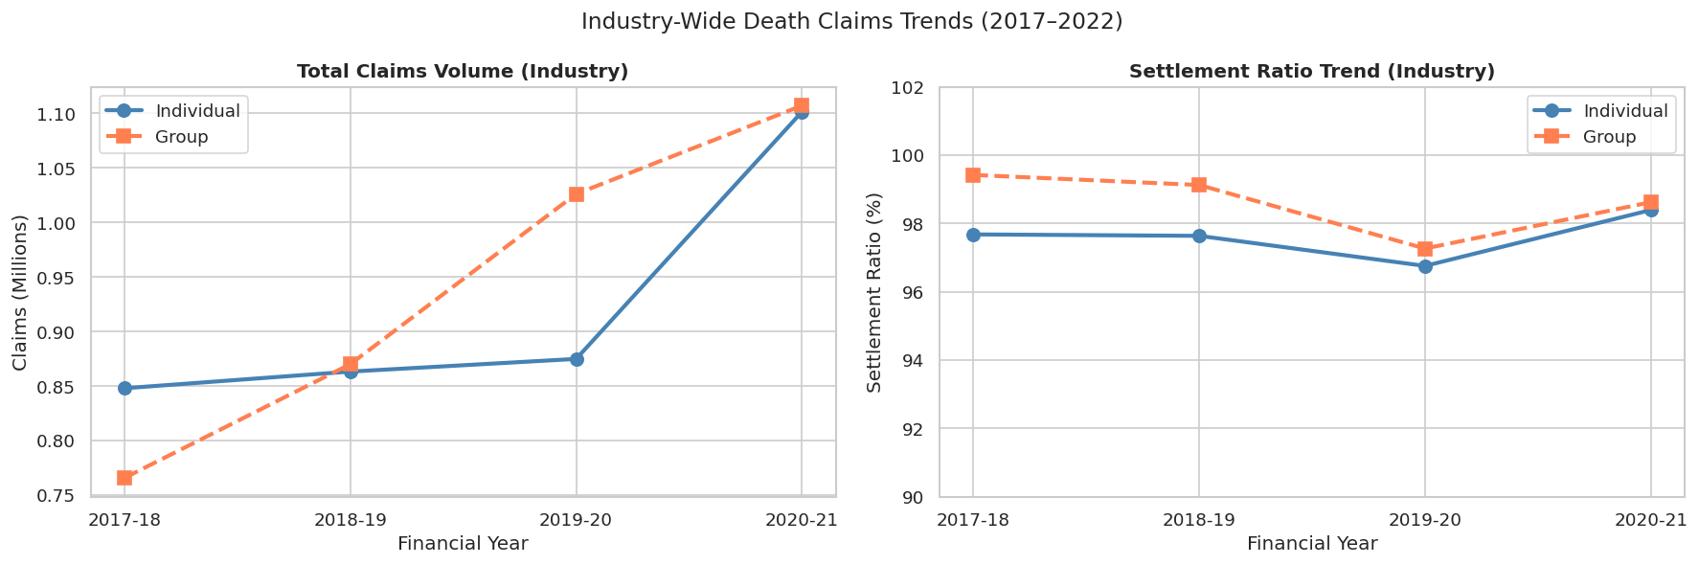
Industry-Wide Death Claims Trends
Claims volume surged in 2020-21 (COVID-19 impact).
Settlement ratios dipped slightly during this stress period.

Slide 7
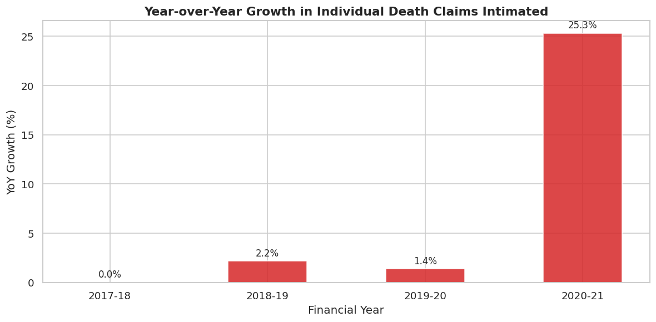
Yearly Variation in Individual Death Claims
2020-21 saw a dramatic spike in death claims — directly linked to COVID-19 pandemic mortality.

Slide 8
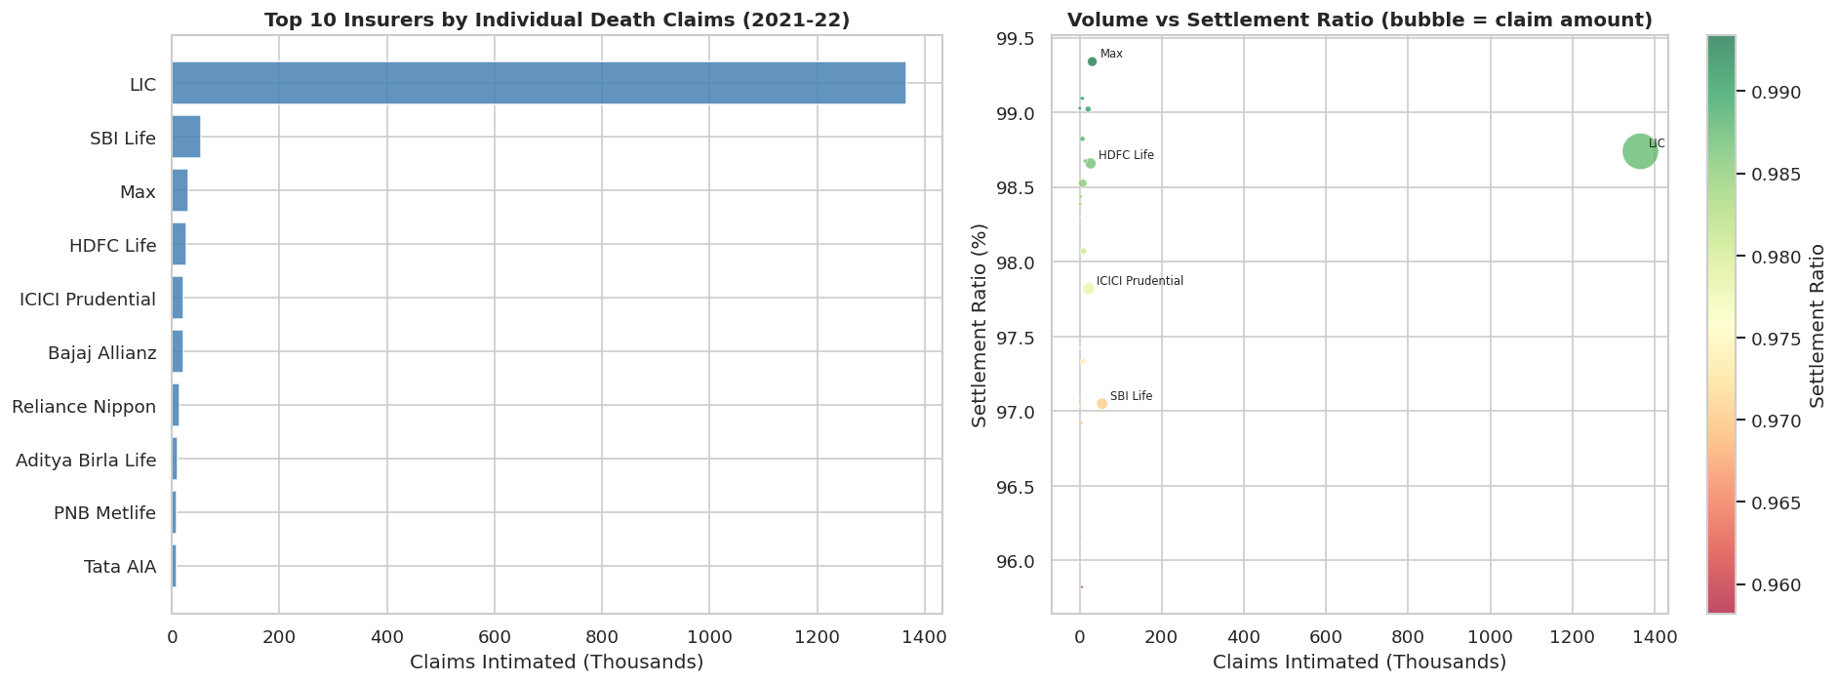
Top Performing Insurers
LIC tops both in individual claims, settlement as well as insurance volume.

Slide 9
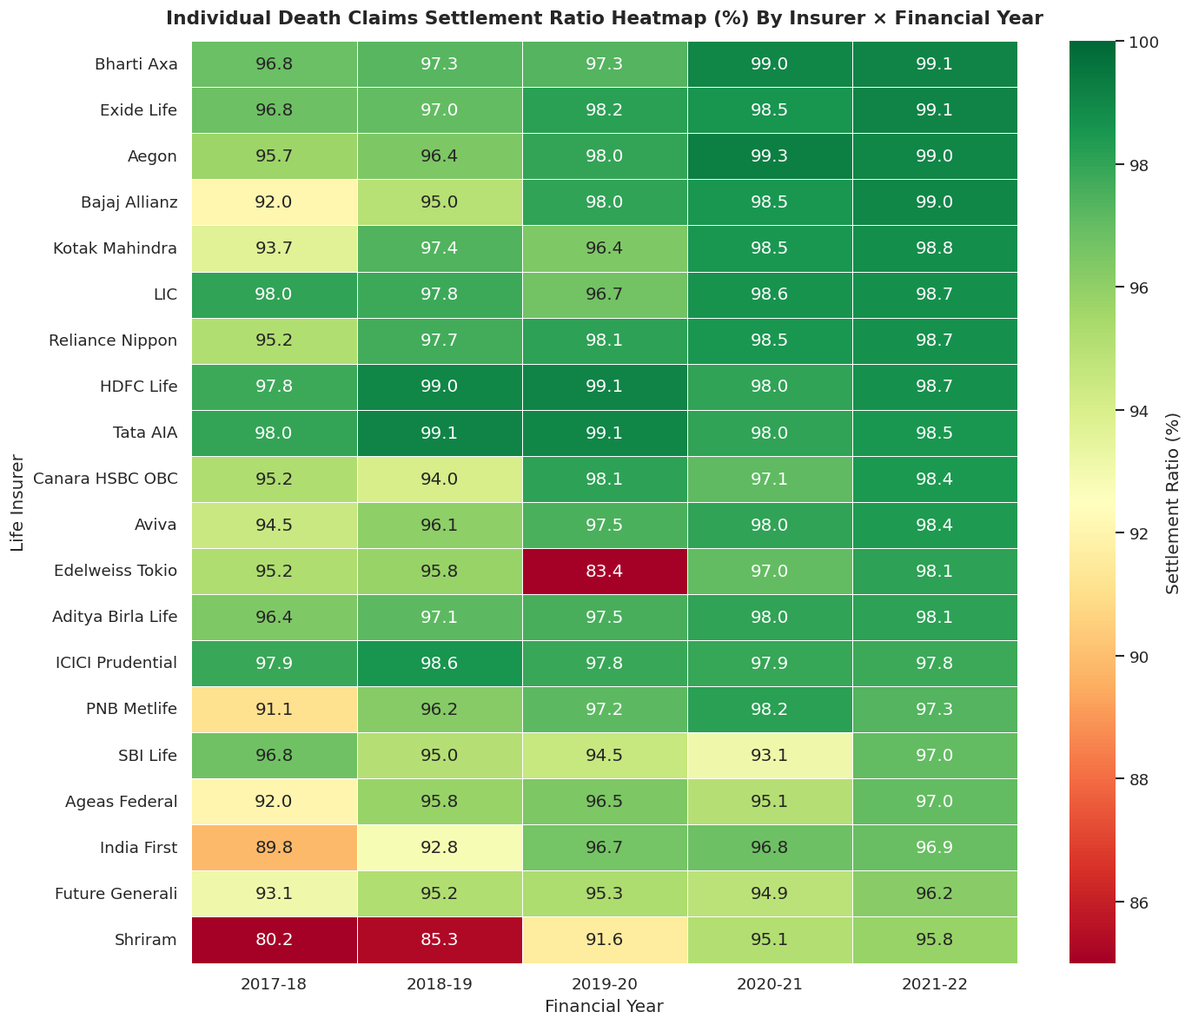
Individual Death Claims Settlement Ratio By Insurer × Financial Year
Red cells reveal stress years (COVID impact in 2020-21) or structurally weaker insurers.

Slide 10
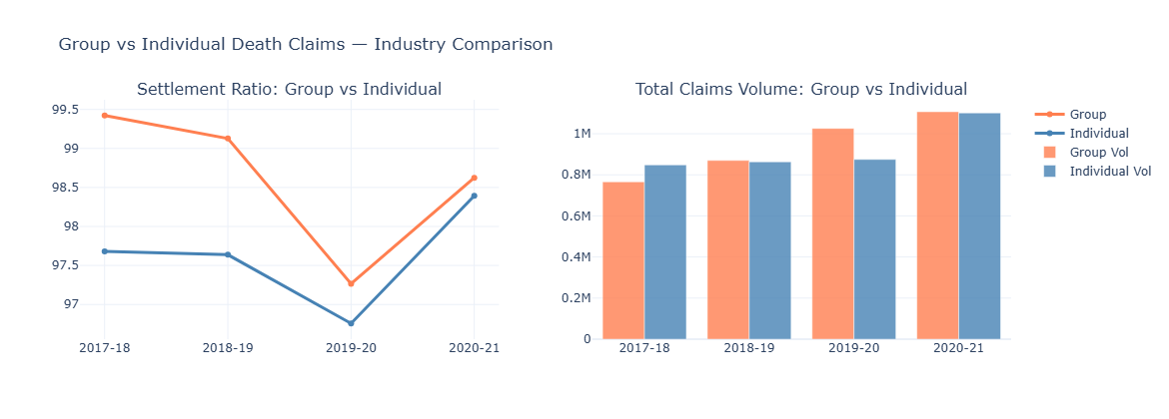
Group vs Individual Death Claims — Industry Comparison
Gradual increase seemed in Claims volume over years, highest in 2020
Settlement ration dropped down in 2020 (Pandemic high mortality impact)

Slide 11
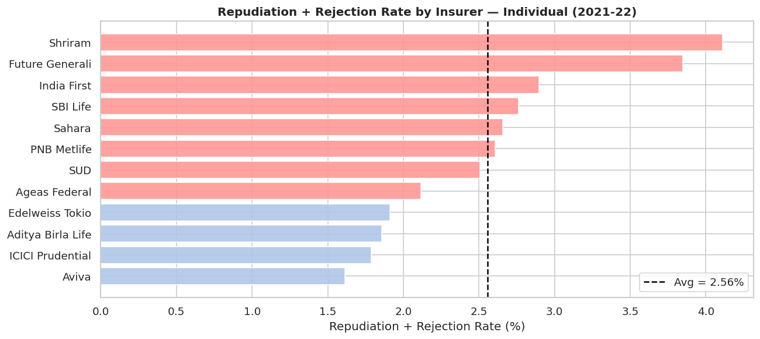
Repudiation + Rejection Rate by Insurer — Individual (2021-22)
High repudiation may signal stricter due diligence OR mis-selling.
Shriram tops in rejection.

Slide 12
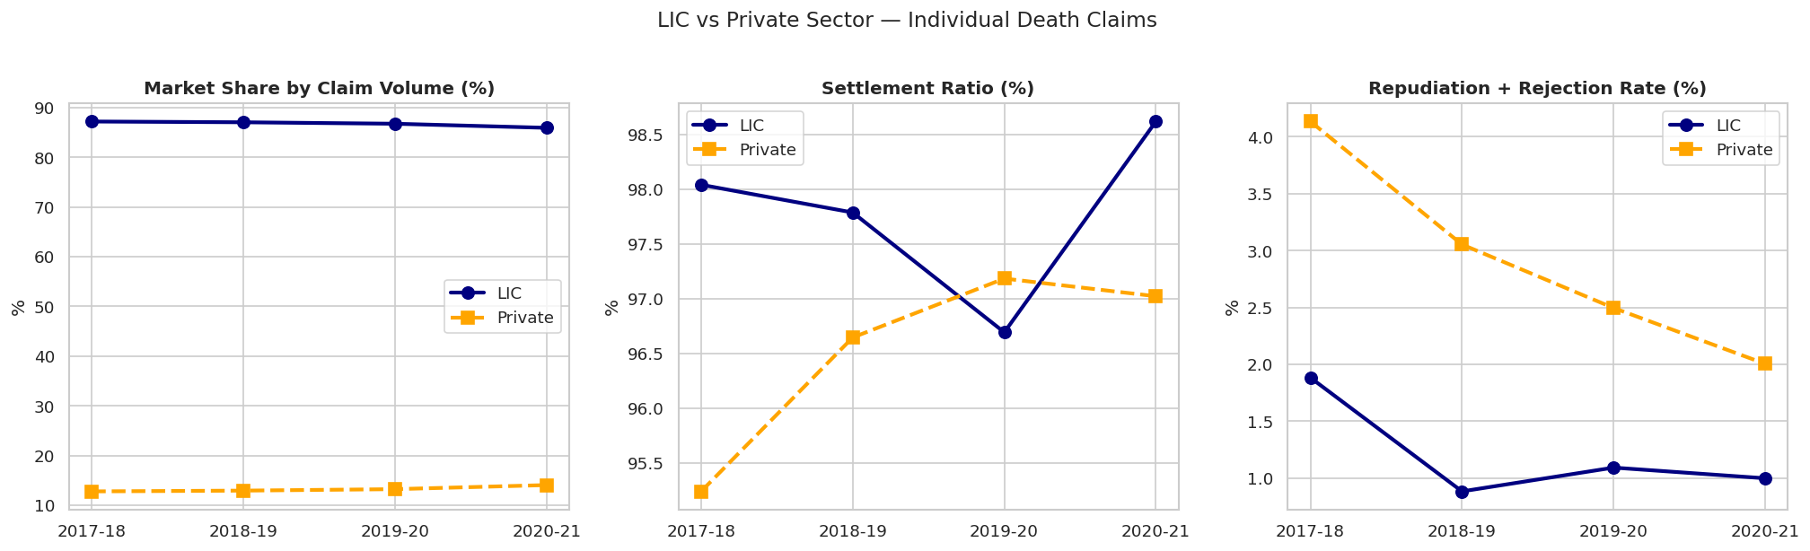
LIC vs Private Sector — Individual Death Claims
Overall report shows LIC is high in market share, moderate settlement and low in repudiation comparing to Private insurers.

Slide 13
Individual Death Claims — Yearly Summary
 | year | avg_settlement_ratio | median_settlement_ratio | total_claims | total_paid | total_repudiated | avg_repudiation_rate
0 | 2017-18 | 90.56% | 95.23% | 847986 | 828314 | 9286 | 4.74%
1 | 2018-19 | 92.13% | 96.60% | 863237 | 842847 | 6372 | 3.36%
2 | 2019-20 | 92.57% | 97.44% | 874849 | 846476 | 8927 | 2.92%
3 | 2020-21 | 95.13% | 98.01% | 1209736 | 1190133 | 10952 | 1.88%
4 | 2021-22 | 98.04% | 98.34% | 1608924 | 1587110 | 12609 | 1.78%
Table shows overall industry summary on individual death claims year by year.
Settlement ratio has increased and repudiation rate has dropped much.

Slide 14
THANK YOU

