Slide 1
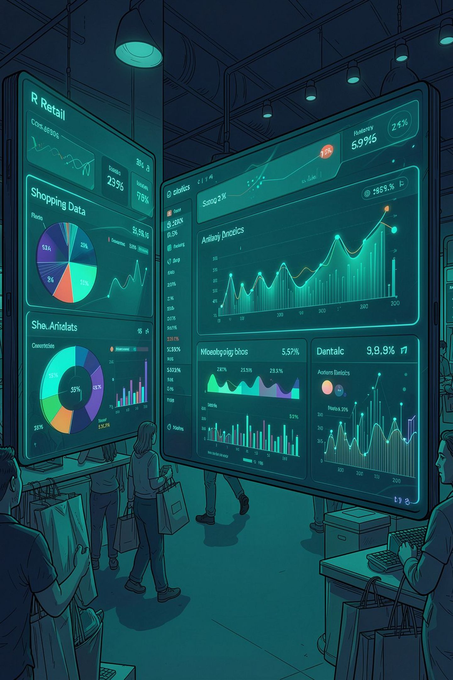
Customer Shopping Behavior Analysis
Uncovering spending patterns, customer segments, and satisfaction drivers across 350 transactions to guide strategic business decisions.

Slide 2


PROJECT OVERVIEW
What We Set Out to Discover
This project analyzes customer shopping behavior using transactional data to uncover insights into:
Spending Patterns
Revenue by membership, city, and age group
Customer Segments
Demographics, gender, and membership tiers
Satisfaction Drivers
What influences customer sentiment and loyalty

Slide 3
DATASET
Dataset at a Glance
350
11
2
Transactions
Columns
Missing Values
Rows in the dataset
Key features tracked
In Satisfaction Level — removed
Customer Demographics
Purchase & Behavior
Age, Gender, City, Membership Type, Satisfaction Level
Item Purchased, Total Spend, Discount Applied, Days Since Last Purchase, Average Rating

Slide 4

DATA PREPARATION
Exploratory Data Analysis in Python
01
Data Loading
Imported dataset using pandas; used df.info() and df.describe() for structure and summary stats
02
Missing Data Handling
Found 2 null values in Satisfaction Level — removed both records
03
Column Standardization
Renamed columns to snake_case for readability and documentation
04
Database Integration
Connected Python to PostgreSQL and loaded cleaned DataFrame for SQL analysis

Slide 5
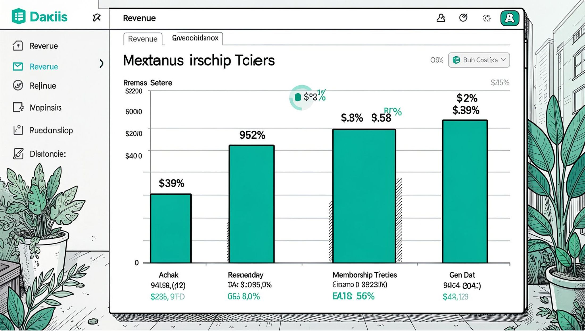
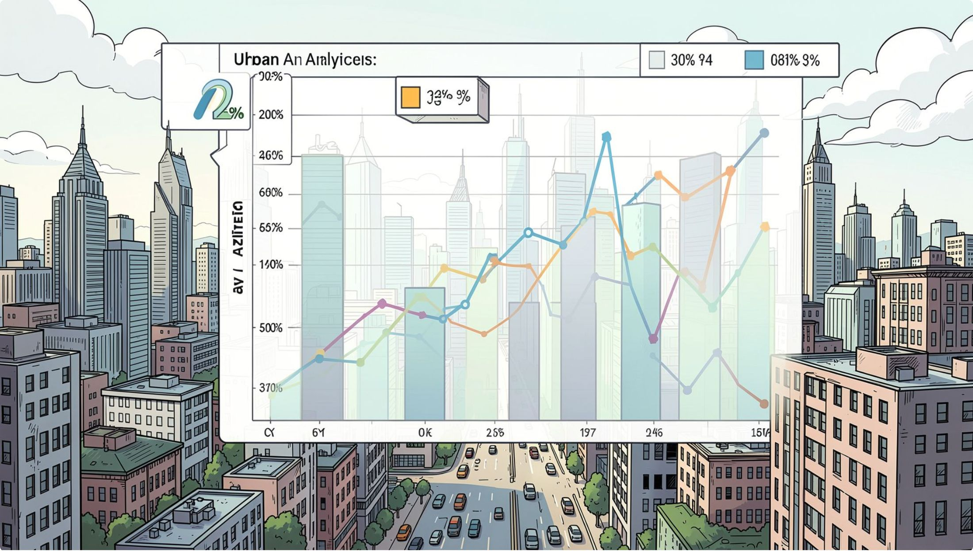
SQL ANALYSIS
Membership Revenue & Average Order Value by City
Revenue by Membership Type
Compared total revenue across Gold, Silver, and Bronze tiers to identify which segments drive the most value.
Average Order Value by City
Identified average order value for each city to surface regional spending differences and opportunities.

Slide 6
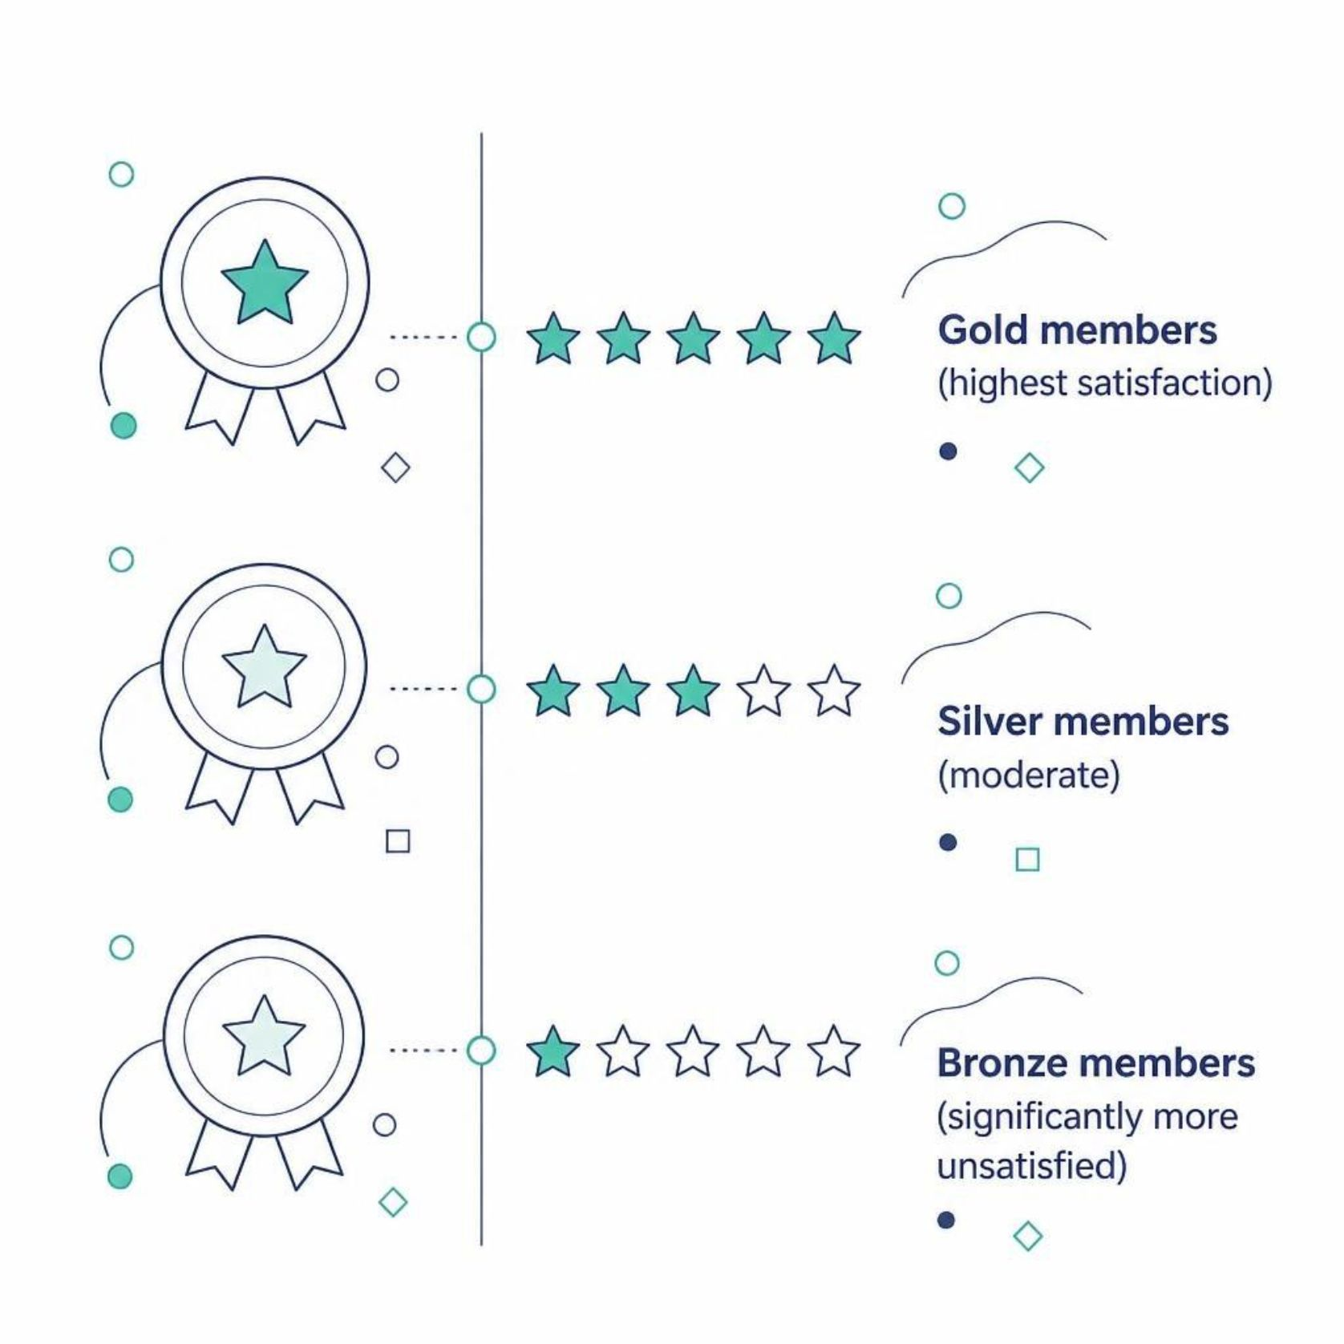
SQL ANALYSIS
Satisfaction Insights
Membership vs. Satisfaction
Bronze members are significantly more "Unsatisfied" than Gold members — a clear loyalty gap to address.
Top City for Satisfaction
San Francisco leads with the highest average satisfaction score among all cities analyzed.

Slide 7

SQL ANALYSIS
Gender Segmentation & Discount Impact
Gender by Membership & City
Segmented member counts by gender, city, and membership type — revealing extreme regional splits. Bronze in Chicago/Houston is 100% Female; Gold in SF and Silver in LA are 100% Male.
Discount Impact on Satisfaction
100% of unsatisfied customers received discounts — yet sentiment did not improve. Discounts are being used as reactive compensation, not a proactive loyalty tool.

Slide 8
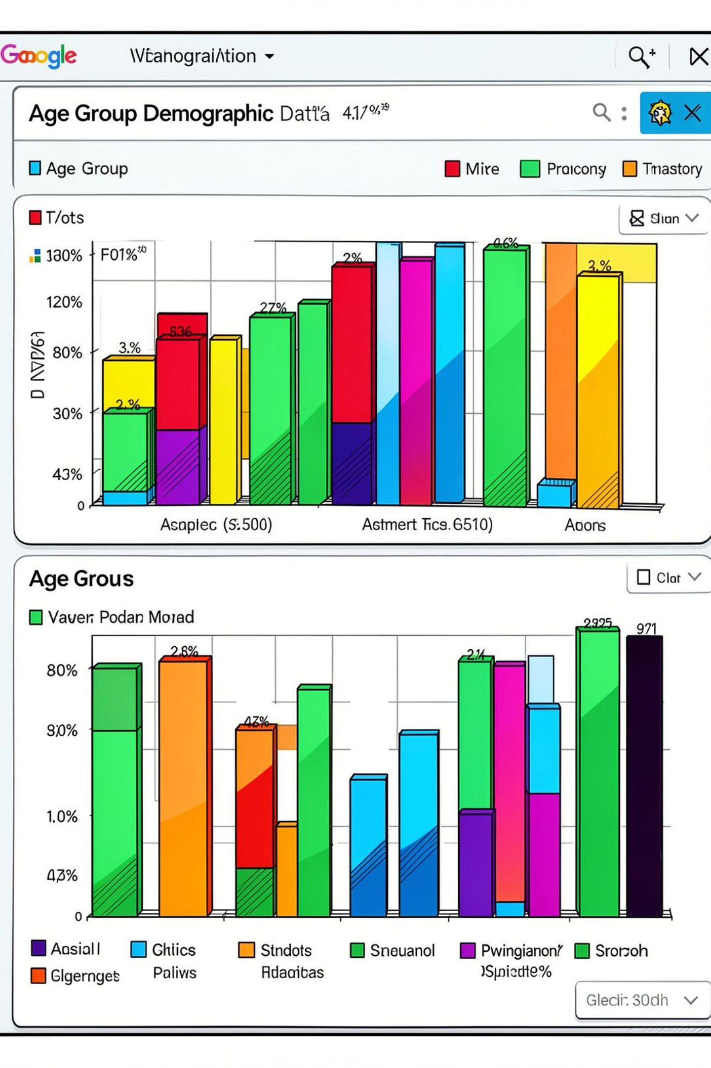
SQL ANALYSIS
Spending & Volume by Age Group
30–39 Age Group
Volume engine — highest total revenue ($192k+) and volume (2,725 items)
20–29 Age Group
Highest individual value — avg spend of $1,072.18 per customer, 16.3 items per customer

Slide 9

DASHBOARD
Power BI Interactive Dashboard
Built an interactive Power BI dashboard to present all insights visually — enabling stakeholders to explore membership performance, city-level metrics, satisfaction trends, and demographic breakdowns at a glance.

Slide 10


RECOMMENDATIONS
Optimized Business Recommendations
Revamp Discount Policy
Gender-Tailored Subscriptions
Stop reactive discounts — shift to proactive loyalty rewards
Target female Bronze members in Chicago/Houston for upsell; design male-centric campaigns for West Coast
Age-Cohort Marketing
Replicate SF & NY Service Model
30–39: volume loyalty programs. 20–29: premium positioning
Document best practices in SF/NY (avg score 3.00) and apply to Miami/Chicago (avg score 1.00)

