Slide 1

Active Systems PTY
Notes:
Logo and name of the client company

Slide 2

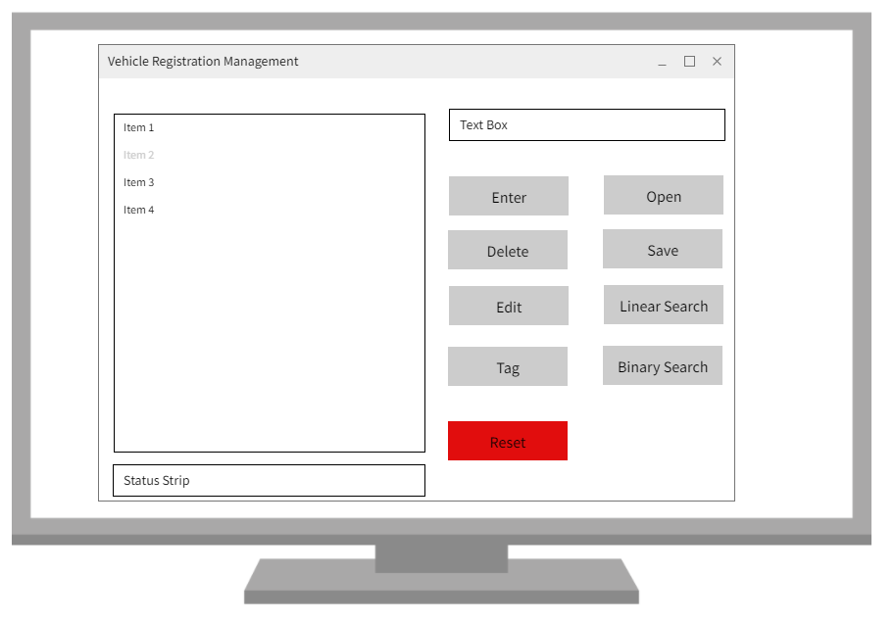
Active Systems PTY
Button Layout

Slide 3
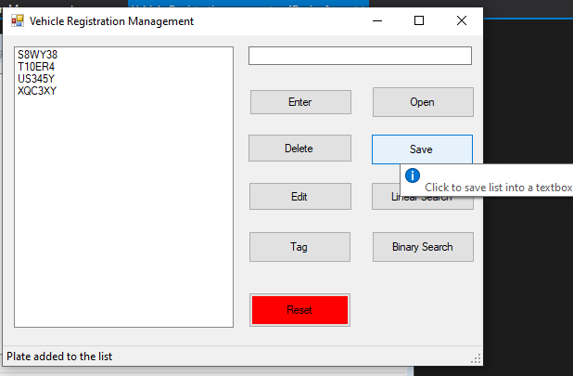
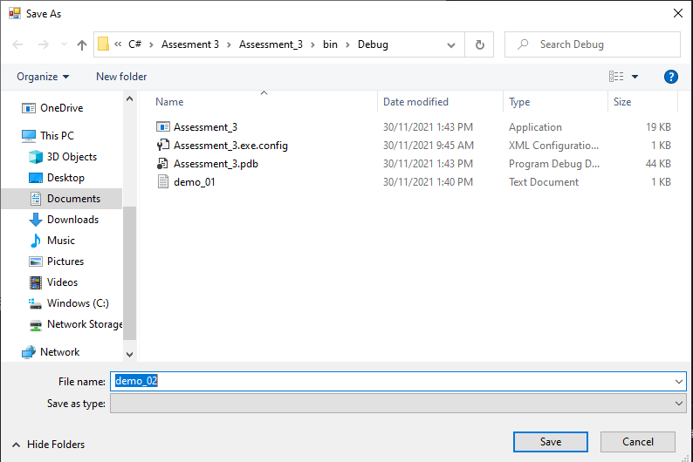
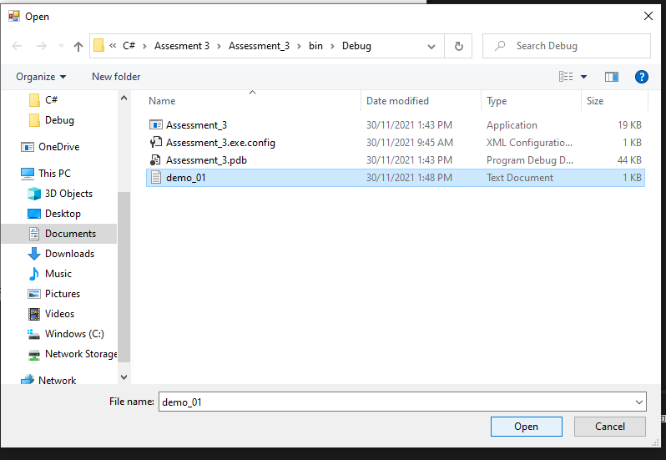
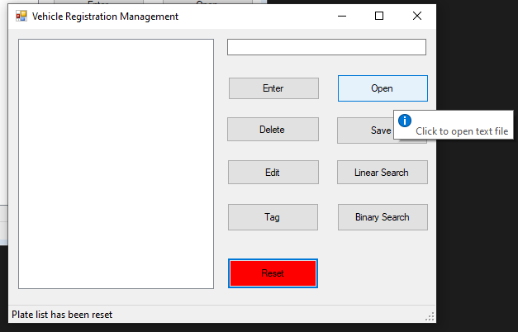
Active Systems PTY
Save Data
Load Data
Notes:
Shows the save and load function of the program

Slide 4
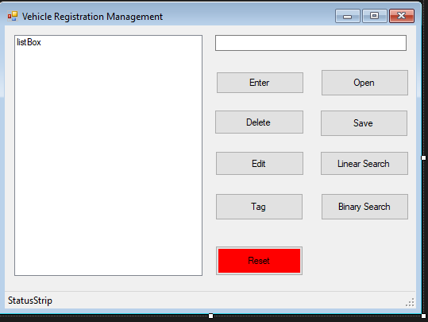
Active Systems PTY
UI layout and features
Opens text files
Allows you to type in plate
Saves the list into a text file
Enter plate into the list
Click to do a liner search
Deletes plate from the list
Click to do a Binary search
Edit plate from the list
Click to deletes all the data from the list
Tags plates from list
Displays the plate list
Notes:
This slide shows the UI layout and all the features of the button

Slide 5
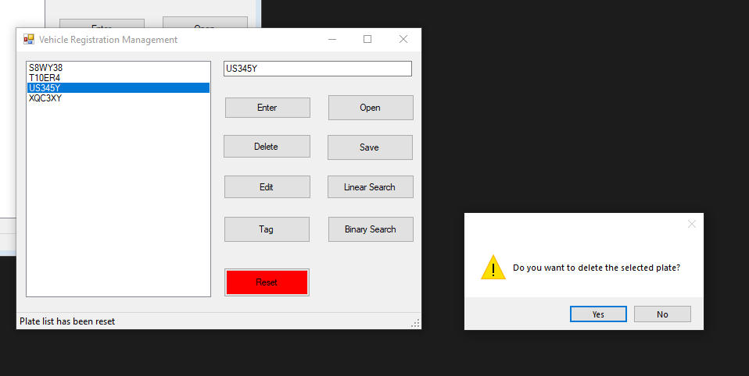
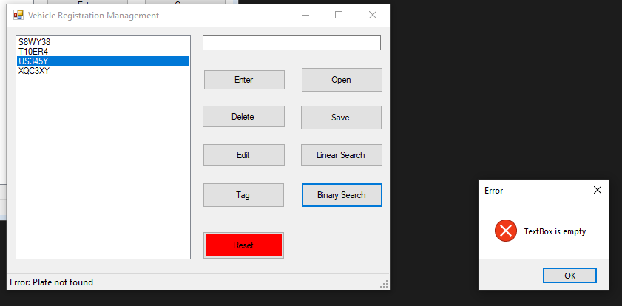
Active Systems PTY
Error and confirmation notification
Notes:
It shows the confirmation message and the error message of the program

Slide 6
Active Systems PTY
Questions
Notes:
Question from the clients

