Slide 1
Artificial Intelligence and Real Time Image Processing
Pooria Ghaffari
CS 131 : Discrete Structures

Slide 2
Computer Vision
Image Processing facts
Algorithms used for Image Processing
Applications

Slide 3
Computer Vision:
Computer vision uses machine learning to analyze, understand and respond to the images and videos. Once the images and video files received from the cameras, deep learning algorithms are being used to analyze the visual data to look for patterns to recognize and classify the events.

Slide 4
Self-driving vehicles: Self-driving vehicles use the following models to operate. The whole system consists of thousands of algorithms: - Computer vision models - Non-computer vision models - Higher level models

Slide 5
What makes the self-driving technology feasible? The video frames captured by all cameras surrounding the vehicles must be analyzed, classified and translated into understandable machine’s language and then an algorithm must decide right away and implement it. More importantly all the process must be down right away. The real time image processing is the main power of computer vision.

Slide 6
Sample algorithm for self-driving vehicles: The following algorithm simulates a simple pseudo code for a self-driving vehicle. We assume the frames f1 through fn are captured by a vehicle front cameras. The frames have already been analyzed, compared and classified. Additionally, pedestrian detection, sign and signal detection procedures have already been executed and the results are available to the algorithm:

Slide 7
Sample algorithm for self-driving vehicles: Procedure SelfDrive(video frames: f1,f2,…,fn) { If any pedestrians on the road detected, then stop Else if other vehicles on the road detected then stop Else if a signal detected, if the signal is red then stop Else if a traffic sign is seen, analyze it. If that’s a stop sign, then stop. Else then drive. }

Slide 8
Computer Vision Procedures: - capturing images and video frames by sensors such as cameras. - Image enhancement for better clarity. - Image restoration for better clarity. - Color processing. - Compression and decompression. - Image recognition to find particular objects on the images.

Slide 9
How does image recognition work? Image recognition uses many filters to remove unwanted parts of the image. Edge detection is a part of the image recognition procedure which uses specific filters to extract desired part of the image. The data that will be used for motion detection, face recognition, pedestrian detection and so on.

Slide 10
How does pedestrian detection work? Pedestrian detection procedure compares the current frames with the previous ones to find the moving parts of the images to distinguish between humans and objects. Then the moving parts will be compared with the dataset to assure the moving parts are humans.

Slide 11
Why could computer vision be beneficial? Anywhere that human capability is costly, physically limited or dangerous, computer vision can solve the problem. Cost: instead of hiring a security guard we can use a surveillance camera. Physical limitation: it’s physically not possible for humans to monitor 2 different industrial locations at the same time however that’s not a problem for a machine designed for that purpose. Danger: There are a wide variety of applications that are so dangerous for humans, but computer vision could help, cases such as sending spacecrafts to outer space.

Slide 12
Computer vision used in different fields: Energy: Computer vision is being used at nuclear plants and wind farms to monitor equipment for signs of wear, detect cracks and licks. Manufacturing: Computer vision helps in automatically counting the products in the inventory, quality control for the products and to monitor employees’ performance. Transportation: Warehouse surveillance and to ensure employing safety protocols by the staff must be a part of transportation field.

Slide 13
Computer vision used in different fields: Healthcare: Computer vision has vastly been used in medical diagnostics and track pharmacy’s inventories. Security surveillance cameras: Popular residential/industrial security IP camera brands like Hikvision, Axis Communication and Siemens use image processing and deep learning algorithms for face recognition, vehicle detection, license plate recognition and other similar technologies and everything is done in real time.

Slide 14
Image Processing Algorithms: Computer vision employs a wide variety of algorithms to extract important information from the images and video frames. Security cameras use these methods to detect the motions. By analyzing the edges of the objects and the color changes comparing to the previous frames the motions could be detected. Comprehending the differences between colors is essential for computer vision and image processing. The following sample java program can detect different colors and can change them.

Slide 15
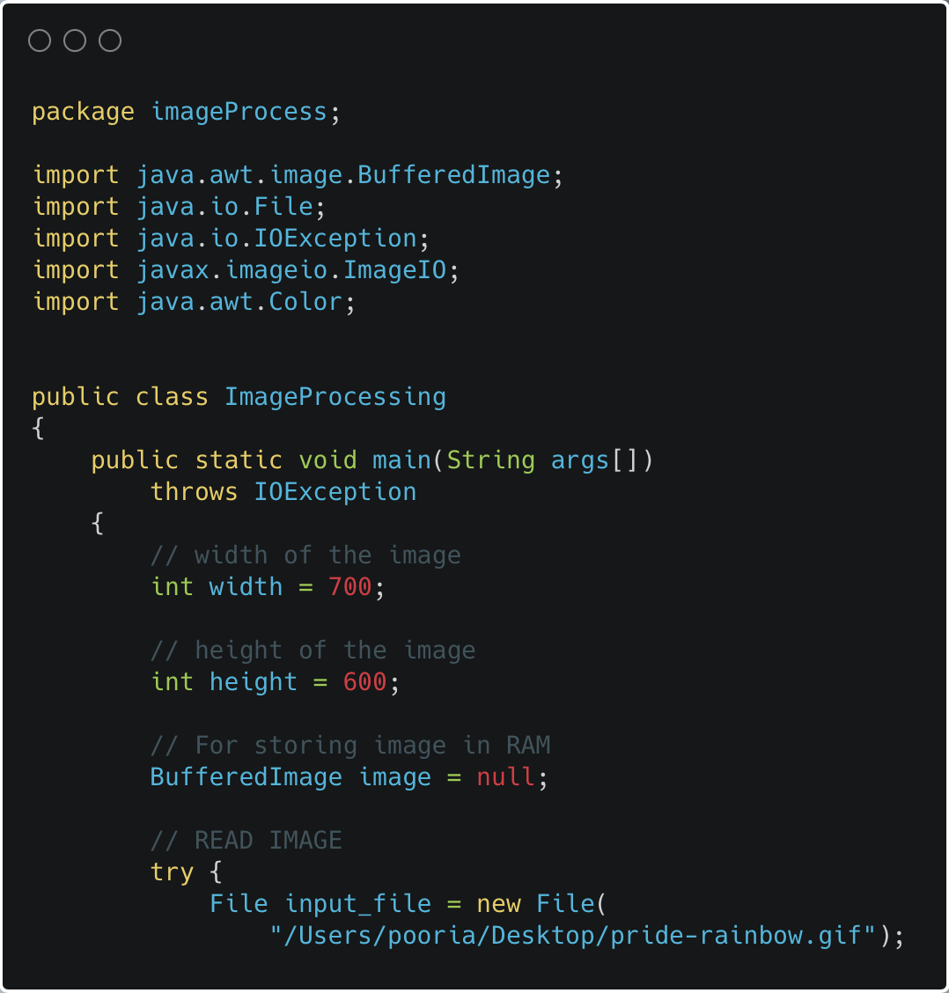

Slide 16
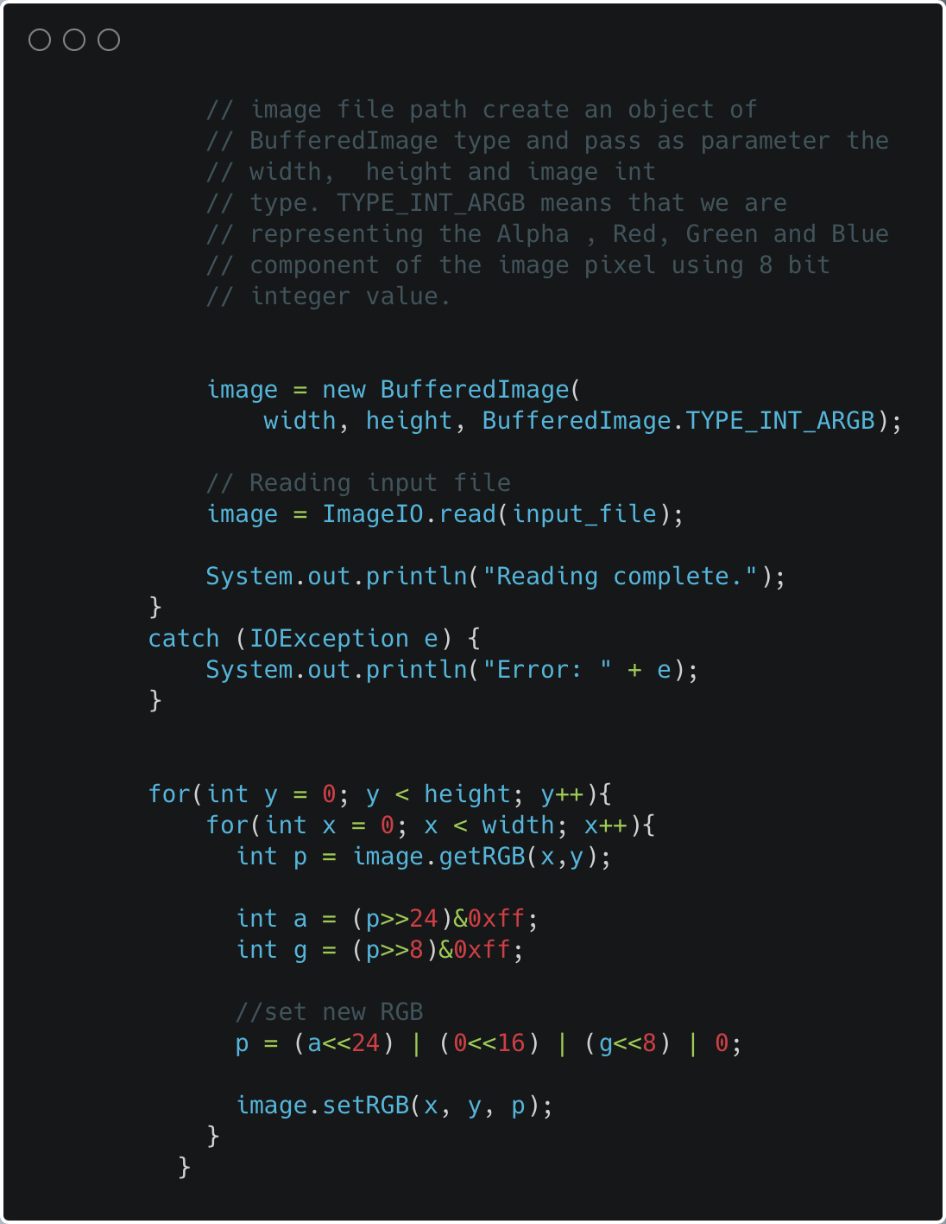

Slide 17
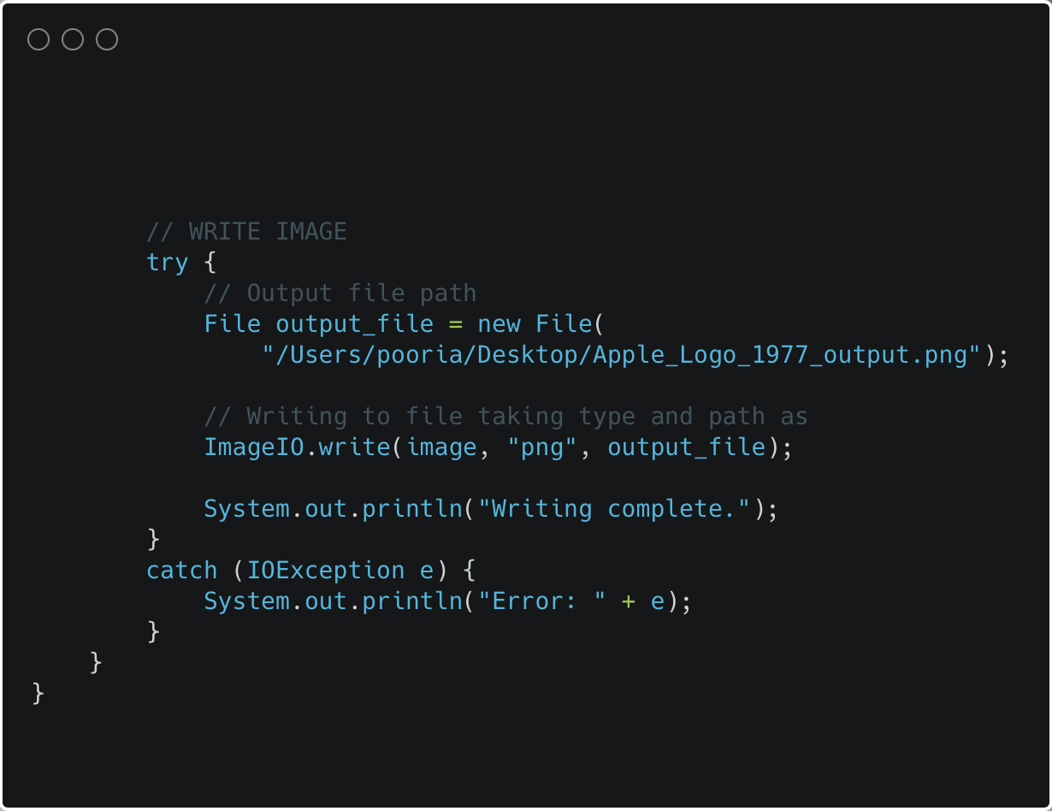

Slide 18
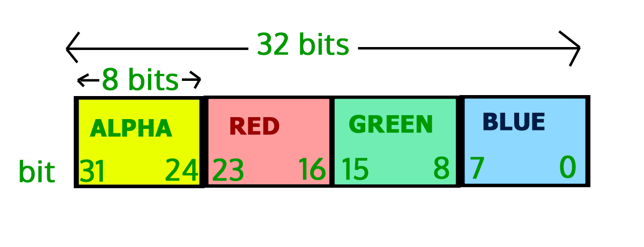

Slide 19


Before : After:

