Slide 2
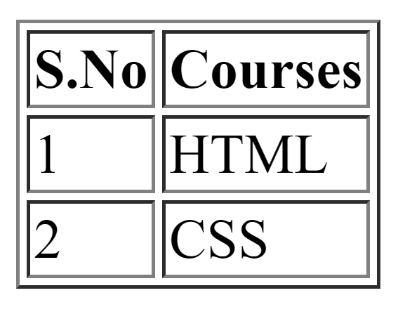
Row 1
Row 2
Row 3
Column 1
Column 2

