Slide 1
Predicting Air Ticket Prices in the Indian Aviation Industry
A Machine Learning Approach to Dynamic Pricing
Your Name & Date

Slide 2
Problem Statement
The Indian aviation sector is expanding rapidly, with multiple airlines offering services across various cities. Air ticket prices are highly dynamic, influenced by factors like demand, timing, and airline reputation.
Accurate prediction of these prices is vital for both airlines and passengers to optimize revenue and ensure affordability.
Objective: Develop a machine learning model to predict air ticket prices within India by analyzing data across airlines and cities.

Slide 3
Data Structure
Total Columns: 11
Total Rows: 10,684
Data Dictionary:
- Airline: Name of the airline.
- Date_of_Journey: Date of the journey.
- Source: Departure city.
- Destination: Arrival city/airport.
- Route: Flight route.
- Dep_Time: Departure time.
- Arrival_Time: Arrival time.
- Duration: Flight duration.
- Total_Stops: Number of stops during the journey.
- Additional_Info: Extra information about the flight.
- Price: Ticket price.

Slide 4
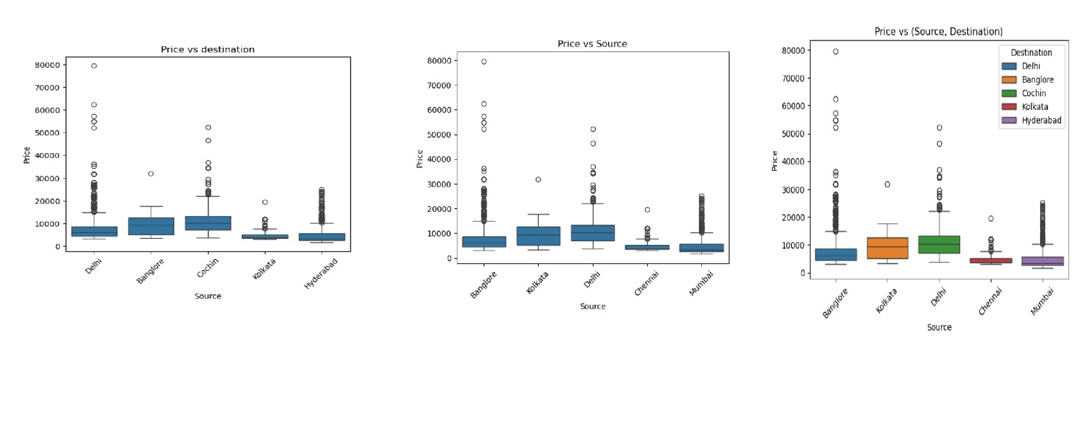
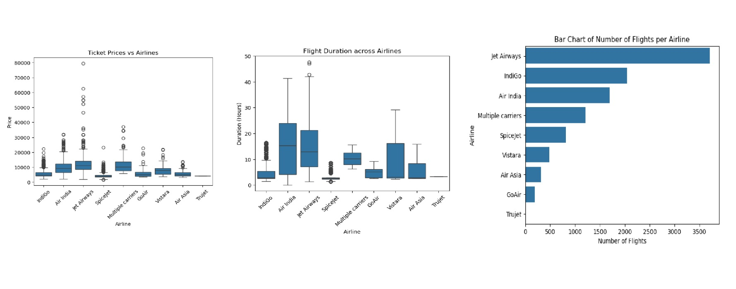
Exploratory Data Analysis (EDA)

Slide 5
Model Summary
Linear Regression:
- Training RMSE: 2072.20
- Testing RMSE: 2100.45
- Testing R² Score: 0.73
Gradient Boosting Regressor:
- Training RMSE: 1874.13
- Testing RMSE: 1941.66
- Testing R² Score: 0.77
Random Forest:
- Training RMSE: 1141.49
- Testing RMSE: 1613.63
- Testing R² Score: 0.84
Gradient Boosting:
- Training RMSE: 1232.60
- Testing RMSE: 1572.60
- Testing R² Score: 0.85

Slide 6
Results and Conclusion
Key Takeaways:
- The Random Forest model provided the best performance with an R² score of 0.84 on the test data.
- Flight prices are highly influenced by factors like city, airline, and duration.
- These models can assist airlines in dynamic pricing strategies and help passengers make informed decisions.
Next Steps:
- Further model optimization.
- Consideration of additional variables like seasonality or holidays.
- Deployment of the model for real-time price prediction.

