Slide 1
Plastic Control
SlideMake.com

Slide 2
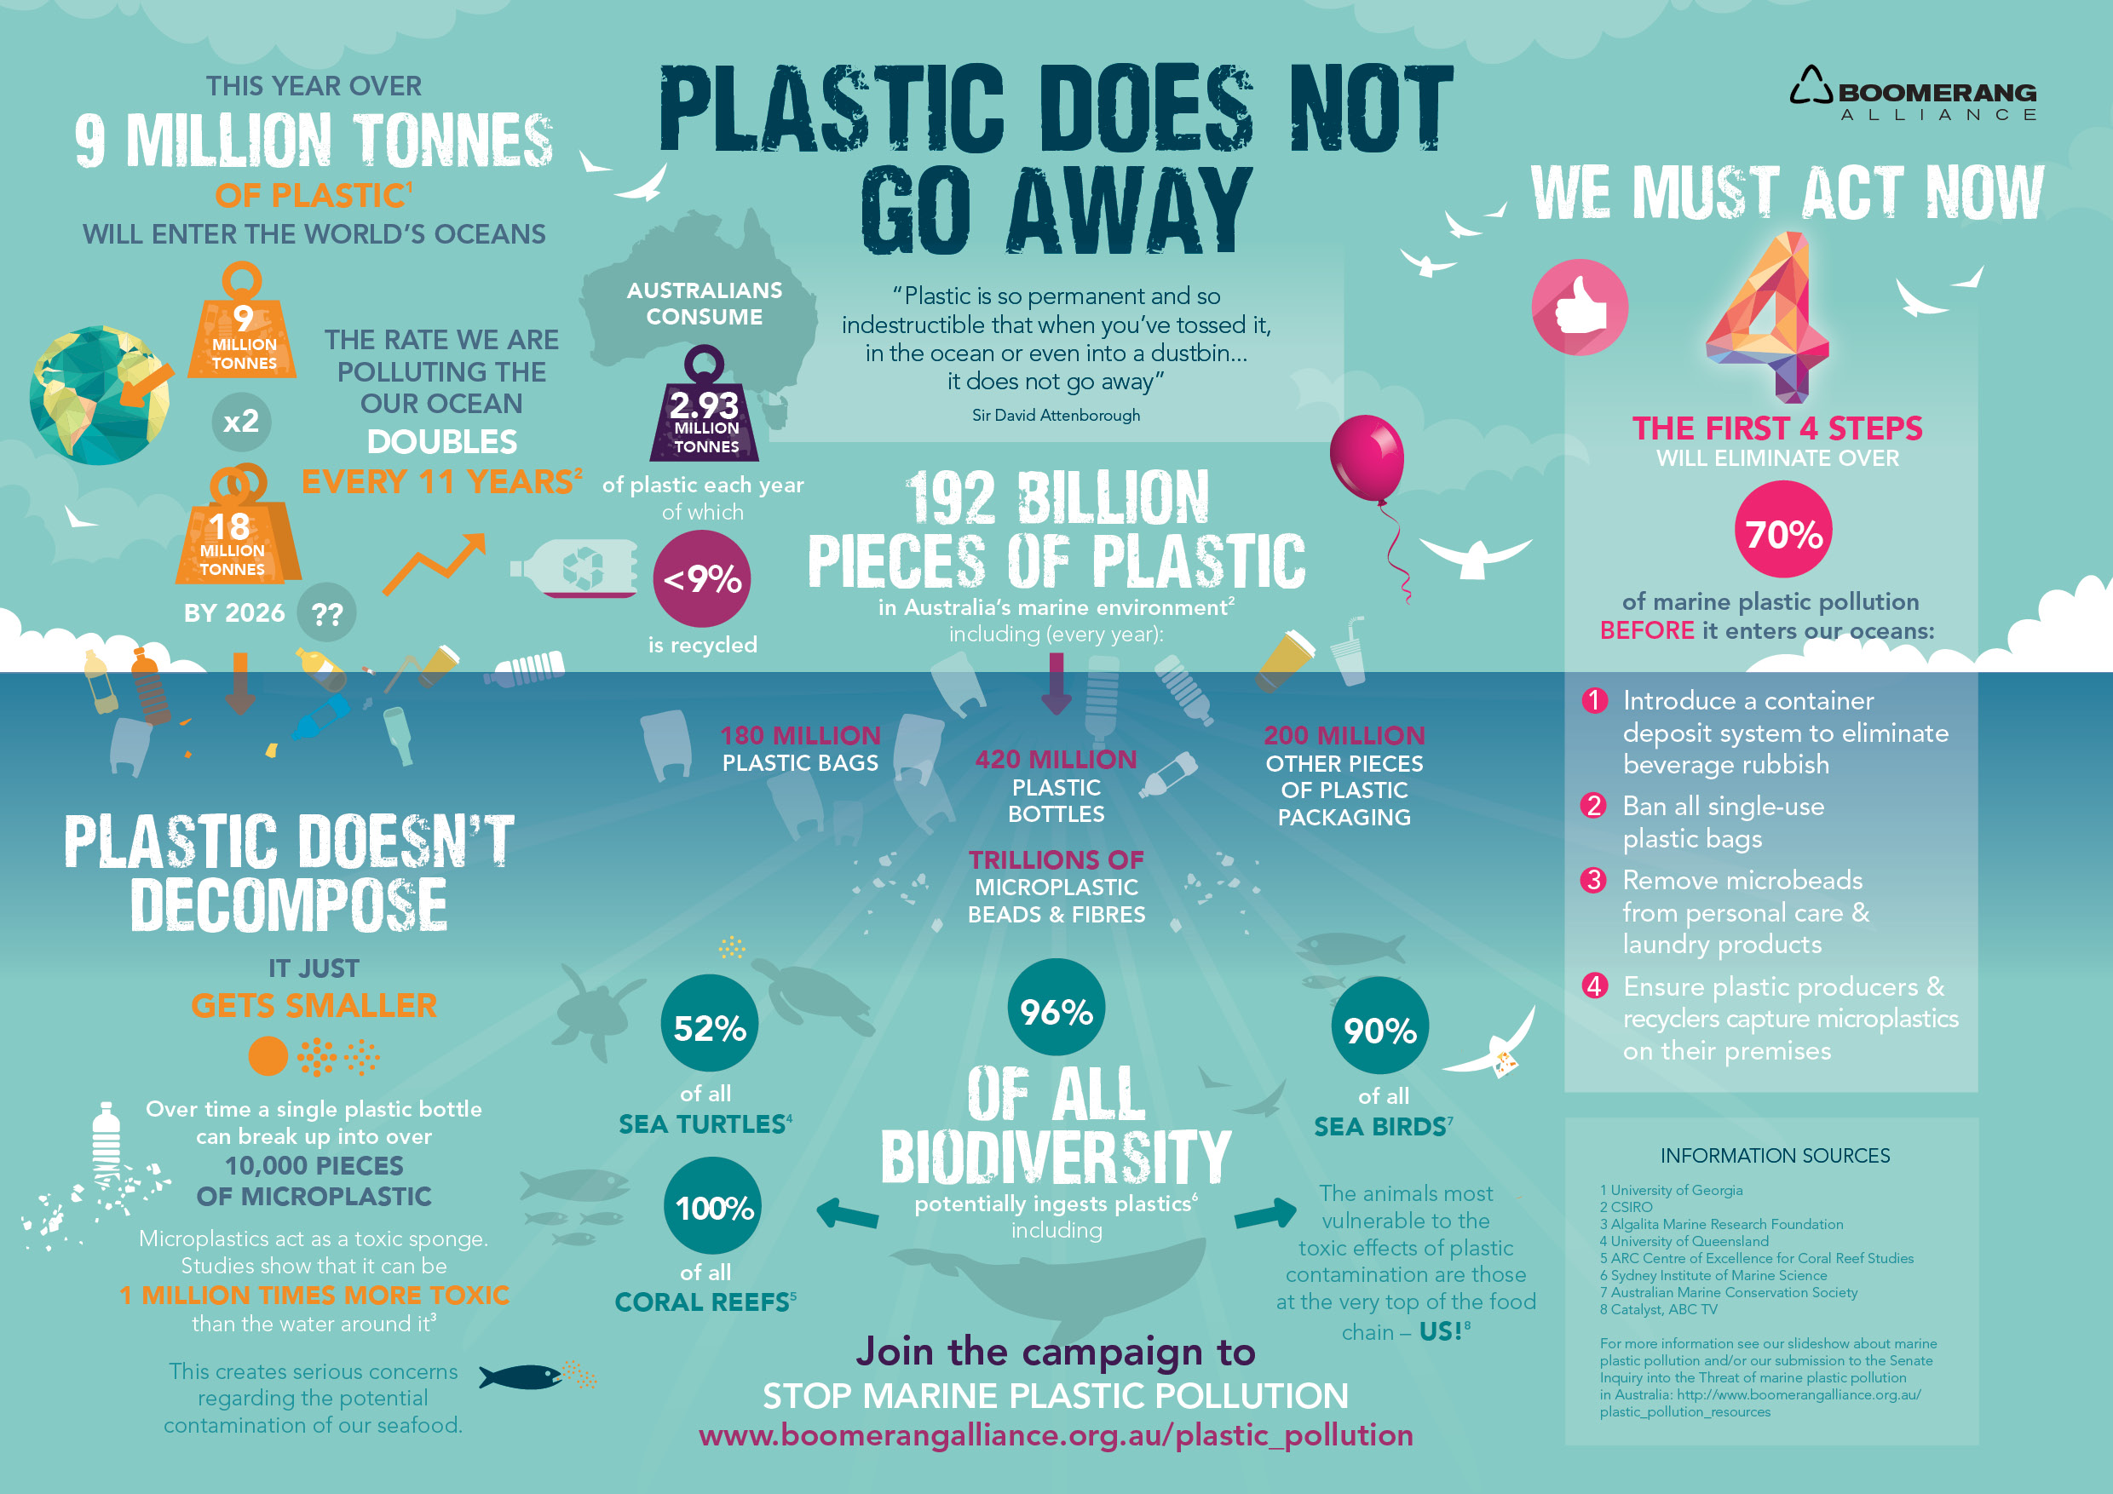
Introduction to Plastic Control
Plastic control encompasses strategies to reduce plastic waste and its environmental impact.
It aims to promote sustainable practices in production, consumption, and disposal of plastics.
Effective plastic control is essential for protecting ecosystems and human health.
Notes:
Image source: https://sites.google.com/view/english-for-climate-education/home/economy-manufacturing-business/microplastics

Slide 3
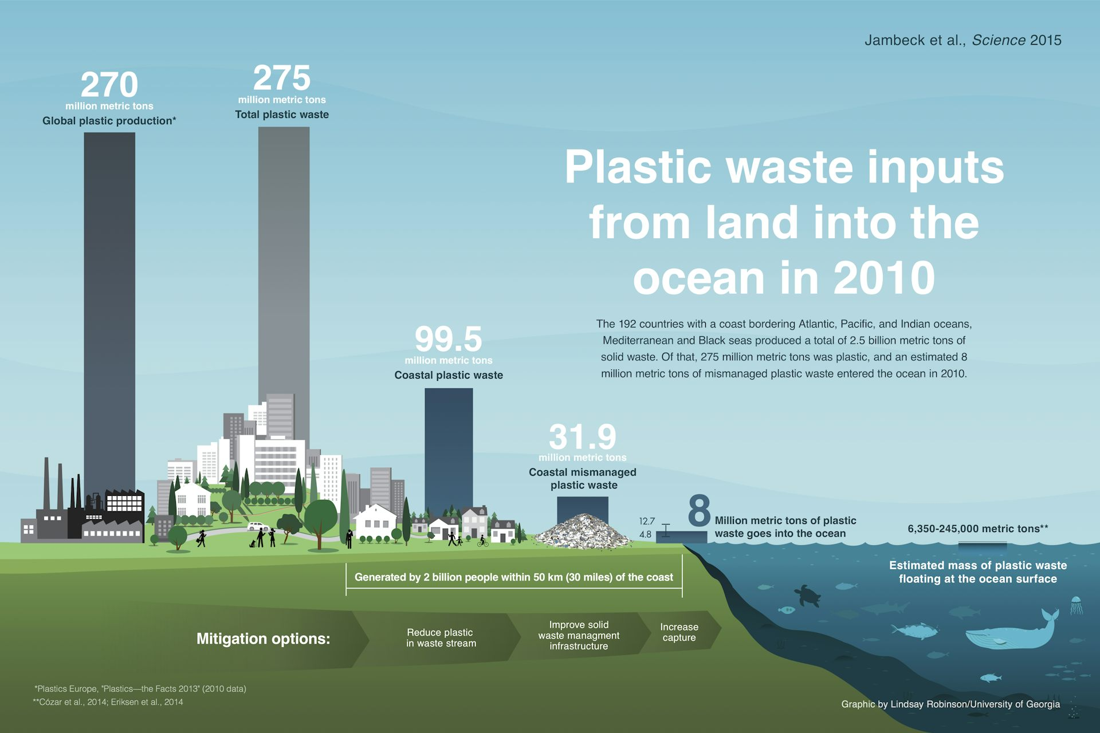
The Plastic Pollution Crisis
Over 300 million tons of plastic are produced globally each year, contributing to massive pollution.
Millions of tons of plastic waste enter oceans annually, harming marine life and ecosystems.
Plastic pollution poses significant risks to wildlife, human health, and biodiversity.
Notes:
Image source: http://theconversation.com/eight-million-tonnes-of-plastic-are-going-into-the-ocean-each-year-37521

Slide 4
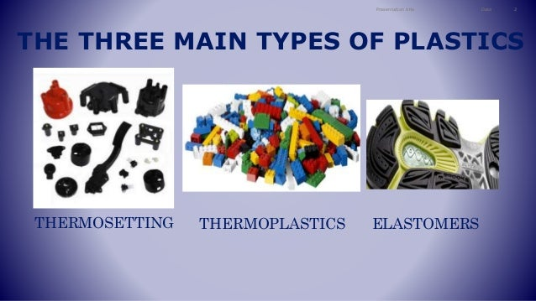
Types of Plastics
Plastics are categorized into two main types: thermoplastics and thermosetting plastics.
Common types include polyethylene, polypropylene, and polystyrene, each with different uses.
Understanding plastic types is essential for effective recycling and waste management.
Notes:
Image source: https://www.slideshare.net/sergyx2000/the-three-main-types-of-plastics

Slide 5
The Importance of Recycling
Recycling reduces the demand for new plastic production, conserving resources and energy.
Proper recycling practices can significantly decrease plastic waste in landfills and oceans.
Enhancing recycling technologies is crucial for improving recovery rates of plastic materials.
Notes:
Image source: https://www.climateofourfuture.org/the-essential-guide-to-plastic-recycling-reducing-plastic-waste-and-conserving-resources/

Slide 6
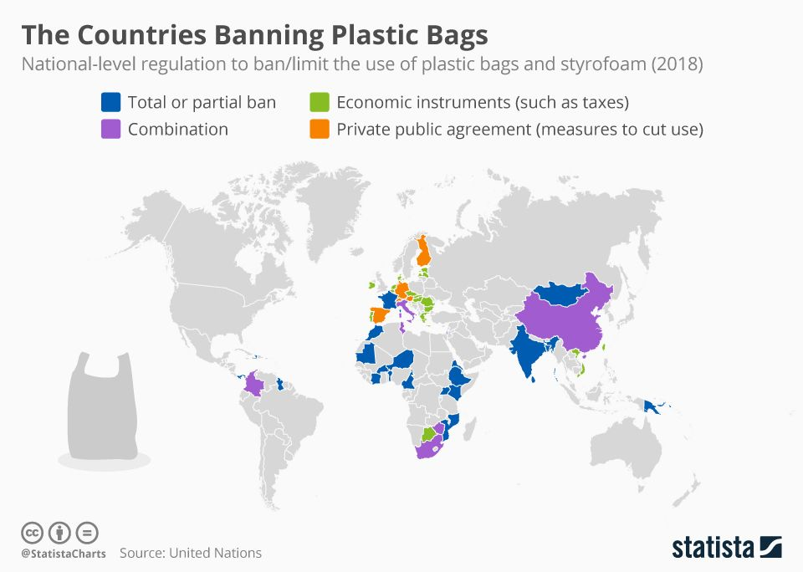
Legislative Efforts in Plastic Control
Many countries are implementing bans on single-use plastics to combat pollution.
Legislation often includes incentives for businesses to adopt sustainable practices.
International agreements are being formed to address plastic waste on a global scale.
Notes:
Image source: https://www.pinterest.com/pin/vivid-maps--657947826786132198/

Slide 7
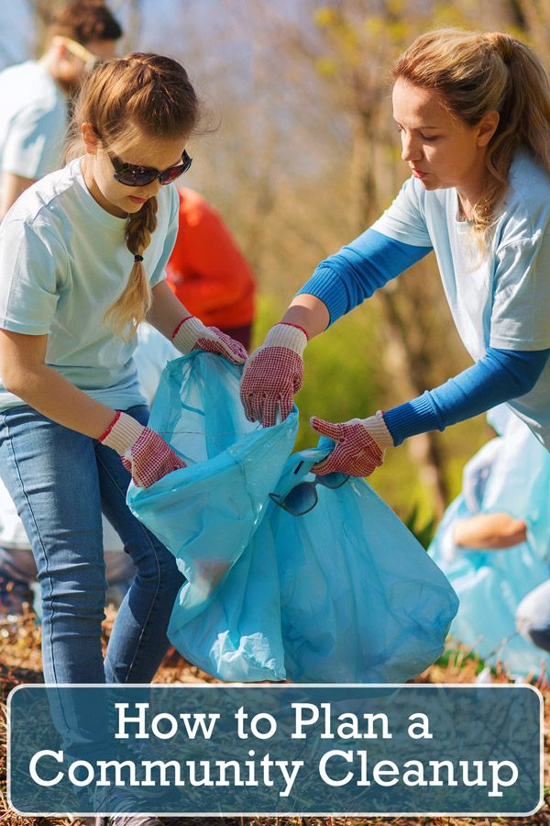
Community Initiatives
Local communities are spearheading clean-up efforts to reduce plastic waste in public spaces.
Educational programs raise awareness about the impacts of plastic pollution and promote alternatives.
Collaborative initiatives between NGOs and local governments can enhance community engagement.
Notes:
Image source: https://www.pinterest.com/pin/515802963569279823/

Slide 8
Role of Businesses
Companies are increasingly adopting circular economy principles to minimize plastic waste.
Packaging redesign and the use of biodegradable materials are becoming industry standards.
Businesses can lead the way in innovation by investing in sustainable practices and technologies.
Notes:
Image source: https://fity.club/lists/suggestions/circular-economy/

Slide 9
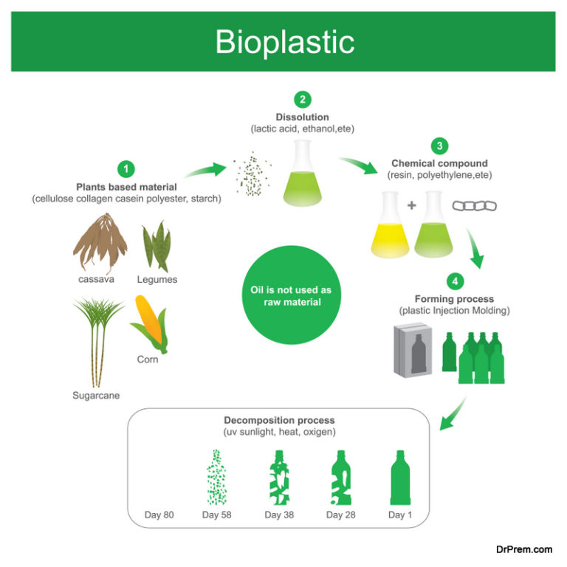
Innovations in Plastic Alternatives
Research is advancing in developing biodegradable and compostable materials to replace plastics.
Innovations such as plant-based plastics offer sustainable alternatives for various applications.
Continued investment in research is necessary for finding effective solutions to plastic dependency.
Notes:
Image source: https://ecofriend.com/how-bioplastics-and-biodegradable-plastics-are-transforming-packaging.html

Slide 10
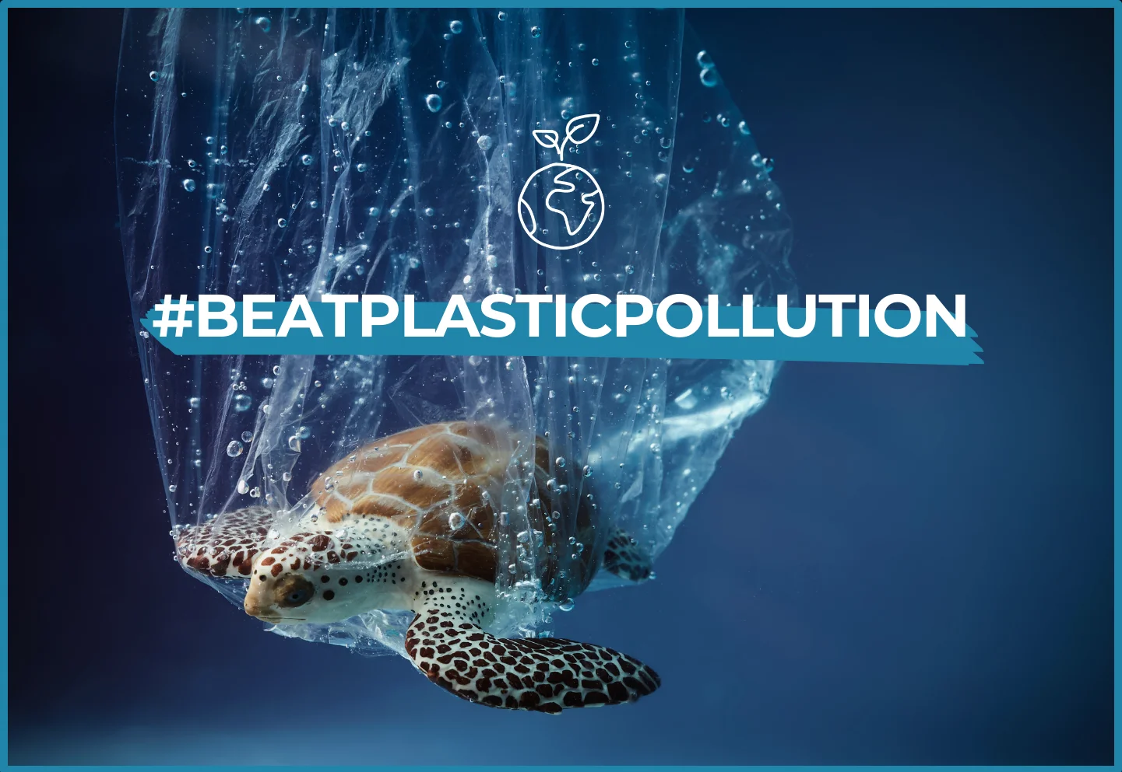
Global Collaboration Efforts
Addressing plastic pollution requires coordinated efforts among nations, NGOs, and industries.
Global initiatives like the "Global Plastics Pact" aim to unite stakeholders for collective action.
Sharing best practices and technologies can accelerate progress in plastic control efforts.
Notes:
Image source: https://www.traveldifferently.org/blog/world-environment-day-2023-your-role-in-beating-plastic-pollution

Slide 11
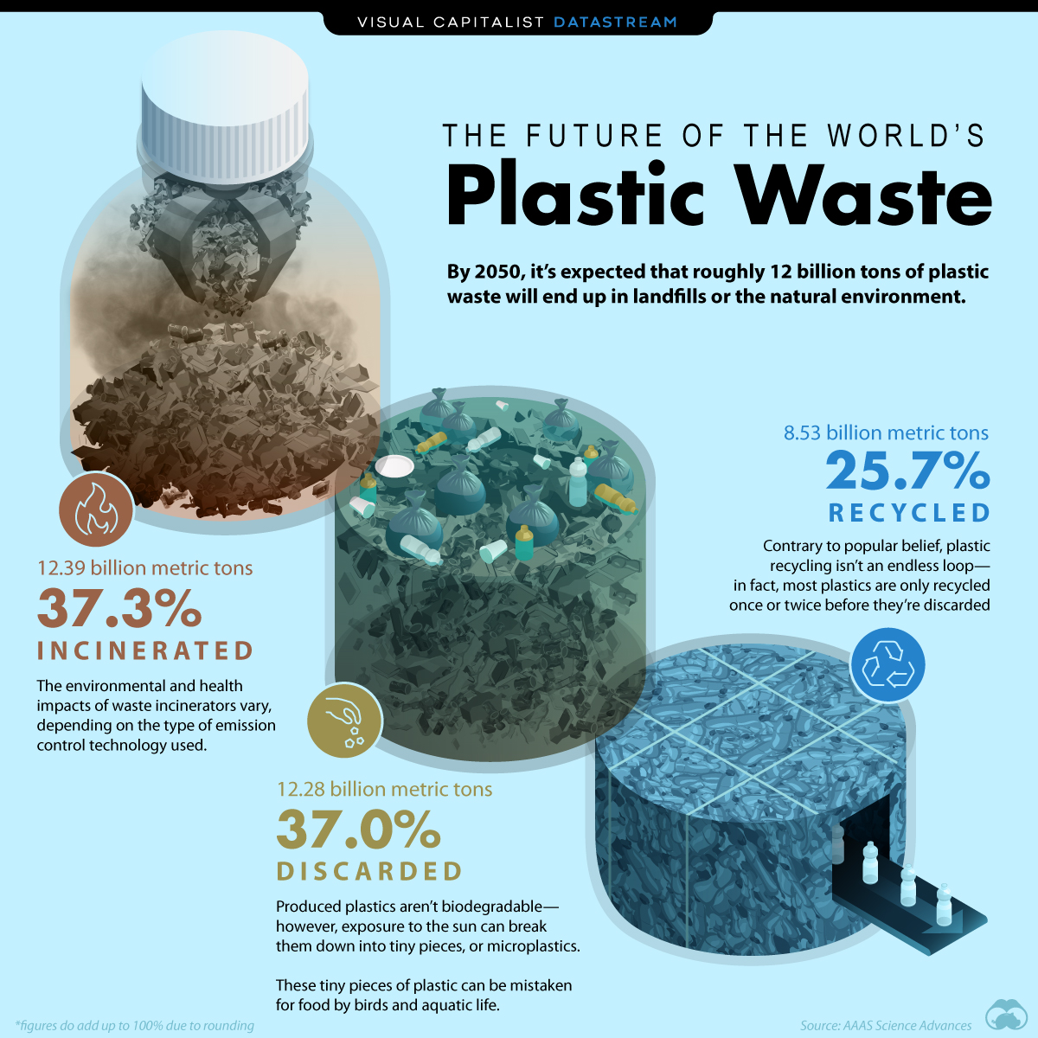
The Future of Plastic Control
The future of plastic control lies in systemic changes in production, consumption, and waste management.
Public awareness and participation are essential for driving meaningful change in plastic use.
A commitment to sustainability and innovation will shape a healthier planet free from plastic pollution.
Notes:
Image source: https://jessikawlacey.pages.dev/vhrgdt-plastics-recycling-world-expo-2024-rjzrllsmr-photos/

Slide 12
References
World Economic Forum. (2021). The New Plastics Economy: Rethinking the Future of Plastics.
United Nations Environment Programme. (2022). From Pollution to Solution: A Global Assessment of Marine Litter and Plastic Pollution.
Ellen MacArthur Foundation. (2020). Completing the Picture: How the Circular Economy Tackles Climate Change.

