Slide 1


KSRM COLLEGE OF ENGINEERING (UGC-Autonomous) Kadapa,Andhra Pradesh,india-516 005.
Innovate In The Agricultural Sector To Enhance Sustainability And Productivity
By
K.Gangi Reddy
L.Prasanth
L.Sai Prakash

Slide 2

Innovating for a
Sustainable Future in Agriculture
Agriculture, the backbone of our global food system, faces the daunting challenge of feeding a rapidly growing population while preserving the environment for future generations. The need for sustainable and innovative practices is paramount, and this presentation explores key areas where we can advance towards a brighter future for agriculture.

Slide 3

Precision Farming: Leveraging Technology for Enhanced Productivity
1
Data-Driven Decisions
Precision farming utilizes technology to gather and analyze data about soil conditions, crop health, and other factors, allowing farmers to make precise decisions for fertilization, irrigation, and pest control. This approach optimizes resource use and reduces waste, leading to increased yields and cost savings.
2
Targeted Interventions
By identifying specific areas within a field that require different treatments, farmers can apply resources only where needed. This targeted approach not only reduces environmental impact but also improves crop quality and profitability.
3
Real-Time Monitoring
Sensors and drones can provide real-time data on crop growth, moisture levels, and potential threats. Farmers can react swiftly to changing conditions, mitigating risks and ensuring optimal crop performance.
4
Sustainable Practices
Precision farming promotes sustainable practices by reducing chemical inputs and minimizing water use, contributing to a healthier environment and responsible resource management.

Slide 4
Sustainable Crop Rotation and Soil Management Practices
Crop Rotation
Rotating different crops in a field helps break disease cycles, control pests, and improve soil health. Each crop has unique nutrient requirements and root structures, contributing to a balanced ecosystem and reducing the need for synthetic fertilizers.
Reduces pest and disease pressure.
Enhances soil fertility by utilizing different nutrient sources.
Improves soil structure and drainage.
Minimizes erosion and promotes biodiversity.
Soil Management
Sustainable soil management practices focus on building soil health, which is crucial for plant growth and overall ecosystem stability. These practices include:
Cover cropping
No-till farming
Organic amendments
Conservation tillage
These techniques minimize soil disturbance, increase organic matter content, and promote microbial activity, leading to healthier, more resilient soils.

Slide 5
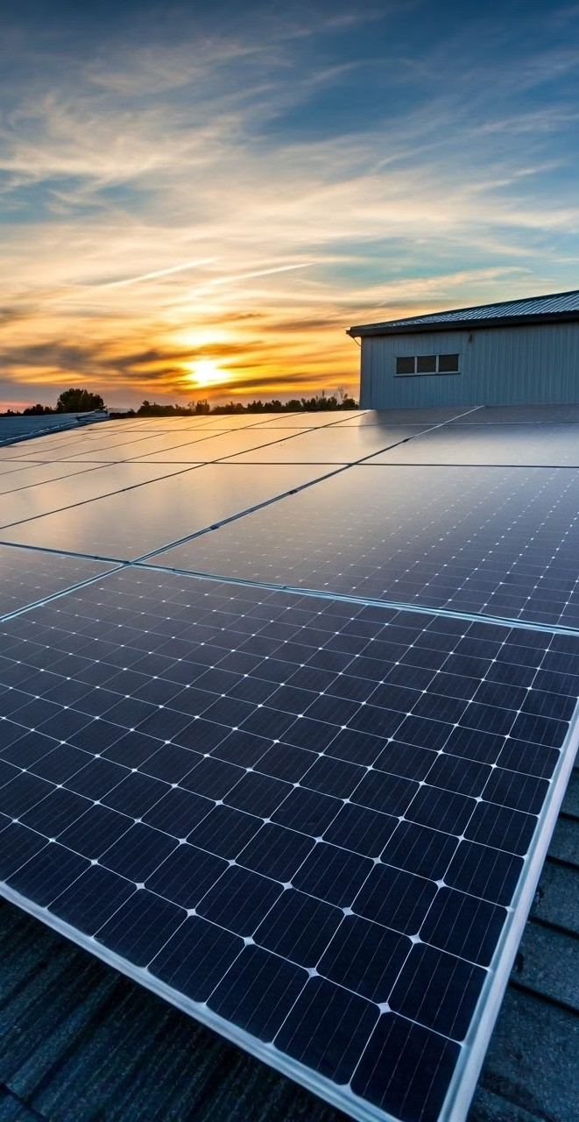
Renewable Energy Solutions for Agricultural Operations
Solar Energy
Solar panels can power farm equipment, irrigation systems, and lighting, reducing reliance on fossil fuels and lowering operational costs. This renewable energy source provides a sustainable solution for powering agricultural operations.
Wind Energy
Wind turbines can generate electricity for farms in areas with consistent wind resources, further reducing greenhouse gas emissions and promoting energy independence.
Biogas
Anaerobic digestion of agricultural waste can produce biogas, a renewable fuel source that can be used for heating, electricity generation, and even transportation. This process also generates valuable organic fertilizer for soil amendment.

Slide 6

Water Conservation and Irrigation Optimization Strategies
Water Audits
Conducting regular water audits to identify leaks and inefficiencies
1
in irrigation systems is a crucial first step. This helps pinpoint areas where water conservation measures can be implemented effectively.
Smart Irrigation Systems
Utilizing sensors and data analysis to optimize irrigation schedules and apply water only when and where it's needed can significantly reduce water use and prevent overwatering.
2
Drip Irrigation
Drip irrigation systems deliver water directly to the roots of plants, minimizing evaporation and runoff. This highly efficient method reduces water use and conserves valuable resources.
3
Water Harvesting
Collecting rainwater and runoff through cisterns and other methods can supplement irrigation needs and reduce reliance on external water sources. This approach promotes water conservation and reduces pressure on local water supplies.
4

Slide 7

Integrated Pest Management: Reducing Chemical Dependency
1
Monitoring and Identification
Regular monitoring of crops for pests and diseases is crucial for early detection. Identifying the specific pest or disease allows for targeted interventions, preventing widespread infestation and reducing the need for broad-spectrum pesticides.
2
Cultural Controls
Utilizing crop rotation, resistant varieties, and appropriate planting times can naturally discourage pest populations and promote healthy plant growth, reducing the reliance on chemical interventions.
3
Biological Controls
Introducing beneficial insects or other natural predators can effectively control pest populations without harming beneficial organisms or the environment. This eco-friendly approach promotes biodiversity and reduces chemical use.
4
Chemical Control (Last Resort)
When other methods are insufficient, carefully targeted applications of pesticides can be used, but only as a last resort. Choosing the least toxic and most effective pesticides is crucial to minimizing environmental impact and protecting human health.

Slide 8
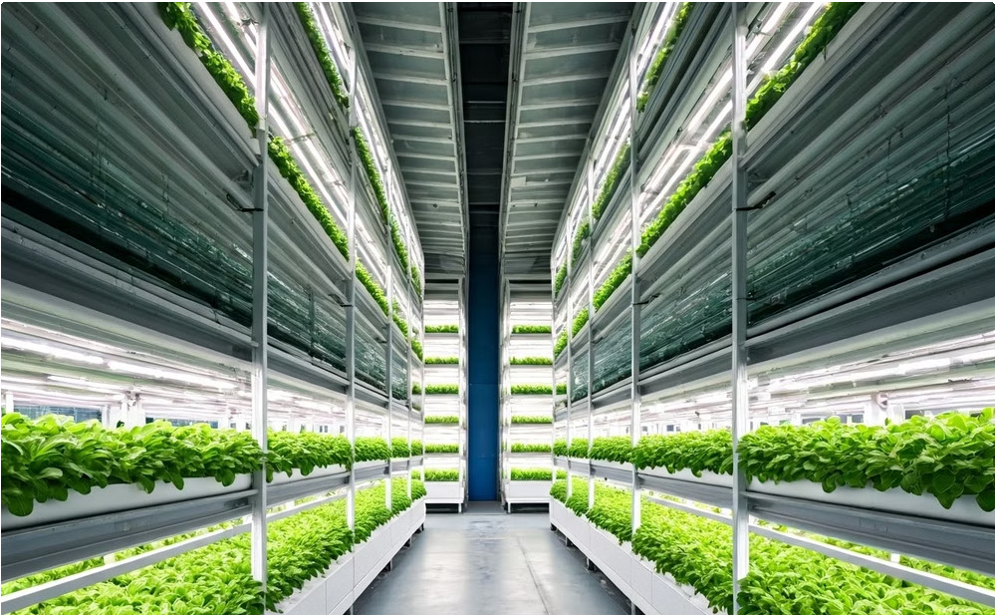
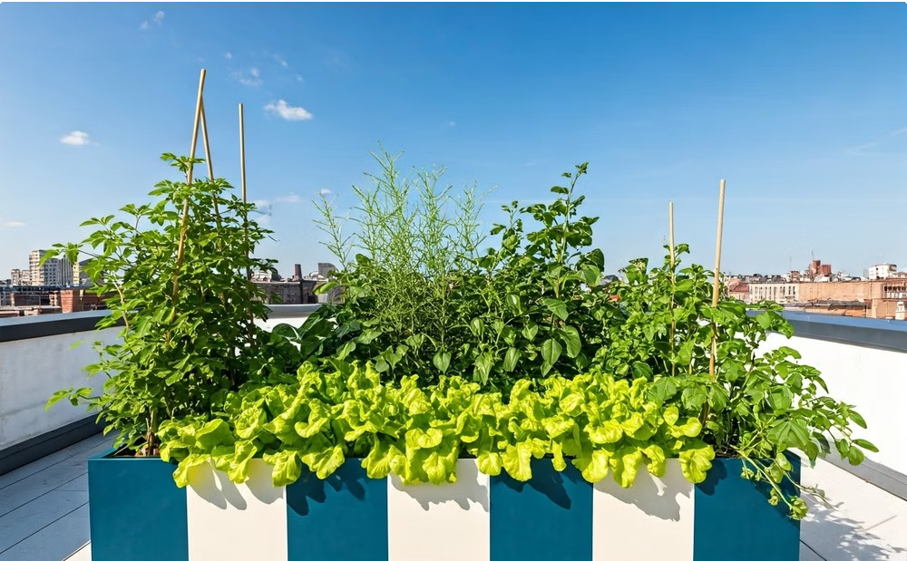
Vertical Farming and Urban Agriculture: Addressing Food Security
Vertical Farming
Vertical farming utilizes stacked layers of crops grown in controlled indoor environments, maximizing space and minimizing land use. This technology allows for year-round production, reducing reliance on seasonal weather patterns and enabling urban agriculture in densely populated areas.
Urban Agriculture
Urban agriculture involves growing food in cities and towns, utilizing rooftops, vacant lots, and other available spaces. This approach not only enhances food security but also beautifies urban landscapes, improves air quality, and promotes community engagement.

Slide 9
Conclusion: Embracing Innovation to Secure a Sustainable Agricultural Landscape
The future of agriculture lies in embracing innovation and adopting sustainable practices. By leveraging technology, embracing sustainable soil management, utilizing renewable energy sources, and implementing water conservation strategies, we can ensure a secure and sustainable food supply for generations to come. The journey toward a brighter future for agriculture requires collaboration, knowledge sharing, and a commitment to creating a more resilient and sustainable food system.

Slide 10
THANK YOU

