Slide 1


GREEN JOURNEY IDEATHON
Plastic Pollution : The Global Crisis

Slide 2

TEAM DETAILS
Madduru vamsi

Slide 3

Problem staement
To reduse the plastic pollution in the environvement
Plastic waste has become a global environmental crisis, polluting our oceans, harming wildlife, and accumulating in landfills. Urgent action is needed to address this pressing issue and find innovative solutions to reduce plastic consumption. Say no to plastic for a better and greener tomorrow.

Slide 4
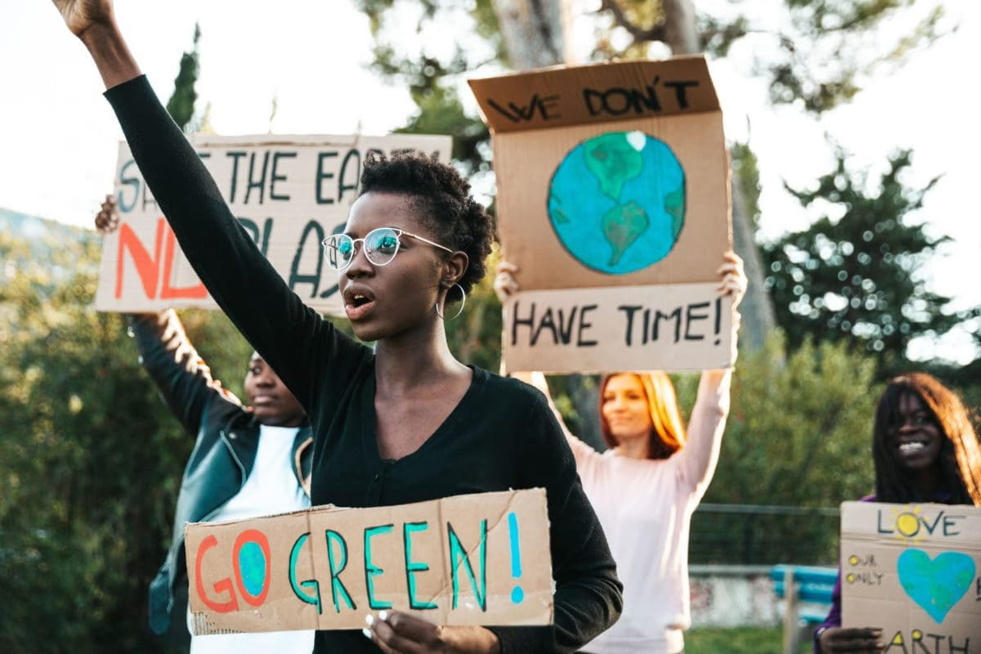
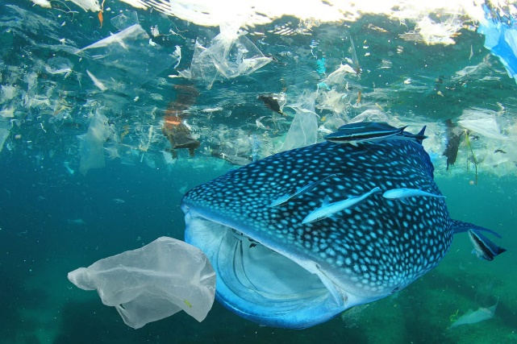
Solution :
the Impact of Plastic Waste
Environmental Damage
Plastic pollution harms marine life, contaminates ecosystems, and persists in the environment for centuries, disrupting natural cycles.
Human Health Risks
Microplastics have been found in the food chain, posing potential health risks to humans through the consumption of contaminated seafood.
Economic Costs
The cleanup and mitigation of plastic waste places a significant financial burden on governments and communities around the world.

Slide 5
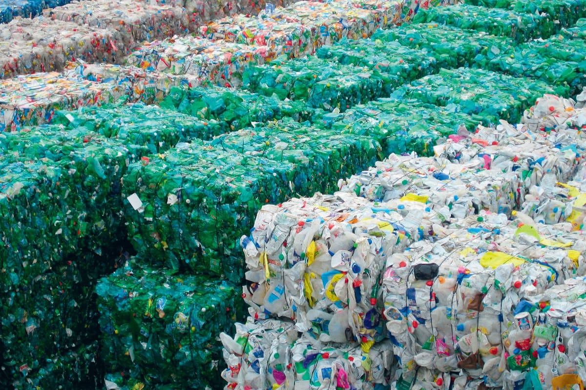
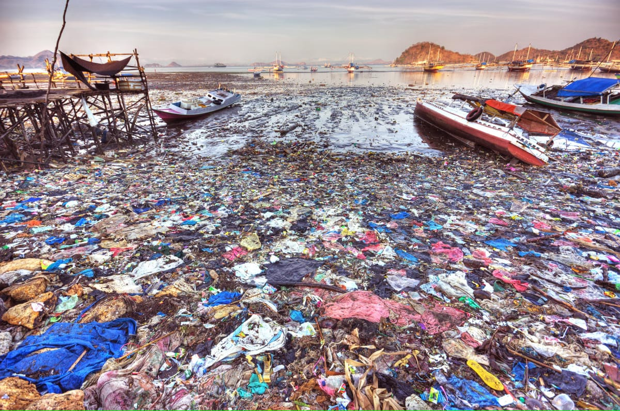
Say no to plastic for a better and greener tomorrow.

Slide 6
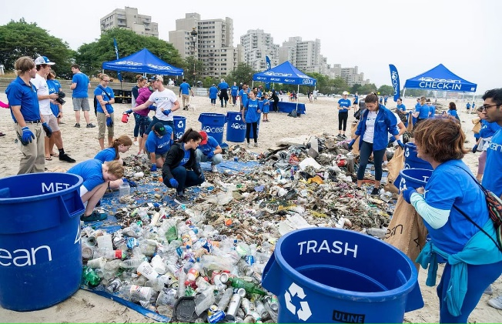
Promoting Sustainable Alternatives :
Reusable Bags
Encourage the use of durable, reusable shopping bags to reduce single-use plastic bag waste.
Reusable Straws
Promote the use of reusable straws made from materials like metal, bamboo, or silicone.
Refillable Containers
Provide access to water refill stations and encourage the use of reusable water bottles.
Compostable Packaging
Support the development and use of compostable packaging alternatives to single-use plastics.

Slide 7

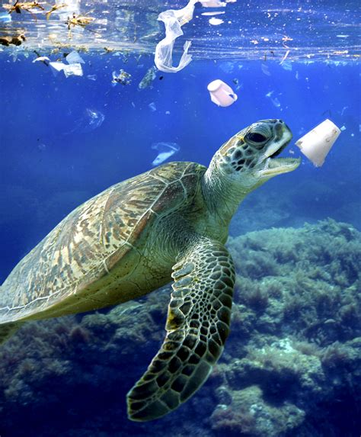

Slide 8
Promoting Sustainable Alternatives
Reusable Bags
Encourage the use of durable, reusable shopping bags to reduce single-use plastic bag waste.
Reusable Straws
Promote the use of reusable straws made from materials like metal, bamboo, or silicone.
Refillable Containers
Provide access to water refill stations and encourage the use of reusable water bottles.
Compostable Packaging
Support the development and use of compostable packaging alternatives to single-use plastics.

Slide 9
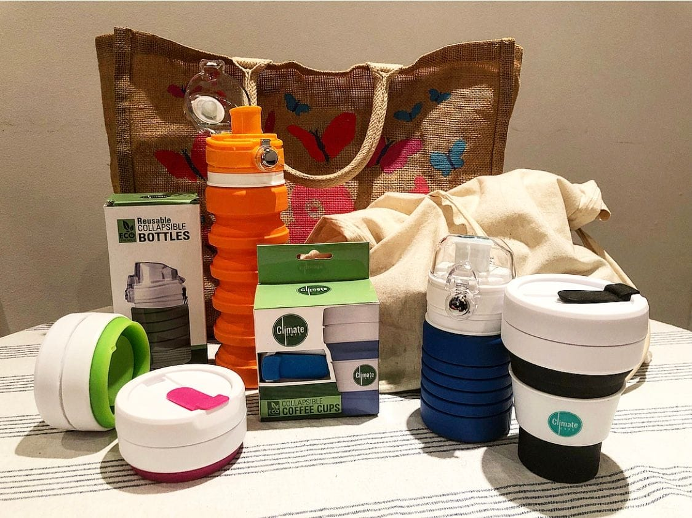

Use these items replace by plastic

Slide 10
About myself :
M vamsi {229y1a0493}
Branch : ece
Section : b
College : ksrmce

Slide 11

The end

