Slide 1

Health
And
Hygiene
^{Submitted by}
^{G Kusuma}

Slide 2
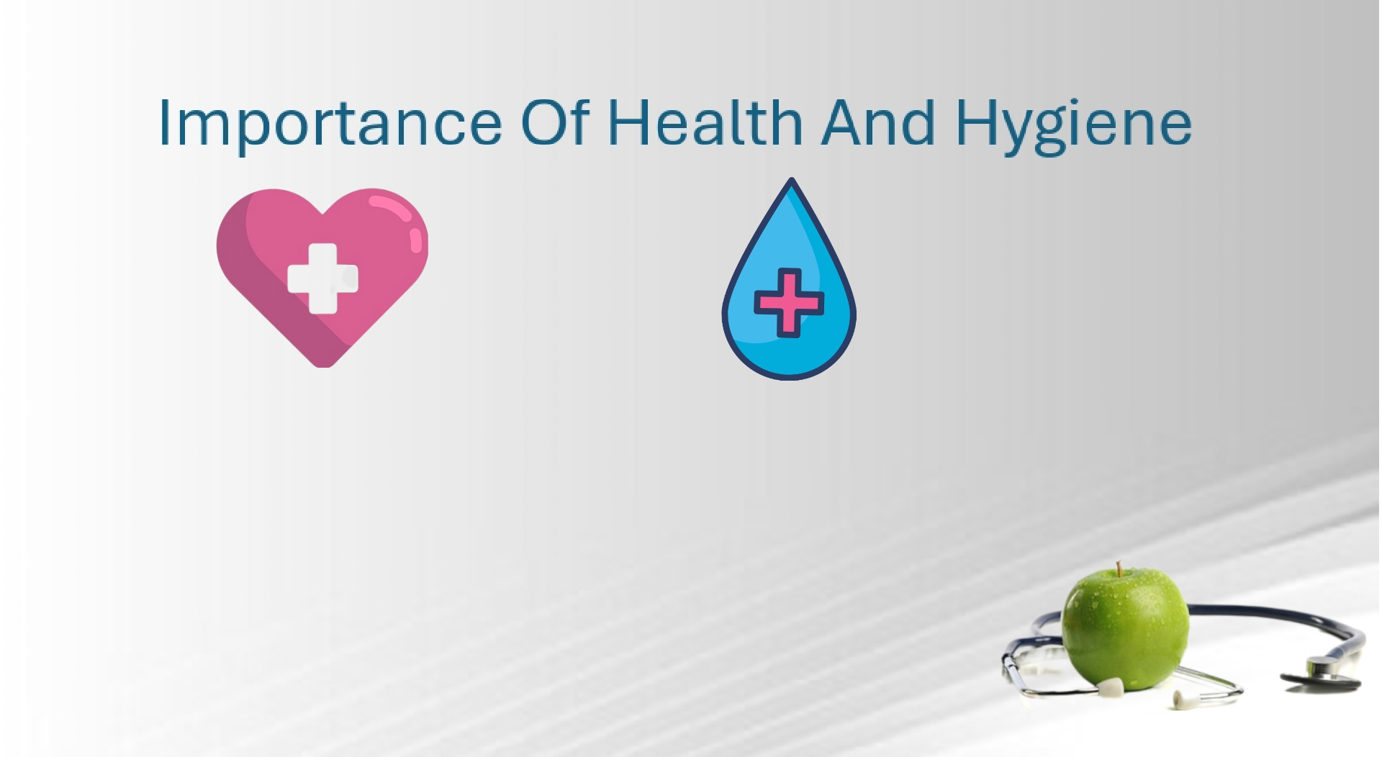
HEALTH HYGIENE
Good health is the
Key
to happiness
Hygiene is the
foundation
of healthy living

Slide 3

HEALTH
Good health is central to handling stress and living a longer, more active life. In this article, we explain the meaning of good health, the types of health a person needs to consider, and how to preserve good health.
Maintaining a Healthy Outlook
• Stay in touch with family and friends. • Be involved in your community.
• Keep your curiosity alive. ...
• Learn to recognize and manage stress
in your life.
• Maintain a positive attitude and do things
that make you happy.

Slide 4
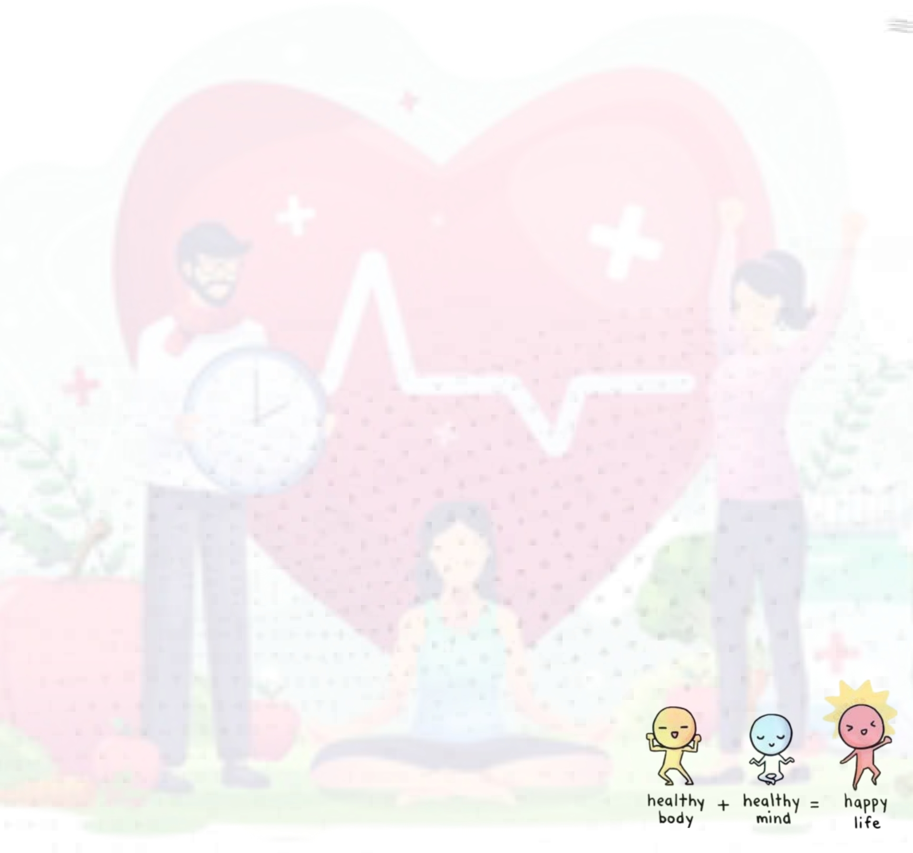
Why is health important?
Our health is very important for us and helps us remain fit. We should take proper care of our health in order to live a healthy life.
We should take proper care of our health in order to live a healthy life.
Staying healthy means we should have a healthy mind along with a healthy body as both are equally important.

Slide 5

Your health is one of the most important things in your life. It affects your physical, mental, and emotional well-being. That’s why it’s so important to be proactive about your health and take steps to prevent illness and disease. Being proactive in health means taking steps to improve your health before you get sick.
Health is important to us.

Slide 6

•This includes things like eating a healthy diet, exercising regularly, getting enough sleep, and managing stress. It also means getting regular check ups with your doctor.
There are many benefits to being proactive in health. By taking steps to prevent illness and disease, you can: • Live longer • Have a better quality of life • Reduce your risk of chronic diseases • Save money on healthcare costs

Slide 7


Is health important in workplace?
• Employee health refers to the overall well-being of employees in the workplace, encompassing physical, mental, emotional, financial, social, occupational, intellectual, and environmental health.
• It involves providing programs and services to promote a healthy and safe work environment, prevent illnesses and injuries, and support employees in maintaining their health and well-being.
• Employee health programs typically include health assessments, check-ups, and wellness initiatives like fitness programs, stress management, nutrition counseling, and financial planning.

Slide 8

HYGIENE
Many people equate hygiene with “cleanliness”, but hygiene is a broad term. It includes such personal habit choices as how frequently to take a shower or bath, wash hands, trim fingernails, and wash clothes. It also includes attention to keeping surfaces in the home and workplace clean, including bathroom facilities.

Slide 9

Importance of hygiene
Good personal hygiene helps stop you from getting sick and spreading germs.
Washing your hands often is a good way to stop the germs on your hands making you sick. Bathing or showering often helps prevent infections and body lice.

Slide 10

Hygiene food
Five keys to safer food manual
keep clean; separate raw and cooked; cook thoroughly; keep food at safe temperatures; and. Use safe water and raw materials.

Slide 11
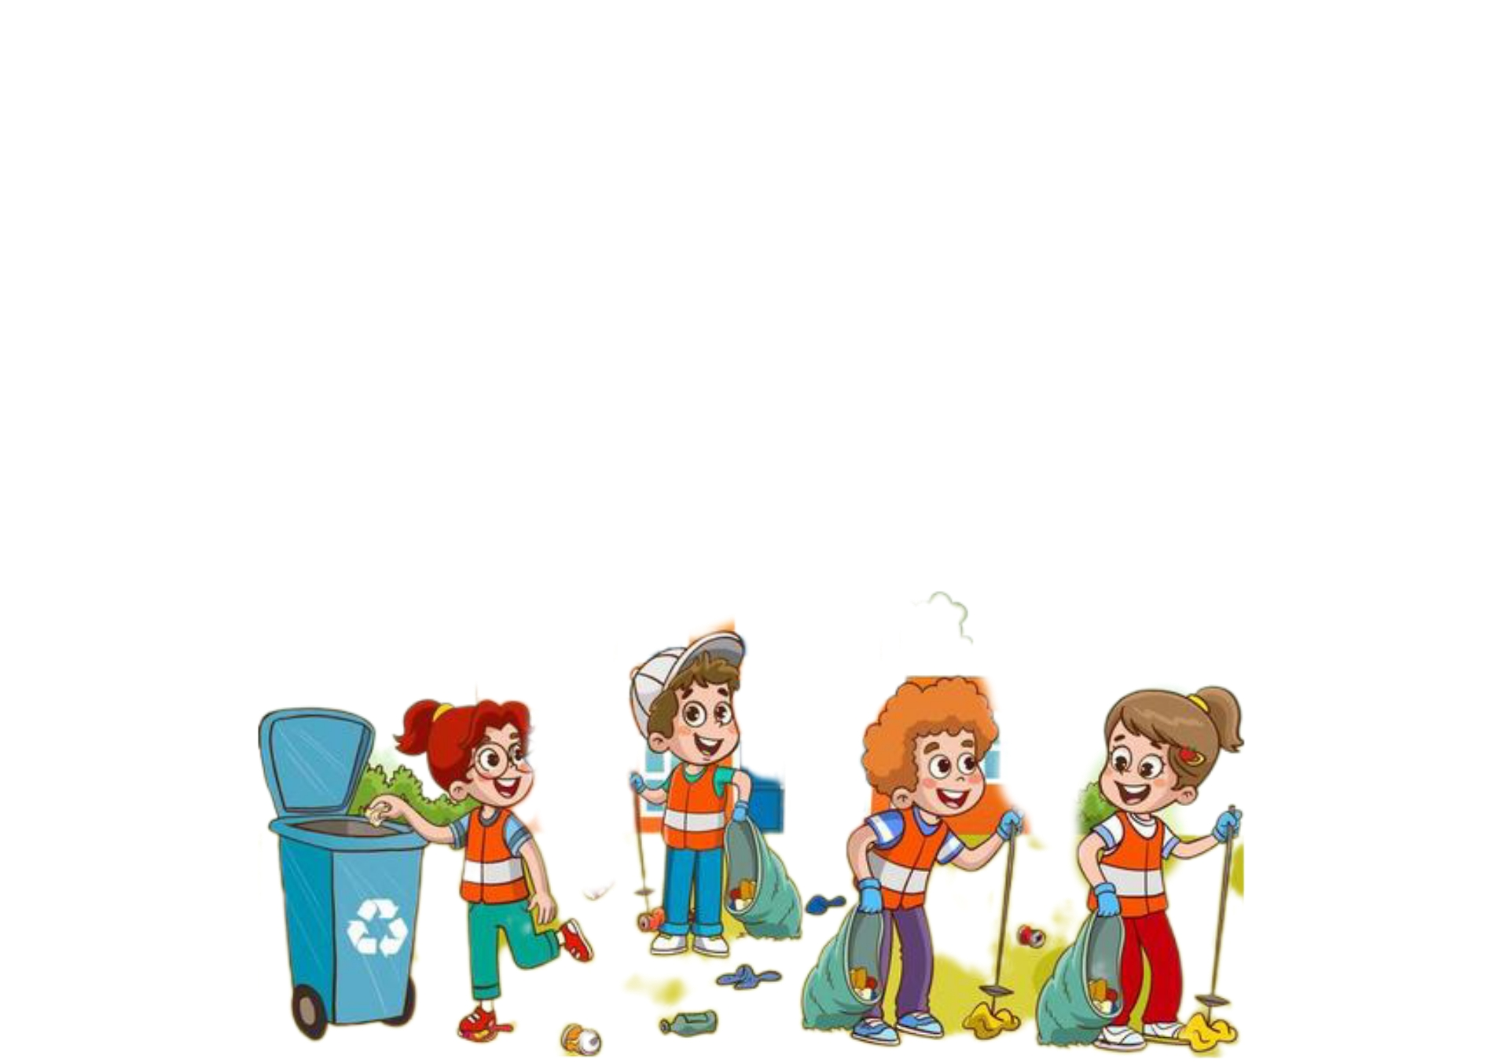
Hygiene in our surroundings
Always keep your home clean. Keep your toilet and kitchen germ free. There are highly effective kitchen gels available in the market that helps in cleaning and disinfecting multiple surfaces.

Slide 12


Practicing self hygiene
Personal hygiene includes:
• cleaning your body every day. • Washing your hands with soap and water after going to the toilet. • Brushing and flossing your teeth twice a day. • Covering your mouth and nose with a tissue (or your sleeve) when sneezing or coughing. • Washing your hands after handling pets and other animals.

Slide 13


