Slide 1

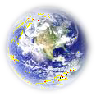

Solar Power!
Determining the amount of solar energy we can capture

Slide 2
Points to be cover….
Why do we need solar power..?
Problems with fossil fuels.
Climate change consequences.
Lack of natural resources.
Potential dangers of deforestation.
Solar energy around the world..
Solar energy close to home..
About half of the incoming solar energy reaches earth.
The amount of solar energy changes with LOCATION and TIME
How much solar energy do we have access to..?

Slide 3
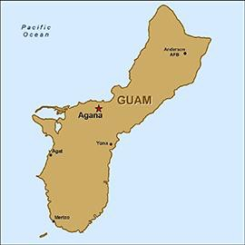
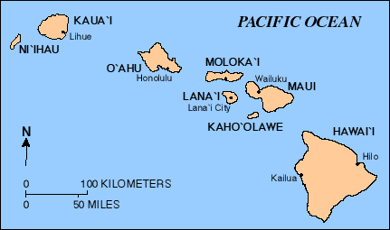
Why do we need solar power?
Many areas of the world don’t have access to fossil fuels.

Slide 4
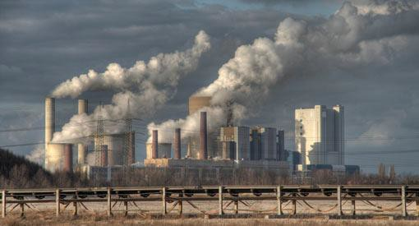
Problems with fossil fuels
Burning fossil fuels such as coal releases carbon dioxide and other greenhouse gases.
These gases trap more of the sun’s heat in our
atmosphere, causing climate change.

Slide 5
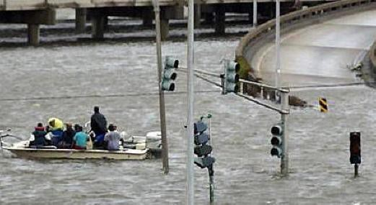
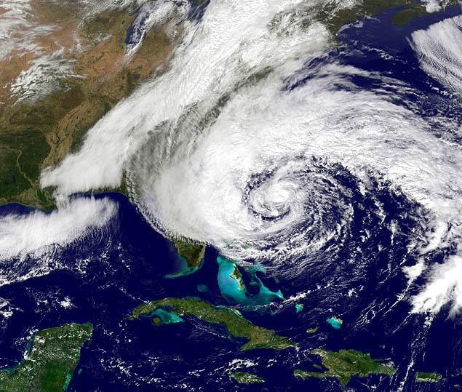
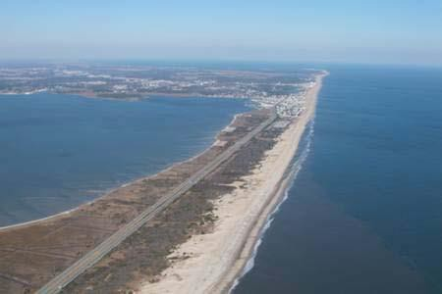
Climate change consequences
Climate change is responsible for . . .
More frequent flooding
More frequent severe storms
Rising sea levels

Slide 6
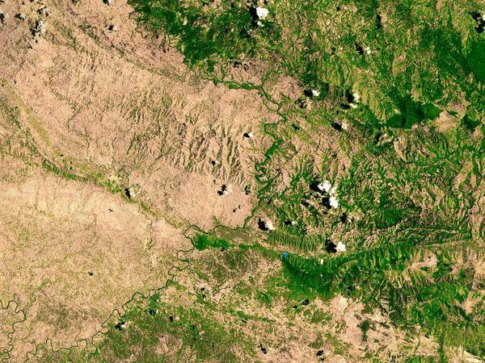
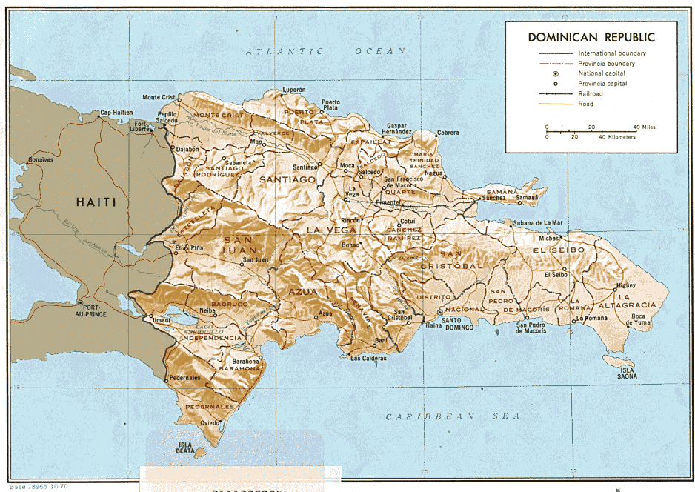
Lack of natural resources
Some countries have used up all of their natural resources.
Haiti allowed deforestation to provide wood for heat
The Dominican Republic did not

Slide 7
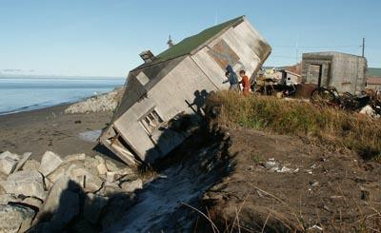
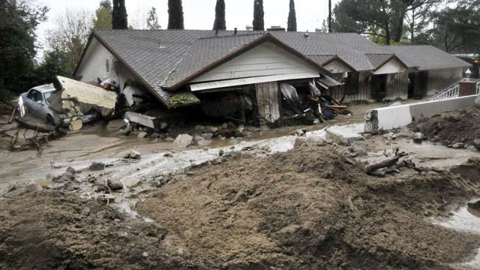
Potential dangers of deforestation
The loss of forests causes . . .
Erosion
Mudslides

Slide 8
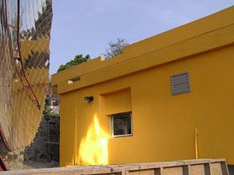
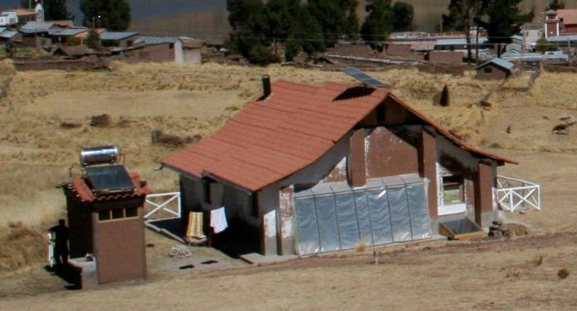

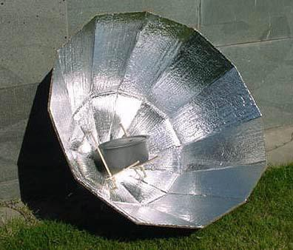
Solar energy around the world…
Solar water heater
Solar Dish Kitchen
Solar energy can also cook food
Trombe wall
Peruvian home with passive solar heating to heat the home and water , using a Trombe wall and solar water heater
Solar Oven

Slide 9
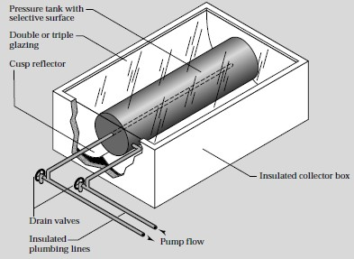
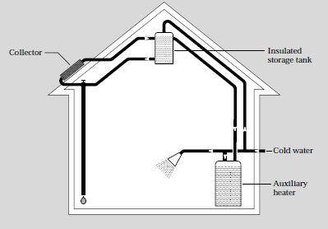
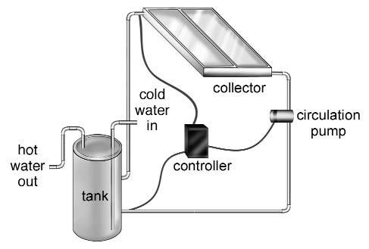
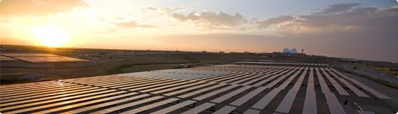
Solar energy close to home…
Solar Water Heaters heat water for domestic use
Batch Heater
Home Installation
Flat Plate Collector
Photovoltaic Panels – the National Renewable Energy Laboratory in Golden, CO researches efficient electricity production from solar energy

Slide 10









About half of the incoming solar energy reaches Earth
6% Reflect ed by atmosphere
20% Reflect ed by clouds
4% Reflect ed by
Earth’s surface
16% Absorbed by atmosphere
3% Absorbed by clouds
~51% reaches Earth’s Surface
🞷 Solar energy is measured as power per unit area (Watt/m²)

Slide 11
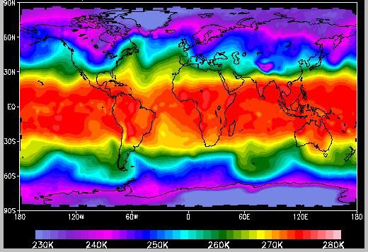
The amount of solar energy changes with
location…
Latitude
Temperature (in Kelvins)
Longitude

Slide 12











…and time
🞷 The location of the sun in the sky changes with the time o day AND the time of year
June 21
North
East
West
December 21
South

Slide 13


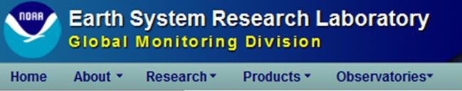
How much solar energy do we have access to?
🞷 First we need to know how to setup our flat plate solar module, such as a solar water heater
🞷 The solar module should be oriented South at an angle from the horizontal equal to the LATITUDE of solar collection (your location)
40.1º N
Example: Latitude of Boulder, Colorado is 40.1º so solar water heater is 40.1º from the ground facing South
W
S
E
🞷 Find Location and determine Latitude
🞷 We will use

Slide 14
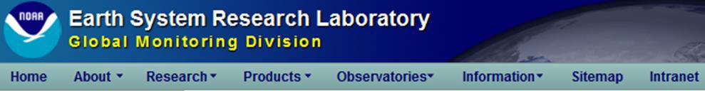
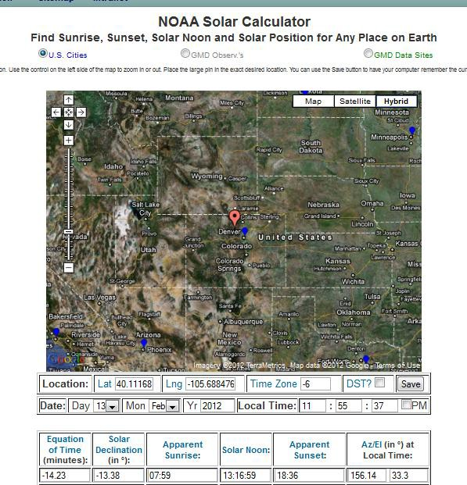

How much solar energy do we have access to?
🞷 We need to know:
🞷 Location: Latitude
🞷 Find this here: http://www.esrl.noaa.go v/gmd/grad/solcalc/
Red balloon

Slide 15
Thank you
Presented by team.
N.Lingesh
N.Mukhesh
K.V.Sai Karthik

