Slide 1


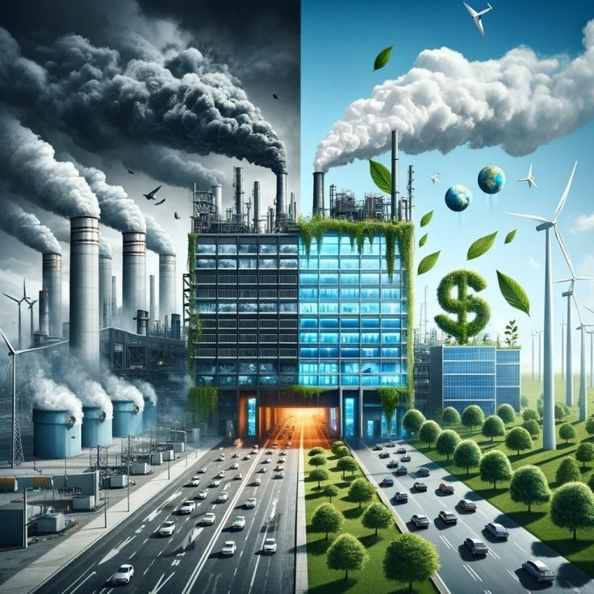
Name - koppolu Gowthami
Roll no- 239Y1A0475
Class - B Tech II Semester
Branch - ECE

Slide 2

OUTLINE
What is sustainability ?
What does eco-friendly mean ?
What are the principles of sustainability ?
What does a sustainable tourism mean ?
How to approach sustainable tourism ?
What are 5 P’s in sustainable tourism?
Benefits of sustainability ?
Conclusion

Slide 3

What is sustainability ?
Meeting our own needs without compromising the ability of future generations to meet their own needs. In addition to natural resources, we also need social and economic resources. Sustainability is not just environmentalism.

Slide 4

What does eco-friendly mean ?
According to Merriam-Webster, the official definition of eco-friendly is: “not environmentally harmful.
When it comes to products, that means everything from production to packaging needs to be considered safe for the environment. But the FTC has strict guidelines on eco-friendly claims, and here’s where it gets tricky: The FTC Green Guides say that in order for a product to be properly labeled as “eco-friendly,” the packaging must explain why it is environmentally responsible.

Slide 5
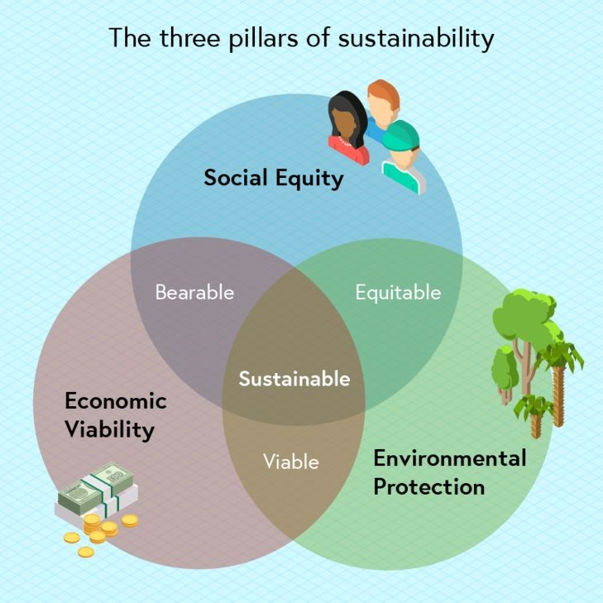
What are the principles of sustainability ?
1. Environmental Sustainability
2. Social Sustainability
3. Economic Sustainability

Slide 6

What does a sustainable tourism mean ?
The World Tourism Organization defines sustainable tourism as “tourism that takes full account of its current and future economic, social and environmental impacts, addressing the needs of visitors, the industry, the environment and host communities”.

Slide 7

How to approach sustainable tourism ?
It is about adopting a holistic and all-rounded approach in the tourism industry across the globe to minimise the adverse effects it can have on the environment and society and maximise its positive attributes.

Slide 8
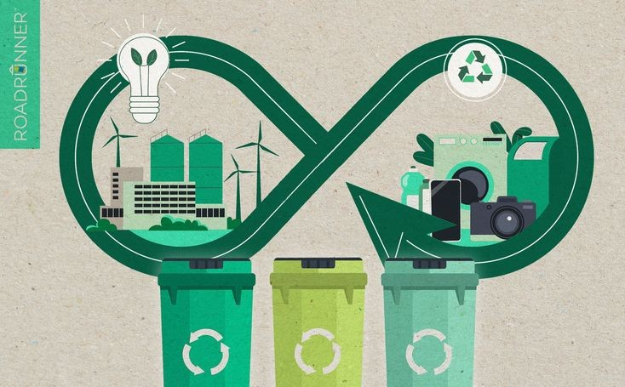
What are 5 P’s in sustainable tourism?
In its agenda for sustainable tourism, the United Nations identified 5Ps, People, Plants, Poverty, Prosperity and Peace, that need to be focused on for achieving the objective of sustainable development by 2030.

Slide 9
Benefits of sustainability!
Economically speaking, sustainable practices can create a healthier, safer and more productive environment. Socially, sustainable practices can help strengthen community bonds, improve quality of life and provide hope for a better future.

Slide 10

Conclusion
Ecotourism plays a significant role in promoting sustainable natural resource management by fostering environmental conservation, supporting local communities, and raising awareness about the importance of preserving fragile ecosystems.

Slide 11



