Slide 1
Impact on food issues on society: challenges and solutions

Slide 2
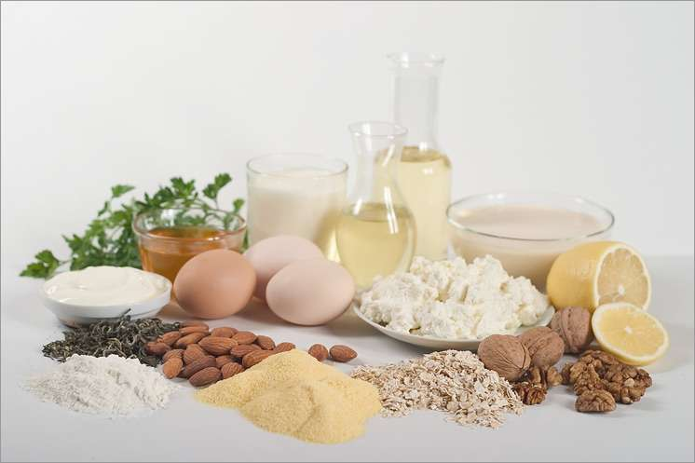
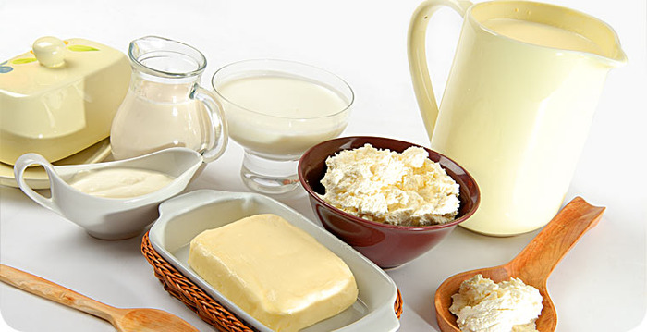
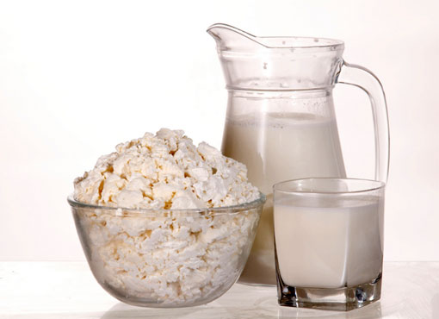
All food is made up of nutrients which our bodies use. There are different kinds of nutrients:
w Carbohydrates
w Proteins
w Fats
w Vitamins
w Minerals

Slide 3
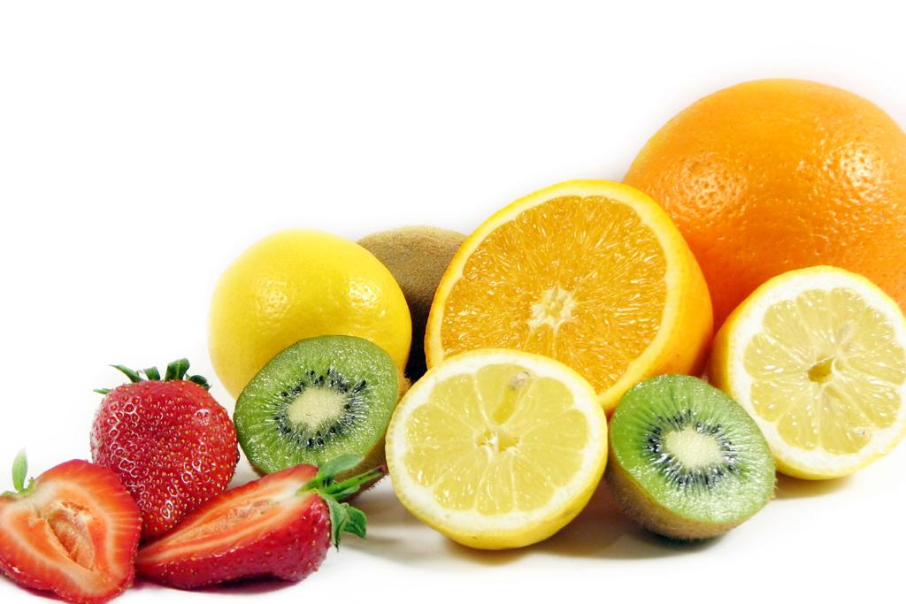
Different food contain different nutrients!

Slide 4
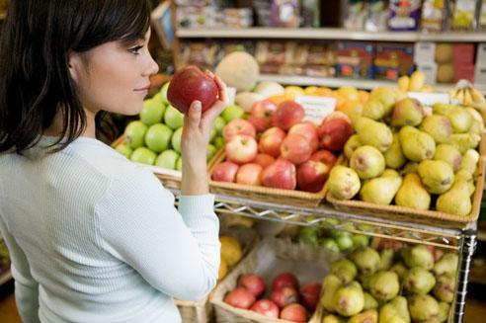
Before we cut down on fat, sugar and salt, we have to know a bit more about the kind of these things might be in.

Slide 5
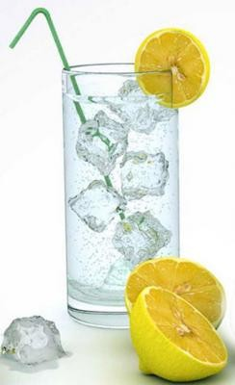
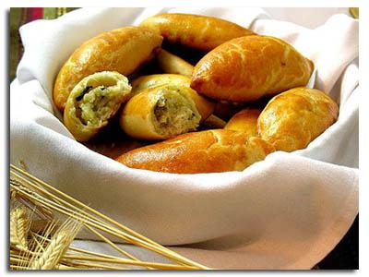

The biggest problem comes when these things are hidden in other foods: biscuits, crisps, sausages, meat pies, soft drinks and so on.

Slide 6

Another thing to know is, for example, that we do need fat to live, it’s an essential part of our diet and physically we couldn’t exist without it. But we all know that to eat much fat is bad for our health.

Slide 7
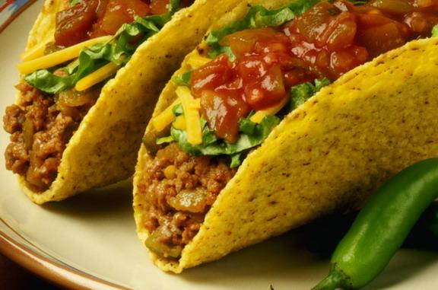
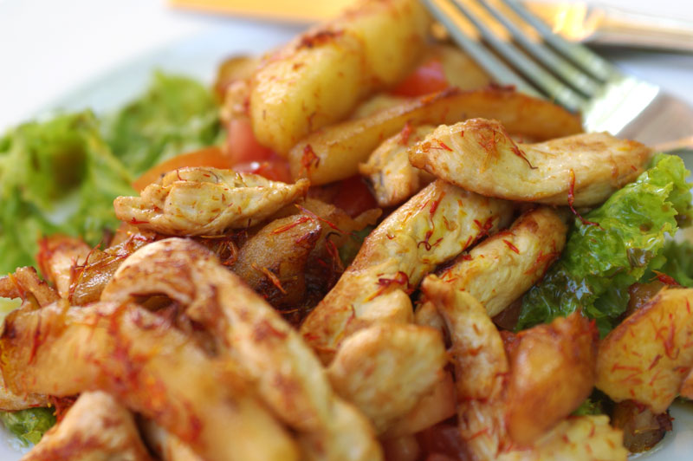
There are fats that are good for us and fats that are bad for us. Eating less of the bad ones and more of the good ones can actually help us to live longer!

Slide 8
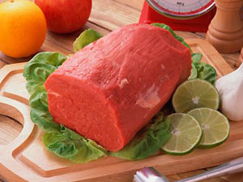

Bad fats, found in animal productions, like red meat, butter and cheese.

Slide 9
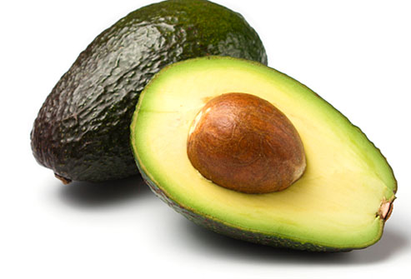
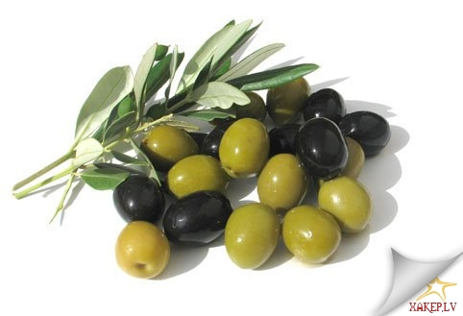
Friendly fats are fats found naturally in foods like nuts and seeds, olives, avocados and fish.

Slide 10
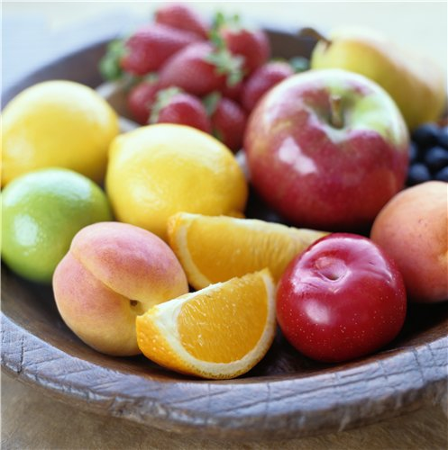
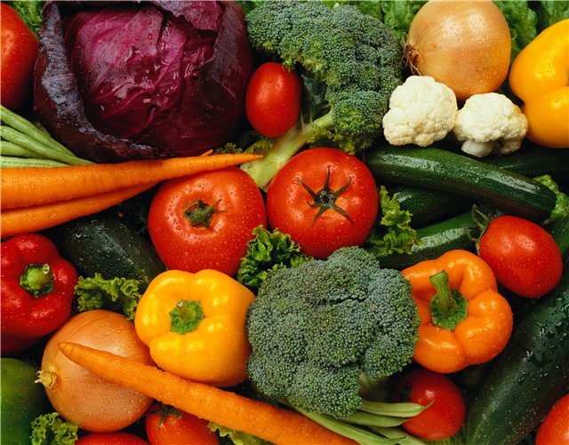
More and more people feel strongly about the way; their food is produced. Nowadays so much of the basic food we eat-meat, fish, fruit and vegetables - is grown using chemicals.

Slide 11
Today there is another problem. It is modified food, which is cheaper that ordinary one. There is a rumour that such food can cause cancer and other problems.

Slide 12
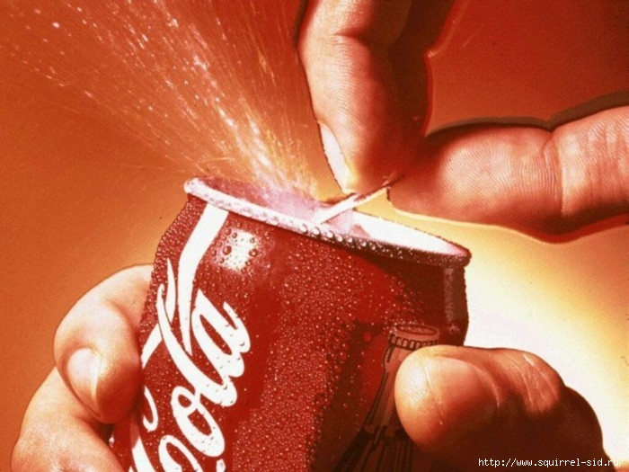
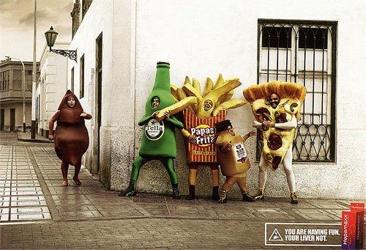
The food we eat depends on lots of things. Taste is a big factor. Culture, religion and health also play a part in what food we eat. Advertising and social factors also have a big influence.

Slide 13
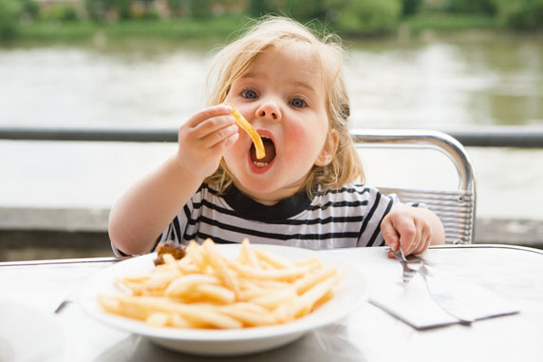
Finally, there are three main messages to follow for healthy eating:

Slide 14
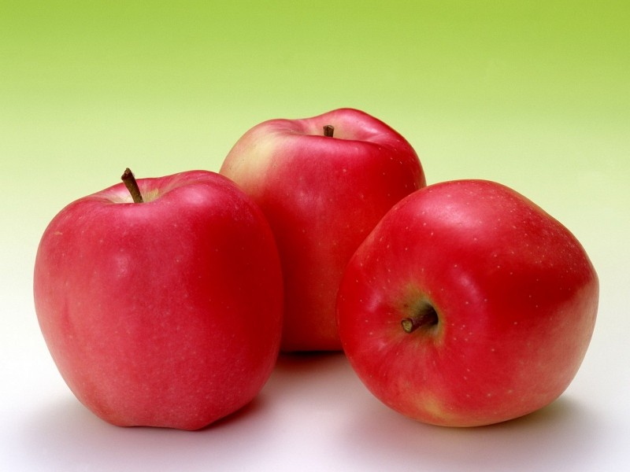
•Firstly, we should eat less fat.
• Secondly, we are to cut down on sugar and salt.
• Thirdly, we must eat more fresh fruit and vegetables.

Slide 15

BE HEALTHY

Slide 16
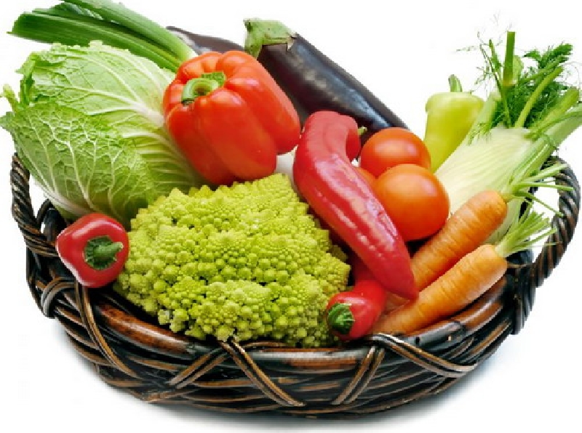
The end.
Urkina Sasha 8 A

