Slide 1


Miracle Institute of Leadership and Excellence
Introduction to UNIX and Putty
By
Satish Mongam
DB2 DBA
IBM Certified Database Associate
smongam@miraclesoft.com

Slide 2
Agenda
Overview of UNIX
UNIX Architecture
UNIX Directory Structure
UNIX Based Operating Systems
Overview if PuTTY

Slide 3


UNIX (UNiplexed Information and Computing System )‏
Unix is a computer operating system based on C language.
Originally developed in 1969 by Ken Thompson, Dennis Ritchie at AT&T Bell Labs.
Dennis Ritchie
Dennis Ritchie
Dennis Ritchie
Ken Thompson

Slide 4
Features of UNIX
Multi-User Operating System
Multi-Tasking Operating System
Portability
Job Control
Hierarchical Structure ( Single Root )‏
Case sensitive
Device Independence - Considers all devices connected to it as files.
Security

Slide 5
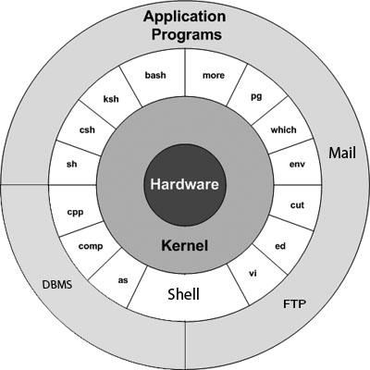
Unix Architecture

Slide 6
Kernel
It is the heart of the UNIX system.
Manages the system resources.
Communicates between hardware and software.
Also handles the scheduling and execution of commands.

Slide 7
Shell
It is a special program which provides you to interact with a UNIX system.
It gathers input from the user executes it and then displays output.
It is similar to the DOS shell , but it is much more powerful than any command interpreters.
It is also a powerful programming language, complete with conditional statements, loops, and functions.

Slide 8
Types of Shells
Bourne Shell (Default Prompt # Character)
  Bourne Shell ( sh )
  Korn Shell ( ksh )‏
  Bourne Again Shell ( bash )‏
  Posix Shell ( sh )‏
C Shell (Default Prompt % Character)‏
  C Shell ( csh )‏
  Tenex C Shell ( tesh )
Note that default prompt for a normal user of Bourne Shell & C Shell ‏is “$” Character.

Slide 9
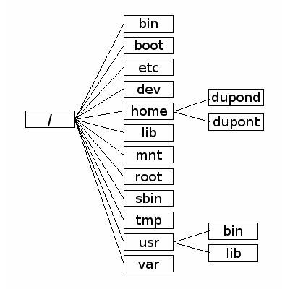
UNIX Directory Structure

Slide 10
The “ / “ Directory
The (“ / “) notes the "root" of the filesystem, where the entire system is contained.
Unlike Microsoft Windows, where each drive has its own root directory named by a letter, such as C:\ or F:\, Unix holds the entire system in this single top-level directory, including each device and document. Thus, it is commonly said that in Unix, everything is a file.
Unix uses the forward slash ( / ) rather than the backslash ( \ ) commonly used in Windows.

Slide 11
The /bin Directory
Stands for "binaries"; Contains commands that may be used by both the system administrator and by users such as ls, cp, mv etc.
The bin directory is where all the executable binaries were kept in early Unix.
Over time, as more and more executables were added to Unix, it became quite unmanageable to keep all the executables in one place and the bin directory split into multiple parts.
  /sbin
  /usr/bin

Slide 12
The /sbin Directory
Stands for "system (or "superuser") binaries".
Contains the essential System Binaries and System Administration tools essential for the system operation and performance such as init, usually needed to start, maintain and recover the system.
A normal user (not a system administrator) can not run directly these executables directly, must give the entire path. Eg:/sbin/ifconfig
If a normal user wants to run it directly, then it must be placed in one of the "bin" directories.

Slide 13
The /boot Directory
This directory contains all the important files which are required for the successful boot process.
It includes config files:
  Grub or Lilo
  initrd
  system.map

Slide 14
The /dev Directory
The /dev directory contains the essential system files and drivers.
  /dev/null -- Also known as the "bit bucket" or "black hole", this virtual file discards all contents written to it (but reports that the write operation succeeded).
  The null device typically used disposing of unwanted output streams of a process, or as a convenient empty file for input streams. This is usually done by redirection.

Slide 15
The /etc Directory
The etc directory is a storage place for all the administrative files and information.
Contains configuration files and directories that are specific to the current system. No binaries are to be put in /etc.
  /etc/hosts.[allow, deny]: you can control access to your network by using these files.
  /etc/profile : when a user logs in, a number of configuration files are executed, including /etc/profile. This file contains settings and global startup information for the bash shell.
  /etc/services : this configuration file maps port numbers to named services.

Slide 16
The /etc Directory cont ...
/etc/passwd : This file contains user information.
  Whenever a new user is added, an entry is added to this file containing the user's login name, password and so on.
  This file is readable by everyone on the system.
  If the password field contains "x", then encrypted passwords are stored in /etc/shadow, a file that is accessible only by the root user.
  root:x:0:0:root:/root:/bin/bash
  miracle:x:500:500::/home/miracle:/bin/bash

Slide 17

The /home Directory
All the user home directories are held under this directory with the exception of the root home directory which is kept under /root directory.
This directory holds users files, personal settings like .profile etc.
On some Unices, this is under /usr/home.

Slide 18
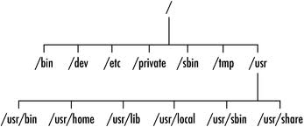
The /usr Directory
It is the second major section of the file system.
It is shareable, read-only data.
It should be shared with other machines with the same architecture and operating system version, and most of the root directory structure is mirrored here.

Slide 19
The /usr Directory cont ...
Originally the directory holding user home directories.
Its use has changed, and it now holds executables, libraries, and shared resources that are not system critical, like the X Window System, KDE etc.
However, on some Unix systems, some user accounts may still have a home directory that is a direct subdirectory of /usr, such as the default ast in Minix.

Slide 20
The /var Directory
/var -- Short for "variable." A place for files that may change often, such as the storage to a database, the contents of a database, log files (usually stored in /var/log), email stored on a server, etc.
/var/log -- Storage for the system log files.
/var/mail -- The place where all the incoming mails are stored. The user can access his/her own mail only unless he/she has admin rights.
/var/spool -- Contains print jobs, mail spools and various other tasks that have been queued , waiting for some related task to finish.

Slide 21
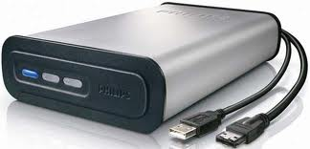
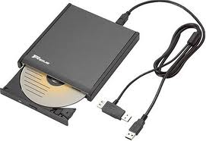
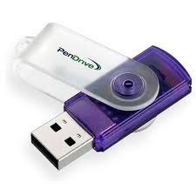
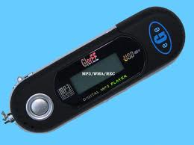
The /media Directory
A default mount point for removable devices.
Eg: CD-ROM, USB, External Hard Disks etc.

Slide 22
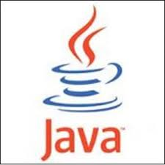





The /opt Directory
/opt is reserved for the installation of add-on application software packages.
A package to be installed in /opt must locate its static files in a separate /opt/<package> directory tree, where <package> is a name that describes the software package.

Slide 23
Other Directories
/lib – The /lib directory should contain only those libraries that are needed to execute the binaries in /bin/ and /sbin/.
  These shared library images are particularly important for booting the system and executing commands within the root file system.
/proc – The /proc/ directory contains special files that either extract information from or send information to the kernel.
/tmp – The tmp directory contains temporary files created by Unix system programs.
  It is recommended that files and directories located in /tmp be deleted whenever the system is booted.

Slide 24
UNIX Based Operating Systems
Linux
HP-UX
Sun Solaris
AIX
Free BSD
MINIX

Slide 25
PuTTY
PuTTY is an SSH, telnet and Rlogin client, developed originally by Simon Tatham for the Windows platform.
These protocols are all used to run a remote session on a computer, over a network.
PuTTY implements the client end of that session: the end at which the session is displayed, rather than the end at which it runs.
Pageant is an SSH authentication agent. It provides authentication to PuTTY.
If you run PuTTY on a Windows machine:
  It to connect to a Unix machine. PuTTY opens a window.
  Then, anything you type into that window is sent straight to the Unix machine, and everything the Unix machine sends back is displayed in the window.
  So you can work on the Unix machine as if you were sitting at its console, while actually sitting somewhere else.

Slide 26
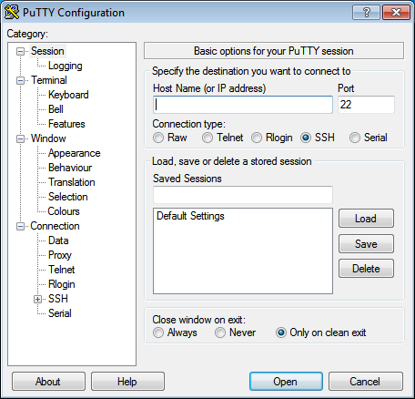
PuTTY cont ...
It’s light-weight with a single putty.exe file and nothing else to install.
PuTTY is open source software that is available with source code and is developed and supported by a group of volunteers.

Slide 27


Any Queries ...

Slide 28
Thank Q

