Slide 1


Miracle Institute of Leadership and Excellence
File Permissions
By
Satish Mongam
DB2 DBA
IBM Certified Database Associate
smongam@miraclesoft.com

Slide 2
Agenda
Viewing Permissions
Basic Permissions
Owner, Group & Other Permissions
Directory Permissions
Tips for a Basic File Security
Changing File and Directory Permissions
Symbolic Method
Octal Method

Slide 3
File Permissions - Viewing Permissions
You can display the permissions of a file using the ls -l command.
$ ls -l /root
produces the following output:
-rw-r--r-- 1 root root 933 Mar 11 2009 abc.log
drwxr-xr-x 5 root root 4096 Jul 29 22:22 Desktop
1. Permissions
7. File Name
3. Owner
5. Size
6. Last Modified
Date/Time
1. File Type
2. No of Links
4. Group

Slide 4
Basic Permissions
Letter | Permission | Definition
r | Read | The user can view the contents of the file.
w | Write | The user can alter the contents of the file.
x | Execute | The user can run the file, which is likely a program. For directories, the execute permission must be set in order for users to access the directory.

Slide 5
Owner, Group & Other Permissions
- rw- r-- r-- 1 root root 933 Mar 11 2009 abc.log
d rwx r-x r-x 5 root root 4096 Jul 29 22:22 Desktop
Owner
Others
Group

Slide 6
Directory Permissions
”x” bit: Grants access to the directory. The read and write permissions have no effect if the access bit is not set.
Read (r): Enables users to use the “ls“ command to view files and their attributes that are located in the directory.
Write (w): Enables users to add and also remove files from the directory.
Execute (x): Only execute permission will not enable the user to view the contents of the directory or add or delete any files from the directory, but it will let the user run executable files located in the directory.

Slide 7
Tips for a Basic File Security
If a file has write permission for owner, group, and other, the file is insecure.
If a file is in a directory that has write and execute permissions for owner, group, and other, all files located in the directory are insecure, no matter what the permissions on the files themselves are.

Slide 8
Changing File and Directory Permissions
Use chmod command.
Syntax: chmod expression files
Here, expression is a statement of how to change the permissions. This expression can be of the following types:
  Symbolic: The symbolic expression method uses letters to alter the permissions,
  Octal: The octal expression method uses numbers. The numbers in the octal method are base-8 (octal) numbers ranging from 0 to 7.

Slide 9
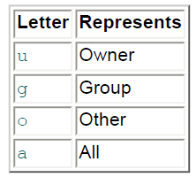
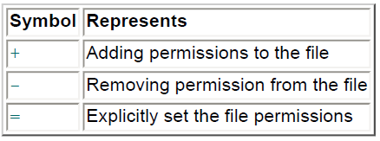
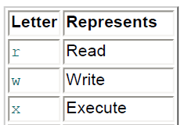
Symbolic Method
The symbolic expression syntax:
chmod (who)(action)(permissions)
Who
Action
Permissions

Slide 10
Symbolic Method cont ...
To give the "world" read access to all files in a directory:
$ chmod a=r * or $ chmod guo=r *
If the command is successful, it produces no output.
To stop writing to a file anyone except the owner:
$ chmod go-w wmb.log
To deny access to the files in your home directory:
$ cd ; chmod go= * or $ cd ; chmod go-rwx *
When specifying the users part or the permissions part, the order in which you give the letters is irrelevant.
Thus these commands are equivalent:
$ chmod guo+rx *
$ chmod uog+xr *

Slide 11
Symbolic Method cont ...
If you need to apply more than one set of permissions changes to a file or files, use a comma separated list:
$ chmod go-w,a+x a.out
  removes the groups and "world" write permission on a.out and adds the execute permission for everyone.
To change permissions for every file in a directory including the files in subdirectories, use the -R option.
$ chmod -R o+r pub
Be careful when doing this to large subtrees because you can change the permissions of a file in a way that you did not intend.

Slide 12
Octal Method
This method uses a single number to assign the desired permission to each of the three categories of users (owner, group, and other).
The values of the individual permissions are the following:
  Read permission has a value of 4
  Write permission has a value of 2
  Execute permission has a value of 1
Give a number between 0 – 7 to grant permissions.
This number will be used to specify the permissions for the owner, group, and finally the other category.
You should specify permissions to all the three categories, can't give permissions to a single category.
To set the "world" read access to all files in a directory, do this: chmod 444 *

Slide 13
Octal Method cont ...
The most important thing to keep in mind is that the octal method sets or assigns permissions to a file, but it does not add or delete them.
This means that the octal mode does not have an equivalent to
chmod u+rw a.out
The closest possible octal version would be
chmod 600 a.out
But this removes permissions for everyone except the user.
It will also reduce the user's permissions by removing the execute permission.

Slide 14


Any Queries ...

Slide 15
Thank Q

