Slide 1


Miracle Software Systems, Inc.
UNIX Text Editors
By
Satish Mongam
DB2 DBA
IBM Certified Database Associate
smongam@miraclesoft.com

Slide 2
Agenda
Editors
Text Editors
Types of Text Editors
vi Editor

Slide 3
Editors
Editing text is the most common task you'll use in your day-to-day work.
There are two types editors.
  Text Editors: It creates Plain Text Files
    vi Editor
    Notepad
    Notepad++ etc.
  Word Processors: It creates Word Documents
    Microsoft Word
    OpenOffice
    WordPerfect etc.

Slide 4
Text Editors
A text editor is a type of program used for editing plain text files.
Text editors are often provided with operating systems or software development packages, and can be used to change configuration files and programming language source code.
Basic Features of Text Editors :
  String Search
  Cut, Copy and Paste
  Line Wrap
  Line Numbering
  Syntax Highlighting

Slide 5
Types of Text Editors
S.NO | Editor Name | Operating System
1. | vi or VIM Editor | Unix Based Operating Systems
2. | Emacs Editor | Unix Based Operating Systems
3. | gedit | Linux
4. | Notepad | Microsoft Windows
5. | SimpleText | Apple Macintosh's Classic Mac OS
6. | TextEdit | Mac OS X

Slide 6
vi Editor
vi is short for visual editor and is pronounced “vee-eye”.
The vi editor is one of the most common plain text editors available on every Modern Unix system.
The original code for vi was written by Bill Joy in 1976 in C language.
The main code was released in May, 1979.
vi is used to create and edit ASCII files, which can be used in variety of situations like:
  Creating shell scripts
  Mail messages
  Source codes
  Editing UNIX systems files etc.

Slide 7
Advantages of vi
vi is universally available on Unix systems. Many clones have been written for other kinds of computers.
vi has many powerful commands that utilize just the alphanumeric keys -- it does not require special function keys.
vi is a small program that does not require a lot of system memory or CPU time.
It works very fast, even on large files.
vi is completely terminal device independent. It will work with any kind of terminal.

Slide 8
vi Modes
vi has two modes: Command Mode, and Insert Mode.
Command Mode:
  This is the initial or default mode.
  Complex, interactive edits can be performed with only a few keystrokes.
  Everything you type on the keyboard gets interpreted by vi as a command.
  You can switch to command mode from insert mode by pressing the Esc key on your keyboard
Insert Mode:
  You can switch to insert mode from command mode by pressing the (i) key on your keyboard.
  Everything you type on the keyboard gets interpreted as characters and will appear in your file--letters, numbers, punctuation, etc.

Slide 9
Getting start with vi editor
vi is the Unix command that invokes the vi editor for an existing file or for a brand new file.
The syntax for the vi command is:
$vi [filename] – Syntax
$vi sample.txt – Example
Note that you must type the command with lower case letters.

Slide 10
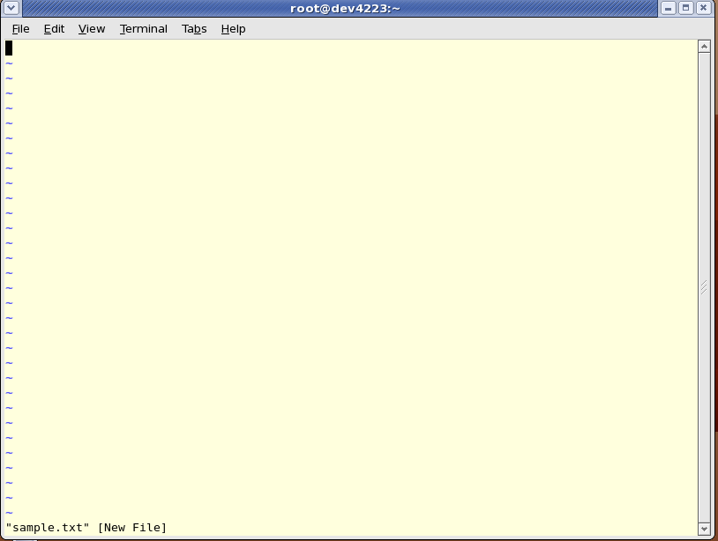
Getting start with vi editor – Command Mode

Slide 11
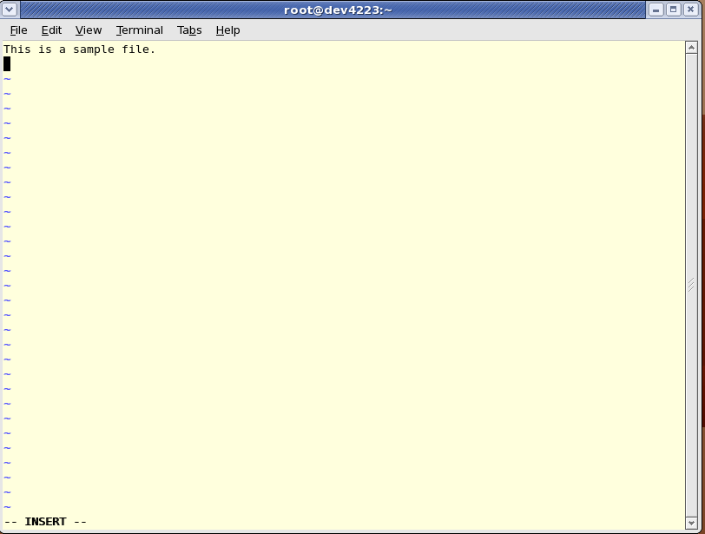
Getting start with vi editor – Insert Mode

Slide 12
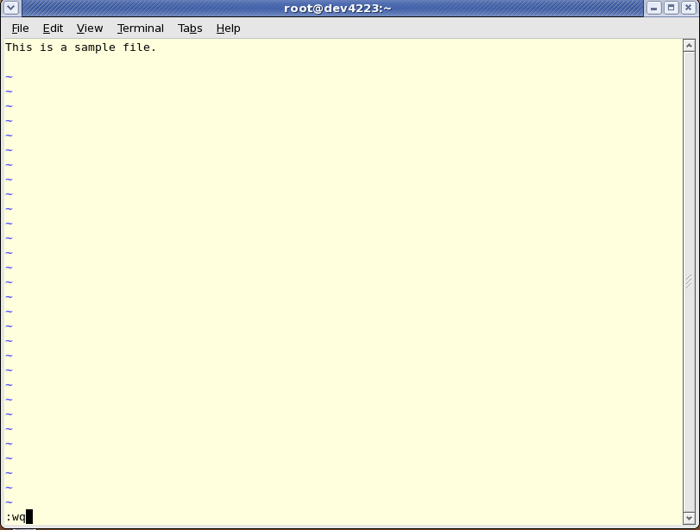
Getting start with vi editor – to save & quit

Slide 13
Things to Do!
Start vi.
Exit from vi.
Moving the Cursor.
Screen Manipulation.
Cut, Copy and Paste.
Search and Replace Text.
Getting/Forwarding Text from/to Other Files.

Slide 14


Any Queries ...

Slide 15
Thank Q

