Slide 1


Miracle Institute of Leadership and Excellence
Cron Jobs
By
Satish Mongam
DB2 DBA
IBM Certified Database Associate
smongam@miraclesoft.com

Slide 2
Agenda
What is Cron Job
Cron Job Command
Cron Job File
Default Paths
Setting up Crob Jobs
Restrictions
Disable e-mail
Points to remember

Slide 3
What is a Cron Job
Cron is a Unix, Linux, Solaris utility that allows tasks to be automatically run in the background at regular intervals by the cron daemon.
Cron: The name cron comes from the word chronograph (a time-piece)‏.
Daemon: It is a program that run in the background process.
CRON is active from the time the computer is turned on.

Slide 4
Cron Job Command
Cron jobs are scheduled by the user using a command called “crontab”.
crontab Command Arguments:
$crontab -e to edit crontab files
-r to remove crontab file
-l to display crontab file
-v to display last time modified

Slide 5
Cron Job File
A Cron Job file has five fields for specifying day, date and time followed by the command to be run at that interval.
* * * * * cp /home/miracle/*.log /home/miracle/backups
5 * 15 * * sh /home/miracle/backup.sh
First - * : indicates the minutes : 0 – 59
Second - * : indicates hours : 0 – 23
Third - * : indicates days : 1 – 31
Fourth - * : indicates months : 1 – 12
Fifth - * : indicates weekdays : 0 – 6 (Sunday to Saturday)

Slide 6
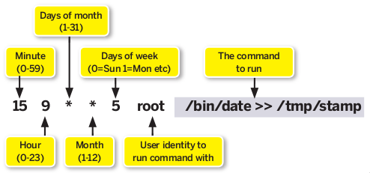
Cron Job File cont ...

Slide 7
Default Path Of Cron Job
The default path for a Cron Job is /var/spool/cron/.
If a user namely miracle saved any Cron Jobs, a file called “miracle” will be created in /var/spool/cron/.
Eg : /var/spool/cron/miracle.
There is only one file exists for each user with the same user name in /var/spool/cron/.
This file contains all the jobs for that user.
If the user deletes all his jobs the file which appears in /var/spool/cron/ for that user will automatically deleted.

Slide 8
Cron Job Restrictions
The user can execute crontab if your name appears in the file /usr/lib/cron/cron.allow.
If that file does not exist, the user can run Cron Job if the user name does not appear in the file /usr/lib/cron/cron.deny.
If only cron.deny exists and is empty, all users can run Cron Jobs.
If neither file exists, only the root user can run Cron Jobs.
The allow/deny files consist of one user name per line.

Slide 9
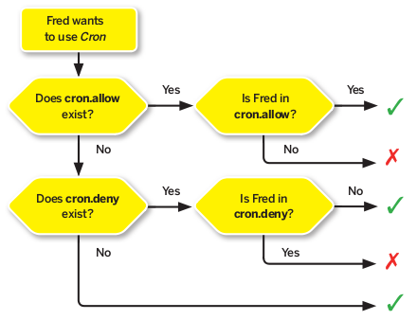
Cron Job Restrictions

Slide 10
Setting up Cron Jobs
There two methods to set a Cron Job.
1. Direct Method:
Step-1: Open a terminal and give the below command:
$crontab -e
It will Creates and Opens a Cron Job file for that User in the /var/spool/cron/ location with the same user name.
For example if a user called miracle runs the command, a file called “miracle” will create in that location.
Step-2: Set your job in the file then Save and Quit .
5 * 10 * * cp /home/miracle/*.log /home/miracle/backups
Step-3: To list the saved cron jobs, use the below command:
$crontab -l
To add more jobs to that file use crontab -e command again.

Slide 11
Setting up Cron Jobs cont ...
2. Indirect Method:
Step-1: Open a terminal and create a file.
$vi miracle.cron
Step-2: Set your job in the file then Save and Quit.
* * * * * cp /home/miracle/*.log /home/miracle/backups
Step-3: Run the file by using crontab Command.
crontab miracle.cron
After running the file, it will Creates Cron Job file for that User in the /var/spool/cron/ location with the same user name.
Step-4: To list the saved cron jobs, use the below command:
$crontab -l
To add more jobs to that file use crontab -e command or follow the same steps starting form the Step-1 again.

Slide 12
Disable e-mail option
By default cron jobs sends a email to the user account executing the cronjob.
If this is not needed put the following command At the end of the cron job line.
>/dev/null 2>&1
* * * * * sh /home/miracle/backup.sh > /dev/null 2>&1

Slide 13
Points to Remember
Press ENTER key after every Cron Job.
You can terminate each job terminates by pressing ENTER key at the end of the job.
Make sure that a blank line will be there at the end of the file.
Always use absolute path for the command line.
Turn off the ‘Word Wrap’ feature with the Notepad.

Slide 14


Any Queries ...

Slide 15
Thank Q

