Slide 1
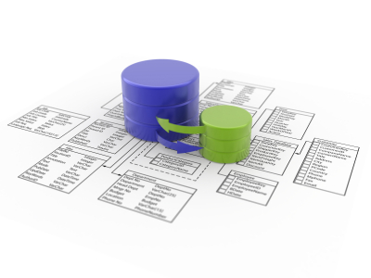

Miracle Institute of Leadership and Excellence
Introduction to DB2 Database
By
Satish Mongam
DB2 DBA
IBM Certified Database Associate
smongam@miraclesoft.com

Slide 2
Agenda
Database Basics
SQL
DB2 Environment
Constraints
Functions
Operators
Views
Index
Generating Automated Values

Slide 3
The Importance of a Database
Organisations must track information about people including employees, clients, potential donors, current donors, event attendees.
Managing this information is crucial.
A database allows you to manage and use an incredible variety of information easily.

Slide 4
Introduction to Database Systems
Data: Activities that are need to be recorded is known as Data.
Database: A database is a collection of information organized into interrelated objects like table spaces, tables, and indexes. It must provide proper storage for large amounts of data, easy and fast access and facilitate the processing of data.
DBMS (Database Management System): DBMS is a set of software that is used to define, store, manipulate and control the data in a database.

Slide 5
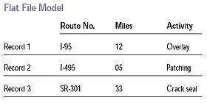
Evolution of Database Modeling - Flat File Model

Slide 6
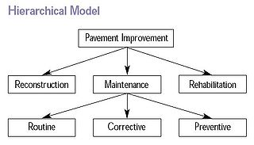
Evolution of Database Modeling - Hierarchical Data Model

Slide 7
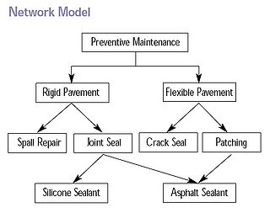
Evolution of Database Modeling - Network Model

Slide 8
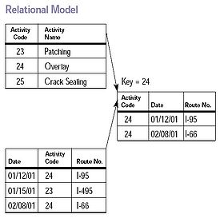
Evolution of Database Modeling - Relational Model

Slide 9

Relational Model cont ...
Edgar Frank "Ted" Codd (August 23, 1923 – April 18, 2003) was a British computer scientist who, while working for IBM, invented the relational model for database management.

Slide 10





Popular RDBMS Vendors

Slide 11
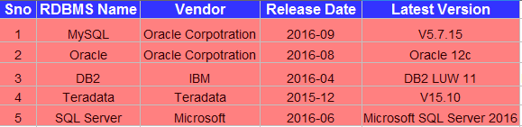
Latest Versions of RDBMS Vendors

Slide 12
DB2 Versions
"DB2" was used to indicate a shift from hierarchical databases - such as the Information Management System (IMS) popular at the time - to the new relational databases.
IBM recognized early on the importance of XML and it released of the first hybrid data server in the market: DB2 9.
DB2 9.1, available since July 2006, is a hybrid (also known as multi-structured) data server because it allows for storing relational data, as well as hierarchical data, natively.
In 2007, IBM released DB2 9.5.
Note as well that there is no DB2 9.2, DB2 9.3 or DB2 9.4. The version was changed from DB2 9 directly to DB2 9.5 to signify major changes and new features in the product.

Slide 13
Code Names
Before a new version of DB2 is publicly available, a code name is used to identify the product.
Once the product is publicly available, the code name is not used.
DB2 9 had a code name of "Viper", DB2 9.5 had a code name of "Viper 2", DB2 9.7 had a code name of "Cobra", DB2 10 had a code name “Galileo” and DB2 LUW 11 has a code name “Kepler” .
Some references in published articles may still use these code names.

Slide 14
DB2 Environment
Instance
Database
Bufferpool
Logs
Syscatspace
Tempspace1
Userspace1
Table1
Table2

Slide 15
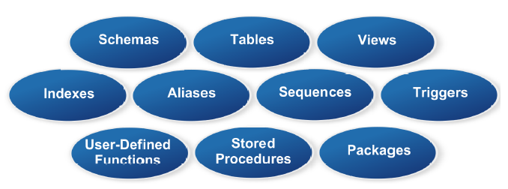
Database Objects

Slide 16
Data Types in DB2
SMALLINT
INT
BIGINT
CHAR
VARCHAR
BLOB
CLOB
DATE
TIME
TIMESTAMP
DECIMAL

Slide 17
Structured Query Language (SQL)
The word SQL came from Structured English QUEry Language or SEQUEL.
DB2 is considered first database product to use SQL (also developed by IBM in 1970s) although Oracle released a commercial SQL database product somewhat earlier than IBM.
SQL is a standard language for accessing and manipulating databases.
According to ANSI (American National Standards Institute), it is the standard language for relational database management systems.
SQL statements are used to perform tasks such as update data on a database, or retrieve data from a database. Some common relational database management systems

Slide 18
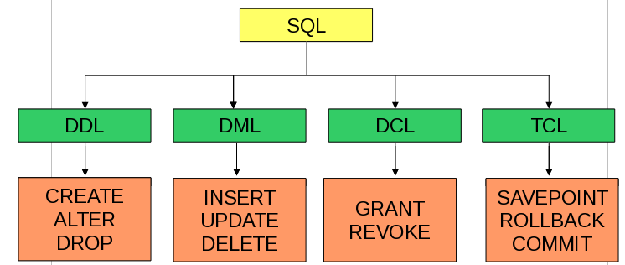
Structured Query Language cont ...

Slide 19
Database Constraints
The data can be restricted before inserting into the table.
Types of Constraints
  Not Null
  Unique
  Primary Key
  Foreign Key
  Check
  Default

Slide 20
DB2 Basics
  Version : DB2/Linux Client V9.1
  Connection : Open A terminal and type
  Syntax:
  db2 connect to <db name> user <user name> using <pass word>
  Example:
db2 connect to mcadb user miracle using miracle
  The key word db2 should add for each and every statement and it should be in lower case only.
  Except db2 remaining all the SQL statements should be in Double quotes.
  db2 “select * from miracle.emp”

Slide 21
Creating DB Objects
  Create all the object with a sql file.
  The file name should contain extension of .sql.
  With in the file every statement should be end with a semicolon(;).
  After creation run that file by the below command
  db2 -tvf staff_table.sql

Slide 22
Sample Script
DROP TABLE EDIDB2A.T_LKP_COMM_PAYER;
CREATE TABLE EDIDB2A.T_LKP_COMM_PAYER (
IN_PAYER_ID VARCHAR(5) NOT NULL,
IN_CLM_OFF_NO VARCHAR(5) NOT NULL,
OUT_PAYER_ID VARCHAR(5),
OUT_CLM_OFF_NO VARCHAR(6)
)IN TBSP_LKP INDEX IN TBSP_INDEX ;
ALTER TABLE EDIDB2A.T_LKP_COMM_PAYER ADD CONSTRAINT X_T_LKP_COMM_PAYER PRIMARY KEY (IN_PAYER_ID,IN_CLM_OFF_NO);

Slide 23
The SELECT Statement
  The most commonly used SQL command is SELECT statement.
  The SQL SELECT statement is used to query or retrieve data from a table in the database.
  A query may retrieve information from specified columns or from all of the columns in the table.
  To create a simple SQL SELECT Statement, you must specify the column(s) name and the table name.
  The whole query is called SQL SELECT Statement.
  Example:
  db2 “select name from emp”
  db2 “select * from emp where name='satish'”

Slide 24
The SELECT Statement cont ...
  The statement begins with the SELECT keyword. The basic SELECT statement has 3 clauses:
* SELECT
* FROM
* WHERE
  The SELECT clause specifies the table columns that are retrieved.
  The FROM clause specifies the tables accessed.
  The WHERE clause specifies which table rows are used. The WHERE clause is optional; if missing, all table rows are used.

Slide 25
OPERATORS
MATHEMATICAL
OPERATORS
COMPARISION
OPERATORS
LOGICAL
OPERATORS
SPECIAL
OPERATORS
MATHEMATICAL OPERATORS
OPERATOR OPERATOR NAME
1. + Addition
2. - Subtraction
3. / Division
4. * Multiplication
COMPARISION OPERATORS
OPERATOR OPERATOR NAME
1. = Equal to
2. > Greater than
3. < Less than
4. >= Greater than or equal to
5. <= Lesser than or equal to
6. <> Not equal to

Slide 26
Database Scripts
LOGICAL OPERATORS:
  AND – OR – NOT
SPECIAL OPERATORS / Predicates:
  IN – LIKE – BETWEEN – NULL – EXISTS
SELECT * FROM DEPT WHERE DEPTNO IN (10,20,30);‏
SELECT DEPTNO,EMPNO,ENAME FROM EMP WHERE DEPTNO LIKE 'SC%'
SELECT EMPNO,SAL FROM EMP WHERE SAL BETWEEN 2000 AND 3000
SELECT EMPNO,SAL,COMM FROM EMP WHERE COMM IS NULL;
SELECT id, job FROM staff a WHERE EXISTS (SELECT * FROM staff b WHERE b.id = a.id 20 AND b.id < 50);

Slide 27
BUILT IN FUNCTIONS
1) CHARACTER FUNCTIONS
2) NUMERIC FUNCTIONS
3) DATE FUNCTIONS

Slide 28
CHARACTER FUNCTIONS
1 ) ASCII ('A')‏ - 65
2) CHR(65)‏ - A
3) CONCAT('MIRACLE ','SOFTWARE')‏ - MIRACLE SOFTWARE
4) 'MIRACLE ' || 'SOFTWARE' || ' SYSTEMS'
- MIRACLE SOFTWARE SYSTEMS
5) LENGTH('MIRACLE')‏ - 8
6) LOWER('MIRACLE')‏ miracle
7) UPPER('miracle')‏- MIRACLE
8) REPLACE('MIRACLEHARD','HARD','SOFT')‏ - MIRACLESOFT
9) SUBSTR('MIRACLE SOFTWARE SYSTEMS',9,8)‏ - SOFTWARE

Slide 29
CHARACTER FUNCTIONS
10) LOCATE('E','MIRACLE')‏ - 7
11) LTRIM(' MIRACLE')‏ - MIRACLE
12) RTRIM('MIRACLE ')‏ - MIRACLE
13) REPEAT('MIRACLE',3)‏
- MIRACLEMIRACLEMIRACLE
14) LEFT('MIRACLE',5)‏ - MIRAC
15) RIGHT('MIRACLE',5)‏ - RACLE

Slide 30
NUMERIC FUNCTIONS
1) ABS(52) - 52 , ABS(-52) - 52‏
2) MOD(14,5)‏ - 4
3) POWER(5,3)‏ - 125
4) CEIL(9.2) - 10 , CEIL(-9.2) - -9‏
5) FLOOR(9.2) - 9, FLOOR(-9.2) - -10‏
6) ROUND(1234.5666,3) - 1234.56670,
ROUND(1234.5664,3) - 1234.56660
7) TRUNC(1234.5666,2) - 1234.5600 ,
TRUNC(1234.5665,3) - 1234.5660
8) SQRT(25)‏ - +5.00000000000000E+000

Slide 31
1) CURRENT DATE
2) CURRENT TIMESTAMP
3) DAY(CURRENT DATE) , MONTH(CURRENT DATE) ,
YEAR(CURRENT DATE).
4) HOUR(CURRENT TIMESTAMP) ,
MINUTE(CURRENT TIMESTAMP)‏
SECOND(CURRENT TIMESTAMP).
5) DAYNAME(CURRENT DATE) ,
MONTHNAME(CURRENTDATE)‏
DAYNAME(CURRENT TIMESTAMP) ,
MONTHNAME(CURRENT TIMESTAMP).
DATE FUNCTIONS

Slide 32
GROUP FUNCTION
COUNT
AVG
MIN
MAX
SUM
SELECT COUNT(SAL),
COUNT(DISTINCT SAL),
AVG(SAL),
AVG(DISTINCT SAL),
MIN(SAL),
MAX(SAL),
SUM(SAL)
FROM EMP
SELECT DEPTNO, AVG(SAL) FROM EMP
GROUP BY DEPTNO
HAVING AVG(SAL) > 1600
The GROUP BY Statement:
The GROUP BY statement is used in conjunction with the aggregate functions to group the result-set by one or more columns.
The HAVING Clause:
The HAVING clause was added to SQL because the WHERE keyword could not be used with aggregate functions.

Slide 33
Function Execution
db2 “select current date from sysibm.sysdummy1”
db2 “select sum(salary) from staff”

Slide 34
Views
A view is another way to look at the data in one or more tables.
A view is a logical or virtual table, which does not, exists physically in the database.
Advantages:
  Security – The confidential columns can be suppressed from viewing and manipulation.
  Readability - Application design becomes easier.
CREATE VIEW EMP_VIEW AS SELECT EMPNO,ENAME FROM EMP;

Slide 35
Index
An index can be created in a table to find data more quickly and efficiently.
The CREATE INDEX statement is used to create indexes in tables.
Indexes allow the database application to find data fast without reading the whole table.
The users cannot see the indexes, they are just used to speed up searches/queries.
CREATE INDEX index_name ON table_name (column_name)

Slide 36
Generation Automated Values in DB2
The Identity Column & The Sequence Object
The Identity Column:
  Introduced in DB2 UDB Version 7.1.
  Automatically generate a unique value for every row in a table.
  The identity column is tied to the table.
  To create an identity column, include the IDENTITY clause in your CREATE TABLE statement.
  The column is declared with a numeric data type.
  Can increment by sequential integers.
  In a table you can use only one identity column.

Slide 37
The Identity Column - Example
CREATE TABLE WIDGET_INVENT
( ROW_ID INT NOT NULL
GENERATED ALWAYS AS IDENTITY
(START WITH 1, INCREMENT BY 1, NO MAXVALUE, NO MINVALUE, NO CYCLE,
NO CACHE),
WIDGET_NO CHAR(6),
INV_COUNT INT WITH DEFAULT 0 );
Inserting Values:
INSERT INTO WIDGET_INVENT (WIDGET_NO, INV_COUNT)
VALUES ('000005', 600), ('000006', 200);
INSERT INTO WIDGET_INVENT
VALUES (DEFAULT,'000005', 600),
(DEFAULT,'000006', 200);

Slide 38
The Sequence Object
The Sequence Object
  Introduced in DB2 UDB Version 7.2.
  Automatically generate a unique value for every row in a table.
  The identity column is not tied to the table.
  It is separate database object.
  The column is declared with a numeric data type.
  Can increment by sequential integers.
  In a table you can use N number of sequences.

Slide 39
The Sequence Object - Example
CREATE SEQUENCE myseq
AS INTEGER
START WITH 1
INCREMENT BY 1
NO MINVALUE
NO MAXVALUE
NO CYCLE
CACHE 10
Inserting Values
INSERT INTO WIDGET_INVENT (NEXT VAL FOR myseq, '000005', 600);

Slide 40


Any Queries ...

Slide 41
Thank Q

