Slide 1
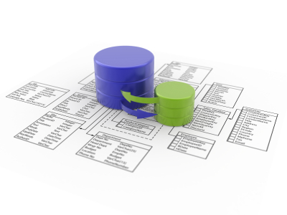

Miracle Institute of Leadership and Excellence
Introduction to DB2 Database
By
Satish Mongam
DB2 DBA
IBM Certified Database Associate
smongam@miraclesoft.com

Slide 2
Agenda
About Join
Types of Joins
INNER JOIN / EQUI JOIN / NATURAL JOIN / SIMPLE JOIN
NON EQUI JOIN
OUTER JOIN
  Left Outer Join
  Right Outer Join
  Full Outer Join
SELF JOIN
CROSS JOIN

Slide 3
What Is a JOIN?
The JOIN keyword is used in an SQL statement to retrieve data from two or more tables, based on a relationship between certain columns in these tables.
Tables in a database are often related to each other with keys.
INNER JOIN / EQUI JOIN / NATURAL JOIN / SIMPLE JOIN
NON EQUI JOIN
OUTER JOIN
  Left Outer Join
  Right Outer Join
  Full Outer Join
SELF JOIN
CROSS JOIN

Slide 4
INNER JOIN
An inner join is the most common join operation used in applications and can be regarded as the default join-type. Returns matching rows from both the joining tables. It is nothing but a EQUI JOIN or also called NATURAL JOIN or SIMPLE JOIN.
INNER JOIN
  SELECT * FROM EMP E INNER JOIN DEPT D ON E.DEPTNO = D.DEPTNO;
EQUI JOIN :
  SELECT ENAME, DNAME, SAL FROM EMP E, DEPT D WHERE D.DEPTNO = E.DEPTNO;

Slide 5
NON-EQUI JOIN
Returns rows by comparing data from one table to the column in another table which has no common columns in both.
Non equi joins is used to return result from two or more tables where exact join is not possible.
  SELECT EMPNO, ENAME, SAL, GRADE FROM EMP E, SALGRADE S WHERE SAL BETWEEN LOSAL AND HISAL;

Slide 6
OUTER JOIN
An outer join does not require each record in the two joined tables to have a matching record.
LEFT OUTER JOIN : Returns non matching rows from the table which is on left side of the join clause.
RIGHT OUTER JOIN : Returns non matching rows from the table which is on right side of the join clause.
FULL OUTER JOIN : Returns non matching rows from both tables used in the join clause.
  SELECT ENAME, DNAME, SAL FROM EMP E FULL OUTER JOIN DEPT D ON D.DEPTNO = E.DEPTNO;

Slide 7
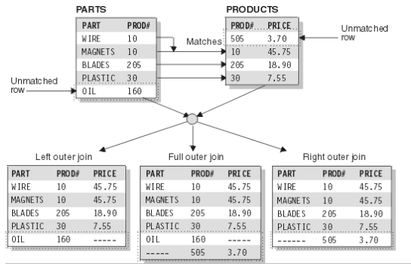
OUTER JOIN cont ...

Slide 8
SELF JOIN
A self join is a join of a table to itself. This table appears twice in the FROM clause and is followed by table aliases that qualify column names in the join condition.
  SELECT E.ENAME, M.ENAME FROM EMP E, EMP M WHERE E.MGR = M.EMPNO;

Slide 9
CROSS JOIN
It gives the Cartesian product of the number of columns present in the two tables.
  SELECT EMPNO, ENAME FROM EMP,DEPT;

Slide 10
Set Operators
The DB2 set operator allows you to combine two or more queries into a single query. Set operators combine queries in a specified manner to create a single result set.
  UNION
  UNION ALL
  INTERSECT
  INTERSECT ALL
  EXPECT
  EXCEPT ALL

Slide 11
UNION & UNION ALL
A UNION operation combines two sets of individual query and removes duplicates.
The UNION ALL expression does the same but does not remove the duplicates.

Slide 12
Index
An index can be created in a table to find data more quickly and efficiently.
The CREATE INDEX statement is used to create indexes in tables.

Slide 13
Index
An index can be created in a table to find data more quickly and efficiently.
The CREATE INDEX statement is used to create indexes in tables.

Slide 14
Index
An index can be created in a table to find data more quickly and efficiently.
The CREATE INDEX statement is used to create indexes in tables.

Slide 15
Index
An index can be created in a table to find data more quickly and efficiently.
The CREATE INDEX statement is used to create indexes in tables.

Slide 16


Any Queries ...

Slide 17
Thank Q

