Slide 1
Overview of Different Types of Applications and Frameworks
Web, Native and Hybrid Apps

Slide 2

About the Speaker
Pavan Ram Potnuru
Software Trainee
Miracle Software Systems, Inc.

Slide 3
Types of Applications
Web Applications
Native Applications
Hybrid Applications
Development Frameworks
Decision Factor
Question and Answers

Slide 4
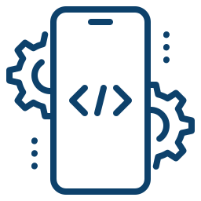


Types of Applications
There are three basic types of Applications if we categorize them by the technology used to code them,
Native apps
Web apps
Hybrid apps
Hybrid
Web
Native

Slide 5
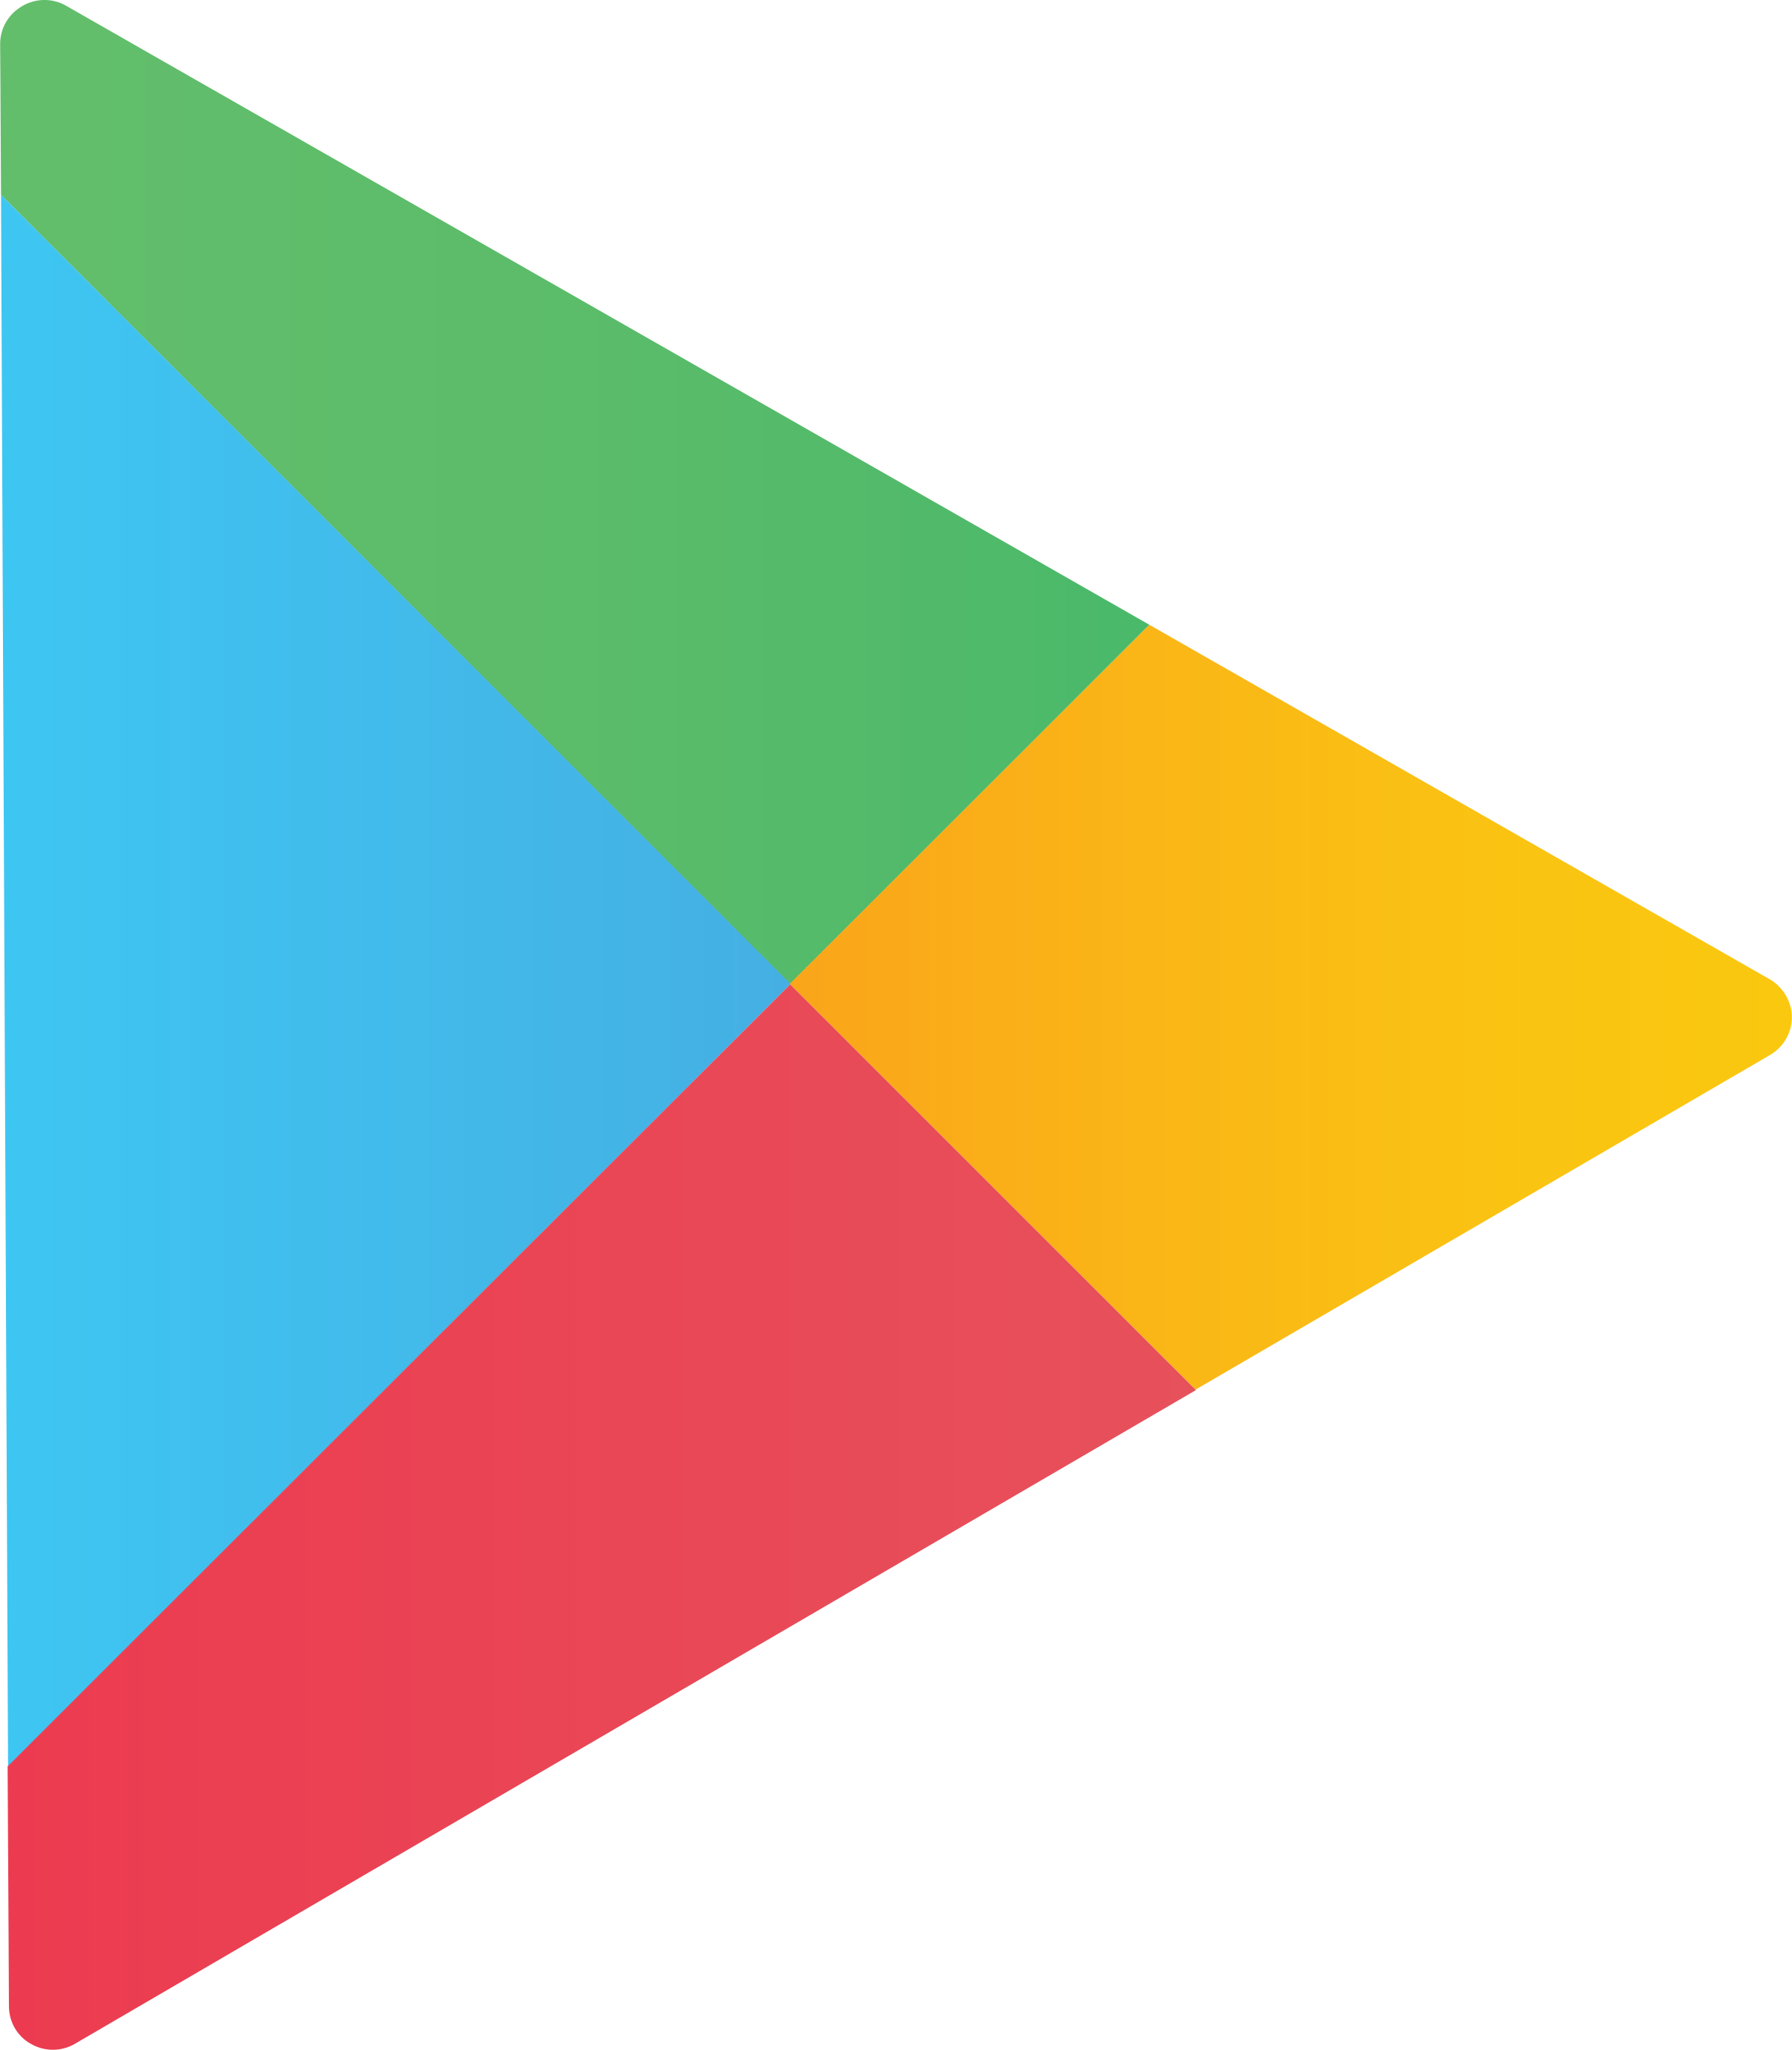
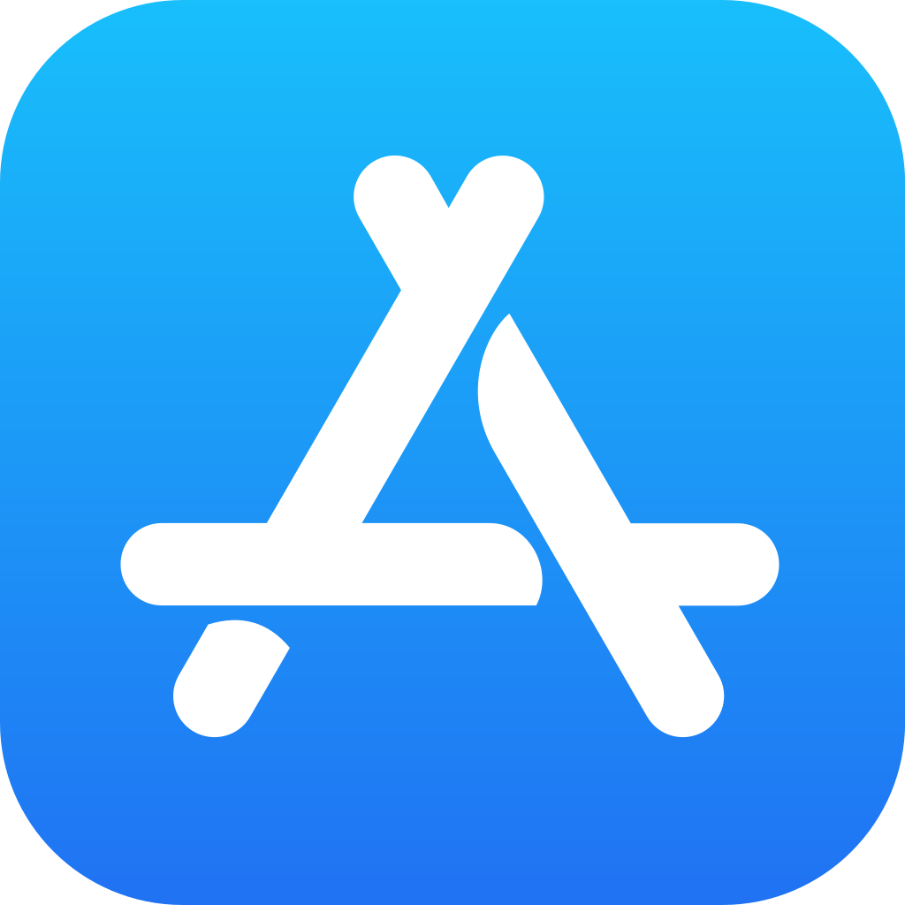
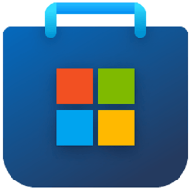
Native Applications
Native apps are built specifically for a mobile device’s operating system (OS). We can have native android app and native iOS app but not both. They share the same functionalities that the builder provides but not the resources present in the device. These have to follow the OS’s UI standards.
Real-time Examples
WhatsApp, Angry Birds, Calculator, Spotify etc.
Development
There are various platforms that provide their own Developer tools to build apps for their operating systems such as,
Google Developer Console(Google Play Store)
Apple Developer(App Store)
Microsoft Partner Center(Microsoft Store) and etc.
Google Store
App Store
Microsoft Store

Slide 6





Native Applications
Pros
Cons
Faster better performance
Native UI
Can access device features
Higher cost to maintain
Takes up space in the device
Updates must be downloaded
Technology Used

Slide 7
Web Applications
Web applications are the applications which can be accessed through browsers only. These applications are independent of a device’s OS. They’re actually responsive websites that adapt its user interface to the device the user is on.
Real-time Examples
SBI Online, WhatsApp Web, Gmail, MS Office Online, etc.
Progressive Web Applications
There are Progressive Web Apps which are web applications that functions like a native mobile application with a home screen app icon, responsive design, fast load speed, offline functionality, and more. These look similar to Hybrid applications but cannot use the resources of the device that the Hybrid app can use.
Real-time Examples
Uber, Pinterest, Make my trip, Swiggy, etc.

Slide 8

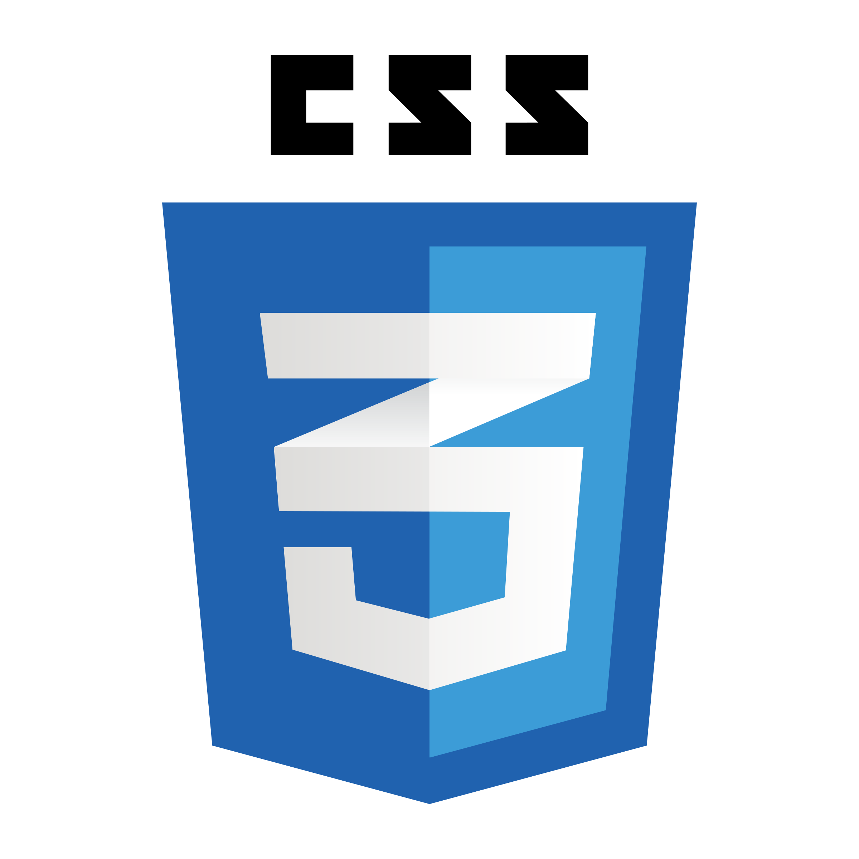


Web Applications
Pros
Cons
Web-based so performs on all devices
Easier to maintain
Users don’t run out of storage
Dependent on a browser
Needs an internet connection
May not always integrate with device hardware
Technology Used

Slide 9
Hybrid Applications
These are web apps that look and feel like native apps. They might have a home screen app icon, responsive design, fast performance, even be able to function offline, but they’re really web apps made to look native. They run on a simplified web-browser within the app called “web-view”.
Real-time Examples
Instagram, Twitter, LinkedIn, Gmail, etc.
Development
Since these are a mixture of web and native apps, they are mostly worked on every platform but should be developed using OS related frameworks with little differences
These type of application developers mostly use cross-platforms
These can be built using standard web technologies such as HTML, CSS and JavaScript
Hybrid apps are best used when you want to build apps that do not require high-performance, full device access apps

Slide 10

Hybrid Applications
Pros
Cons
Quicker/Cheaper to build
Load quickly
Less code to maintain
Lacks power of native apps
Slower since it has to download each element
Certain features might not be usable on devices
Technology Used

Slide 11
Overview on Development Frameworks
Development Frameworks

Slide 12






Desktop Application Frameworks

Slide 13
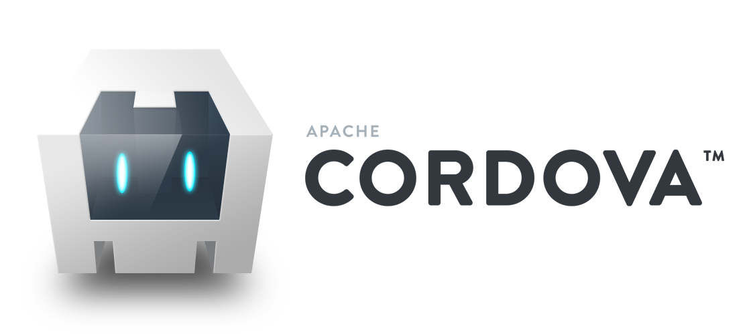


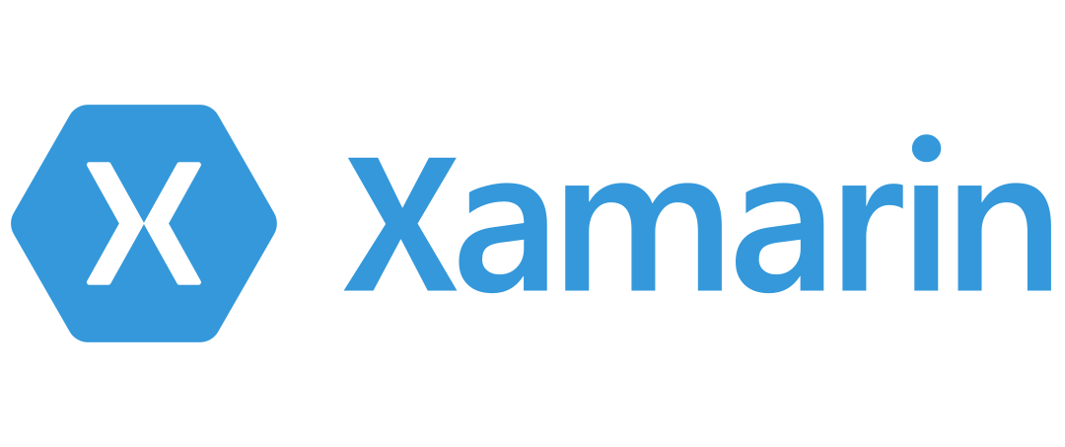



Mobile Application Frameworks

Slide 14
Overview on Decision Factor
Decision Factor

Slide 15

I Need an App ASAP!
If you absolutely must have an app in the shortest amount of time possible, then you need to invest in building a web app. Not only will one codebase drastically speed up development time, but it will also mean that your users already have what they need to use it - a mobile browser.

Slide 16

I Have Limited Resources
If time and money are not on your side, then consider either a web app or a hybrid app. The hybrid app gives you a chance to test the market with a minimum viable product that can be in the hands of users within a few months. And if successful, you can decide to build a full-fledged native version later on.

Slide 17

My App Must Be Fast and Stable
If performance is of the utmost importance, then there’s no way around it, you need to develop a native app. This type of app will give you the speed, stability, and customization features you deem crucial to your success.

Slide 18
Question and Answers Time!
We’re more than happy to help out

