Slide 1
ANALYSIS OF USED CARS SALES AND PREDICTION OF SALLING PRICE
Batch H-3
Sarana Poornachand DELBC8011
Ronanki Sai Charan DELBC8012
Radhika Menon DELBC8013
Sharmili Tangellapalli DELBC8014
Vishnu Vardhan Chinnam DELBC8015

Slide 2
About The Project
Domain:
Automotive Industry
About:
This is about an automobile company XYZ from USA which aspires to enter the US used car market by setting up their company locally to give competition to their counterparts.
As part of the project we need to do analysis about various features that are involved in increasing the sales of the cars and also which involve in building a Machine Learning model that involve in predicting selling price of used cars.

Slide 3
Significant Features
 | Sales_ID | year | selling_price | km_driven | seats
Sales_ID | 1.000000 | -0.001304 | -0.012125 | 0.009556 | -0.014154
year | -0.001304 | 1.000000 | 0.412302 | -0.428548 | -0.007923
selling_price | -0.012125 | 0.412302 | 1.000000 | -0.222158 | 0.041617
km_driven | 0.009556 | -0.428548 | -0.222158 | 1.000000 | 0.227259
seats | -0.014154 | -0.007923 | 0.041617 | 0.227259 | 1.000000

Slide 4
Type of Fuel Which Impact In Sales of Cars
 | sale | selling_price | km_driven | percent
Fuel_Type
Diesel | 1052 | 836903.476236 | 83923.622624 | 52.60
Petrol | 935 | 501153.604278 | 51532.865241 | 46.75
CNG | 7 | 362142.714286 | 52142.857143 | 0.35
LPG | 6 | 201166.666667 | 96500.000000 | 0.30

Slide 5
Average Mileage where most people were Interested to Buy a Car
 | sale | selling_price | km_driven | percent
mileage
18.9 kmpl | 51 | 315999.941176 | 68151.549020 | 2.55
19.7 kmpl | 44 | 126295.454545 | 80886.727273 | 2.20
18.6 kmpl | 41 | 520902.439024 | 34756.487805 | 2.05
21.1 kmpl | 34 | 240500.000000 | 60344.117647 | 1.70
15.96 kmpl | 33 | 509909.030303 | 97332.575758 | 1.65

Slide 6
State where Most Number of Used Cars were Sold
 | sale | selling_price | km_driven | percent
State or Province
New York | 293 | 6.958071e+05 | 69979.000000 | 14.65
California | 274 | 6.286788e+05 | 70237.062044 | 13.70
Illinois | 148 | 5.778243e+05 | 83738.520270 | 7.40
Texas | 138 | 6.576449e+05 | 73880.847826 | 6.90
Washington | 120 | 6.410083e+05 | 67080.391667 | 6.00

Slide 7
City With Most Number of Sales of used Cars
 | sale | selling_price | km_driven | percent
City
New York City | 196 | 688987.224490 | 68372.102041 | 9.80
Los Angeles | 191 | 654246.026178 | 68726.460733 | 9.55
Seattle | 86 | 627348.802326 | 66981.011628 | 4.30
Chicago | 83 | 618168.590361 | 72614.216867 | 4.15
Boston | 69 | 696695.608696 | 64191.811594 | 3.45

Slide 8
Type of Cars that were Selling most
 | sale | selling_price | km_driven | percent
name
Maruti Swift Dzire VDI | 42 | 5.805952e+05 | 74238.095238 | 2.10
Maruti Alto 800 LXI | 21 | 2.477142e+05 | 38351.476190 | 1.05
BMW X4 M Sport X xDrive20d | 19 | 5.468421e+06 | 7973.684211 | 0.95
Maruti Wagon R VXI BS IV | 16 | 3.493749e+05 | 38361.812500 | 0.80
Maruti Wagon R LXI | 15 | 1.649333e+05 | 81249.600000 | 0.75

Slide 9
Kind of Owner for a Car which have High Percent of Sales
 | sale | km_driven | selling_price | percent
owner
First Owner | 1326 | 57276.268477 | 837219.423077 | 66.30
Second Owner | 490 | 86976.832653 | 390865.563265 | 24.50
Third Owner | 135 | 103632.592593 | 306403.688889 | 6.75
Fourth & Above Owner | 49 | 99132.653061 | 197989.734694 | 2.45

Slide 10
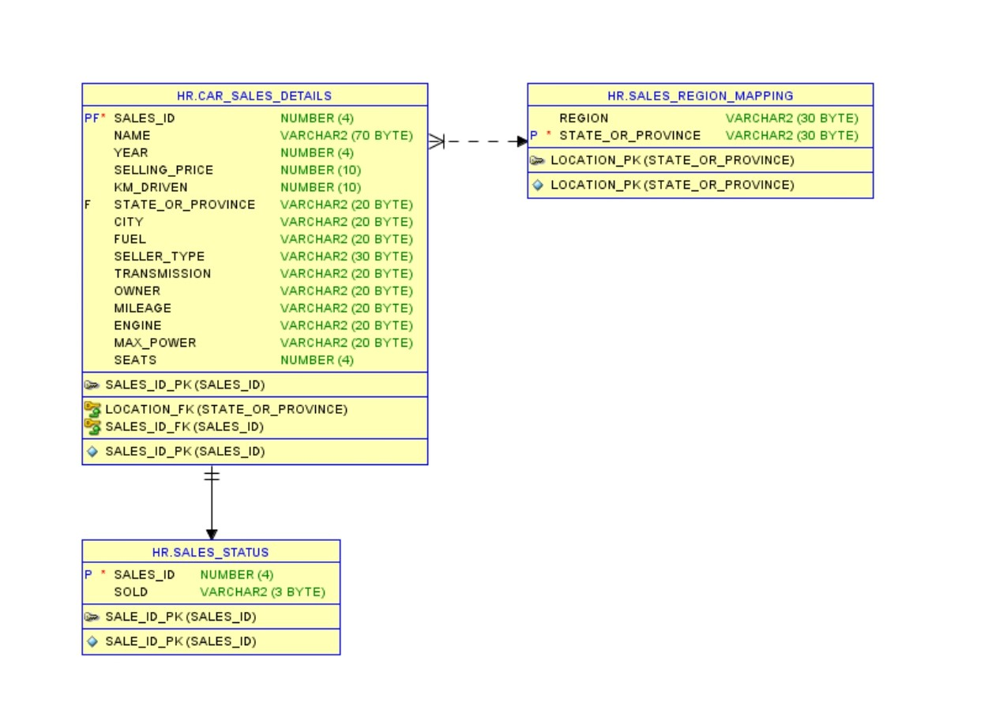
ER Diagram

Slide 11
MEAN AND MEDIAN
->Mean, Median values were calculated for the numerical values like selling_ price, km_ driven, seats etc..,
->This descriptive values will help us in Feature Engineering and in Exploratary Data Analysis.
->Along with Mean, Median Varience and Standard Deviation is calculated which were kept on following slide.

Slide 12
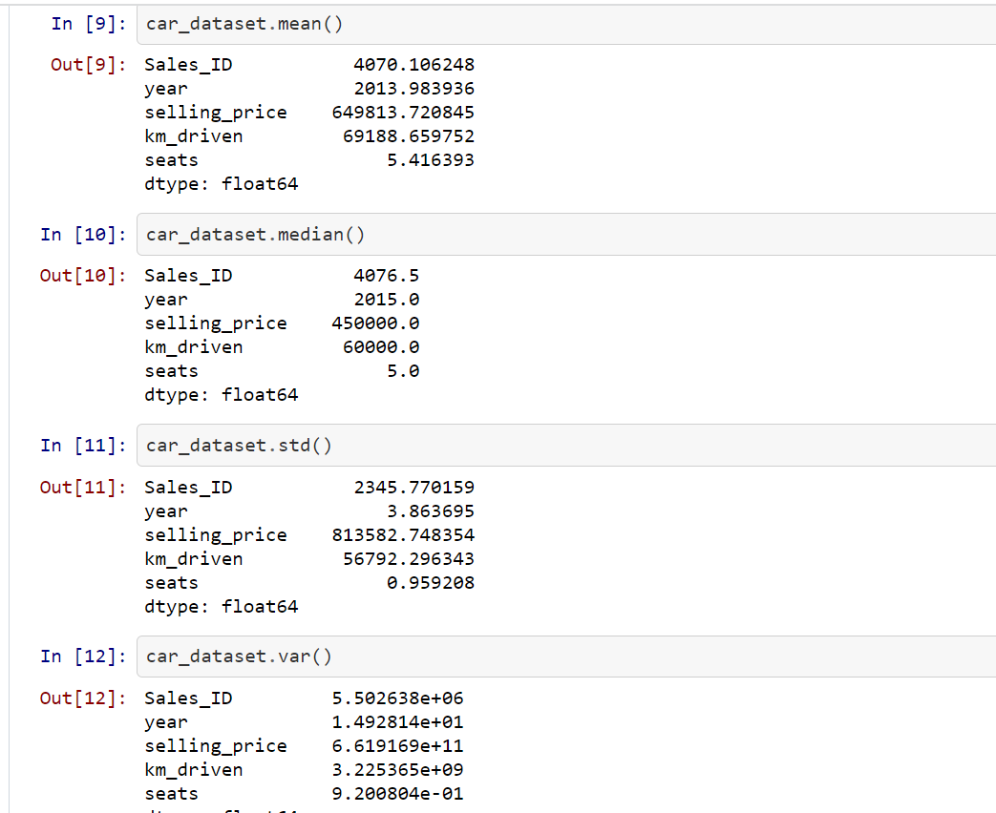

Slide 13
HYPOTHESIS TESTING: One Sample T Test -> Hypothesis Testing is done using the selling_ price of car as it is the dependent Variable or feature.
from scipy.stats import ttest_1samp
tstat, pval = ttest_1samp(car_dataset["selling_price"][1:3950], mean_selling_price)
pval
0.6200425011685295
As the p value is greater than 0.05 the null hypothesis is failed to be rejected and the mean value of sample is same as population

Slide 14
HYPOTHESIS TESTING : Two Sample T Test
from scipy.stats import ttest_ind
tstat, pval = ttest_ind(car_dataset['selling_price'][1:3950],car_dataset['selling_price'][3950:])
print("p-value",pval)
p-value 0.47449264084160103
As p-val is greater than 0.05 we fail to reject the null hypothesis and samples are related with each other

Slide 15
HYPOTHESIS TESTING : One way Anova
model = ols('selling_price ~ C(City)’,
data=car_dataset).fit() aov_table = sm.stats.anova_lm(model, typ=2)
aov_table
 | sum_sq | df | F | PR(>F)
C(City) | 1.467652e+15 | 1309.0 | 1.964365 | 8.171808e-65
As p value(PR) less than 0.05 the null hypothesis is rejected and there is significant difference between different city selling price

Slide 16
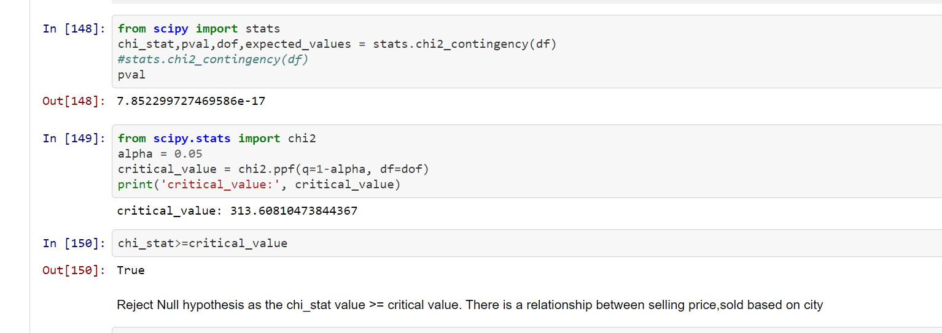
CHI SQUARE TEST

Slide 17
Thank you!

