Slide 1



INVENTORY MANAGEMENT SYSTEM
BY:
POORNACHANDRAN N C 23CDR120
PARTHASARATHI M 23CDR116

Slide 2
Introduction
This project showcases an online Inventory Tracking System (ITS) built with PHP and MySQL. It is aimed at optimizing inventory-related processes by offering digital modules for stock supervision, supplier handling, purchase/sales logs, and automated reporting. The platform delivers secure login roles, improves data handling, and reduces stock management errors. Designed for small to mid-level businesses, ITS transforms manual stock tracking into a real-time digital experience.

Slide 3
Abstract
The Inventory Tracking System is a web-driven platform developed using PHP and MySQL to digitize how companies oversee inventory. It replaces spreadsheets and paper-based systems with a unified digital solution that manages stock entries, vendor databases, order tracking, and report generation. It features user-specific access controls, real-time quantity updates, and barcode-supported operations. This system enhances accuracy, facilitates better decision-making, and scales well with growing operational needs.

Slide 4
Problem Description
Inventory mismanagement leads to stockouts or overstocking.
Tracking stock manually is time-intensive and prone to mistakes.
Lack of timely updates causes delayed decision-making.
No single platform to monitor products, suppliers, and stock status.
Role-specific functions (admin/staff/supplier) are not defined.

Slide 5
Problem Statement
Managing inventory manually causes inefficiencies, data inconsistencies, and lack of real-time updates. No centralized system handles products, stock levels, supplier information, or role-based access for admins, staff, and suppliers making inventory tracking, ordering, and management challenging It becomes difficult to monitor stock movement and avoid stockouts or overstocking. This lack of visibility can result in financial losses and reduced customer satisfaction.
5

Slide 6
Objectives
Automate inventory tracking and stock updates.
Streamline communication with suppliers for smoother procurement.
Enable tracking of sales and purchase history.
Improve inventory visibility and transparency at all times.
Ensure scalability to handle growing product catalogs.
6

Slide 7
Types of Modules
Inventory Reports Management
Purchase Order Management
Sales Order Management
User Management
Product Management
Supplier Management
Stock Management
Order Management
Reports and Analytics
Data Storage and Retrieval
7

Slide 8
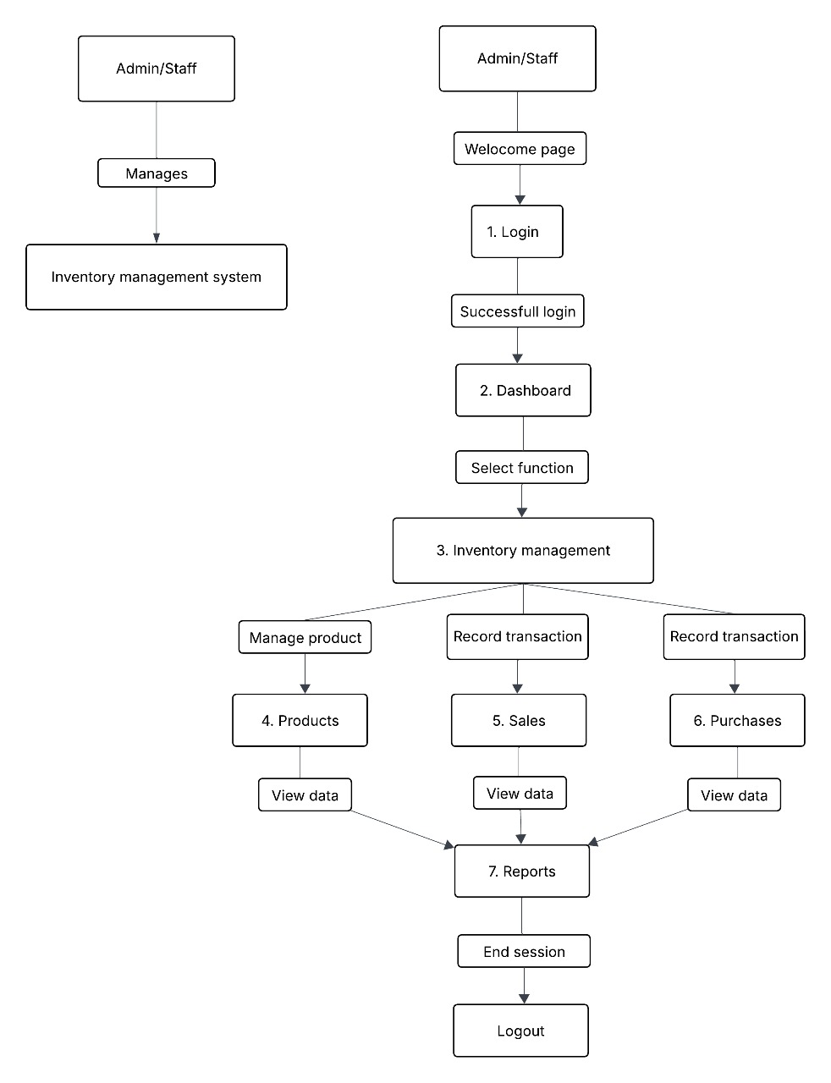
Data Flow Diagram
8

Slide 9
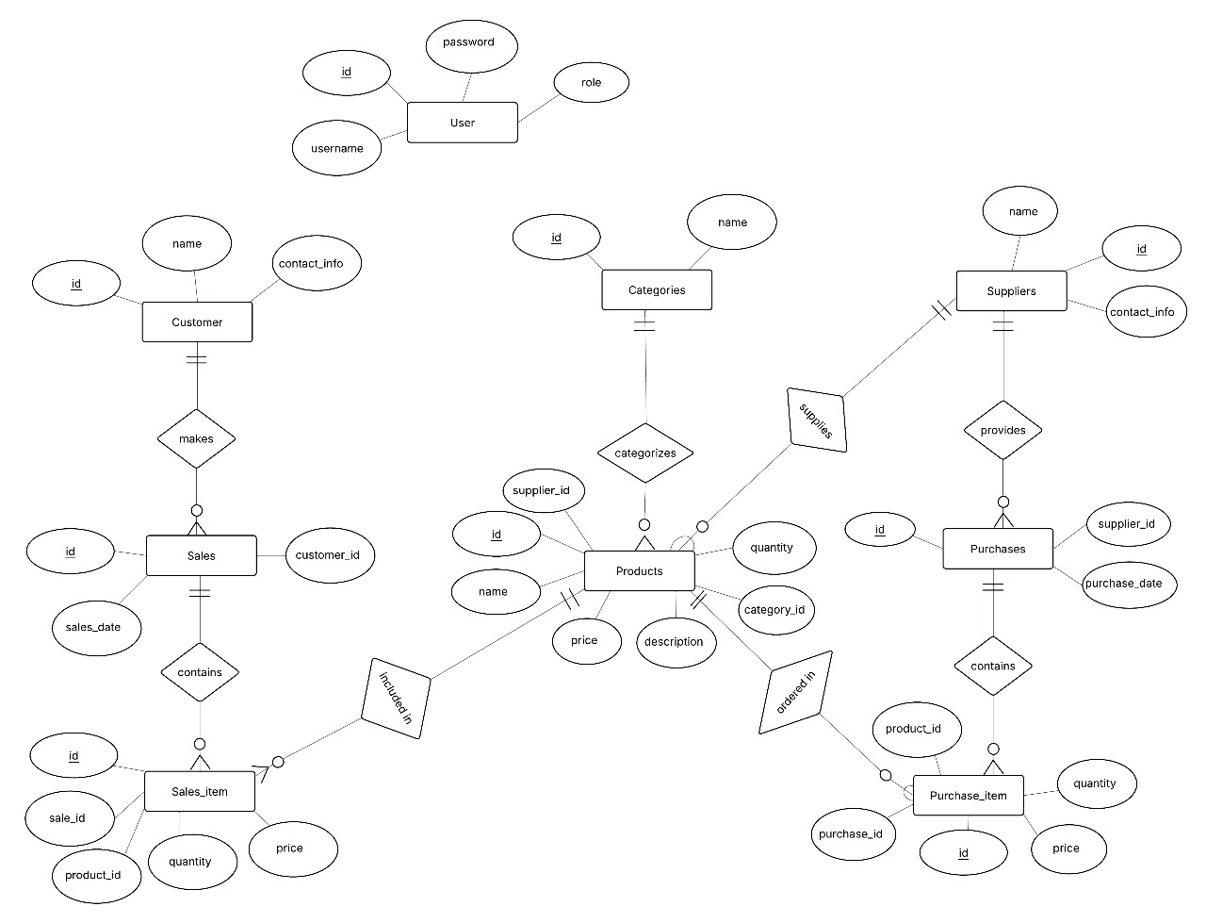
ER Diagram
9

Slide 10
Sample Table
id(int) – Primary Key | Id of the product.
Name (varchar) | Enter the name of product.
Description (text) | Enter the description of product.
Category_id (date) | Enter the category id of product.
Supplier_id (int) | Enter the supplier id of product.
Quantity (int) | Enter the quantity of the product.
Price (decimal) | Enter the price of the product.
10

Slide 11
Tech Stack
PHP
JavaScript
Bootstrap
Tailwind CSS
Apache
phpMyAdmin
11

Slide 12
Existing System
Manual Stock Logging: Inventory is often tracked using physical registers or spreadsheets, which are prone to human error and lack real-time accuracy.
No Centralized Data: Product details, supplier info, and stock levels are stored separately or inconsistently across departments, making access and updates difficult.
Inaccurate Reordering: Restock decisions are based on rough estimates or delayed checks, leading to overstocking, shortages, or missed sales.
Lack of Alerts and Notifications: There are no automated reminders for low stock levels, expired items, or pending purchase orders, which results in inefficiencies.
Poor Supplier Coordination: Supplier details and transactions are not integrated with stock data, causing confusion and delays in procurement.
No Access Control or Audit Trail: All users often have the same access privileges, making it difficult to control who changes what. There's little to no tracking of inventory changes.

Slide 13
Proposed System
Centralized Inventory Database: All stock, supplier, and transaction data are stored in a unified MySQL database, allowing quick access, consistency, and easy updates across departments.
Automated Stock Updates: Inventory levels are updated in real time with every sale, purchase, or stock movement.
Threshold Alerts & Notifications: The system automatically alerts users when stock falls below a defined threshold or when items are nearing expiration, enabling proactive restocking.
Supplier Integration: Vendor details and procurement history are directly linked to stock items, improving order accuracy and streamlining communication with suppliers.
Role-Based Access Control: Different user roles (admin, manager, employee) are defined with specific access permissions, ensuring data security and accountability.
Audit Trails and History Logs: Every inventory change is recorded with timestamps and user details, allowing full traceability for reviews and audits.

Slide 14
Advantages
Ensures optimal stock levels — reduces overstocking/stockouts.
Quick generation of sales, stock, and supplier reports.
Improves supplier collaboration and order processing.
Helps forecast inventory needs with historical data.
Disadvantages
Requires initial training for staff and suppliers.
Dependent on server/database — risk of downtime.
Requires periodic backups to prevent data loss.
No automatic real-time stock sync across multiple branches.

Slide 15
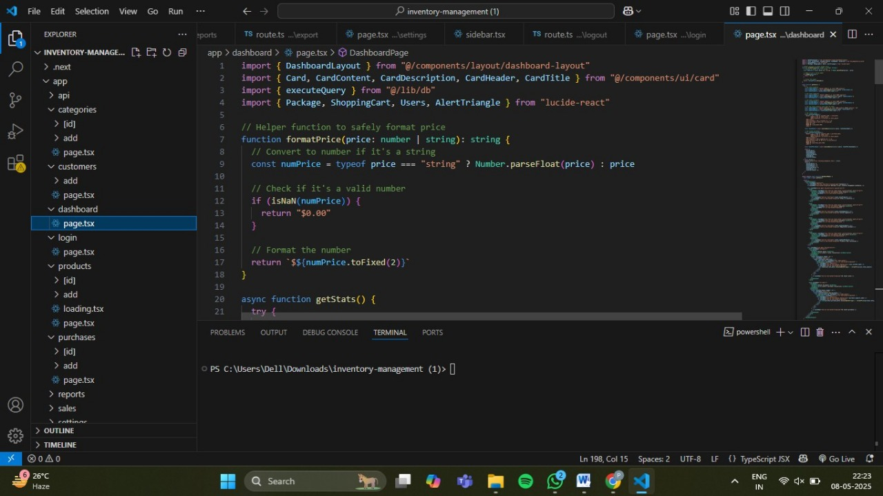
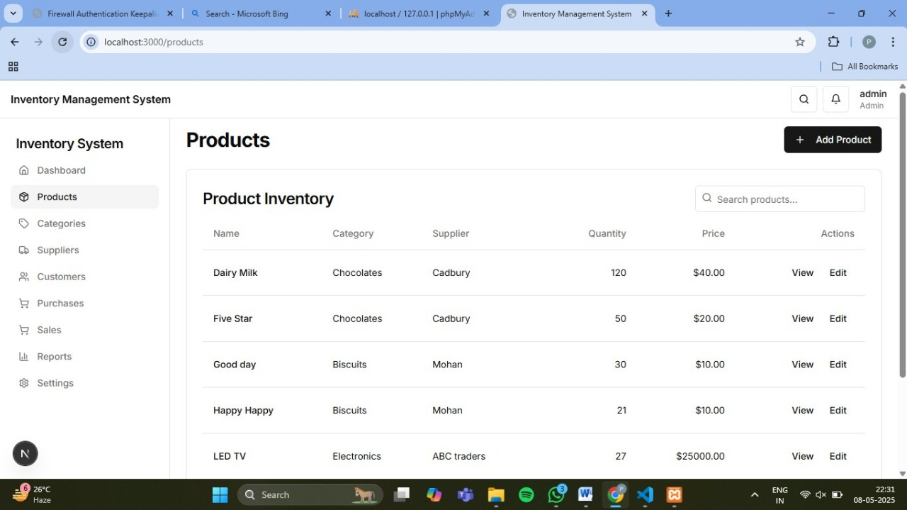
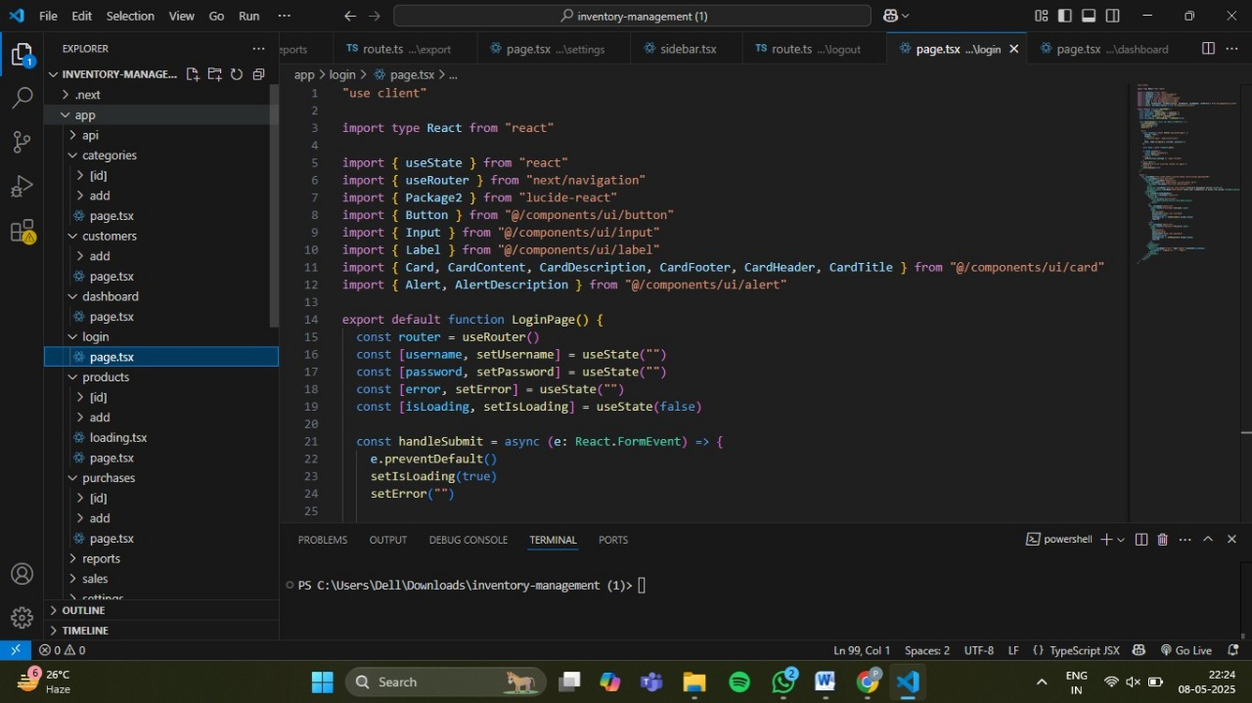
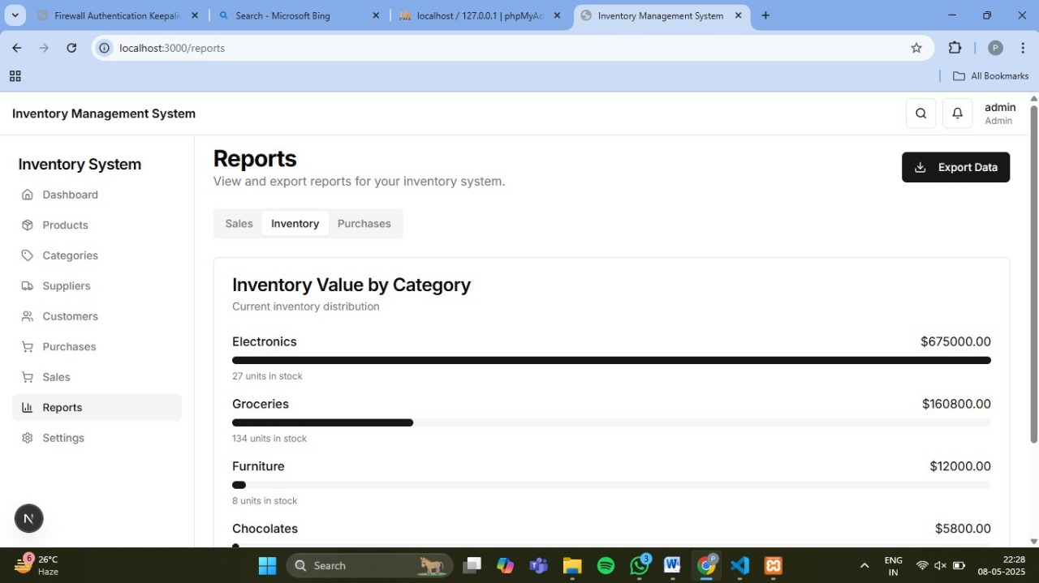
Implementation

Slide 16
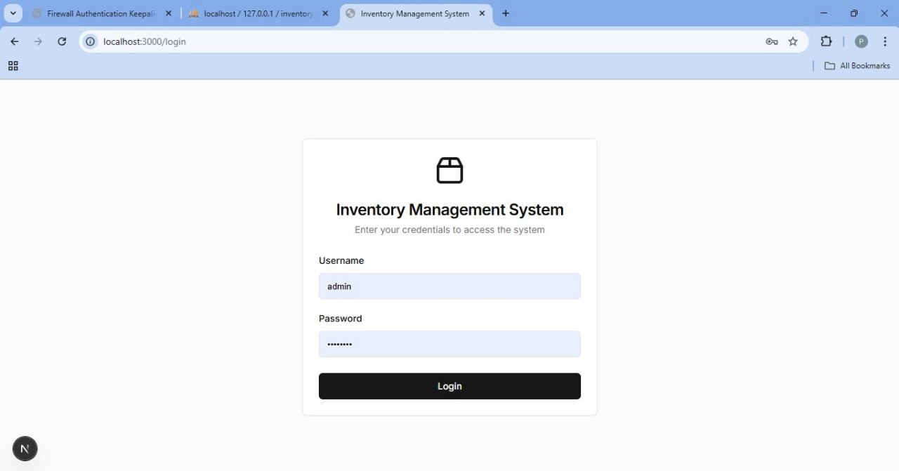
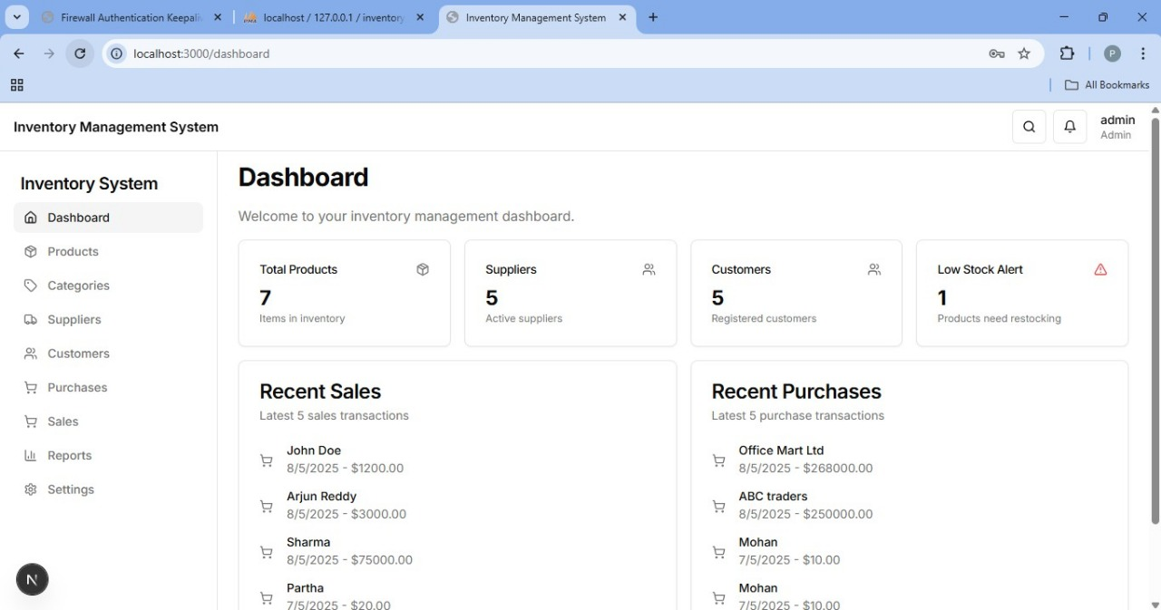
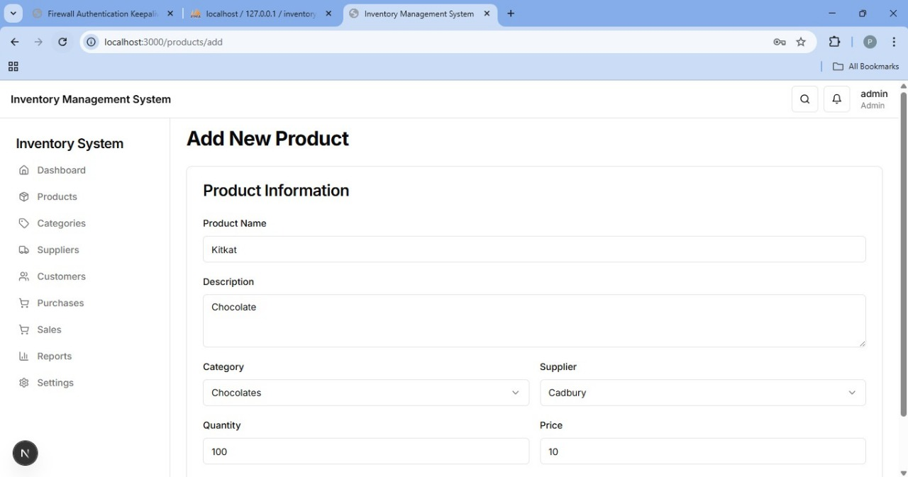
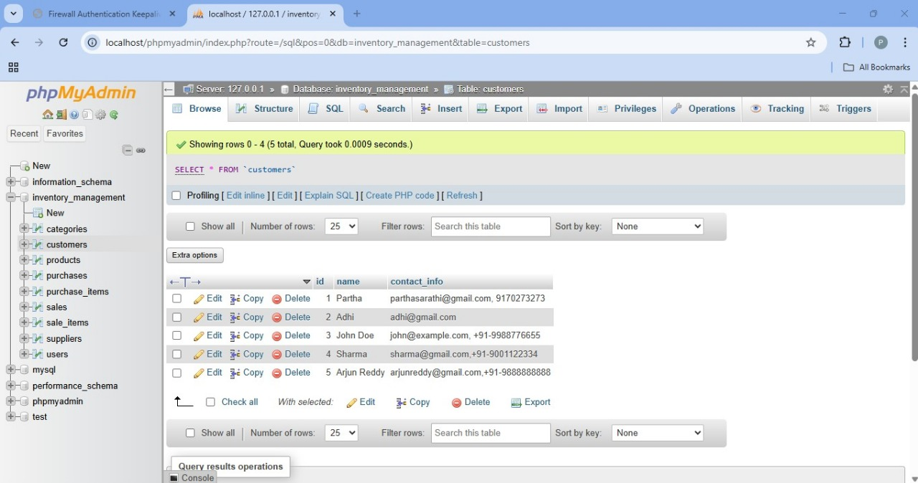

Slide 17
Conclusion
The Inventory Management System offers a modern, reliable solution for automating stock control, reducing manual errors, and improving operational efficiency. By centralizing data, streamlining processes, and enabling real-time visibility, it addresses the critical limitations of traditional inventory methods. The system not only simplifies day-to-day operations but also supports better planning, faster decision-making, and stronger supplier coordination . With features like role-based access, automated alerts, and detailed reporting, it empowers businesses to manage resources more effectively and minimize financial losses due to stockouts or overstocking. Though initial setup may require some technical investment and training, the long-term benefits in accuracy, speed, and scalability far outweigh the challenges.

Slide 18
THANK YOU

