Slide 1
AUTOMATE BUSINESS PROCESS
PRESENTED BY
Poorna

Slide 2
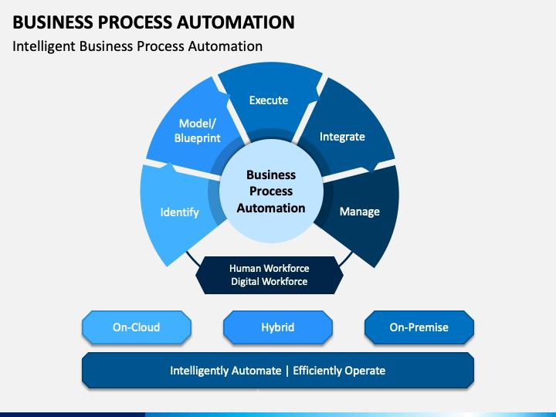

Slide 3
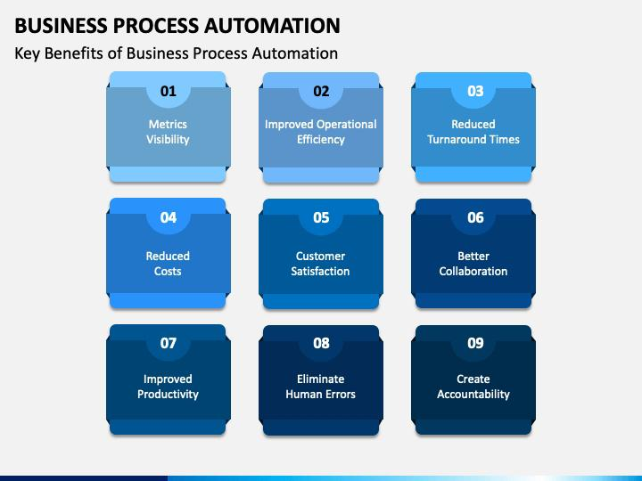

Slide 4
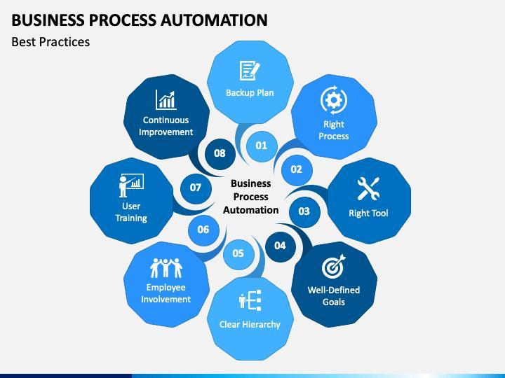

Slide 5
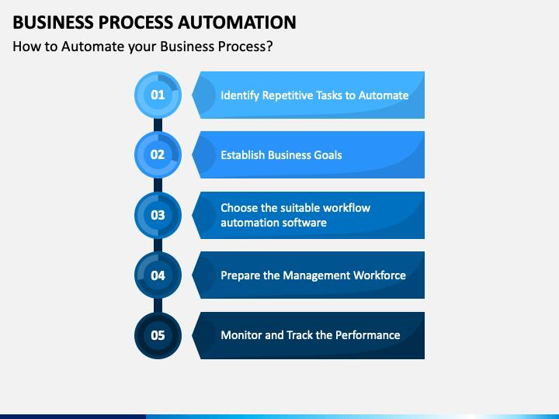

Slide 6
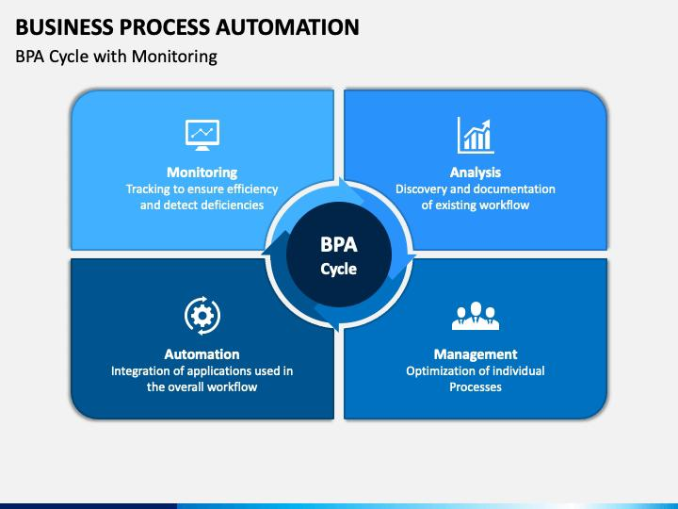

Slide 7
