Slide 1
Hackathon Presentation
Topic- Identify New Bikes
TEAM 2 (INTQEA22QE063)
GENC TRAINING

Slide 2
Team Members
1.Sajjanna Gari Rakesh
2.Gpoorna Prasant Sai
3.Arava Chowhith
4.Nikhil s
5.Abbas Ali Shaik
(2147870)
(2147650)
(2148361)
(2149098)
(2148363)

Slide 3
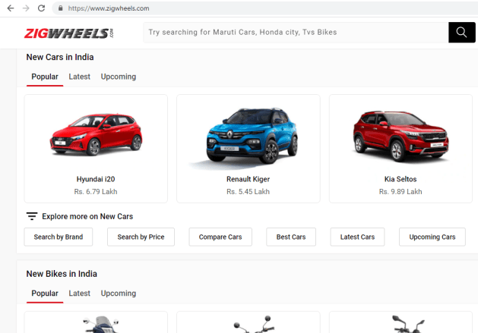
Website:
https://www.zigwheels.com/

Slide 4
DESCRIPTION:
1. Display "Upcoming" bikes details like bike name, price and expected launch date in India, for manufacturer 'Honda' & Bike price should be less than 4Lac. 2. For Used cars in Chennai, extract all the popular models in a List; Display the same 3. Try to 'Login' with google, give invalid account details & capture the error message (Suggested site: zigwheels.com however you are free to use any legitimate site)

Slide 5
TOOLS & TECHNOLOGY USED:
01. Selenium with Java in Eclipse
03. Maven
Selenium is a portable framework for testing web applications. Selenium provides a playback tool for authoring functional tests.
Maven is a build automation tool used primarily for Java projects.
Maven can also be used to build and manage projects written in C#, Ruby and other languages.
02. TestNG
04. POM with POI
TestNG is a testing framework for the Java programming language with flexible execution model by using annations support.
A Project Object Model or POM is the fundamental unit of work in Maven. It is an XML file that contains information about the project.

Slide 6
Work Done
1.The Code is written in JAVA and is automated in different browsers with the help of Selenium. The project and dependencies are managed with the help of Maven.
3. Input data is obtained from properties file and from excel sheet with the help of Apache POI.
2. POM is used to create classes for each page therefore reducing usage of same code for various objects.

Slide 7
Requirements and Execution Steps:
Display "Upcoming" bikes details like bike name, price and expected launch date in India, for manufacturer 'Honda' & Bike price should be less than 4Lac.
For Used cars in Chennai, extract all the popular models in a List; Display the same
Try to 'Login' with google, give invalid account details & capture the error message
Go to Used cars drop down and select the following cities: Chennai.
Display new bikes from Honda manufacturer
Search in search bar
Display upcoming bikes under 4lacs in console
Click on Login button in Homepage
Login to google with invalid credentials and capture screenshot.

Slide 8
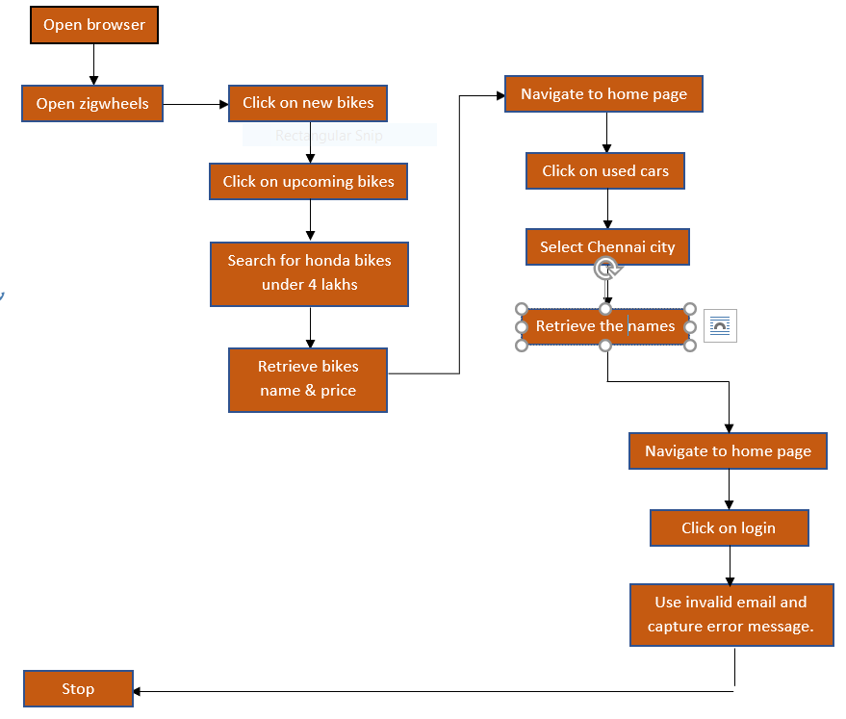
PROJECT CODE FLOW:

Slide 9
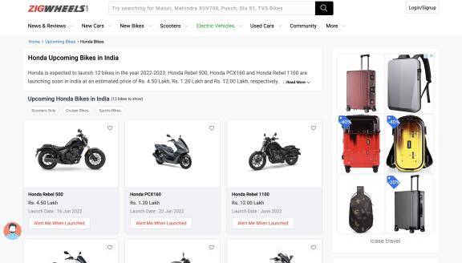
Screenshots

Slide 10
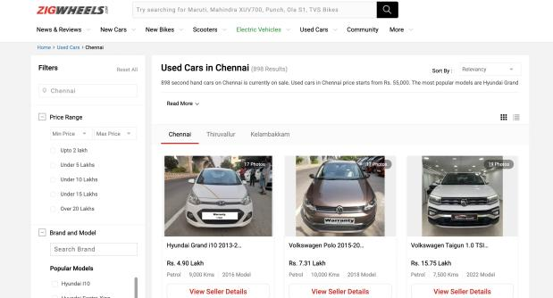

Slide 11
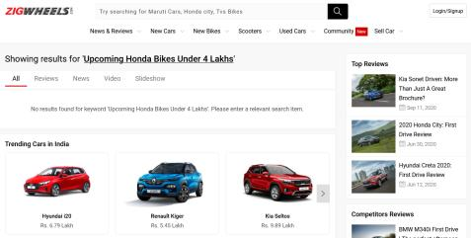
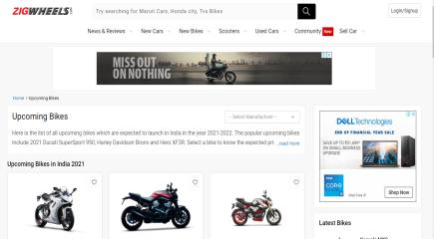
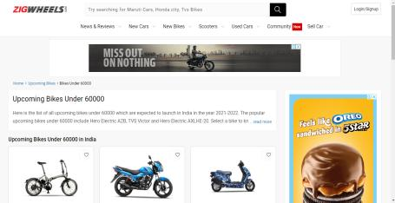
Screenshots

Slide 12
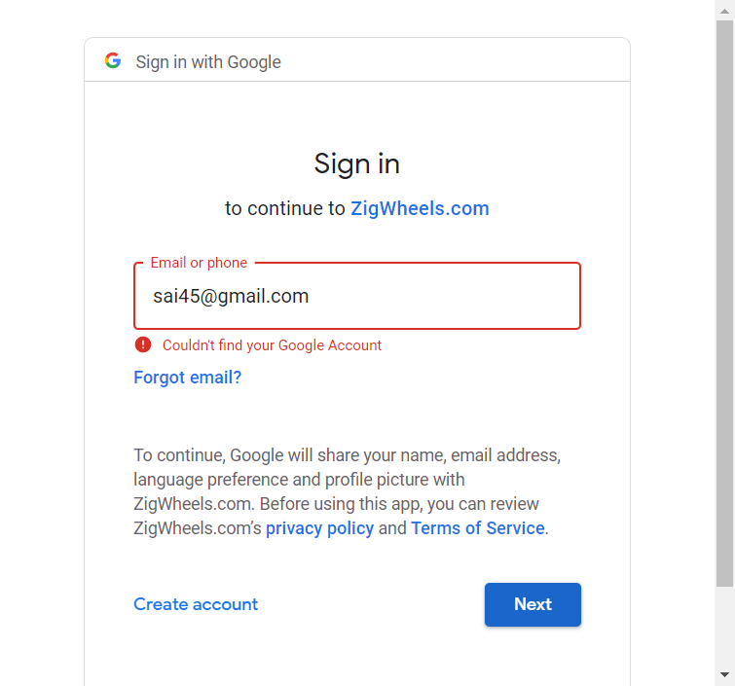
Screenshots

Slide 13
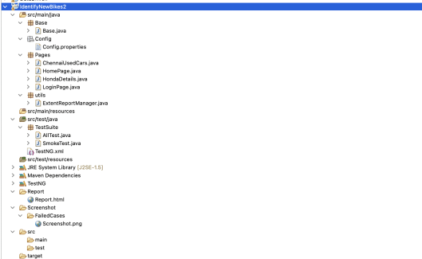
Project structure

Slide 14
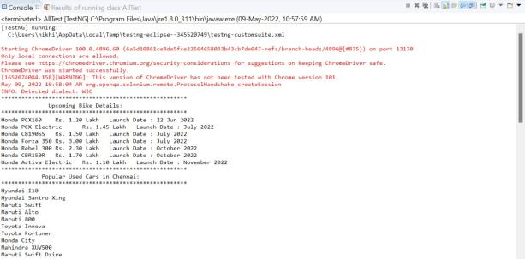
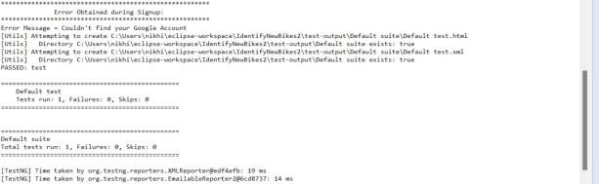
results

Slide 15
Thank you

