Slide 1
K-d tree
Poornima Kaniarasu

Slide 2
Algorithm
For a 3-d tree
Split the point set on x coordinate
Split the point sets on y coordinate
Split the point sets on z coordinate
Again, Split the point sets on x co-ordinate and so on….
At nth level, we split the points on n%3 rd component
This concept can be extended to k-d tree

Slide 3
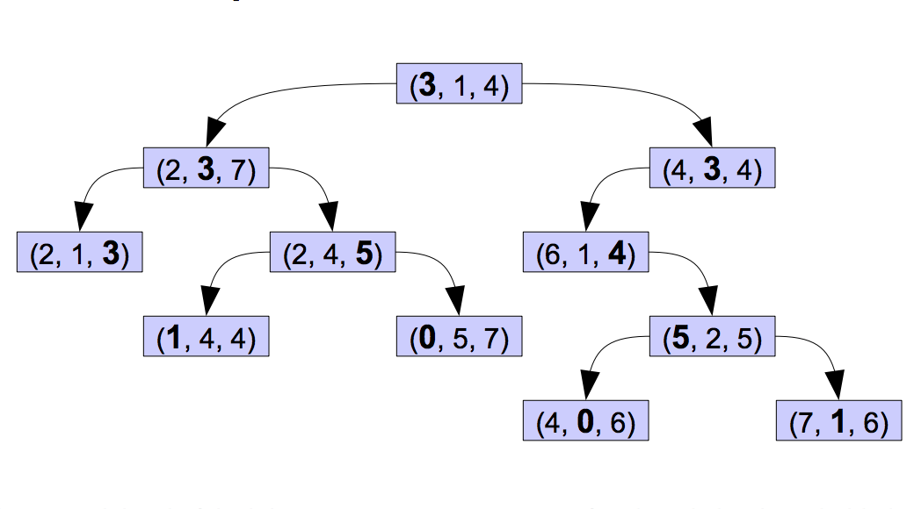
Algorithm
http://web.stanford.edu/class/cs106l/handouts/assignment-3-kdtree.pdf

Slide 4
Implemented
Construction/destruction (RAII style)
Create a tree from a set of points in an N-dimensional space
Create a tree on the fly from points as they come in
Support efficient exact query for k-nearest points
Support I/O to save/load the tree from disk
The splitting method takes in either mean or median (median being the default)

Slide 5
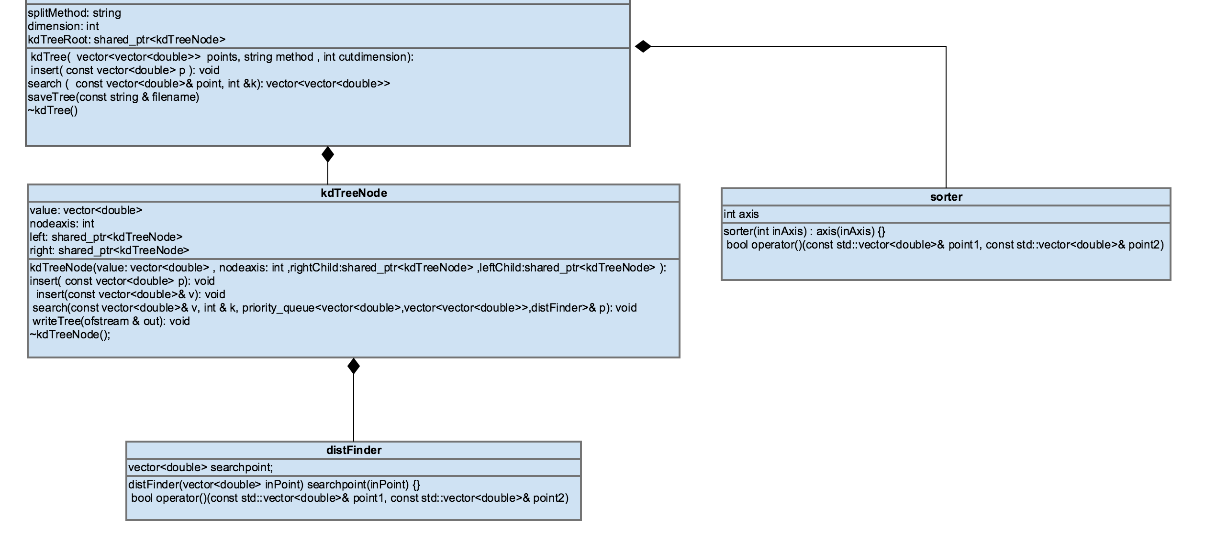
Design Approach
KdTree

Slide 6
Design Choices
Tree Construction
Used shared pointer from the STL for Construction/Destruction in RAII style
std::vector of doubles is used to hold points of varying size. The whole set itself is a vector of these vectors.
The points in the kdTree are assumed to be doubles. Given time the solution can be more generalized.
I/O Operations:
“#” character is used as the delimiter to identify when a leaf node is reached when writing the tree to disk.
Newline character is used to differentiate between node values for I/O operations

Slide 7
Design Choices
Finding root node
Root node can be chosen using median or mean both supported.
To find median, all the points are sorted resulting in O(nlogn) complexity.
This can be improved upon by using quick select with O(n) complexity

Slide 8
References
[1] https://en.wikipedia.org/wiki/K-d_tree
[2] web.stanford.edu/class/cs106l/handouts/
assignment-3-kdtree.pdf
[3] http://www.cplusplus.com/reference/stl/

