Slide 1


Slide 2
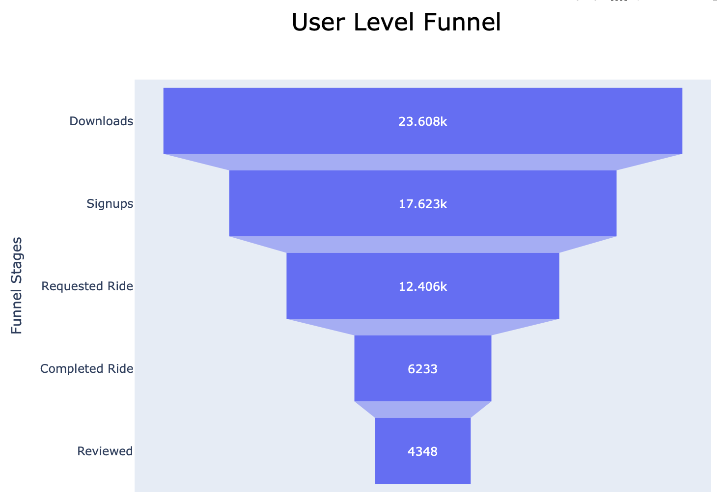


Drop off is between
30% – 50% on average at each Stage

Slide 3
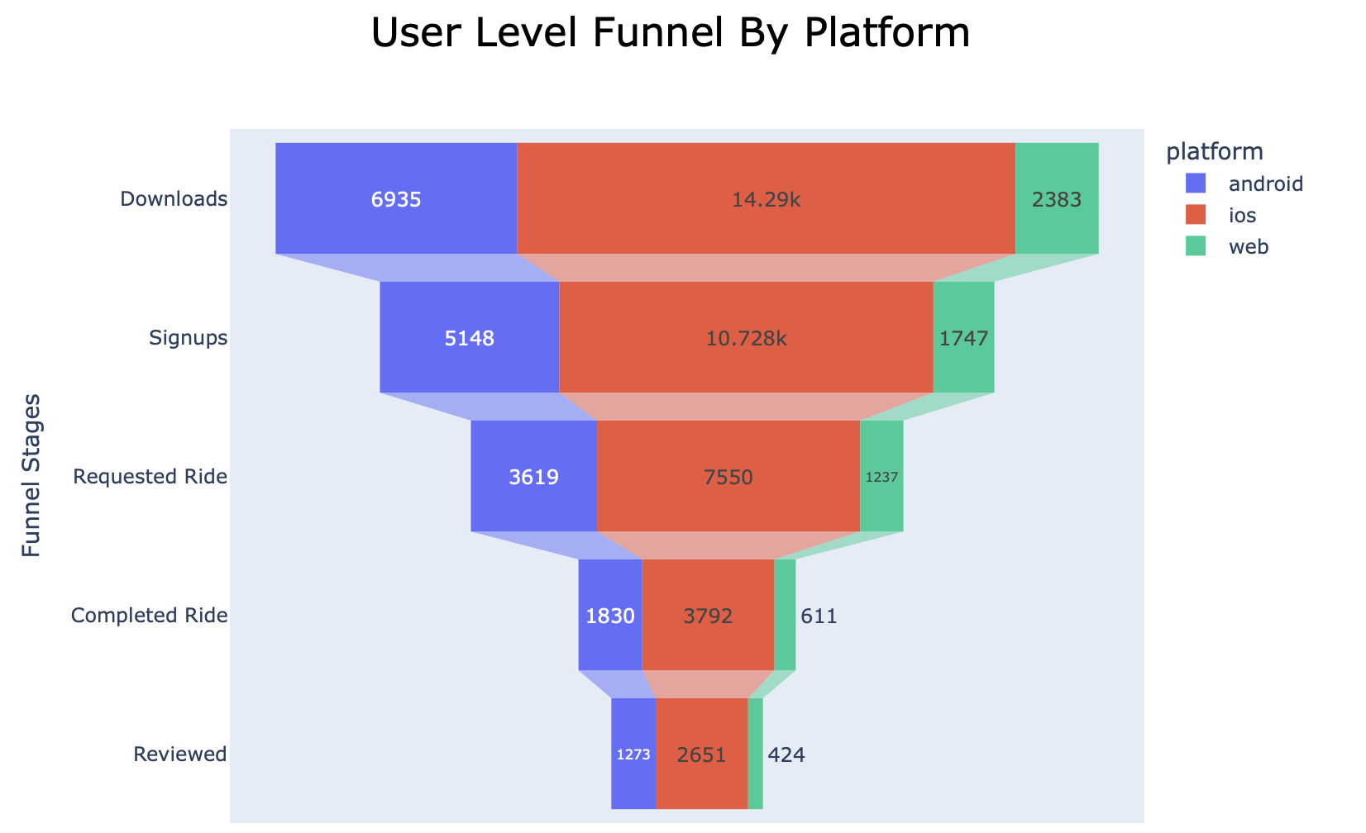
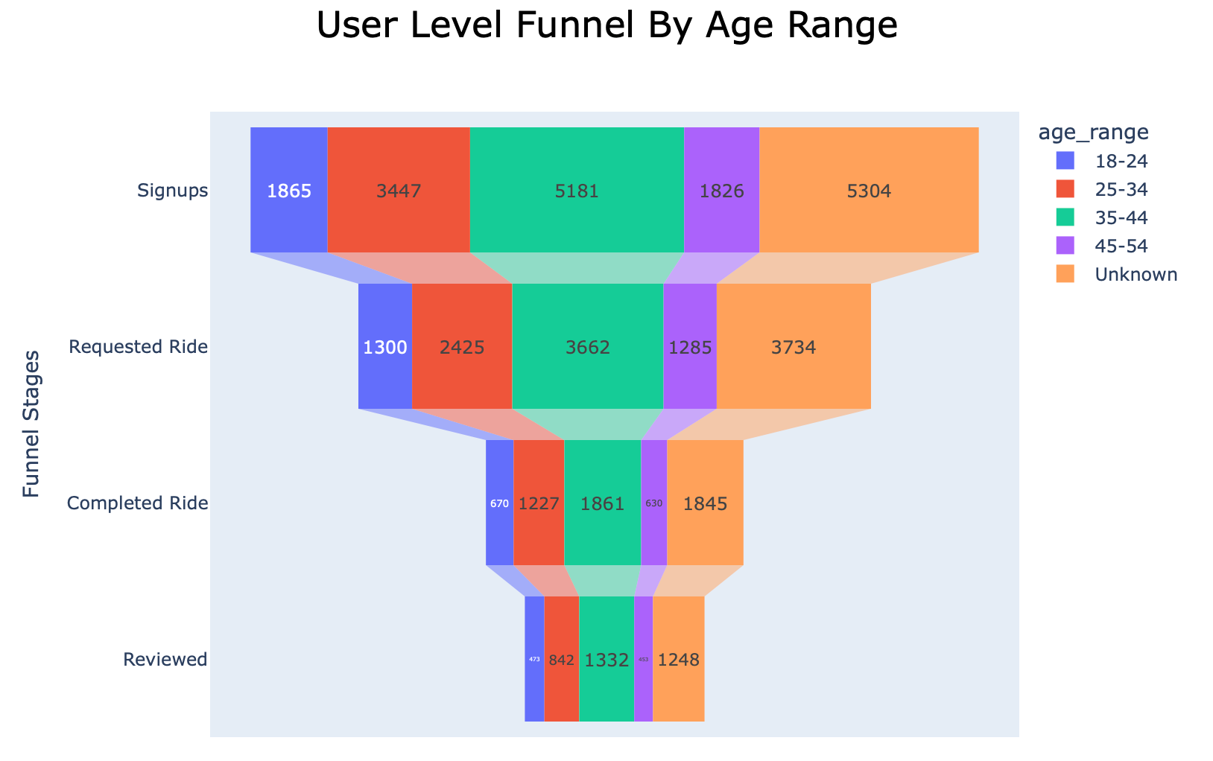
Further Analysis on User Level Data
Majority of the users :
have an iOS device
fall into the age group between 25 and 44 years old.
Large number of customers with Unknown ages.

Slide 4
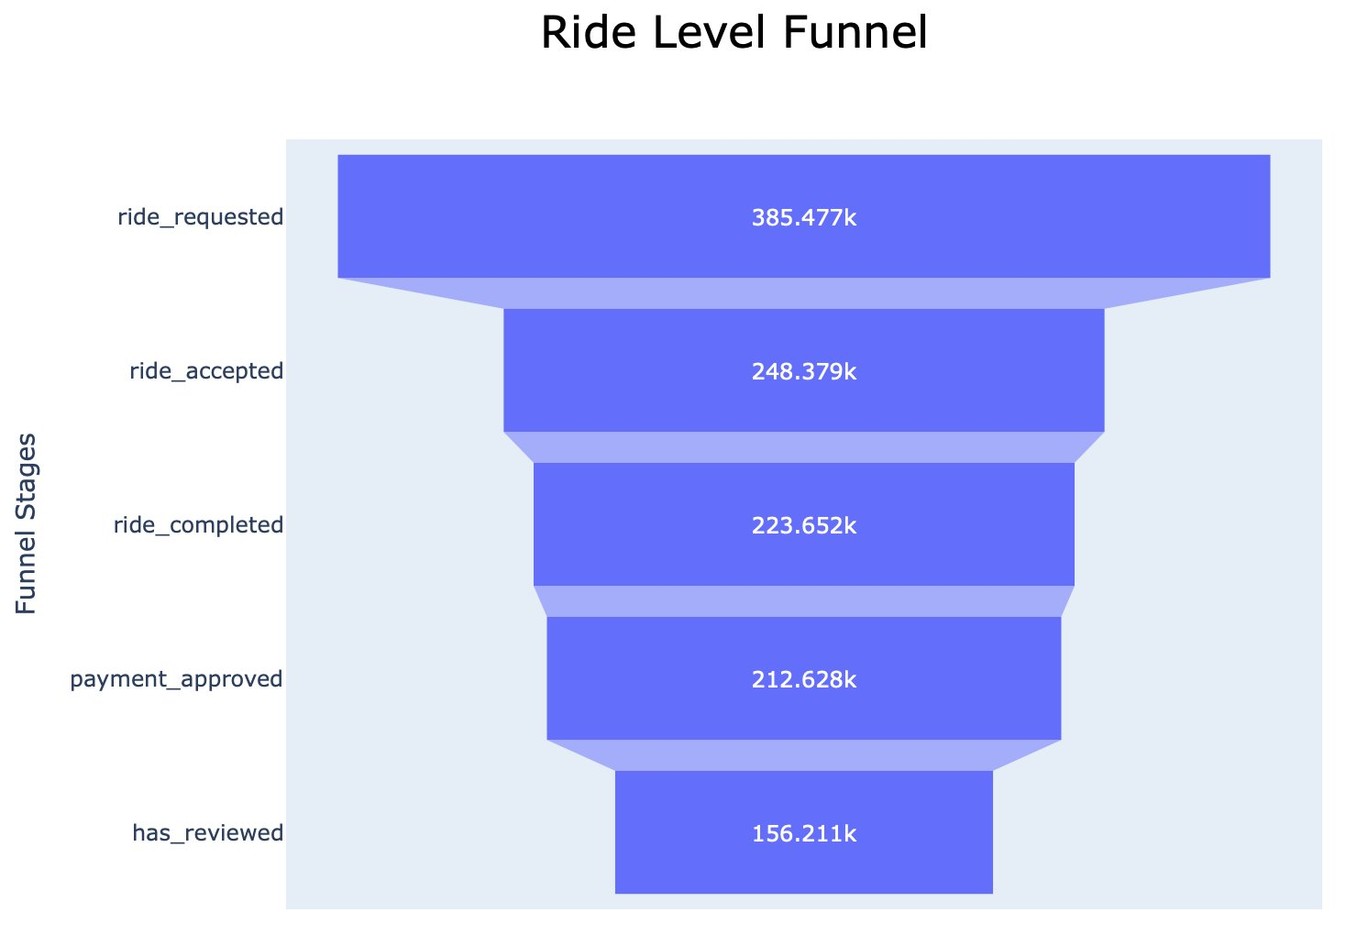


The highest drop off (almost 35%) between ride requested and
ride accepted stages

Slide 5
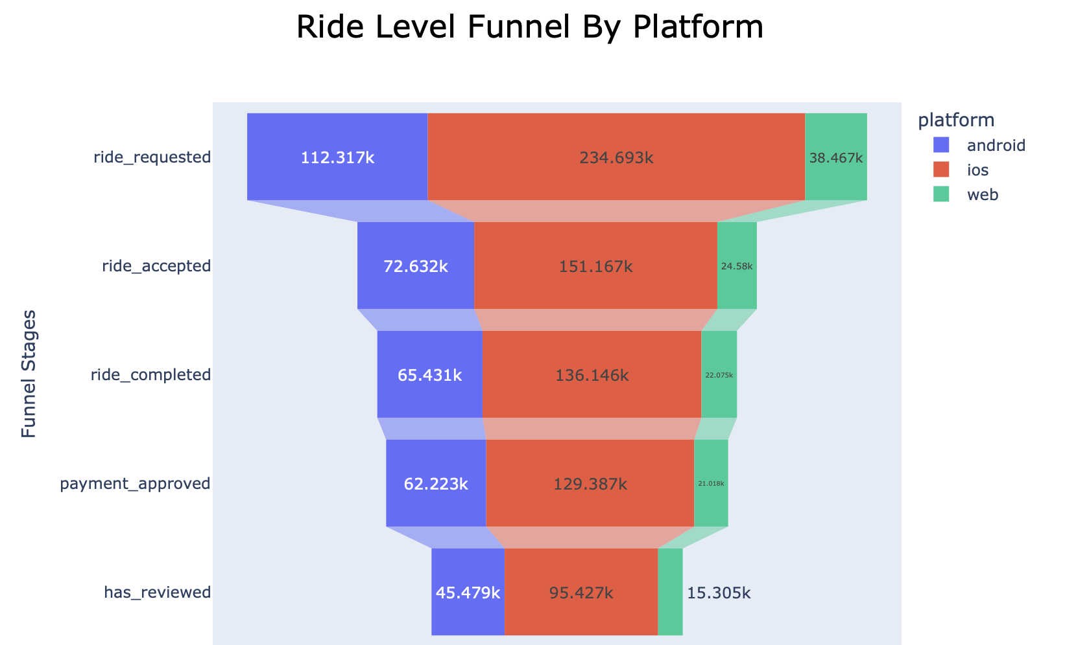
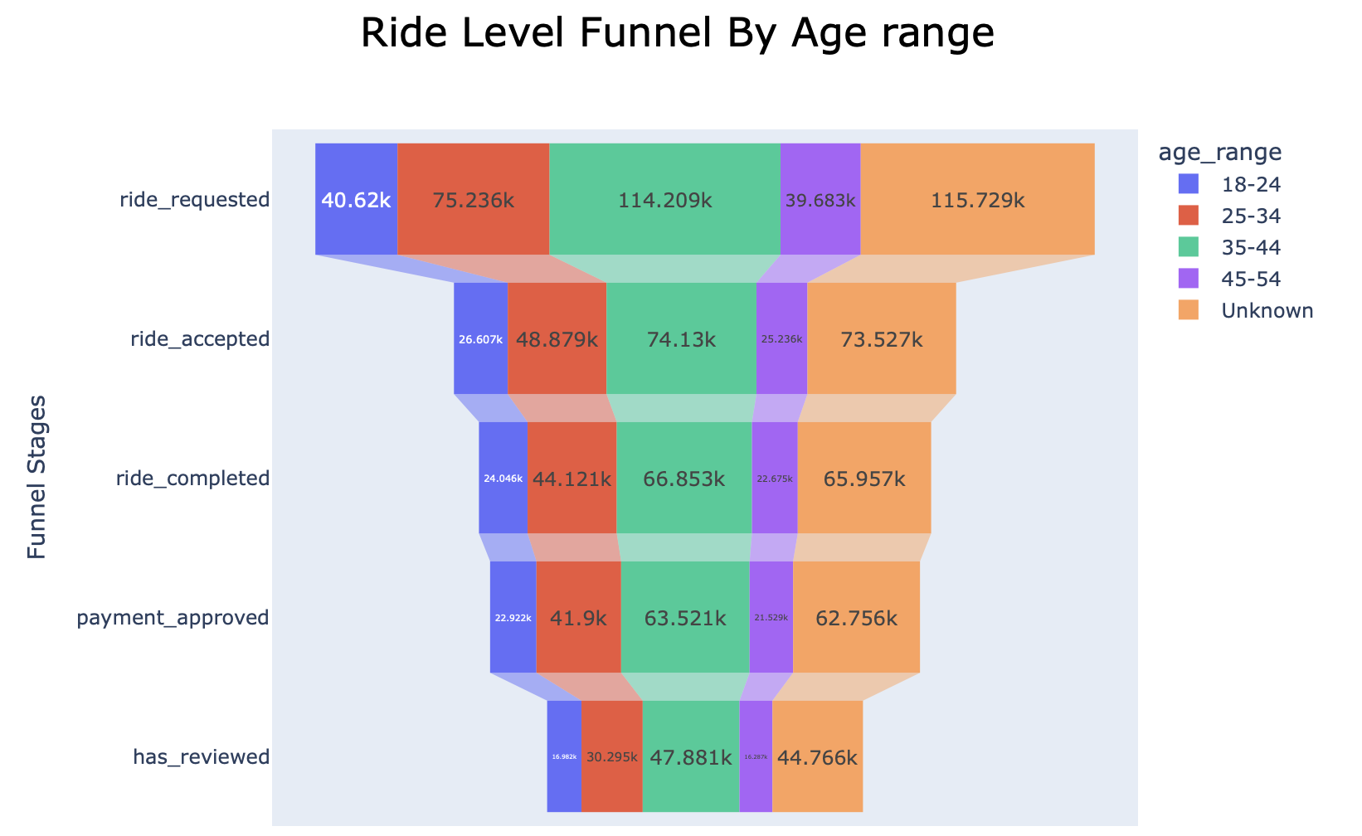
Further Analysis on Ride Level Data
The web platform is underperforming
Target audience for marketing campaign should be age range of 25-34 and 35-44

Slide 6
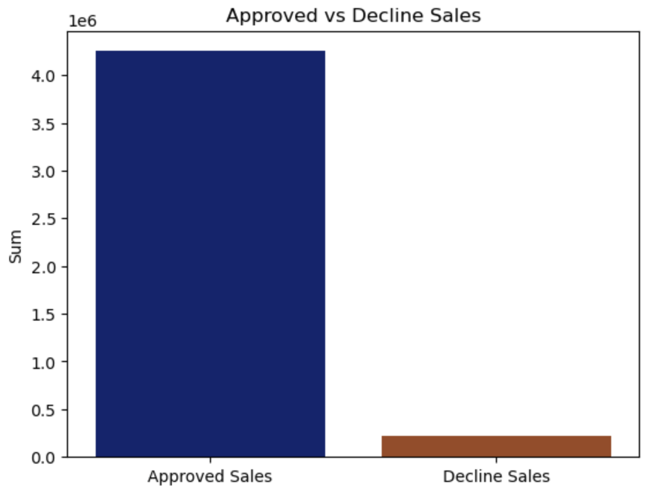
Approved Vs Declined Sales
5.2% of the total sales amount is declined
Users with a "Payment Declined" status should be addressed

Slide 7
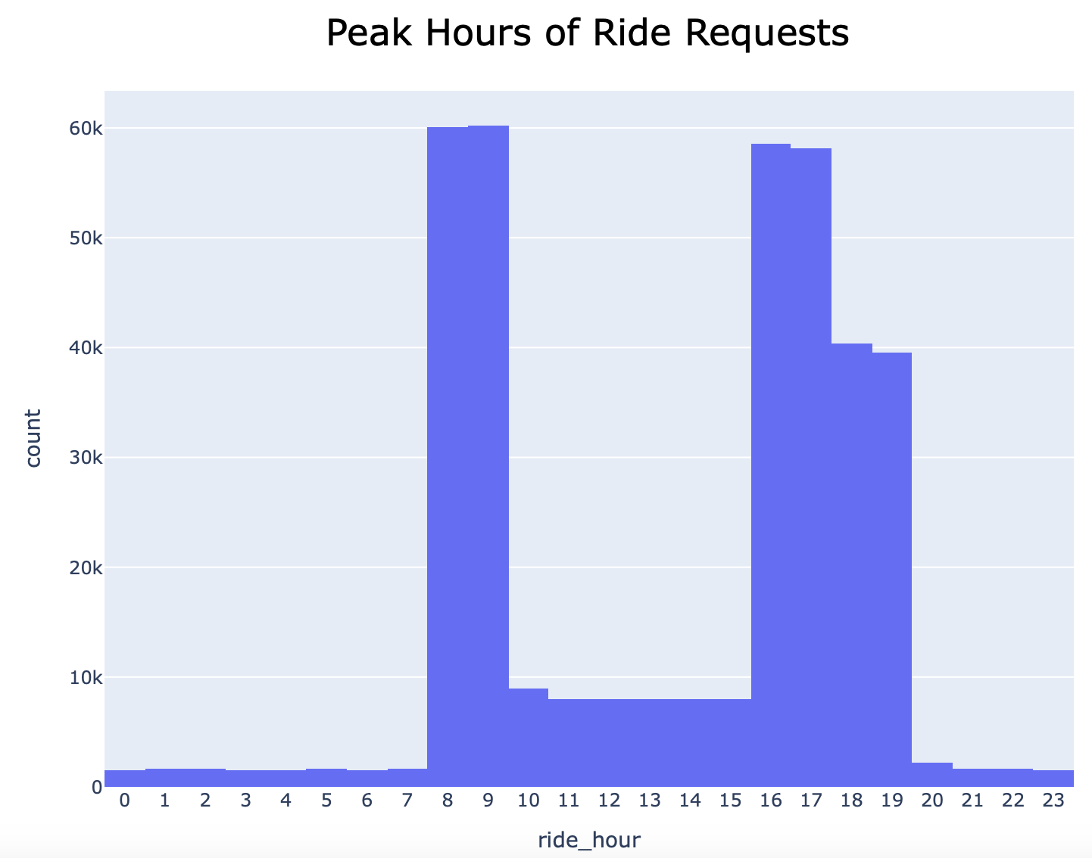
Peak Hours
Peak hours to adopt a price-surging strategy are
8 to 10 in morning
4 to 6 in evening

Slide 8
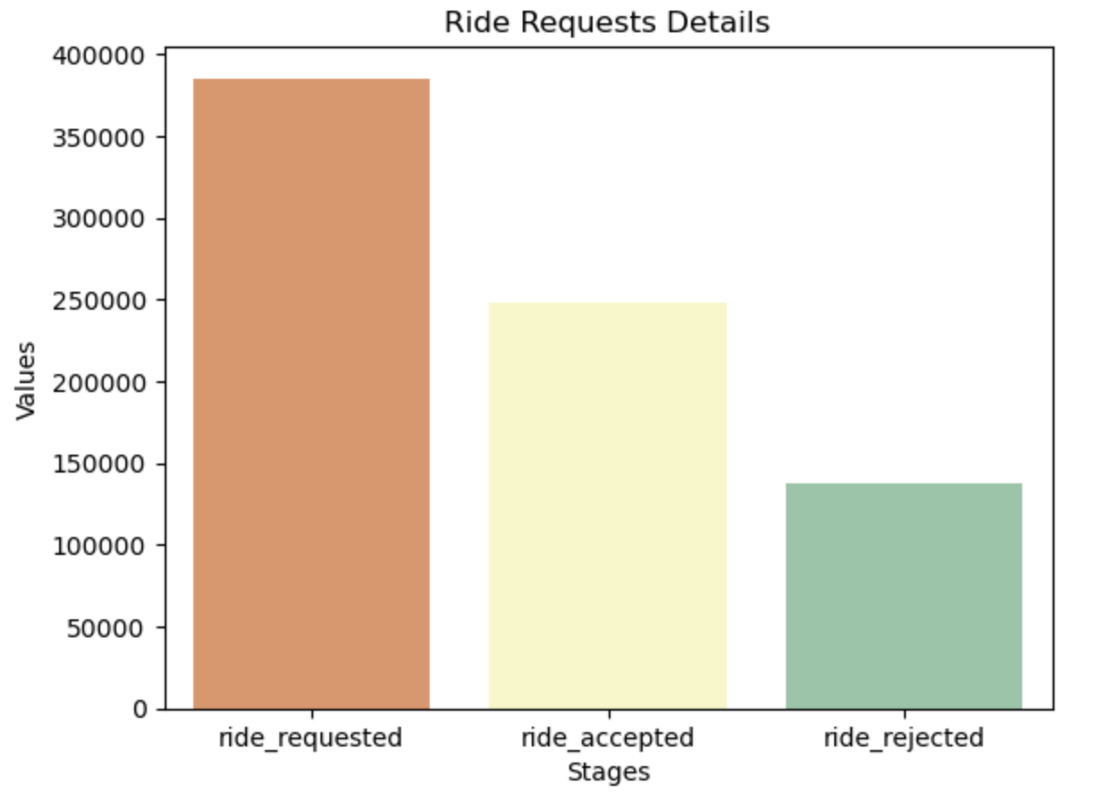
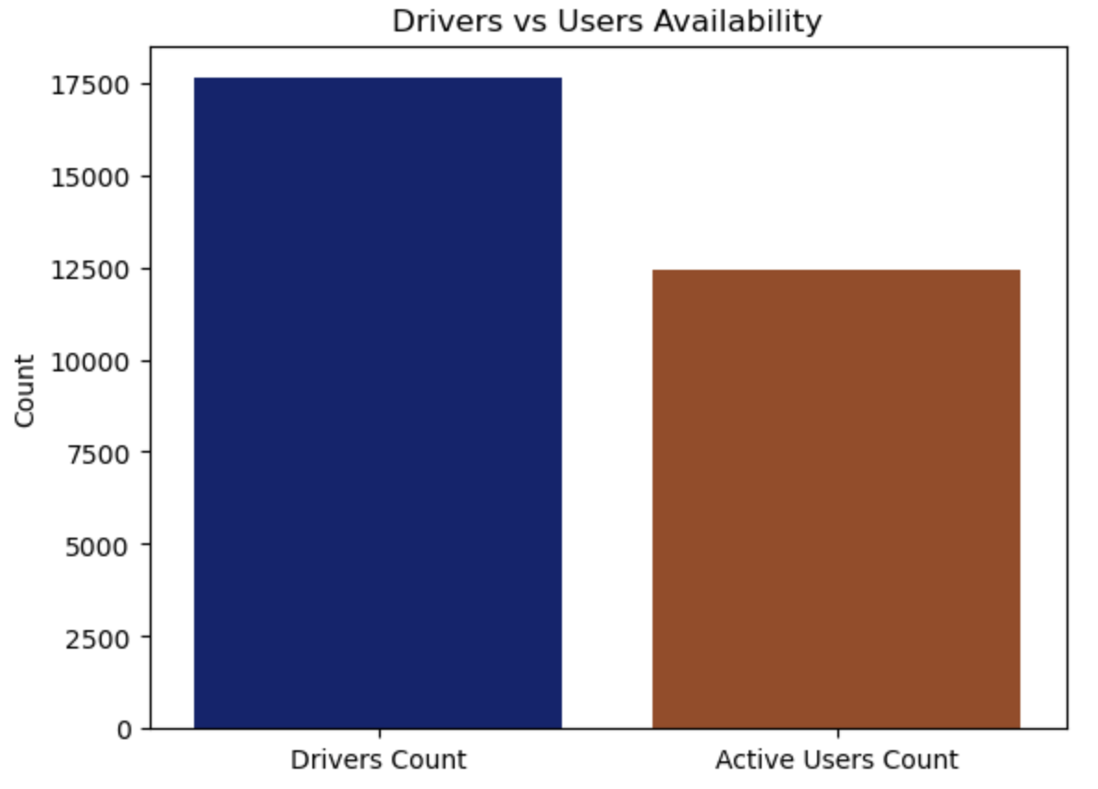
The graph below suggests that additional data is needed to understand why drivers are not accepting rides despite being available and to develop solutions to address this issue.
​
35% of ride requests are missing a driver ID

Slide 9
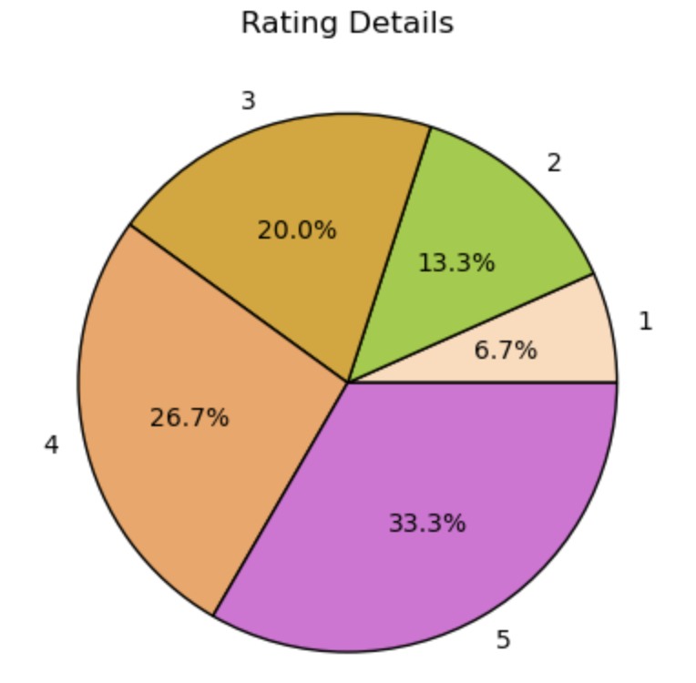
1 - poor 5 - excellent
Customer reviews to understand their perspectives by assessing ratings.
Only 40.5% of the customers have given reviews
60% of reviews are positive (4 and 5)

Slide 10
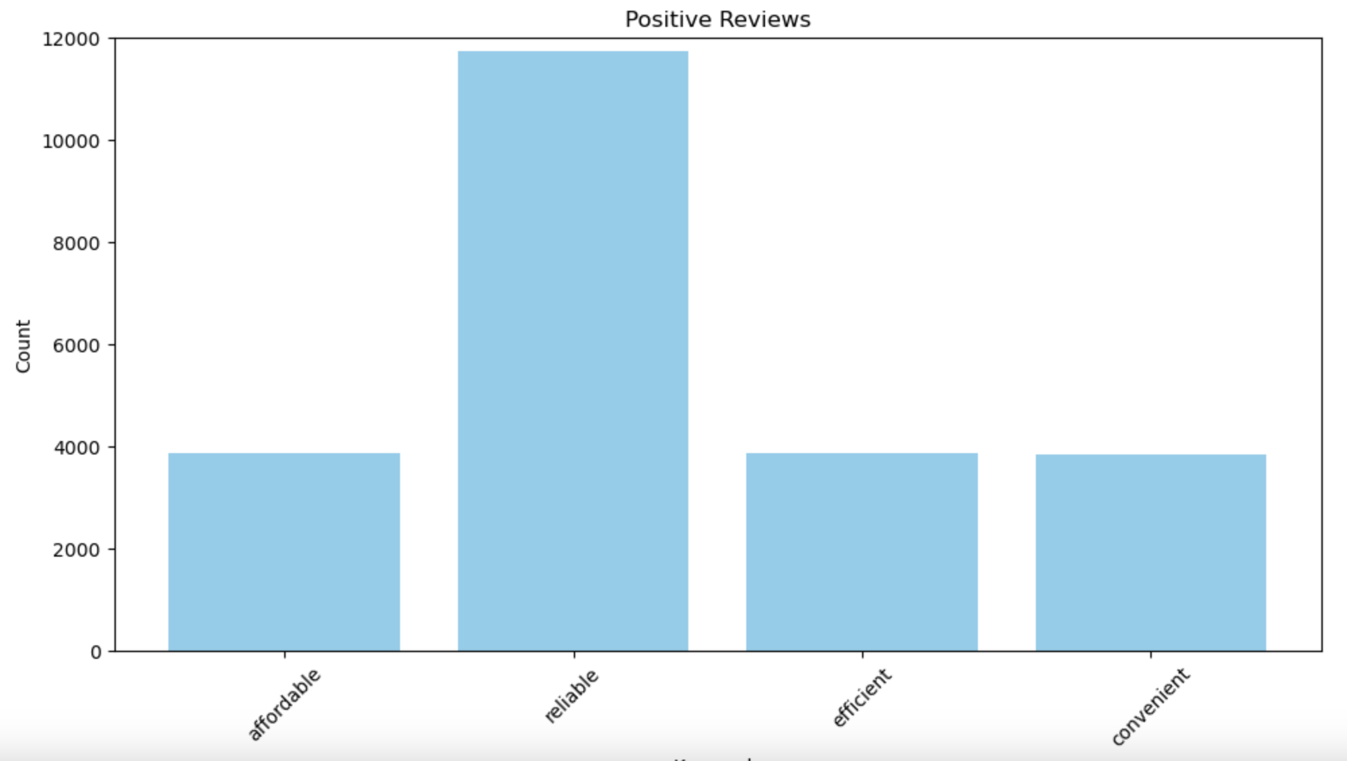
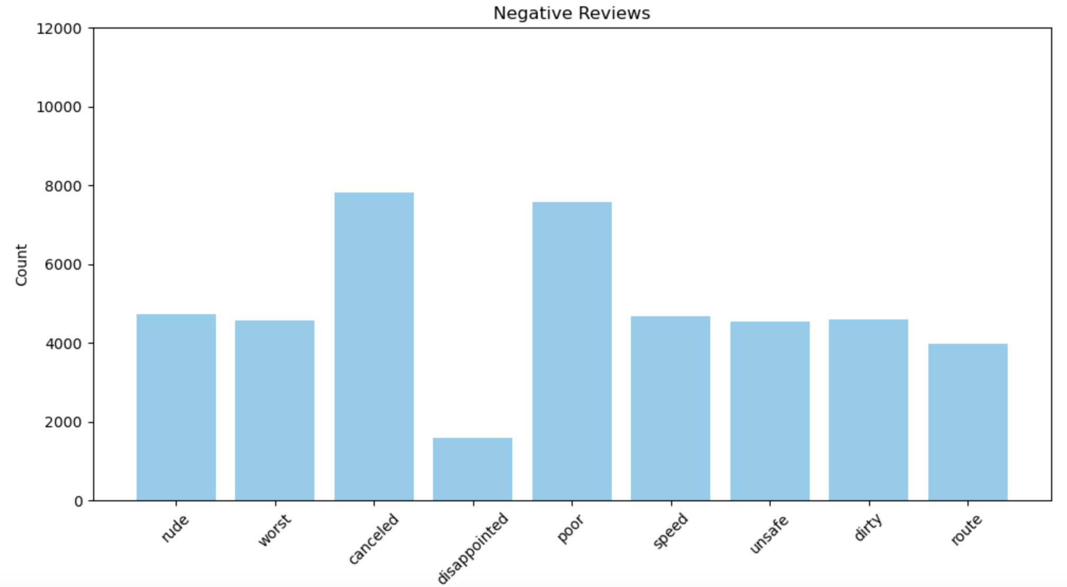



Positive and Negative Reviews

Slide 11
Recommendations
Implement speed limit in vehicles
Update to latest navigation systems to avoid longer routes
Provide training to address rude behavior and unprofessionalism
Conduct daily vehicle inspections and record keeping
Lowest conversion rate is from ride requested to ride accepted which can be improved through these recommendations

Slide 12


