Slide 1



CODEVEDA - HACKATHON 2026
Problem Statement Title: AI Powered - Smart Urban Mobility & Traffic Intelligence Platform for Bengaluru
Theme: Using Azure AI and real-time data to solve urban traffic congestion
Team Name: Debugging Trio
Team Leader’s Name: Poornima H A
Team Members: Muskhan B S, Monisha Thomas B, Poornima H A
Alliance School of Advanced Computing | Microsoft Azure Developer Community 1

Slide 2

SMART URBAN MOBILITY PLATFORM
Problem Statement & Proposed Solution
Bengaluru faces severe traffic congestion due to rapid urban growth, increasing vehicle density, and limited real-time traffic intelligence systems.
We developed a cloud-based smart mobility platform leveraging Azure AI, geospatial analytics and real-time data to predict congestion and recommend optimized routes.
Unique features: Dynamic signal management, Azure AI alerts, Emergency vehicle routing, 4-hour traffic prediction — all in one real-time dashboard
ASAC
2
Alliance School of Advanced Computing | Microsoft Azure Developer Community 2
Notes:
2

Slide 3
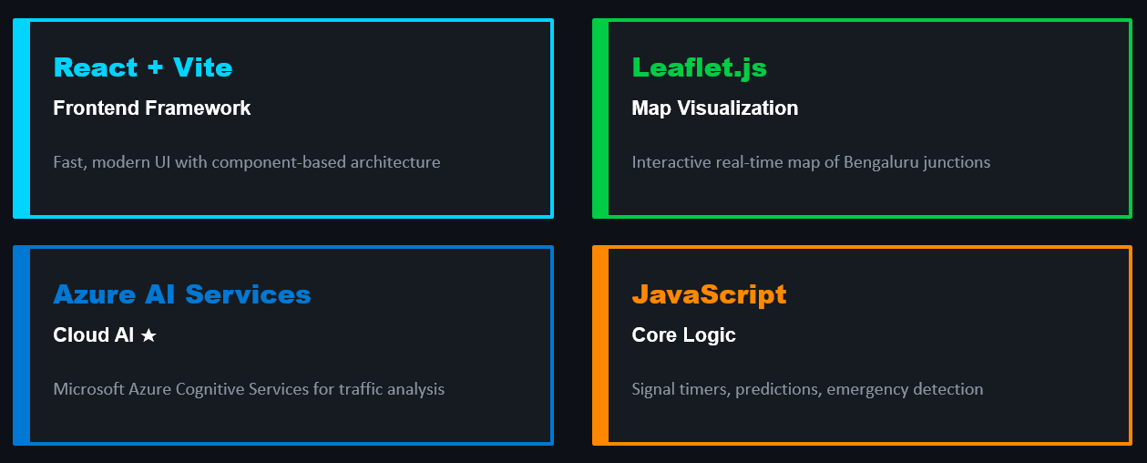
TECHNOLOGY & METHODOLOGY
Alliance School of Advanced Computing
3
Alliance School of Advanced Computing | Microsoft Azure Developer Community 3
Notes:
3

Slide 4
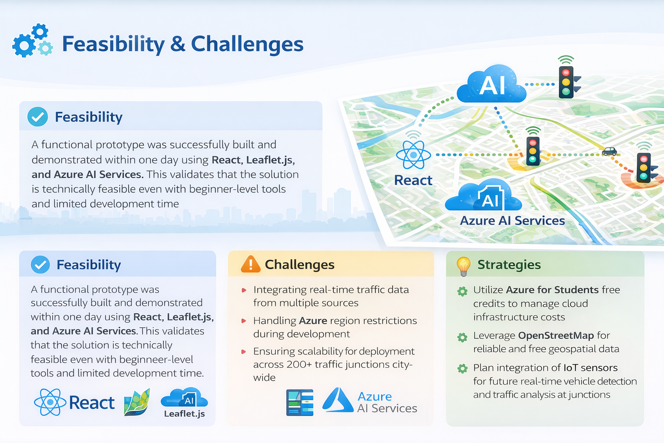
FEASIBILITY AND VIABILITY
Alliance School of Advanced Computing
4
Alliance School of Advanced Computing | Microsoft Azure Developer Community 4
Notes:
4

Slide 5
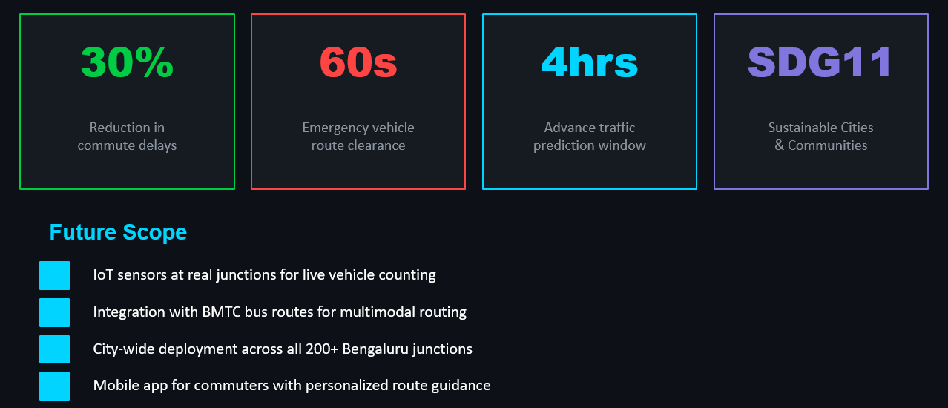
IMPACT AND BENEFITS
Alliance School of Advanced Computing
5
Alliance School of Advanced Computing | Microsoft Azure Developer Community 5
Notes:
5

Slide 6
RESEARCH AND REFERENCES
Microsoft Azure AI Services — https://learn.microsoft.com/en-us/azure/ai-services/
Leaflet.js Map Library — https://leafletjs.com
OpenStreetMap Geospatial Data — https://www.openstreetmap.org
SDG 11 Sustainable Cities — https://sdgs.un.org/goals/goal11
Traffic Index 2024-26 — Bengaluru ranked top 10 most congested cities globally
Alliance School of Advanced Computing
6
Alliance School of Advanced Computing | Microsoft Azure Developer Community 6
Notes:
6

