Slide 1
Impact of COVID-19 on Housing Market
Mecklenburg County, NC
Poornima Muthukumar

Slide 2
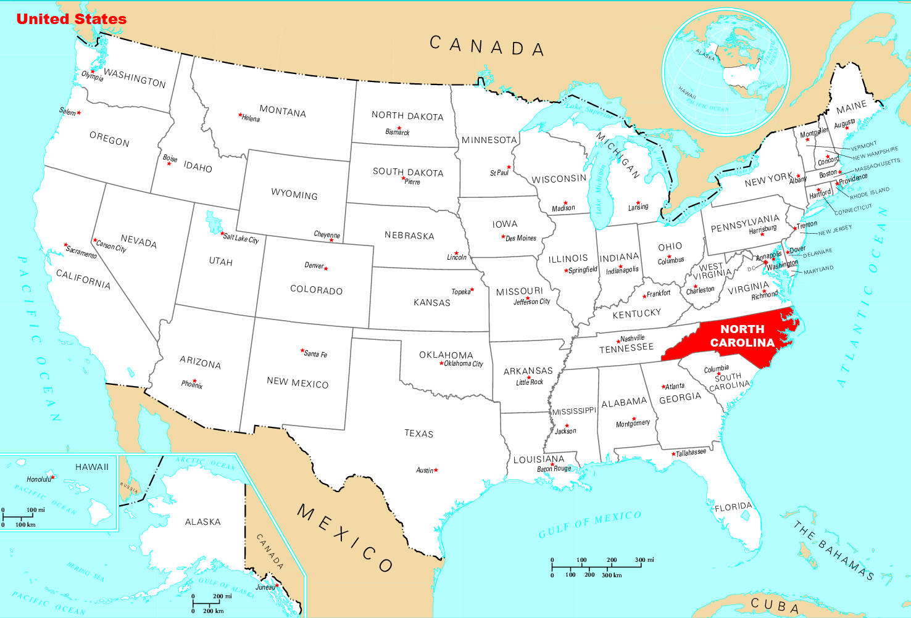
Mecklenburg County
This analysis will look to determine how surges in COVID-19 Cases have impacted Real Estate sale price trends in/around Mecklenburg county in 2020 & 2021.
State of North Carolina
Population of 1.1M

Slide 3
Motivation
Volatility: Housing market has been immensely volatile since the start of the pandemic.
Complexity: Several home buyers were wondering whether to wait till the housing market crashes or should they buy before it increases further.

Slide 4

Research Question
During the COVID-19 pandemic did the housing prices go up or down from January 2020 through August 2021?
Did the number of COVID-19 cases have an impact on the housing prices, inventory, list price, sale price from January 2020 through August 2021
Where there any other trends in the housing market related to the covid-19 pandemic.

Slide 5
Data Source
The weekly housing market data from Redfin.
The monthly housing market data from Redfin.
The RAW_us_confirmed_cases.csv file from the Kaggle repository of John Hopkins University COVID-19 data.

Slide 6
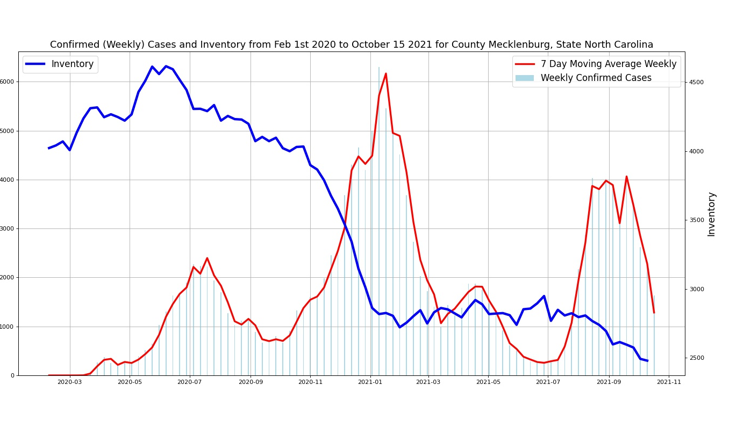
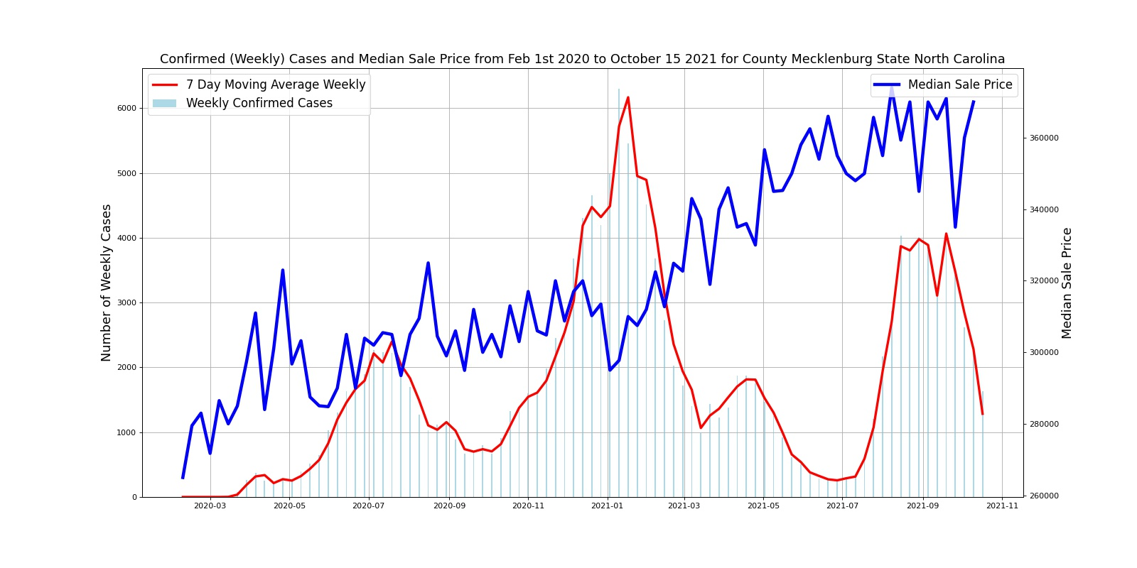
Weekly Cases Vs Housing Inventory & Median Sale Price
Housing Inventory
There was a sudden drop in housing inventory as the cases started to rise in January 2021.
Median sale price have an upward trend with a sharp increase since January 2021 perhaps directly correlated to the reduction in inventory.
Median sale price

Slide 7
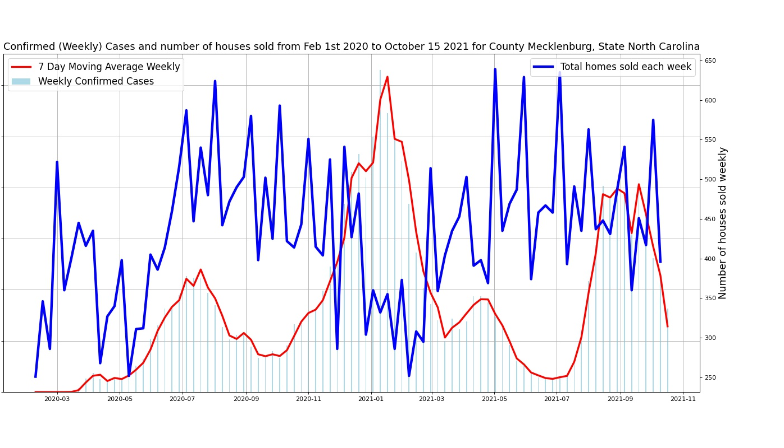
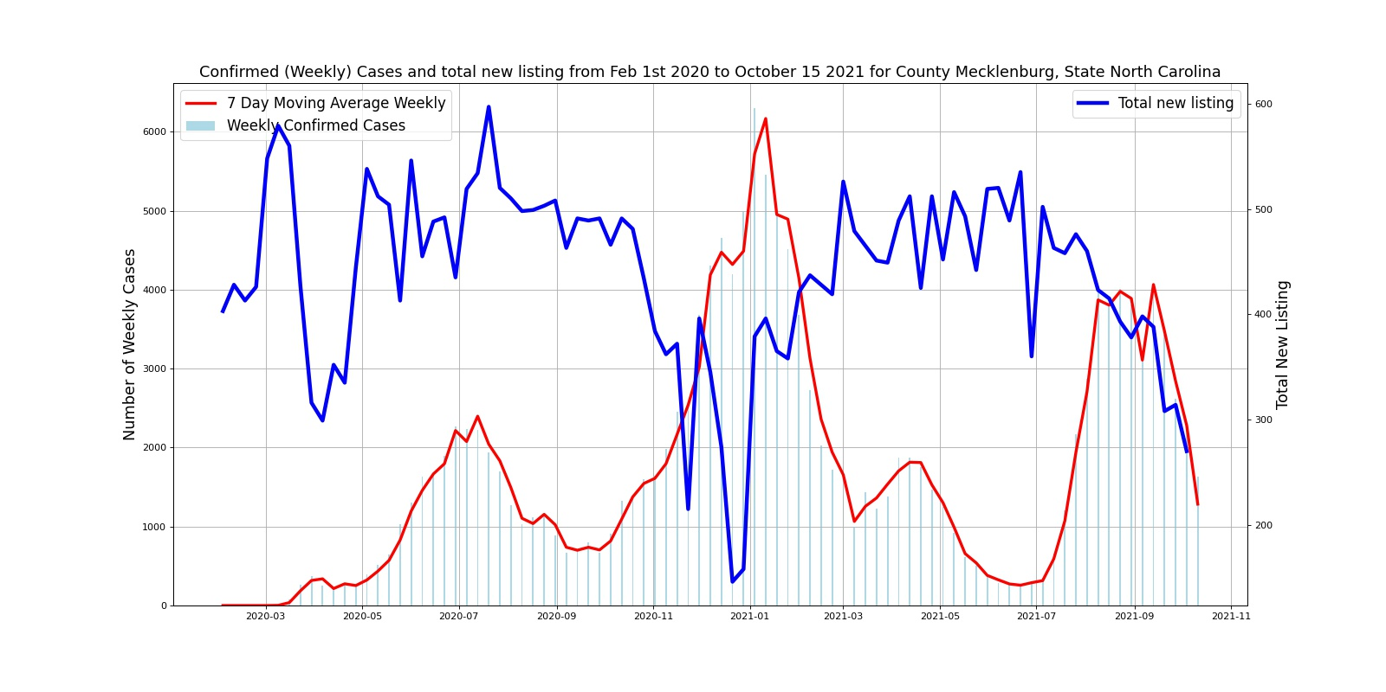
Weekly Cases Vs Total Homes Sold & Total New Listing
Total Homes Sold
Total Homes Sold dropped when there was a sudden rise in cases around January 2021 – perhaps pointing to a lockdown making it difficult to sell homes.
Similarly, we can see Total New Listing dropped every time there was an increase in weekly cases more than 4000.
Total New Listing

Slide 8
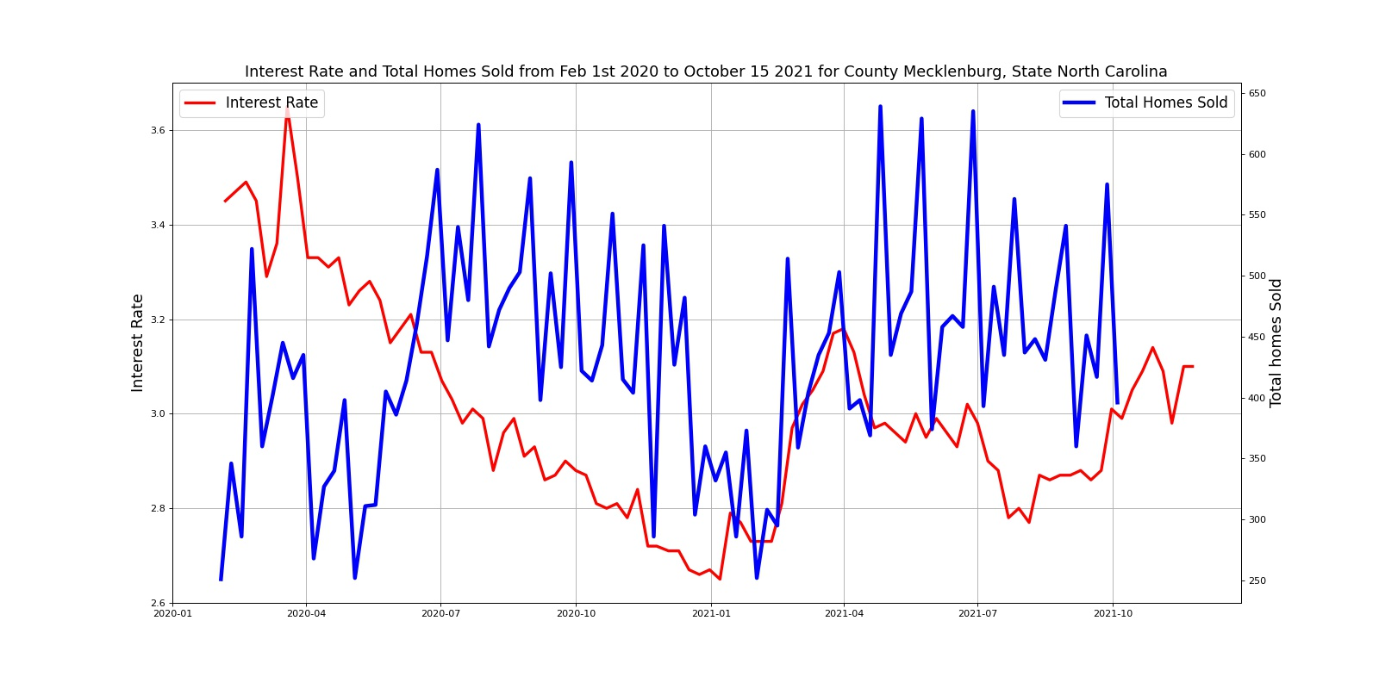
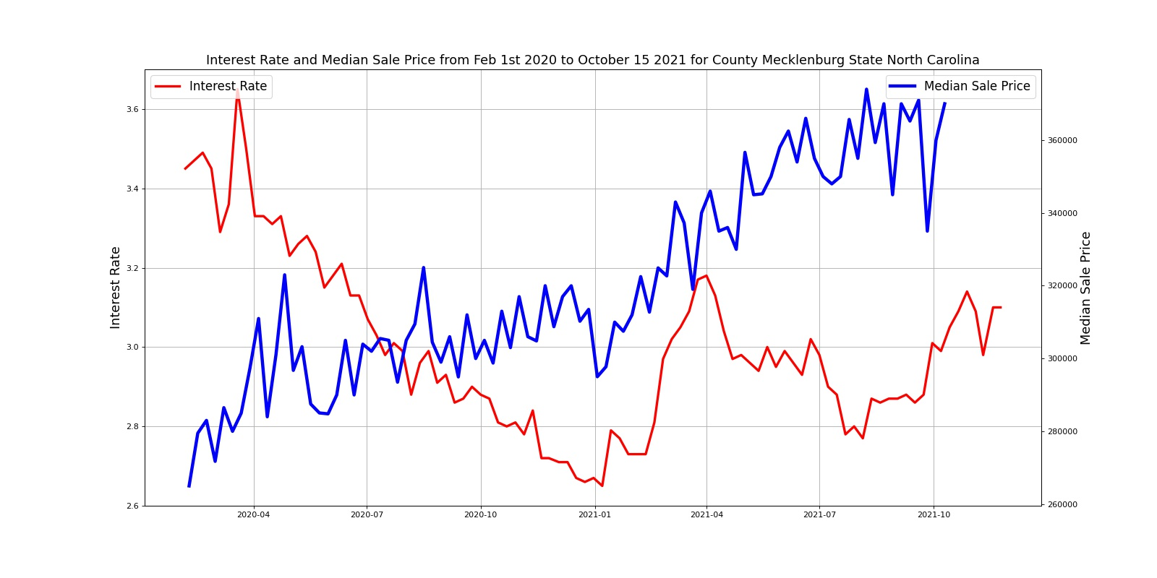
Interest Rate Vs Total Homes Sold & Median Sale Price
Total Homes Sold
Sudden decrease in interest rate did not lead to higher number of homes sold as one would think. Perhaps, people were scared to buy homes at the peak of uncertainty which is also the same time the interest rate dropped to the lowest.
The median sale price increased as the interest rate dropped. But is it hard to tell whether the increase in median sale price was linked to a drop in increase rate. Median sale price increase seems more likely linked to drop in inventory and increase in overall cost.
Median Sale Price

Slide 9
Linear Regression
I performed linear regression to predict housing prices for 2020 and 2021 and compare it with actual housing prices to see if there is a difference between predicted and actual housing prices for 2020 and 2021.

Slide 10
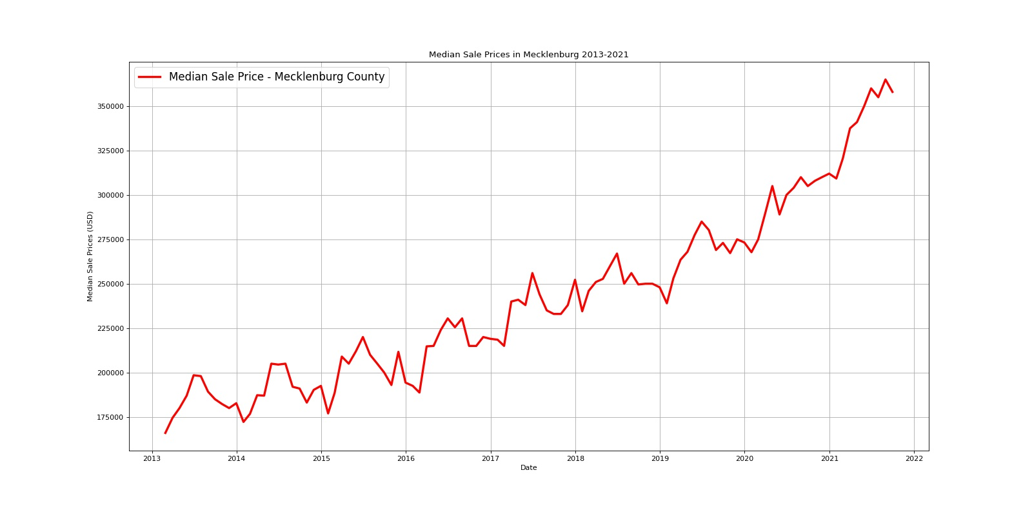
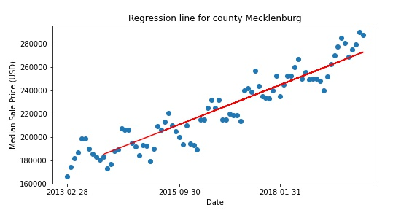
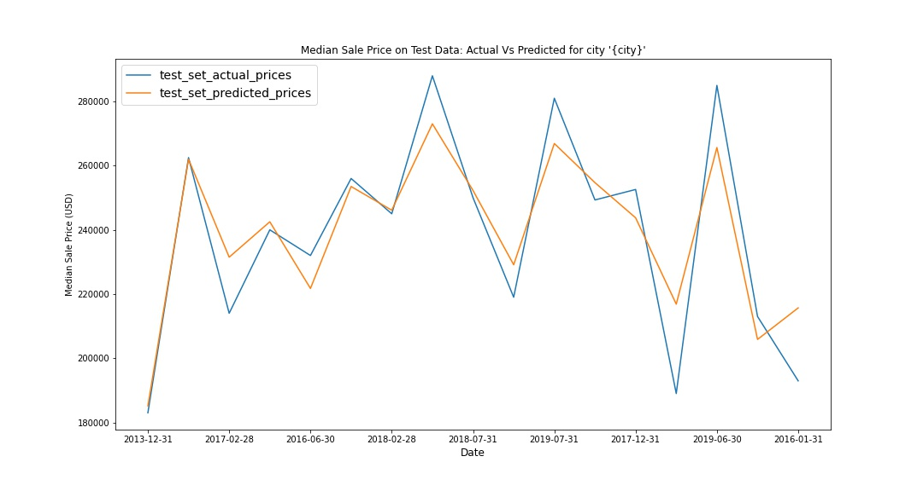
Linear Regression
Took Redfin’s Monthly Housing Market Data to train the model.
Wanted to avoid 2008 recession data due to outliers.
Took data set from 2010 – 2019 for training the model.
Split the data into 80/20 for training and testing the model.
Restricted data to single family homes (SFH).
Median Sale Price
Regression Line
Test Set Prediction

Slide 11
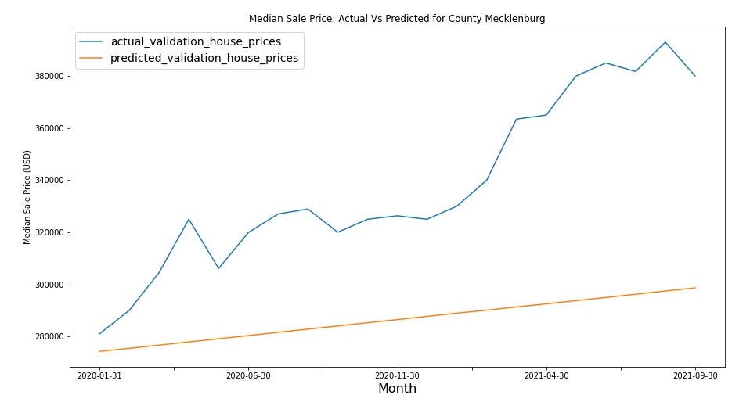
Housing Price Increase in 2020 & 2021 is significantly higher compared to previous years.
Year | % Change
2014 | 0.026586
2015 | 0.051282
2016 | 0.131707
2017 | 0.012931
2018 | 0.089362
2019 | 0.050781
2020 | 0.222770
2021 | 0.194801

Slide 12
Reflection
Since January 2021 when covid cases reached its peak, there has been a sudden drop in housing inventory and a sudden increase in median sale price of the house.
Every time there was a sudden spike in cases (cases > 4000) there was a decline in the number of homes sold and the number of new listings perhaps indicating due to a lockdown.
A combination of drop in interest rate and drop in inventory fueled median sale price of homes to increase.
Percentage Change in median Housing price in 2020 & 2021 is much higher than previous years.

