Slide 1

CVR COLLEGE OF ENGINEERING DEPARTMENT OF EMERGING TECHNOLOGIES MINOR PROGRAMME-CYBERSECURITY
Detection of Denial of Service Attack(DOS) in Wireless Sensor Networks using Machine Learning
by
Dussa Pavan (20B81A05L3)
Jirra Vigneshwar(20B81A0457)
Under guidance of
MS. K. Sindhuja
Assistant Professor

Slide 2
Contents
Abstract
Domain Introduction
Challenges and Problem Statement
Existing methodologies
Proposed Solution
Technology Stack
Use-Case Diagram
Class Diagram
Activity Diagram
System Architecture
Dataset
Conclusion
Results
References

Slide 3
Abstract
Wireless sensor networks (WSNs) are like a bunch of tiny smart devices that communicate wirelessly to gather and share information. Wireless sensor networks (WSNs) are widely used in many areas due to their features and effectiveness.
A Denial-of-Service (DoS) attack is meant to shut down a machine or network, making it inaccessible to its intended users.
This project aims to develop a system that detects DOS attacks in Wireless sensor networks (WSN) using Machine Learning. Earlier proposed approaches use Decision Trees (DT) to detect DOS attacks which provided an accuracy of about 90% .
This project aims to overcome the earlier problems using other Machine Learning Algorithms such as Naive Bayes, XGBoost ,Random Forest , etc. which help to enhance the performance in the detection of DOS Attacks in WSN.

Slide 4
Domain Introduction
Cybersecurity:
Protects computer systems, networks, and data.
Focuses on threat detection, prevention, and response.
Utilizes tools like firewalls, IDS, encryption.
Addresses malware, phishing, DoS attacks, insider threats.
Machine Learning:
Subset of AI enabling computers to learn from data.
Develops algorithms for pattern recognition, prediction.
Used in various fields like NLP, computer vision, finance.
Increasingly applied in cybersecurity for threat detection.
Innovations driven by advancements in algorithms and data availability.

Slide 5
Challenges and Problem Statement
Wireless Sensor Networks (WSNs), integral to diverse applications, face a critical security challenge with the rising threat of denial-of-service (DoS) attacks.
Existing methods exhibit limitations in effectively addressing the evolving nature of DoS attacks, often lacking in efficiency, adaptability, computational cost, power etc.
The proposed approach aims to overcome the existing problems and provide a light weight Machine Learning Approach in detecting DOS attack in Wireless Sensor Networks.

Slide 6
Existing Methodologies
Author | Title | Description | Year of Publication
Vinaya Kumar | Deep Learning Approach for Intrusion Detection system | limitations and constraints regarding cost | 2019
Otoum | Deep Learning Techniques to detect Dos attacks in sensor networks | Deep learning approach requires more computational power than Machine Learning model. | 2019
Prem Kumar | Deep Learning Based defensive mechanism for Dos attacks | Appropriate for only for low or no mobility sensor networks | 2020
Ismail | A lightweight Multilayer Machine Learning Approach for Dos attack Detection | Two classification layers requires more computational cost | 2022

Slide 7
Existing Methodologies
Method | Accuracy | Key Models
Advancements in Wireless Sensor Network Security Using Artificial Neural Networks | 97.3% | Artificial Neural Networks
Deep Learning Techniques for DoS Attacks Detection in Wireless Sensor Networks | 98.1% | CNN+RNN, DNN
Enhancing Intrusion Detection Systems with Machine Learning Techniques | 98.4% | KNN, DT, LR
Proposed Method | 99.76% | Naïve Bayes, XGBoost, Random Forest

Slide 8
Proposed Solution
The proposed solution leverages a diverse set of machine learning algorithms including Naive Bayes, XGBoost, Random Forest , among others, to enhance the detection performance of Denial of Service (DoS) attacks in Wireless Sensor Networks (WSNs).
By harnessing the strengths of these algorithms, the approach aims to provide robust and adaptive defense mechanisms capable of effectively identifying and mitigating DoS threats in resource-constrained WSN environments.

Slide 9
Technology Stack
Jupyter Notebook 6 or higher
Python 3.11.4 or higher
Machine Learning algorithms
XGBoost
Random Forest
Naïve Bayes
NumPy
Pandas
Sklearn
Matplotlib

Slide 10
Hardware Requirements
Processor : Intel i3 or Ryzen 3 and higher
RAM: 4GB and Higher
OS: Windows 10 and higher or Mac OS
ROM:128GB and higher

Slide 11
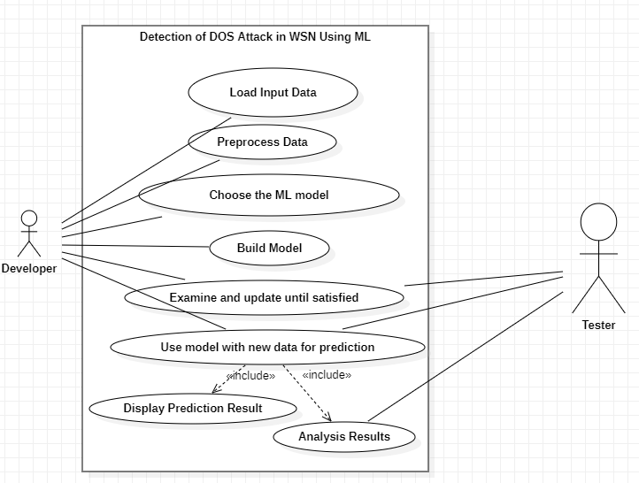
Use Case Diagram

Slide 12
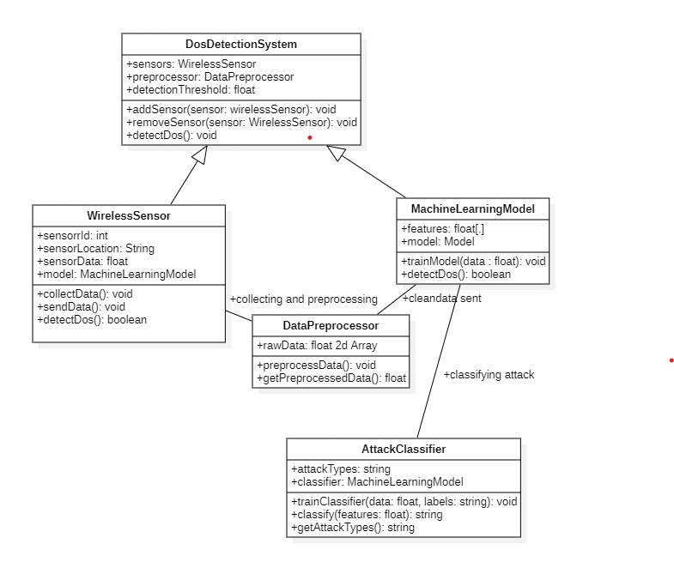
Class Diagram

Slide 13
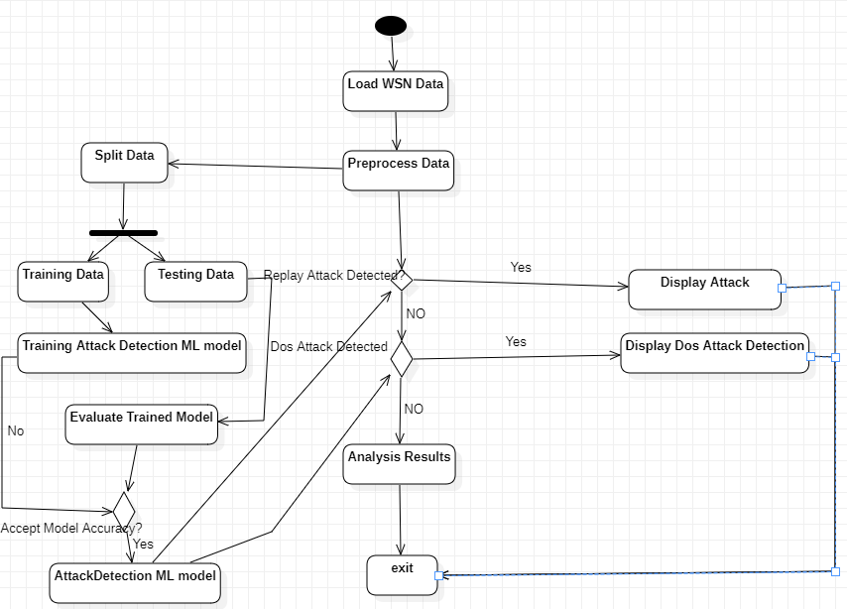
Activity Diagram

Slide 14
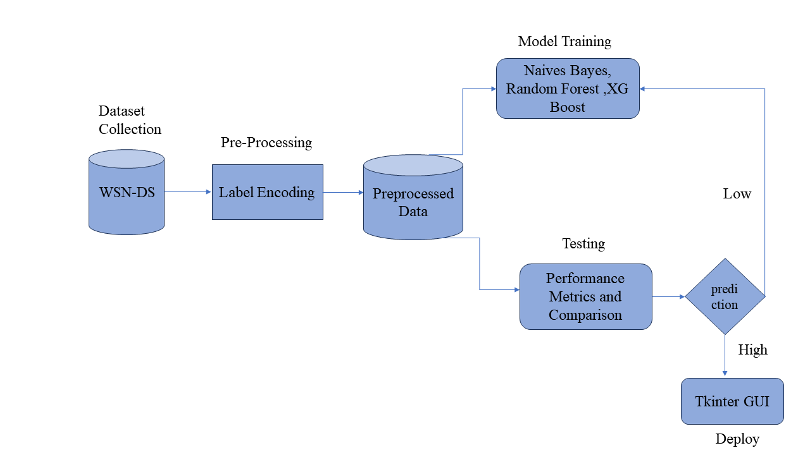
System Architecture Diagram

Slide 15
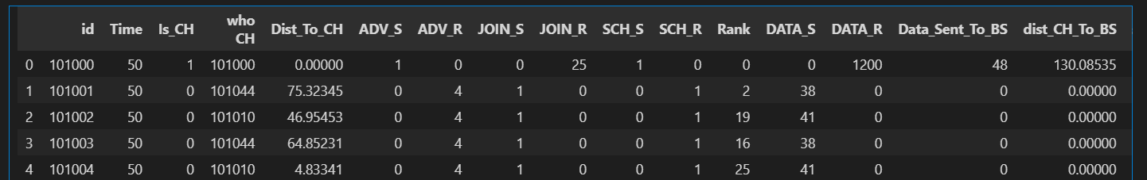
Dataset
Name of the Dataset : WSN-DS
Size :374,661 x 19
Types of Attacks : Black hole ,Gray Hole, TDMA Floods

Slide 16
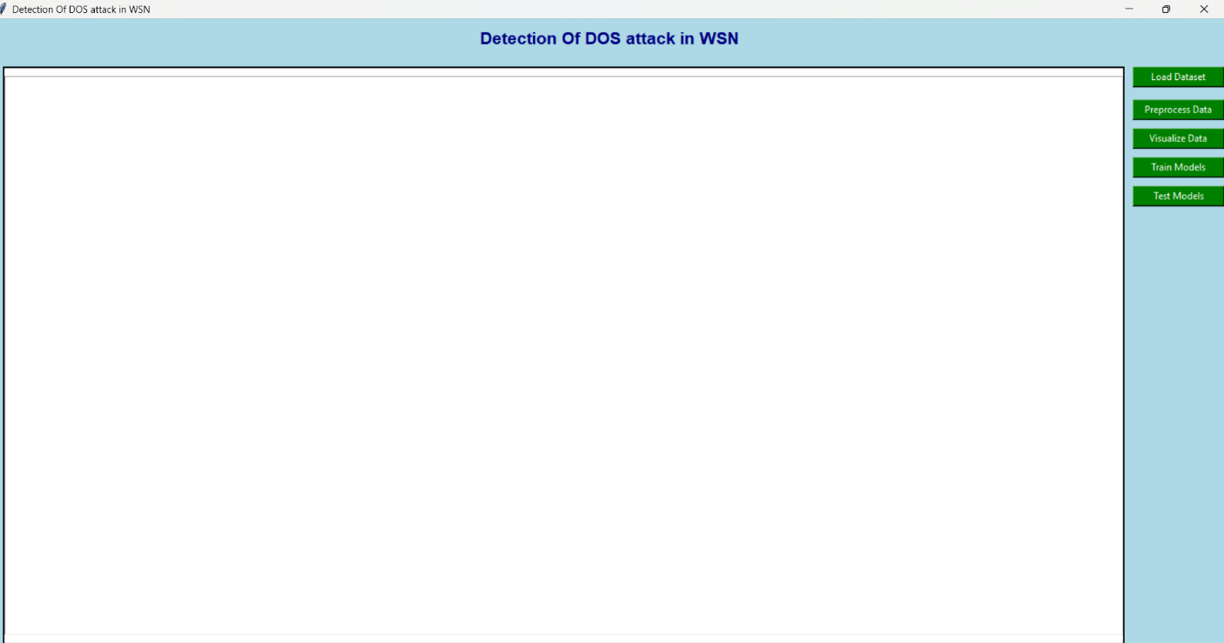
Proposed System
UI of DOS Attack Detection System

Slide 17
Conclusions
Model | Accuracy | F1-score | Precision | Recall
XGBoost | 99.76 | 100 | 99.0 | 98.2
Random Forest | 99.72 | 100 | 98.6 | 98.0
Naïve bayes | 84.86 | 85 | 56.2 | 70.6

Slide 18
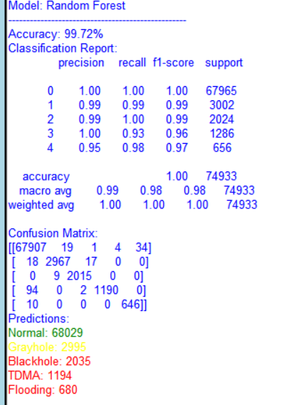
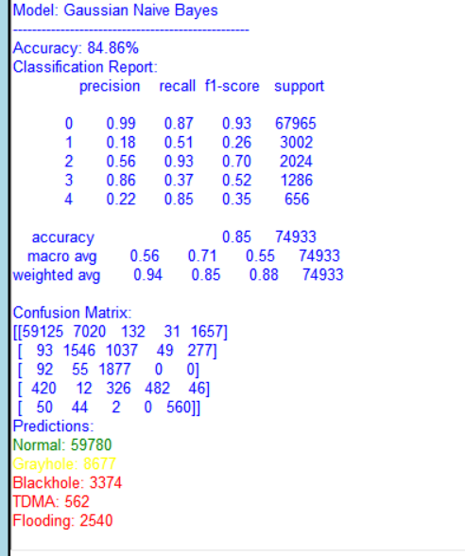
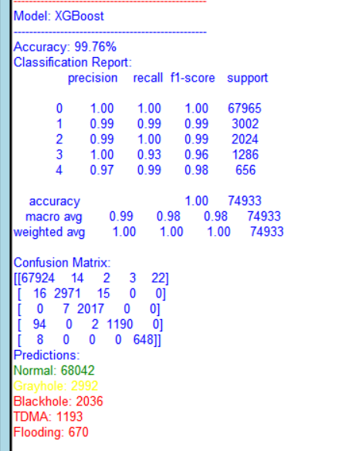
Results

Slide 19
References
[1] M. A. Elsadig, "Detection of Denial-of-Service Attack in Wireless Sensor Networks: A Lightweight Machine Learning Approach," in IEEE Access, vol. 11, pp. 83537-83552, 2023, doi: 10.1109/ACCESS.2023.3303113.
[2] G. G. Gebremariam, J. Panda, and S. Indu, ‘‘IoT-based wireless sensor networks using federated learning,’’ Wireless Commun. Mobile Comput., vol. 2022, pp. 1–27, Jan. 2023, doi: 10.1155/2022/8068038.
[3] M. Faris, M. N. Mahmud, M. F. M. Salleh, and A. Alnoor, ‘‘Wireless sensor network security: A recent review based on state-of-the-art works,’’ Int. J. Eng. Bus. Manage., vol. 15, Jan. 2021, Art. no. 184797902311572, doi: 10.1177/18479790231157220.
[4] S. Ashraf, O. Alfandi, A. Ahmad, A. M. Khattak, B. Hayat, K. H. Kim, and A. Ullah, ‘‘Bodacious-instance coverage mechanism for wireless sensor network,’’ Wireless Commun. Mobile Comput., vol. 2020, pp. 1–11, Nov. 2020, doi: 10.1155/2020/8833767.
[5] X. Feng, X. Ding, and S. Sun, ‘‘A security detection scheme based on evidence nodes in wireless sensor networks,’’ in Proc. 6th Int. Conf. Biomed. Eng. Informat., Dec. 2019, pp. 689–693, doi: 10.1109/BMEI.2019.6747027.
[6] H. Yang, L.-X. Wei, and X.-Y. Yang, ‘‘Sybil attack detection scheme in wireless sensor network,’’ Jisuanji Gongcheng/Comput. Eng., vol. 37, no. 12, pp. 122–124, 2019.

