Slide 1




Attention-Based RUL Prediction for Aircraft Engine Health Monitoring
Group 7:
Ch. Sarvani Sruthi - cb.sc.u4aie24311
Poornima P - cb.sc.u4aie24343
Shri Manasa S - cb.sc.u4aie24356
Sowmya A - cb.sc.u4aie24357

Slide 2

Introduction
  Aircraft engine failures can lead to severe safety risks and high maintenance costs
  Traditional maintenance strategies are:
  Reactive (after failure)
  Schedule-based (fixed intervals)
  These approaches do not utilize real-time sensor data effectively
  Predictive maintenance aims to estimate the Remaining Useful Life (RUL) of equipment before failure
  Data-driven deep learning models enable accurate modeling of complex degradation patterns in modern engines

Slide 3
Problem Statement
  Aircraft turbofan engines operate under complex mechanical and thermal conditions.
  Continuous sensor measurements generate high-dimensional multivariate time-series data.
  Predicting the Remaining Useful Life (RUL) of an engine is challenging due to:
  Non-linear degradation behavior
  Sensor noise and redundancy
  Long-term temporal dependencies
  Manual sensor selection is subjective and may ignore important degradation patterns.
  Therefore, there is a need for a data-driven, automated, and robust approach to accurately predict the RUL of turbofan engines using sensor data.

Slide 4
Objectives
  To predict the Remaining Useful Life (RUL) of turbofan engines using sensor data.
  To perform automatic sensor selection using data-driven degradation metrics.
  To capture temporal degradation behavior using deep learning models.
  To integrate CNN, Bidirectional LSTM, and Attention mechanisms for improved RUL prediction.
  To evaluate model performance using standard metrics such as:
  RMSE
  MAE
  R² Score
  Tolerance-based accuracy
  To visualize prediction performance and error characteristics for interpretability.

Slide 5

NASA C-MAPSS Dataset
  The C-MAPSS (Commercial Modular Aero-Propulsion System Simulation) dataset is developed by NASA.
  It simulates degradation of turbofan aircraft engines until failure.
  Widely used for:
  Remaining Useful Life (RUL) prediction
  The dataset is divided into four sub-datasets:
  FD001
  FD002
  FD003
  FD004

Slide 6

Each sub-dataset contains:
FD002 – Dataset Description
  Operating Conditions: Multiple
  Fault Modes: Single
  Environmental Variability: Present
  Complexity Level: Medium
FD003 – Dataset Description
  Operating Conditions: Single
  Fault Modes: Multiple
  Environmental Variability: None
  Complexity Level: Medium
FD004 – Dataset Description
  Operating Conditions: Multiple
  Fault Modes: Multiple
  Environmental Variability: High
  Complexity Level: High
  Engine ID – Unique engine identifier
  Cycle Number – Time index of engine operation
  Operating Conditions:
  Op1
  Op2
  Op3
  Sensor Measurements:
  21 sensors monitoring engine health

Slide 7

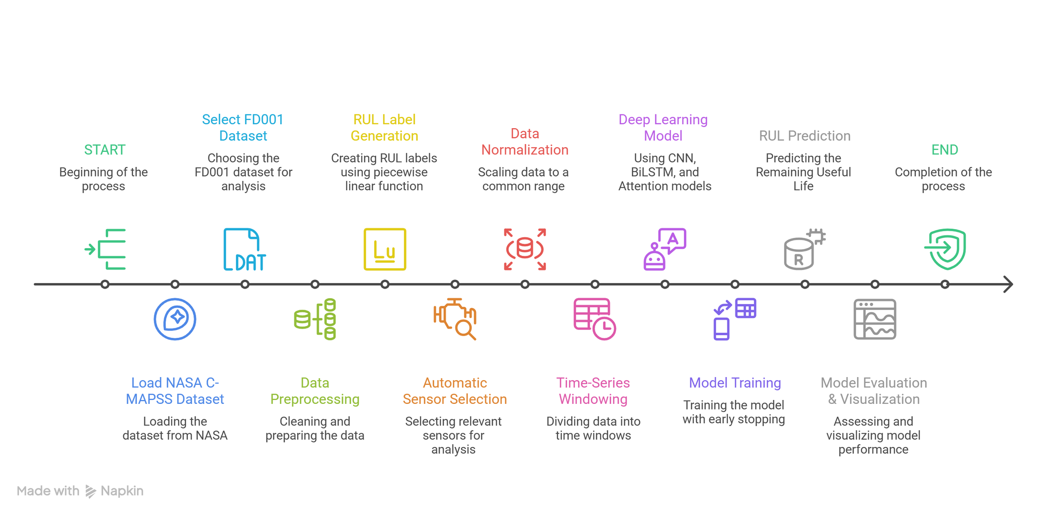

Flow Chart
fig 1

Slide 8
Methodology Overview
  The proposed methodology follows a data-driven approach for Remaining Useful Life (RUL) prediction of turbofan engines.
  Multivariate sensor time-series data is processed through multiple stages:
  Data preprocessing
  Automatic sensor selection
  Feature normalization
  Time-series modeling
  Deep learning-based prediction
  A hybrid CNN–BiLSTM–Attention architecture is employed to model degradation behavior effectively.

Slide 9
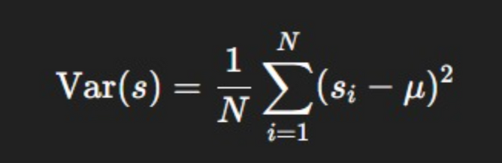

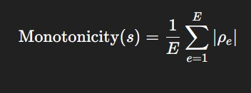
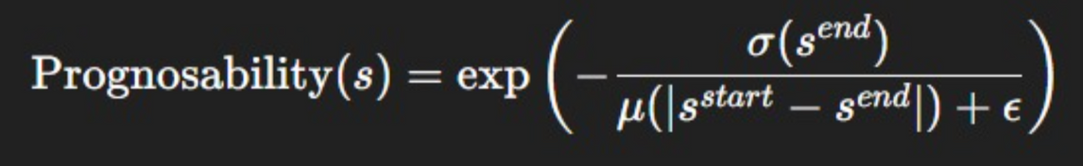
Step 1 — Variance-Based Filtering
Objective
  Remove sensors with almost constant values.
Step 2 — Monotonicity Measure
  Select sensors that show a consistent trend over time as the engine degrades.
Step 3 — Prognosability Measure
  Select sensors that show similar behavior at failure across engines.
  Mathematical Formulation

Slide 10
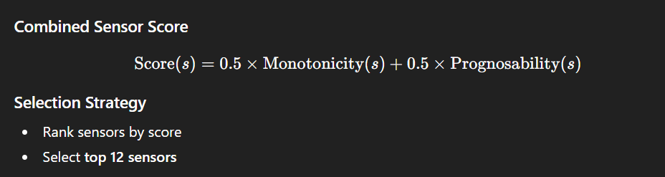
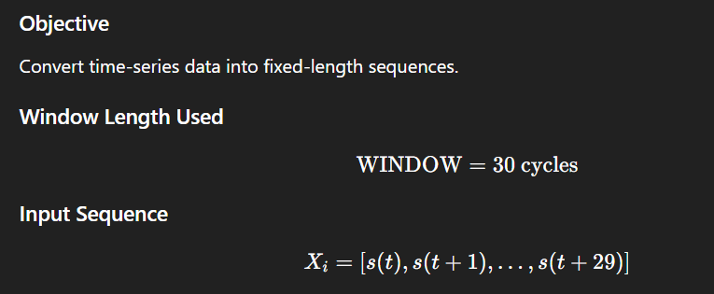
STEP 4: Final sensor scoring
step 5: Sliding window

Slide 11
Feature Extraction Using CNN
Temporal Modeling Using BiLSTM
  One-dimensional convolutional layers are applied to the sensor sequences.
  CNN layers capture:
  Local temporal patterns
  Short-term degradation features
  Max pooling is used to reduce dimensionality and noise.
  Bidirectional Long Short-Term Memory (BiLSTM) networks are used to model long-term dependencies.
  BiLSTM processes sequences in:
  Forward direction
  Backward direction
  This allows the model to capture both past and future context in degradation behavior.
  Layer Used
  Conv1D
Filters = 32
Kernel size = 3
Activation = ReLU
  MaxPooling1D

Slide 12
Attention Mechanism
RUL Prediction Model
  Features obtained from the attention layer are passed through fully connected layers.
  Dropout is applied to prevent overfitting.
  The final output layer predicts a single continuous value:
  Remaining Useful Life (RUL)
  An attention layer is integrated after the BiLSTM layer.
  Attention assigns different weights to time steps in the sequence.
  This enables the model to:
  Focus on critical degradation periods
  Improve prediction accuracy
  Enhance interpretability

Slide 13
Model Training Strategy
  The model is trained using the Mean Squared Error (MSE) loss function.
  Early stopping is employed to:
  Prevent overfitting
  Restore the best-performing model weights
  A validation split is used to monitor generalization performance.
Performance Evaluation
  Model performance is evaluated using:
  Root Mean Square Error (RMSE)
  Mean Absolute Error (MAE)
  R² Score
  Tolerance-based accuracy
  Multiple visualization techniques are used:
  Training vs validation loss curves
  Predicted vs true RUL plots
  Error distribution analysis

Slide 14
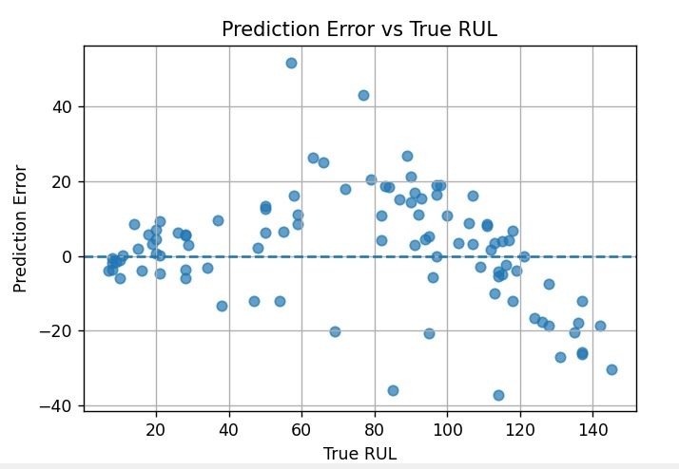
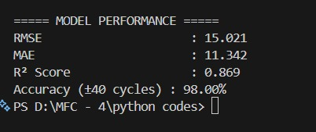
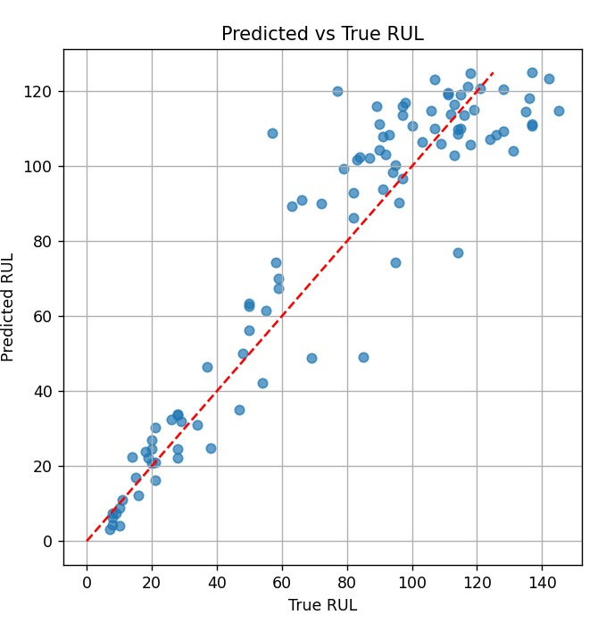
PYTHON RESULTS
fig 2.1
fig 2.2
The figures illustrate the performance of the RUL prediction model. The predicted vs. true RUL plot shows that most predictions closely follow the ideal diagonal line, indicating good agreement with actual values. The prediction error plot demonstrates that errors are generally centered around zero, with limited dispersion across the RUL range, suggesting minimal bias. Overall, the displayed metrics confirm that the model achieves accurate and reliable RUL estimation.
fig 2.3

Slide 15
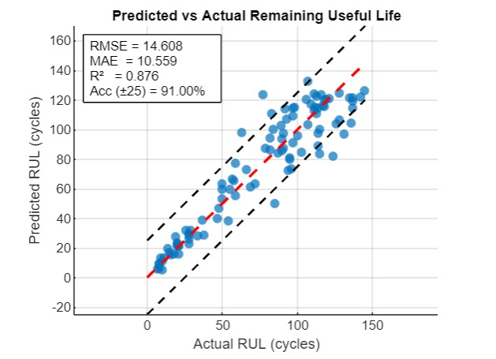
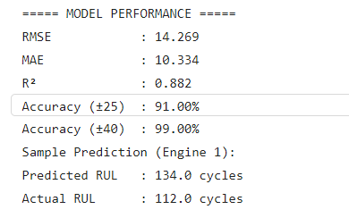
MATLAB RESULTS
The MATLAB results demonstrate strong RUL prediction performance. The predicted versus actual RUL plot shows most points clustered around the ideal diagonal line, indicating good prediction accuracy. The performance metrics (RMSE, MAE, and R²) further confirm that the model provides reliable and accurate Remaining Useful Life estimation.
fig 3.2
fig 3.1

Slide 16
future scope
  Incorporate operating condition information directly into the model architecture.
  Perform hyperparameter optimization using automated search techniques.
  Evaluate model robustness under noisy and incomplete sensor data.
  Deploy the model using edge or cloud-based platforms for real-time monitoring.

Slide 17

Thank You

