Slide 1
Predictions on 311 City Service Requests (in DC) Dataset
Anurag Kunchi
Manisha Karnati
Poornima Kolasani
Snehal Choudhari
Suhana Shaik
Professor: Masoud Soroush

Slide 2
Introduction:
311 is a non-emergency telephone number that residents of many cities in the United States can use to access local government services. When someone dials 311, they can report non-emergency issues, seek information, or request various municipal services.
In the course of this project, we have engaged with diverse machine learning models to forecast different aspects associated with 311 city service requests and their subsequent fulfillment.
Problem Statement:
Predict the time required for the completion of service requests.
Predict if the service is completed within allocated timeframe or got delayed.
Predict the zip code of the location where the service is required.

Slide 3
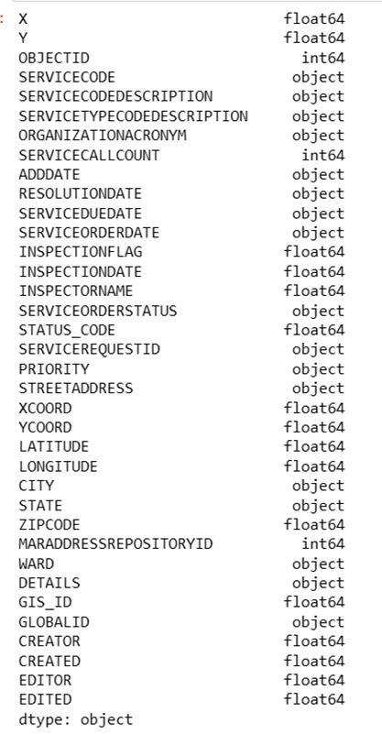
Dataset Source
311 City Service Requests: The dataset consists of 360816 rows with 36 columns.
Below are the columns in the dataset:
Source link: https://opendata.dc.gov/datasets/DCGIS::311-city-service-requests-in-2021/about

Slide 4
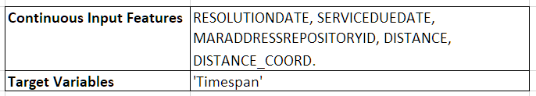
Problem statement:1 Predict the time required for the completion of service requests.

Slide 5
Linear Regression:
Linear regression is a statistical method used to model the relationship between a dependent variable and one or more independent variables by fitting a linear equation to the observed data.
The goal of linear regression is to find the best-fitting straight line (or hyperplane in the case of multiple independent variables) that minimizes the sum of the squared differences between the predicted and actual values of the dependent variable.

Slide 6

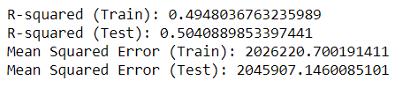
Results:

Slide 7
Random Forest:
Random forest is a popular machine learning technique used for both regression and classification problems.
The random forest algorithm builds a collection of decision trees and combines their predictions to generate the final output.
Each decision tree in the forest is trained independently on a randomly sampled subset of the training data, using a random subset of features at each node.

Slide 8

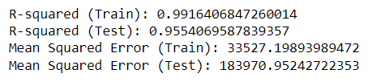
Results:

Slide 9
Boosting:
Boosting is a machine learning ensemble technique that aims to improve the predictive performance of a model by combining the strengths of multiple weak learners (usually simple models or classifiers).
The term "weak learner" refers to a model that performs slightly better than random chance on a given task.

Slide 10
Gradient Boosting:
Gradient boosting is a popular and powerful machine learning technique used for both regression and classification problems.
The idea behind gradient boosting is to iteratively add new models to the existing ensemble, where each new model tries to correct the errors made by the previous models.

Slide 11


Results:

Slide 12
XGBoost:
XGBoost, which stands for eXtreme Gradient Boosting, is a powerful and efficient open-source implementation of the gradient boosting framework.
XGBoost is based on the gradient boosting framework, which involves combining the predictions of multiple weak learners to create a strong predictive model. It builds a series of decision trees sequentially, with each tree aiming to correct the errors of the previous ones.

Slide 13

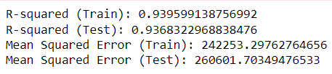
Results:

Slide 14
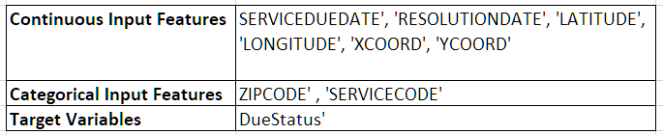

Problem statement:2 Predict if the service is completed within allocated timeframe or got delayed.
In this problem statement, our objective is to anticipate whether a service will experience delays, taking into consideration the assigned due date for that particular service.
This is Unbalanced Binary Classification:

Slide 15
Methodology
Performed Feature Importance to get the features that have significant impact.
Performed Label Encoding (on ordinal) and One-Hot Encoding (on nominal) categorical features.
Applied Various suitable Machine Learning Algorithms.
Tuned the models wherever required.

Slide 16
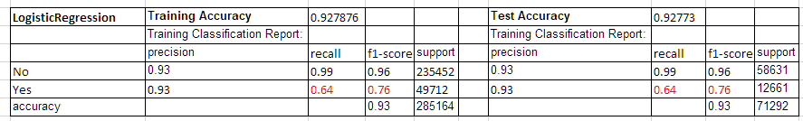
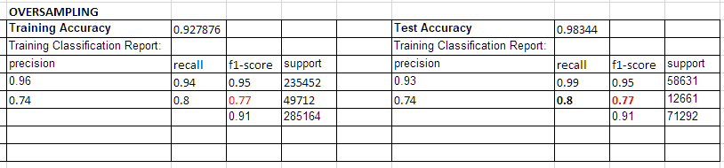
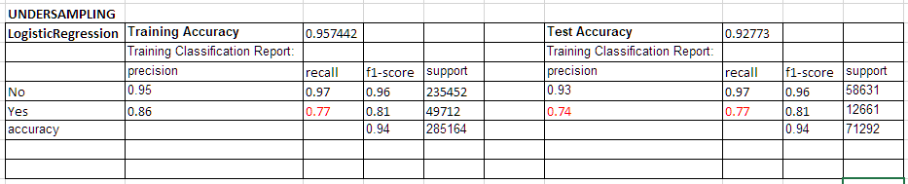
Model Assessment:
1. Logistic Regression:

Slide 17
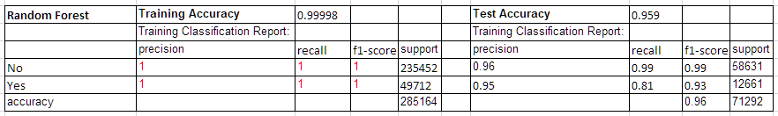
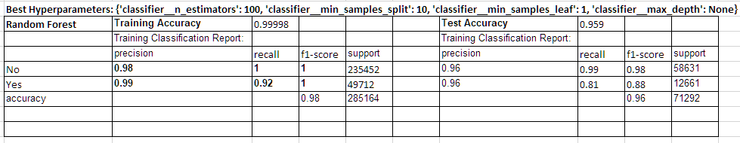
2. Random Forest
Best Hyperparameters: {'classifier__n_estimators': 100, 'classifier__min_samples_split': 10, 'classifier__min_samples_leaf': 1, 'classifier__max_depth': None}

Slide 18
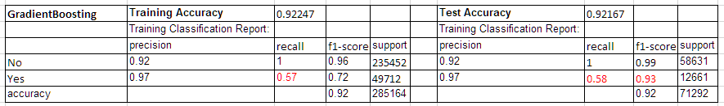
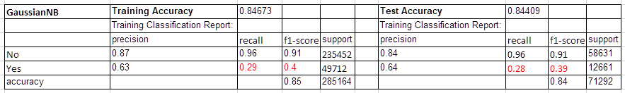
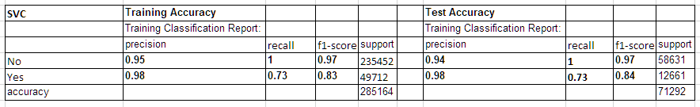
3. Gradient Boosting Classifier
4. Guassian NB Classifier
5. Support Vector Classifier

Slide 19
Problem statement 3: Predict the zip code of the location where the service is required
We have used 6 features for predicting our target variable.
[‘YCOORD’, 'XCOORD’, 'LATITUDE’, 'LONGITUDE’, 'MARADDRESSREPOSITORYID’, 'STREETADDRESS’]
ZIPCODE is our target variable

Slide 20
Methodology
Calculated the Feature Importance
Chose features based on the results.
Applied Various Machine Learning Algorithms.
Tuned the models wherever required.

Slide 21
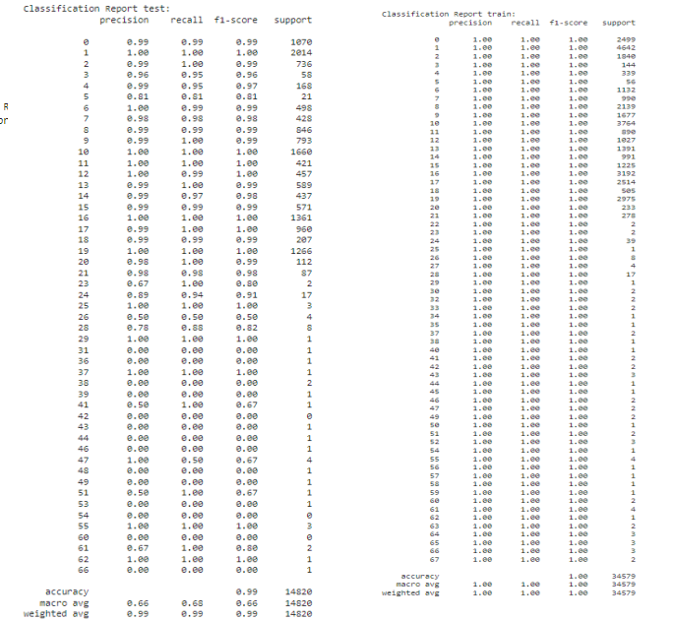
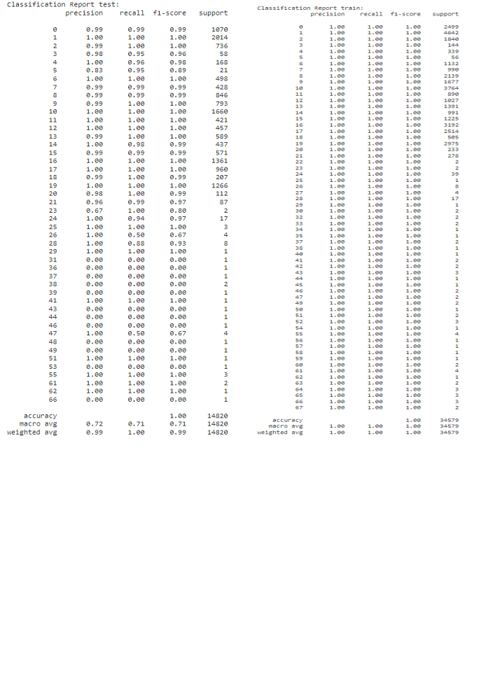
Results:
Logistic Regression results for train and test subsets:
Random forest results:

Slide 22
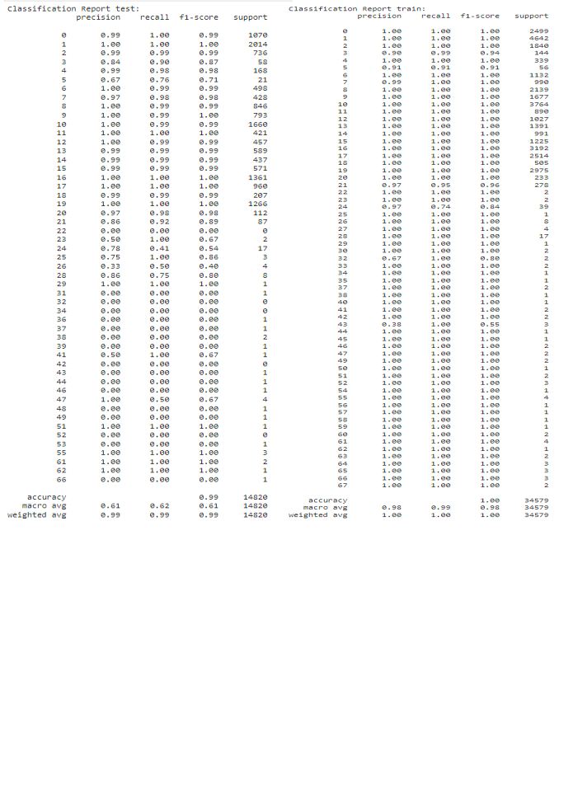
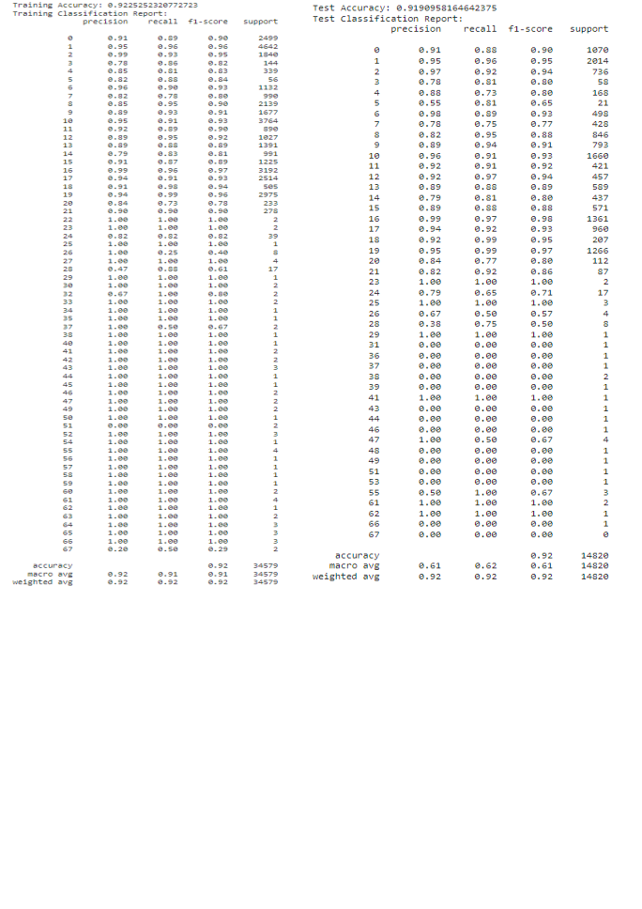
Results:
Gradient Boosting classifier:
Gaussian Naive Bayes Classifier:

Slide 23
Future Recommendations:
predict future trends in service request volume.
Investigate the impact of including weather, time of day, or other external factors on service request completion times.
Develop algorithms or models to optimize the routes of service vehicles for more efficient and timely response to service requests.
Develop real-time decision support systems that can dynamically allocate resources based on incoming service requests and changing conditions.
In future data if there are any missing values for ZIP code they can be handled them by using the location based prediction model.

Slide 24
Conclusion:
The XGBoost regressor excels in predicting service request time spans due to its robust performance and proficiency in handling complex relationships within the data. Its ability to capture intricate patterns and nonlinear trends, coupled with effective regularization techniques, ensures reliable predictions while mitigating overfitting.
For service request Due status, the random forest classifier is a fitting choice. Its ensemble learning approach, constructing multiple decision trees trained on data subsets, reduces overfitting concerns. This classifier's capability to handle categorical variables proves valuable in scenarios with discrete service request status outcomes.
In ZIP code prediction, the Gaussian Naive Bayes classifier stands out. Despite assuming feature independence, it excels where features exhibit some degree of independence, making it ideal for ZIP code prediction. Efficient with continuous features and reliable for relatively small datasets, it offers a probabilistic framework that not only accurately predicts ZIP codes but also provides a measure of confidence, crucial for decision-making. Overall, the Gaussian Naive Bayes classifier proves highly effective for superior ZIP code prediction performance.

Slide 25
Thank you!

