Slide 1

CampusEats - Group 15
Team Members:
Poornima Pulakandam
Vineela Punuru
Maniparthu manne
Koosha Sharifani

Slide 2
CampusEats - Group 15
We have added four additional tables to create the rating system's support.
Ratings, Driver Ratings, and Restaurant Ratings are the new tables to support the ratings system and Menu table has been created with restaurant’s menu.
we have created seperate tables for driver ratings and restaurant ratings to avoid data inconsistency without including them in ratings table.

Slide 3
CampusEats - Group 15
Ratings of an order are recorded in the ratings table. driver’s ratings and restaurant ratings of an order are recorded in driver ratings and restaurant ratings tables respectively.
The order table and the ratings table have a one-to-one relationship.
The order ratings can be accessed by using the FK (order_id) from the ratings table.

Slide 4
Queries
Rating Table:
CREATE TABLE `rating` (
`rating_id` int(11) NOT NULL AUTO_INCREMENT,
`order_id` int(11) NOT NULL,
`rating` int(1) DEFAULT NULL,
PRIMARY KEY (`rating_id`),
FOREIGN KEY `fk_Rt_order_id` (`order_id`) REFERENCES `order` (`order_id`) ON DELETE CASCADE
) ENGINE=InnoDB AUTO_INCREMENT=206 DEFAULT CHARSET=latin1;
restaurant_rating Table:
CREATE TABLE `restaurant_rating` ( `restaurant_rating_id` int(11) NOT NULL AUTO_INCREMENT,
`rating_id` int(11) DEFAULT NULL,
PRIMARY KEY (`restaurant_rating_id`),
FOREIGN KEY `fk_R_rating_id` (`rating_id`) REFERENCES `rating` (`rating_id`) ON DELETE CASCADE
) ENGINE=InnoDB AUTO_INCREMENT=26 DEFAULT CHARSET=latin1;

Slide 5
Queries
driver_rating Table:
CREATE TABLE `driver_rating` (
`driver_rating_id` int(11) NOT NULL AUTO_INCREMENT,
`rating_id` int(11) DEFAULT NULL,
PRIMARY KEY (`driver_rating_id`),
FOREIGN KEY `fk_D_rating_id` (`rating_id`) REFERENCES `rating` (`rating_id`) ON DELETE CASCADE
) ENGINE=InnoDB AUTO_INCREMENT=26 DEFAULT CHARSET=latin1;
Menu Table:
CREATE TABLE IF NOT EXISTS `campus_eats_fall2021`.`menu` (
`item_id` INT NOT NULL,
`price` FLOAT NOT NULL,
`description` VARCHAR(45) NOT NULL,
`name` VARCHAR(45) NOT NULL,
`restaurant_id` INT NOT NULL,
PRIMARY KEY (`item_id`, `restaurant_id`),
INDEX `fk_menu_idx` (`restaurant_id` ASC) VISIBLE,
CONSTRAINT `fk_menu`
FOREIGN KEY (`restaurant_id`)
REFERENCES `campus_eats_fall2021`.`restaurant` (`restaurant_id`) ON DELETE NO ACTION
ON UPDATE NO ACTION)ENGINE = InnoDB;

Slide 6
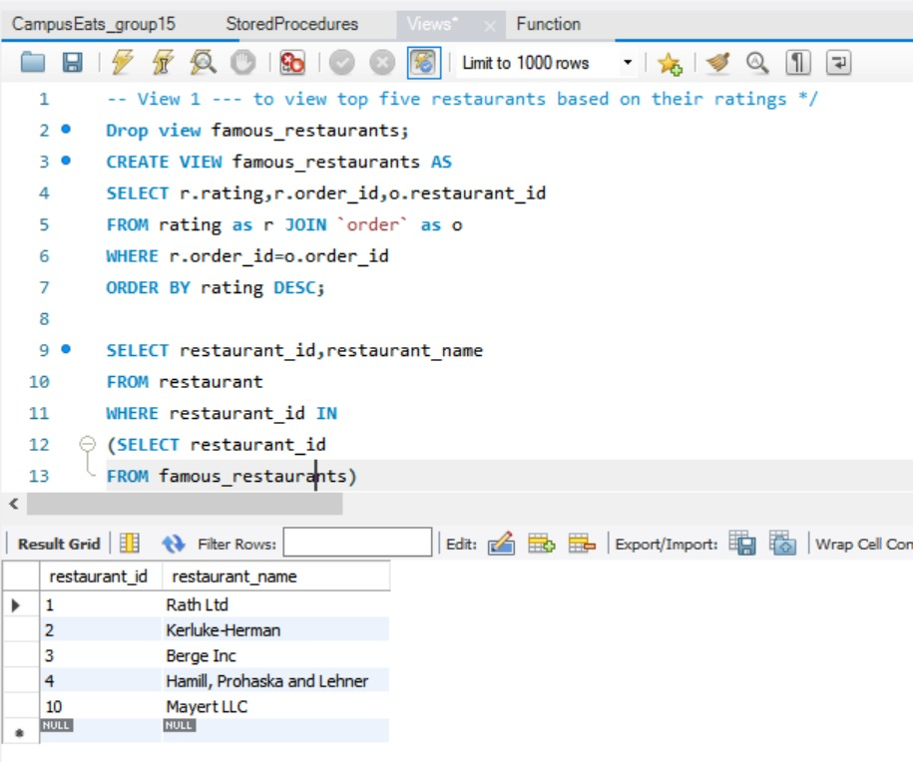
Views For CampusEats

Slide 7
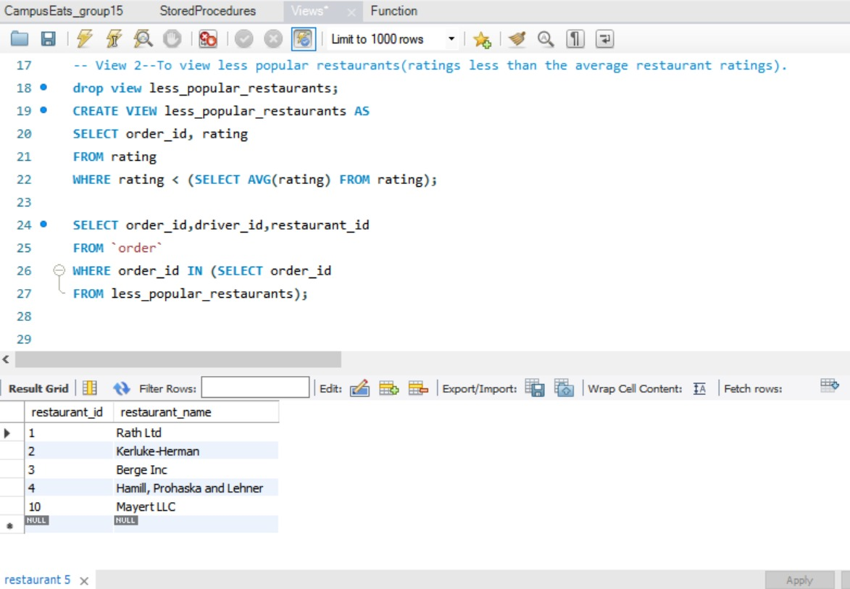
Views For CampusEats

Slide 8
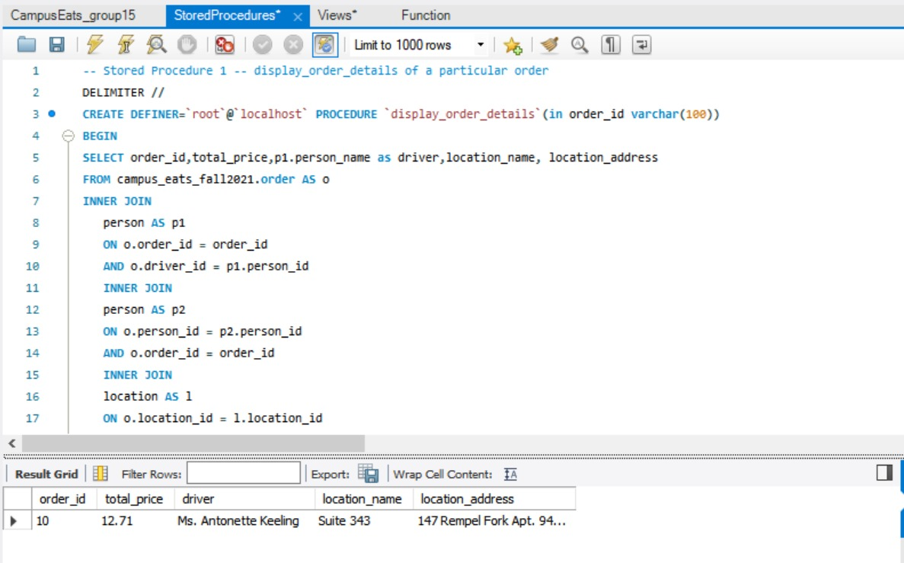
Stored Procedure For CampusEats

Slide 9
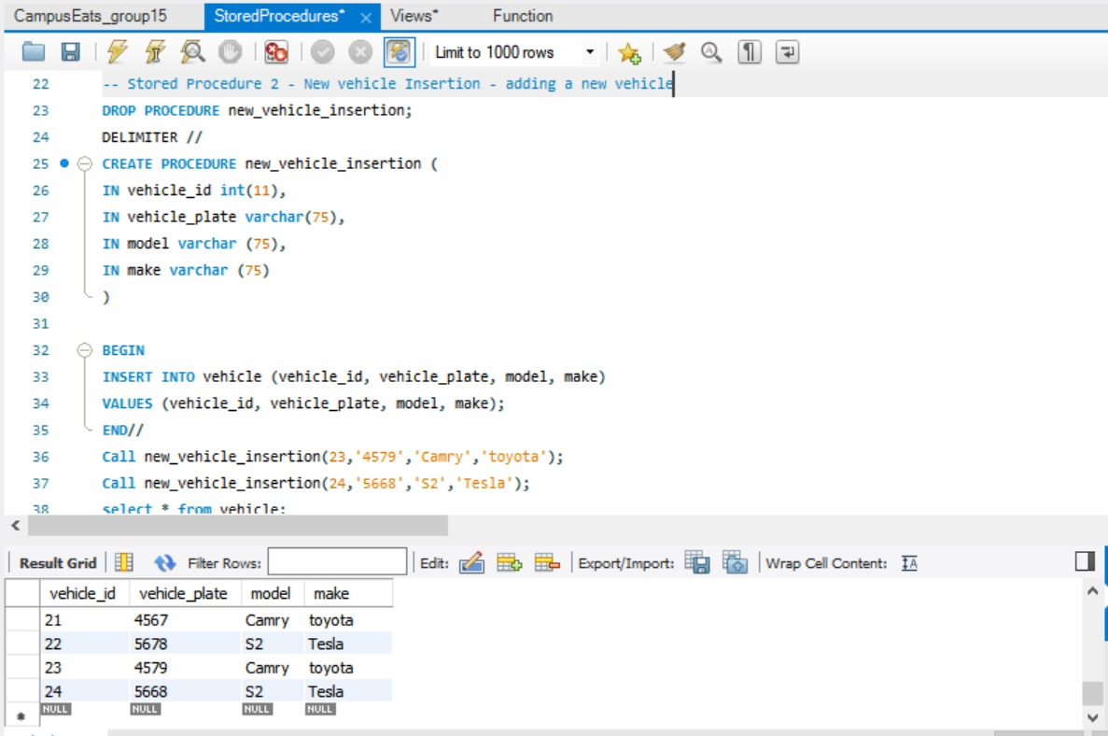
Stored Procedure For CampusEats

Slide 10
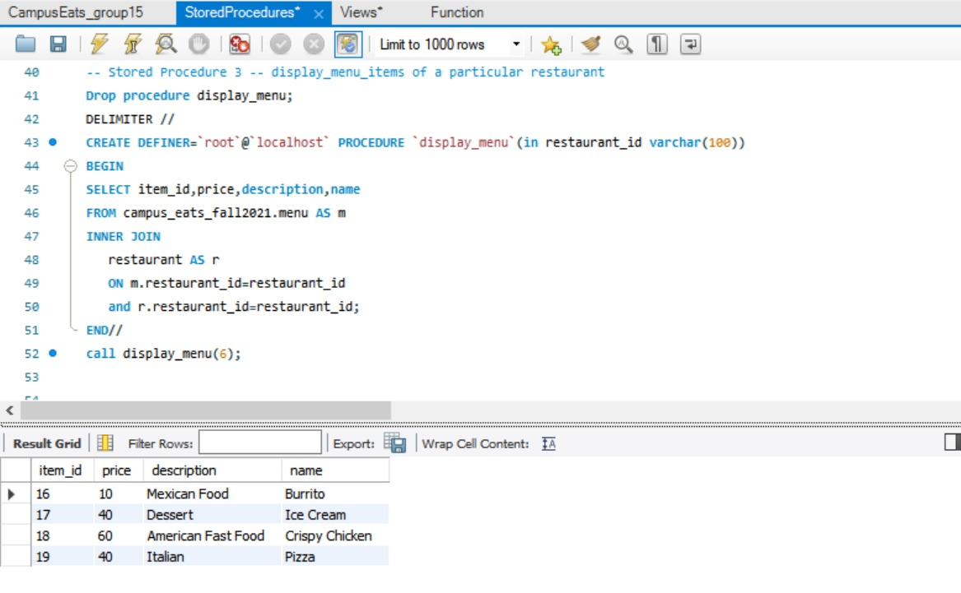
Stored Procedure For CampusEats

Slide 11
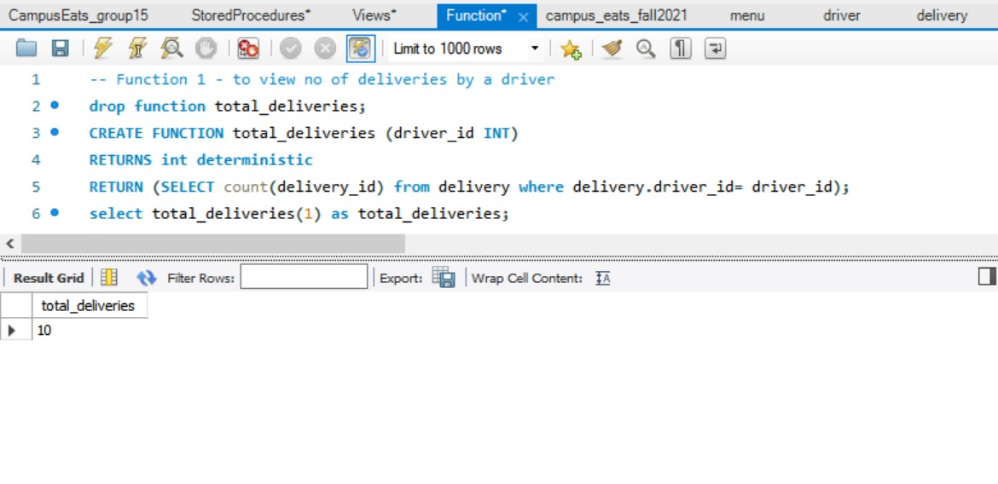
Functions For CampusEats

Slide 12
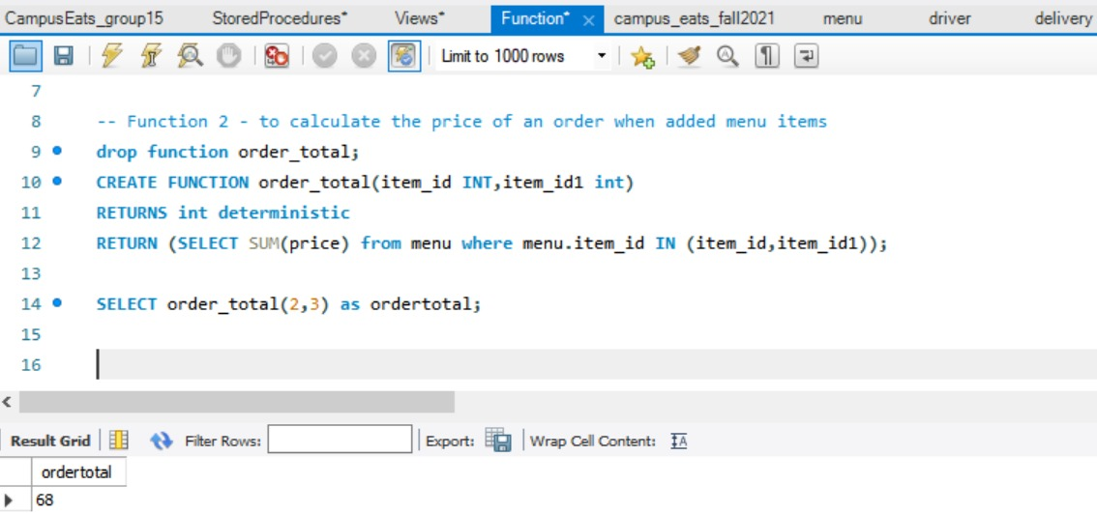
Functions For CampusEats

Slide 13
Indexes
Indexes for delivery table: PK index, fk_delivery_driver_id, fk_delivery_vehicle_id
Indexes for driver table: PK index, fk_D_student_id.
Indexes for faculty table: PK index, fk_F_person_id
Indexes for location table:PK index, location_index_desc, idx_location_location_name.
Indexes for Person cation table: PK index.
Indexes for restaurant table: PK index.
Indexes for staff table: PK index, fk_S_person_id.
Indexes for student table: PK index, fk_St_person_id
Indexes for vehicle table: PK index.
Indexes for order table: PK index, fk_O_person_id, fk_O_delivery_id,fk_O_location_id, fk_O_driver_id, fk_O_restaurant_id.
Indexes for ratings table: PK index,fk_Rt_order_id.
Indexes for driver_ratings table:PK index, fk_DR_rating_id
Indexes for restaurant_ratings table:PK index, fk_RR_rating_id.
Indexes For Menu table:PK index, fk_menu_idx.

Slide 14
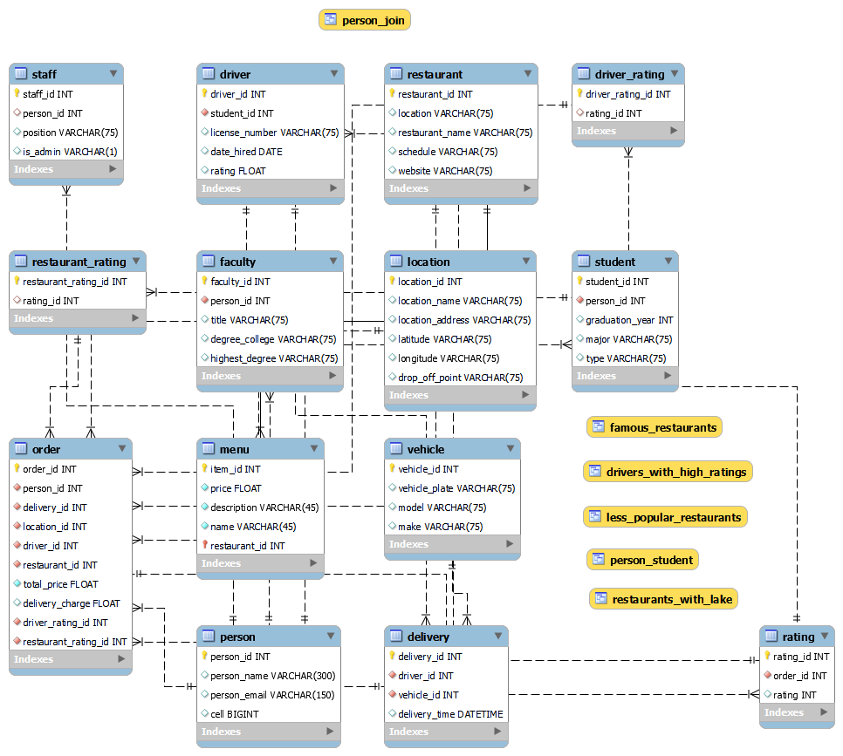
CampusEats -Final EERD

Slide 15
Thank You

