Slide 1
.NET masterclass 2022

Slide 2
Who we are
Mentors
Allan Thraen
Toni Petrina
Ivan Milosavljevic
Mentor assistants
Elham Dargi
Calin Durnea

Slide 3
What we want to do
Focus on server-side knowledge
Reuse of Meal sharing frontend
Use C#, ASP.NET Core

Slide 4
What is .NET?
.NET is a software framework developed by Microsoft
It is a framework not a language
Enables developers to build different types of applications
It is an open source developer platform https://github.com/dotnet
Key features: multi language support, portable, rich set of built in libraries and functions, automatic memory management, security, type safety

Slide 5
History
First version of .NET Framework was released in February 2002
In 2008 parts of the .NET Framework source code become available
In 2014 Microsoft announced development of .NET Core
In April 2019 last major release of .NET Framework (4.8)
In November 2020 .NET (Core) 5.0 was released, replacing .NET Framework

Slide 6
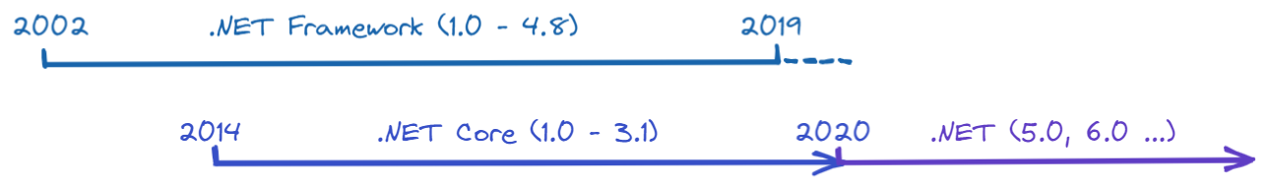
Current state
.NET Framework 4.8 is last major version of .NET Framework
.NET 6.0 is latest implementation and runs technically on all platforms
.NET Framework vs .NET (ex .NET Core)

Slide 7
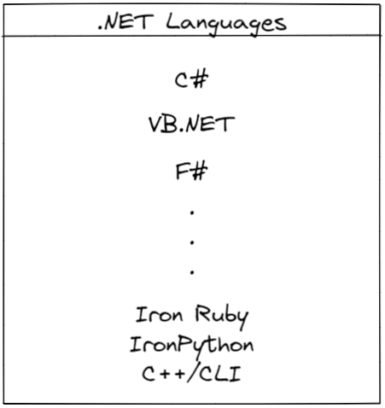
Language support

Slide 8
C# language
Anders Hejlsberg was original creator of C#
C-like programming language
Multi-paradigm
Type-safe
Statically typed
Strongly typed

Slide 9
Tools/IDE
C# 10
.NET 6
VS Code

Slide 10
DEMO

Slide 11
Data types
C# type system
Specifying types
Built in types
Custom types
Array and List<T>

Slide 12
Kahoot time!

Slide 13
Controlling program flow
If/else statement
For-loop
Foreach-loop
While-loop
Switch statement

Slide 14
Examples
Create a name variable where its value is your full name and write it on the screen
Make an variable Celsius with custom integer value. Create a function that converts value of Celsius variable to Fahrenheit and returns it. (C*9/5) + 32 = F
Using Random.Shared.Next method, create an variable and write in the console if the variable value is even or odd (modus operand %)
Write an array of fruits. Pass array to the PrintFruits function that will print it out in the console

Slide 15
Q&A

