Slide 1
VPN: Virtual Private Network
Notes:
‹#›

Slide 2
By.
P. Victer Paul
Dear,
We planned to share our eBooks and project/seminar contents for free to all needed friends like u.. To get to know about more free computerscience ebooks and technology advancements in computer science. Please visit....
http://free-computerscience-ebooks.blogspot.com/
http://recent-computer-technology.blogspot.com/
http://computertechnologiesebooks.blogspot.com/
Please to keep provide many eBooks and technology news for FREE. Encourage us by Clicking on the advertisement in these Blog.

Slide 3
Introduction: What is a VPN?
Virtual
- the artificial connection.
Private
- access is restricted to defined set of entities
Network
- collection of devices that can communicate in
some fashion.

Slide 4
A VPN is a set of tools which allow networks at different
locations to be securely connected, using a public network as
the transport layer.
A VPN is private network constructed within a public
network infrastructure, such as the global Internet.
VPNs use cryptography to provide protections against
eavesdropping and active attacks.
VPNs are most commonly used today for telecommuting and
linking branch offices via secure WANs
Notes:
‹#›

Slide 5
The Wide area network before VPNs
Firms would spend thousands of dollars per month for private, dedicated circuits to link branch offices.
The rise of the internet created cheap but insecure bandwidth.
The VPN concept was to produce the virtual “dedicated circuit”, pump it over the internet, and use cryptography to make it secure.

Slide 6
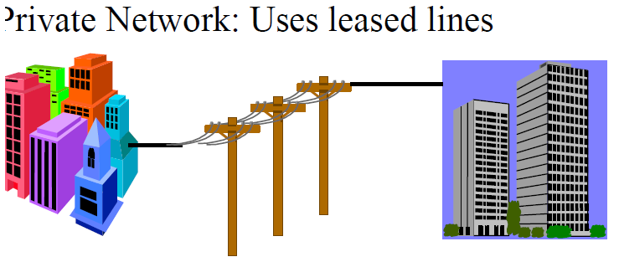
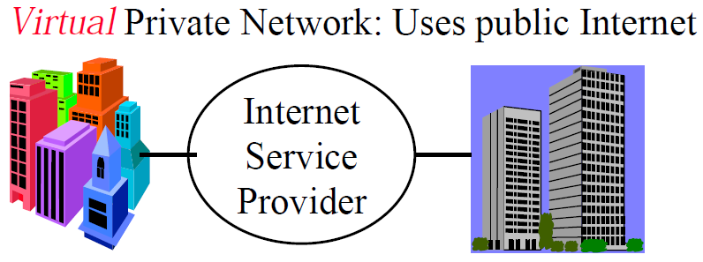

Slide 7
Tunneling
A virtual point-to-point connection
made through a public network. It transports
encapsulated datagram's.
Original Datagram
Encrypted Inner Datagram
Datagram Header Outer Datagram Data Area
Data Encapsulation [From Comer]
Two types of end points:
Remote Access
Site-to-Site

Slide 8
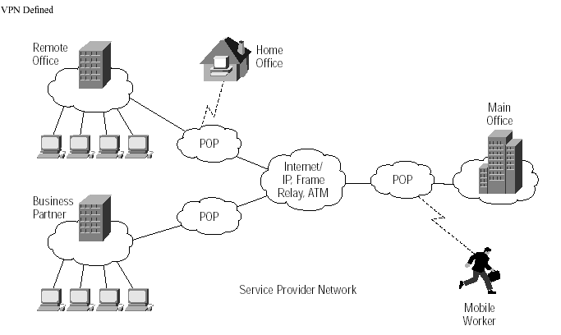

Slide 9
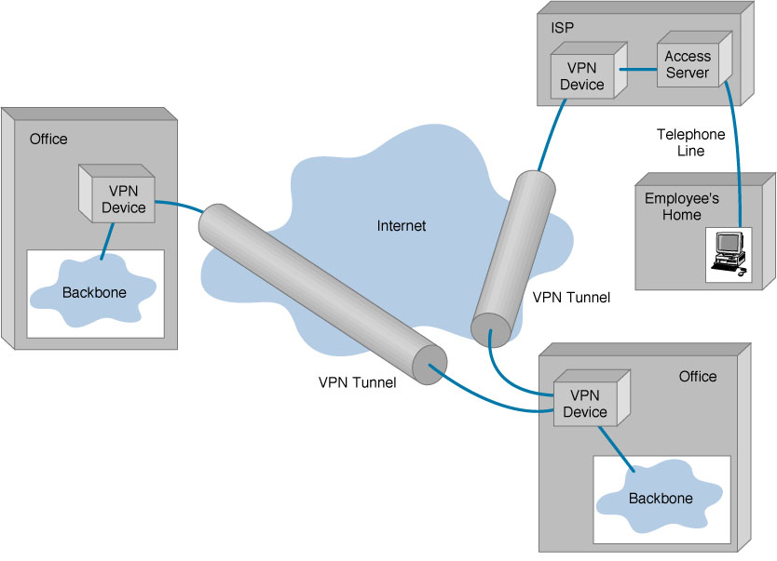
Virtual Private Networks (VPN) Basic Architecture

Slide 10
VPN Topology: Types of VPNs
Remote access VPN
- Employee to Business
Intranet VPN
- Within an organization
Extranet VPN
- Outside an organization

Slide 11
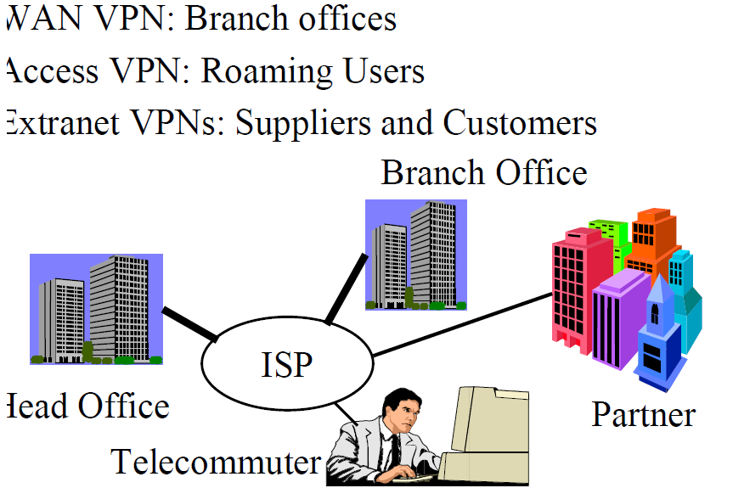

Slide 12
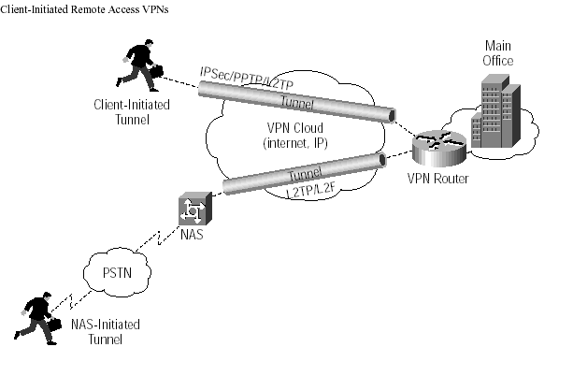
VPN Topology: Remote Access VPN

Slide 13
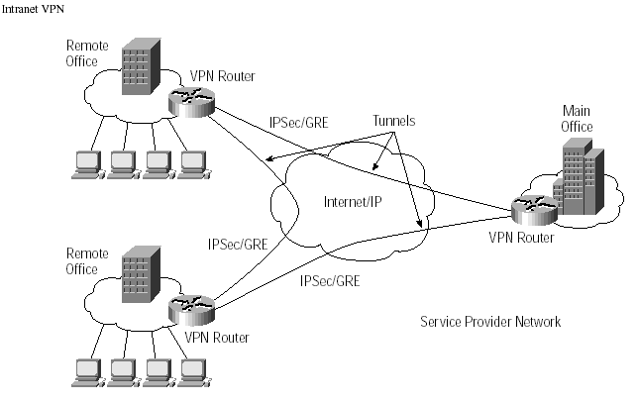
VPN Topology: Intranet VPN

Slide 14
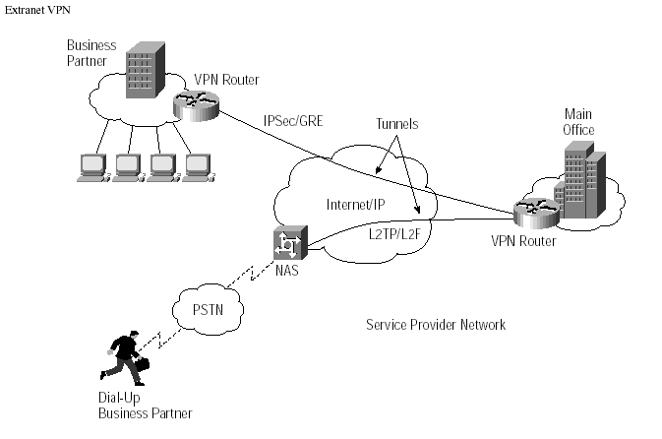
VPN Topology: Extranet VPN

Slide 15
VPN Topology: Advantages and Disadvantages of VPN
Advantages:
Greater scalability
Easy to add/remove users
Reduced long-distance telecommunications costs
Mobility
Security

Slide 16
VPN Topology: Advantages and Disadvantages of VPN
Disadvantages
Lack of standards
Understanding of security issues
Unpredictable Internet traffic
Difficult to accommodate products from different vendors

Slide 17
VPN Topology: What is needed?
Existing hardware (Servers, workstations,…)
Internet connection
VPN - Router/Switch
Software to create and manage tunnels
Security Device such as firewall

Slide 18
VPN Topology: How it works
Operates at layer 2 or 3 of OSI model
Layer 2 frame – Ethernet
Layer 3 packet – IP
Tunneling
allows senders to encapsulate their data in IP packets that hide the routing and switching infrastructure of the Internet
to ensure data security against unwanted viewers, or hackers.

Slide 19
VPN COMPONENTS
What are the components of VPN?

Slide 20
VPN Components
Protocols
Security
Appliances

Slide 21
VPN Components: Protocols
IP Security (IPSec)
Transport mode
Tunnel mode
Point-to-Point Tunneling Protocol (PPTP)
Voluntary tunneling method
Uses PPP (Point-to-Point Protocol)
Notes:
‹#›

Slide 22
VPN Components: Protocols
Layer 2 Tunneling Protocol (L2TP)
Exists at the data link layer of OSI
Composed from PPTP and L2F (Layer 2 Forwarding)
Compulsory tunneling method

Slide 23
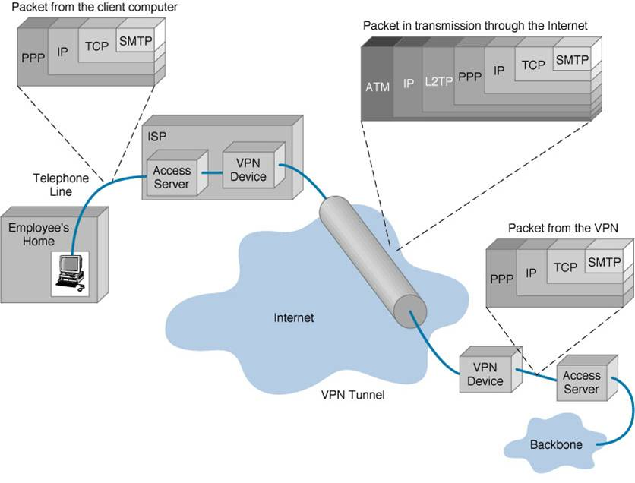
Example of packet encapsulation

Slide 24
VPN Components: Security
Encryption
Technique for scrambling and unscrambling information
Unscramble – called plain-text
Scrambled information – cipher-text

Slide 25
VPN Components: Security
Keys
Secret code that the encryption algorithm uses to create a unique version of cipher-text
8-bits keys = 256 combinations or two to the eighth power
16-bits keys = 65,536 combinations or two to the 16th power
56-bits keys = 72,057,594,037,927,900 or two to the 56th power
168-bits keys …

Slide 26
VPN Components: Security
Authentication
Determine if the sender is the authorized person and if the data has been redirect or corrupted
User/System Authentication
Data Authentication

Slide 27
VPN Components: Appliances
Intrusion detection firewalls
Monitors traffic crossing network parameters and protects enterprises from unauthorized access
Packet-level firewall checks source and destination
Application-level firewall acts as a host computer between the organization’s network and the Internet

Slide 28
VPN PRODUCTIVITY AND COST BENEFITS
How can companies benefit from VPN?

Slide 29
VPN Productivity and Cost Benefits: Benefits
Extends geographic connectivity
Boosts employee productivity
Improves Internet security
Scales easily

Slide 30
VPN Productivity and Cost Benefit: Costs
Costs associated with implementing VPN
In House implementation
Outsourced implementation
Middle Ground implementation

