Slide 1

BF751 – Bionumbers Project 2021
Poorva Juneja
[Click the slideshow symbol from bottom right for voice recording to go along with slides]

Slide 2
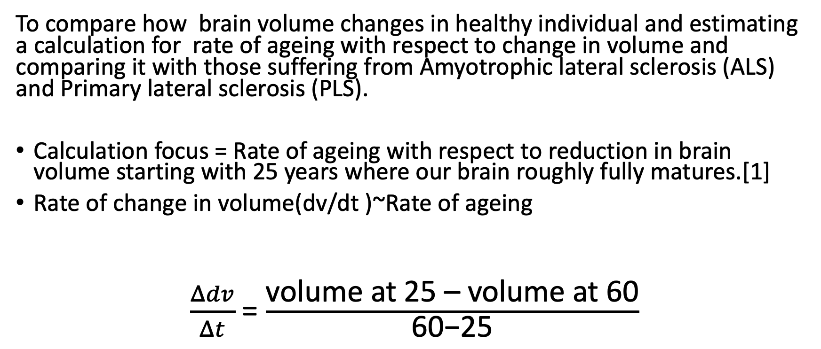
Topic
To compare how brain volume changes in healthy individual and estimating a calculation for rate of ageing with respect to change in volume and comparing it with those suffering from Amyotrophic lateral sclerosis (ALS) and Primary lateral sclerosis (PLS).
Calculation focus = Rate of ageing with respect to reduction in brain volume starting with 25 years where our brain roughly fully matures.[1]
Rate of change in volume(dv/dt )~Rate of ageing
$\frac{Δdv}{Δt}$ = $\frac{\text{volume} \text{at}\text{ 25 – }\text{volume} \text{at}\text{ 60}}{\text{60−25}}$

Slide 3
Average Volume (mm3) in different parts of brain at age ~ 25.1 +- 3.8 in healthy individual [2]
Age Group Mean(25.1 +- 3.8)
Structure | Volume Mean+-Standard Deviation(mm3)
Brain | 1571956+-180197.2
Grey Matter | 673700+-5670
White Matter | 543400+-6480
Thalamus | 17378+-1232.98
Hippocampus | 6533.3+-898.94
Caudate | 7750+-945.94
Putamen | 11291+-1215.55
Amygdala | 3064.4+-497.28
Pallidum | 3690+-375.05
Nucleus Accumbens | 1035+-207.44

Slide 4
Average Volume changes in different parts of brain at age ~ 60.5 +-10.5 in healthy individual [3]
Age Group Mean(60.5 +-10.5)
Structure | Volume Mean+-Standard Error(mm3)
Brain | 1120083.15+-2418.78
Grey Matter | 581579.05+-1860.11
White Matter | 538504.10+- 1686.23
Thalamus | 15016.8+-101.3
Hippocampus | 5668.0+-90.8
Caudate | 6986.3+-67.6
Putamen | 9434.1+-90.3
Amygdala | 2392.7+-46.2
Pallidum | 3552.6+-41.1
Nucleus Accumbens | 872+-20.7

Slide 5
Structure | Volume Mean+-Standard Deviation(mm3) | Healthy individual | Volume change with respect to age for Healthy Individuals | Rate of volume change with respect to age for Healthy Individuals
Brain | 1571956+-180197.2 | 1120083.15+-2418.78 | ﻿451872.85 +-﻿182615.98 | ﻿﻿﻿﻿12910.65
Grey Matter | 65460+-738.00 | 581579.05+-1860.11 | 92120.95+-﻿7530.11 | 2632.02
White Matter | 520700+-658.00 | 538504.10+- 1686.23 | 4895.9+-﻿8166.23 | 139.88
Thalamus | 17378+-1232.98 | 15016.8+-101.3 | 2361.2+-﻿1334.28 | 67.46
Hippocampus | 6533.3+-898.94 | 5668.0+-90.8 | 865.3+-﻿989.74 | 24.72
Caudate | 7750+-945.94 | 6986.3+-67.6 | 763.7+-﻿1013.54 | 21.82
Putamen | 11291+-1215.55 | 9434.1+-90.3 | 1856.9+-﻿1305.85 | 53.05
Amygdala | 3064.4+-497.28 | 2392.7+-46.2 | 671.7+-﻿543.48 | 19.19
Pallidum | 3690+-375.05 | 3552.6+-41.1 | 137.4+-﻿416.15 | 3.92
Nucleus Accumbens | 1035+-207.44 | 872+-20.7 | 163+-﻿228.14 | 4.65
Rate of change in Total Brain Volume volume(dv/dt )~Rate of ageing ~12910.65/yr
Rate of change in Grey matter Volume ~2632.02
Rate of change in White matter Volume ~139.88

Slide 6
Average Volume changes in different parts of brain at age ~ 60.5 +-10.5 individual with ALS [3]
Average Volume changes in different parts of brain at age ~ 60.5 +-10.5 individual with PLS [3]
Age Group Mean(60.5 +-10.5) ALS
Structure | Volume Mean+-Standard Error(mm3)
Brain | 1102296.7+-2601.27
Grey Matter | 570739.91+-2000.45
White Matter | 531556.79+- 1813.45
Thalamus | 14558+-108.9
Hippocampus | 5514.5+-97.6
Caudate | 6794.3+-72.6
Putamen | 9294.8+-97.3
Amygdala | 2235.2+-49.7
Pallidum | 3527+-44.1
Nucleus Accumbens | 805.4+-22.2
Age Group Mean(60.5 +-10.5) PLS
Structure | Volume Mean+-Standard Error(mm3)
Brain | 1091914.54+-4523.89
Grey Matter | 568470.85+-3479.00
White Matter | 523443.69+- 3153.79
Thalamus | 13940.5+-179.4
Hippocampus | 5421.1+-169.8
Caudate | 6695.7+-126.3
Putamen | 9176.4+-169
Amygdala | 2333.6+-86.3
Pallidum | 3447.4+-169
Nucleus Accumbens | 800.7+-38.6

Slide 7
ALS
Rate of change in Total Brain Volume (dv/dt )~Rate of ageing ~13418.83/yr
Rate of change in Grey matter Volume ~2941.71
Rate of change in White matter Volume ~338.37
PLS
Rate of change in Total Brain Volume volume(dv/dt )~Rate of ageing ~13715.47/yr
Rate of change in Grey matter Volume ~3006.54
Rate of change in White matter Volume ~570.18

Slide 8
Structure | Volume Mean+-Standard Deviation(mm3) | Volume Mean+-Standard Error(mm3) ALS | Volume change with respect to age for ALS | Rate of volume change with respect to age for ALS
Brain | 1571956+-180197.2 | 1102296.7+-2601.27 | ﻿﻿﻿469659.3 +-82798.47 | ﻿﻿﻿﻿﻿13418.83
Grey Matter | 65460+-738.00 | 570739.91+-2000.45 | 102960.09+-﻿7670.45 | 2941.71
White Matter | 520700+-658.00 | 531556.79+- 1813.45 | 11843.21+-﻿8293.45 | 338.37
Thalamus | 17378+-1232.98 | 14558+-108.9 | 2820.+-﻿ 1341.88 | 80.57
Hippocampus | 6533.3+-898.94 | 5514.5+-97.6 | 1018.8+-﻿996.54 | 29.10
Caudate | 7750+-945.94 | 6794.3+-72.6 | 955.7+-﻿1018.54 | 27.30
Putamen | 11291+-1215.55 | 9294.8+-97.3 | 1996.2+-﻿1312.85 | 57.03
Amygdala | 3064.4+-497.28 | 2235.2+-49.7 | 829.2+-﻿546.98 | 23.69
Pallidum | 3690+-375.05 | 3527+-44.1 | 163+-﻿419.15 | 4.65
Nucleus Accumbens | 1035+-207.44 | 805.4+-22.2 | 229.6+-﻿229.64 | 6.56

Slide 9
Structure | Volume Mean+-Standard Deviation(mm3) | Volume Mean+-Standard Error(mm3)PLS | volume change with respect to age for PLS | Rate of volume change with respect to age for PLS
Brain | 1571956+-180197.2 | 1091914.54+-4523.89 | ﻿﻿480041.46 +-﻿184721.09 | ﻿﻿﻿﻿﻿﻿13715.47
Grey Matter | 65460+-738.00 | 568470.85+-3479.00 | 105229.15 +-﻿9149 | 3006.54
White Matter | 520700+-658.00 | 523443.69+- 3153.79 | 19956.31 +-﻿9633.79 | 570.18
Thalamus | 17378+-1232.98 | 13940.5+-179.4 | 3437.5+-﻿1412.38 | 98.21
Hippocampus | 6533.3+-898.94 | 5421.1+-169.8 | 1112.2+-﻿1068.74 | 31.77
Caudate | 7750+-945.94 | 6695.7+-126.3 | 1054.3+-﻿1072.24 | 30.12
Putamen | 11291+-1215.55 | 9176.4+-169 | 2114.6+-﻿1384.55 | 60.41
Amygdala | 3064.4+-497.28 | 2333.6+-86.3 | 730.8+-583.58 | 20.88
Pallidum | 3690+-375.05 | 3447.4+-169 | 242.6+-﻿544.05 | 6.93
Nucleus Accumbens | 1035+-207.44 | 800.7+-38.6 | 234.3+-﻿246.0 | 6.69

Slide 10
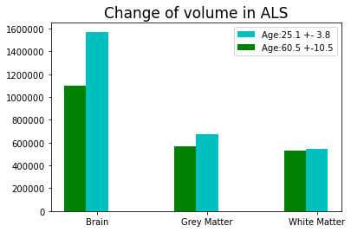
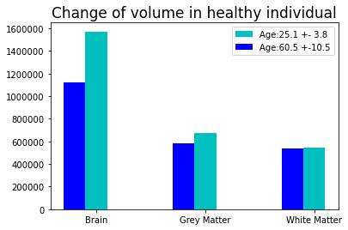
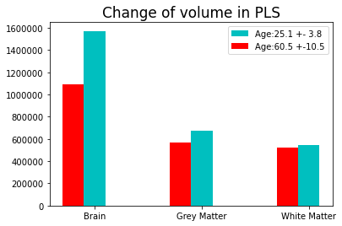

Slide 11

% rate of change difference (ROC)
% ROC = $\frac{rate of change\left( healthy\right)−rate of change\left(in ALS/PLS\right)}{rate of change\left( healthy\right)}$ x 100

Slide 12
Structure | Rate of volume change with respect to age for Healthy Individuals | Rate of volume change with respect to age for ALS | Percentage of difference of change in Rate (Healthy-ALS) | Rate of volume change with respect to age for PLS | Percentage of difference of change in Rate (Healthy-PLS)
Brain | ﻿﻿﻿﻿12910.65 | ﻿﻿﻿﻿﻿13418.83 | ﻿﻿﻿﻿﻿3.93% | ﻿﻿﻿﻿﻿﻿13715.47 | ﻿﻿﻿﻿﻿﻿6.23%
Grey Matter | 2632.02 | 2941.71 | 11.76 | 3006.54 | 14.22%
White Matter * | 139.88 | 338.37 | 141.90% | 570.18 | 307.62%*
Thalamus | 67.46 | 80.57 | 19.43% | 98.21 | 45.58%
Hippocampus | 24.72 | 29.10 | 17.71% | 31.77 | 28.51%
Caudate | 21.82 | 27.30 | 25.11% | 30.12 | 38.03%
Putamen | 53.05 | 57.03 | 7.50% | 60.41 | 13.87%
Amygdala | 19.19 | 23.69 | 23.44% | 20.88 | 8.80%
Pallidum | 3.92 | 4.65 | 18.62% | 6.93 | 76.78% z*
Nucleus Accumbens | 4.65 | 6.56 | 41.07% | 6.69 | 43.87%

Slide 13
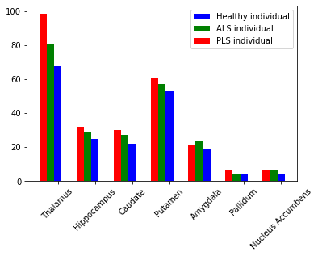
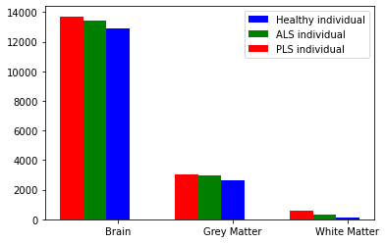
Difference in Rate of change of volume with respect to age

Slide 14
Big Picture Idea
Brain volume can be measured from magnetic resonance imaging (MRI) using softwares. The loss/rate of change in brain volume can be used as a marker to observe neurodegeneration in the specific areas being affected more and having a significant decline for example PLS population had significant decline in white matter volume compared to other parts of brain.
Also this rate of change can be used as a predictor of disability and to measure its progression.

Slide 15
References
Arain M, Haque M, Johal L, et al. Maturation of the adolescent brain. Neuropsychiatry Dis Treat. 2013;9:449-461. doi:10.2147/NDT.S39776
Kennedy DN, Hodge SM, Gao Y, Frazier JA, Haselgrove C. The internet brain volume database: a public resource for storage and retrieval of volumetric data. Neuroinformatics. 2012;10(2):129-140. doi:10.1007/s12021-011-9130-1
Finegan E, Hi Shing SL, Chipika RH, et al. Thalamic, hippocampal and basal ganglia pathology in primary lateral sclerosis and amyotrophic lateral sclerosis: Evidence from quantitative imaging data. Data Brief. 2020;29:105115. Published 2020 Jan 10. doi:10.1016/j.dib.2020.105115
Scahill RI, Frost C, Jenkins R, Whitwell JL, Rossor MN, Fox NC. A Longitudinal Study of Brain Volume Changes in Normal Aging Using Serial Registered Magnetic Resonance Imaging. Arch Neurol. 2003;60(7):989–994. doi:10.1001/archneur.60.7.989
Beheshti I, Maikusa N, Matsuda H. Effects of aging on brain volumes in healthy individuals across adulthood. Neurol Sci. 2019;40(6):1191-1198. doi:10.1007/s10072-019-03817-3

