Slide 1
Medians and Order Statistics
CLRS Chapter 9

Slide 2



What Are Order Statistics?
The k-th order statistic is the k-th smallest element of an array.
3
4
13
14
23
27
41
54
65
75
8th order statistic
The lower median is the -th order statistic
The upper median is the -th order statistic
If n is odd, lower and upper median are the same
3
4
13
14
23
27
41
54
65
75
lower median
upper median

Slide 3
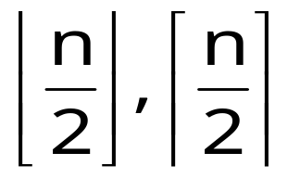
What are Order Statistics?
Selecting i^{th}-ranked item from a collection.
  First: i = 1
  Last: i = n
  Median(s): i =

Slide 4
Order Statistics Overview
Assume collection is unordered, otherwise trivial.
find ith order stat = A[i]
Can sort first – Θ(n lg n), but can do better – Θ(n).
I can find max and min in Θ(n) time (obvious)
Can we find any order statistic in linear time? (not obvious!)

Slide 5
Order Statistics Overview
How can we modify Quicksort to obtain
expected-case Θ(n)?
?
?
Pivot, partition, but recur only on one set of data. No join.

Slide 6
Using the Pivot Idea
Randomized-Select(A[p..r],i) looking for ith o.s.
  if p = r
  return A[p]
  q <- Randomized-Partition(A,p,r)
  k <- q-p+1 the size of the left partition
  if i=k then the pivot value is the answer
  return A[q]
  else if i < k then the answer is in the front
  return Randomized-Select(A,p,q-1,i)
  else then the answer is in the back half
  return Randomized-Select(A,q+1,r,i-k)

Slide 7
Randomized Selection
Analyzing RandomizedSelect()
  Worst case: partition always 0:n-1
    T(n) = T(n-1) + O(n)
    = O(n²)
    No better than sorting!
  “Best” case: suppose a 9:1 partition
    T(n) = T(9n/10) + O(n)
    = O(n) (Master Theorem, case 3)
    Better than sorting!
  Average case: O(n) remember from quicksort

Slide 8
Worst-Case Linear-Time Selection
Randomized algorithm works well in practice
What follows is a worst-case linear time algorithm, really of theoretical interest only
Basic idea:
  Guarantee a good partitioning element
  Guarantee worst-case linear time selection
Warning: Non-obvious & unintuitive algorithm ahead!
Blum, Floyd, Pratt, Rivest, Tarjan (1973)

Slide 9
Worst-Case Linear-Time Selection
The algorithm in words:
  1. Divide n elements into groups of 5
  2. Find median of each group (How? How long?)
  3. Use Select() recursively to find median x of the ⎣n/5⎦ medians
  4. Partition the n elements around x. Let k = rank(x)
  5. if (i == k) then return x
  if (i < k) then use Select() recursively to find ith smallest element in first partition
  else (i > k) use Select() recursively to find (i-k)th smallest element in last partition

Slide 10


Order Statistics: Algorithm
Select(A,n,i):
  Divide input into groups of size 5.
  /* Partition on median-of-medians */
  medians = array of each group’s median.
  pivot = Select(medians, , )
  Left Array L and Right Array G = partition(A, pivot)
  /* Find i^{th} element in L, pivot, or G */
  k = |L| + 1
  If i=k, return pivot
  If i<k, return Select(L, k-1, i)
  If i>k, return Select(G, n-k, i-k)
T(n)
O(n)
All this
to find a
good split.
O(n)
T( )
O(n)
O(1)
O(1)
Only one
done.
T(k)
T(n-k)

Slide 11
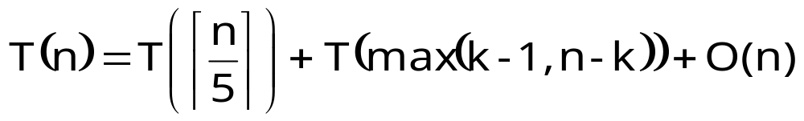
Order Statistics: Analysis
#less
#greater
How to simplify?

Slide 12
Order Statistics: Analysis
Lesser
Elements
Median
Greater
Elements
One group of 5 elements.

Slide 13
Order Statistics: Analysis
Lesser
Medians
Median of
Medians
Greater
Medians
All groups of 5 elements.
(And at most one smaller group.)

Slide 14
Order Statistics: Analysis
Definitely Lesser
Elements
Definitely Greater
Elements

Slide 15
Order Statistics: Analysis 1
Must recur on all elements outside one of these boxes.
How many?

Slide 16


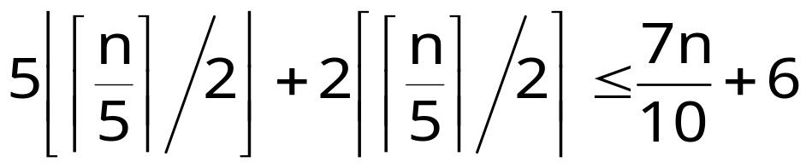
Order Statistics: Analysis 1
full groups of 5
partial groups of 2
Count elements outside smaller box.
At most

Slide 17
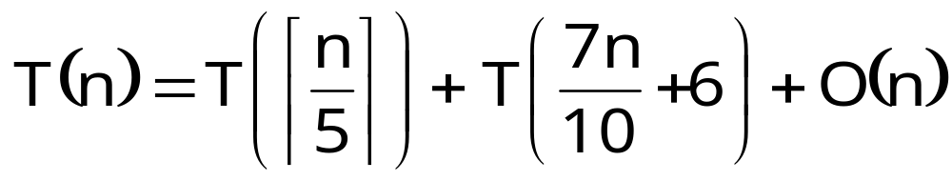
Order Statistics: Analysis
A very unusual recurrence. How to solve?
?
?

Slide 18
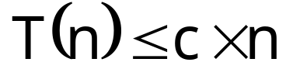
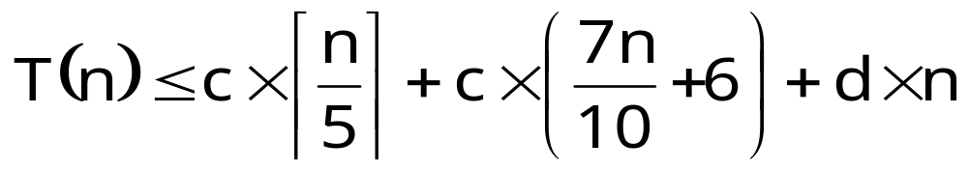
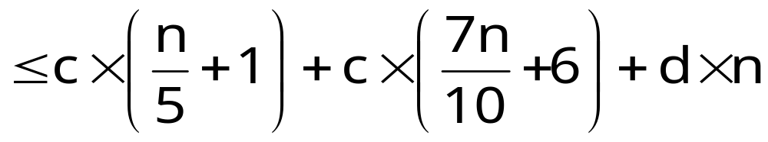
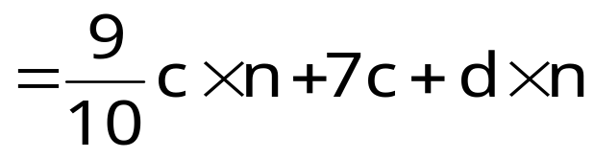



Order Statistics: Analysis
Substitution: Prove .
Overestimate ceiling
Algebra
Algebra
when choose c,d such that

Slide 19
Order Statistics
Why groups of 5?
?
?
Sum of two recurrence sizes must be < 1.
Grouping by 5 is smallest size that works.

